Slide 1
Instruction Set Architecture (ISA)

Slide 2
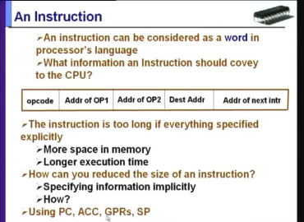

Slide 3
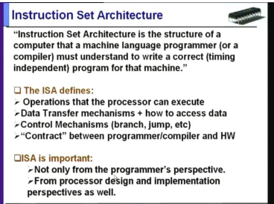

Slide 4
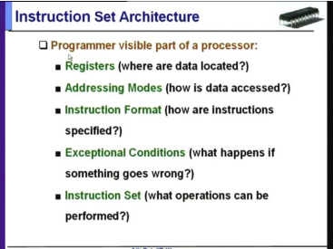

Slide 5
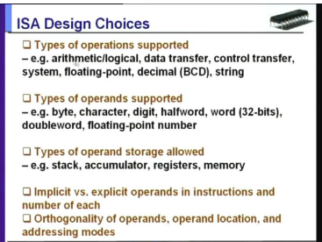

Slide 6
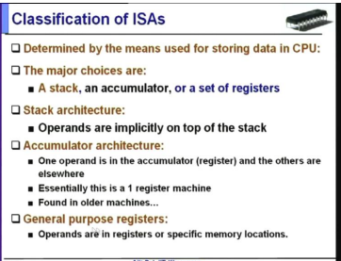

Slide 7
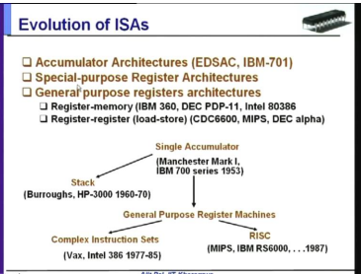

Slide 8
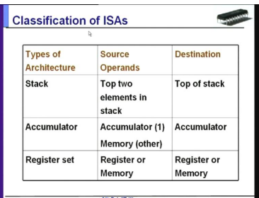

Slide 9
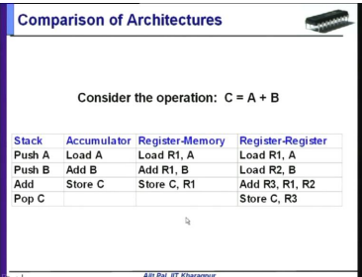

Slide 10
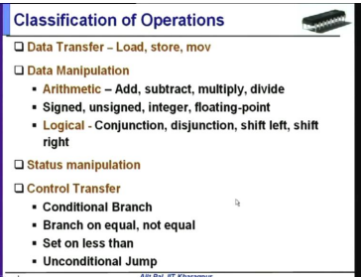

Slide 11
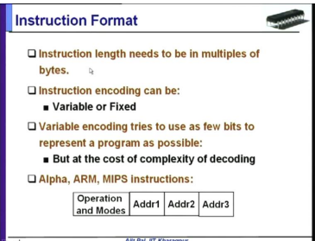

Slide 12
Register transfer language (RTL) Instruction

Slide 13
Register
Register is a very fast computer memory, used to store data/instruction in execution
A register is a group of flip-flops with each flip-flop capable of storing one bit of information
An n-bit register ha a group of n flip-flops and is capable of storing binary information of n-bits
A register is consists of a group of flip-flops and gates
The flip-flops holds the binary information and gates controls when and how new information is transferred into a register
The simplest register is one that consists of only one flip-flop with no external gates

Slide 14
Some of the common registers:
Accumulator: this is the most common register, used to store data taken out from the memory
General Purpose Registers: this is used to store data intermediate results during the program execution. It can be accessed via assembly programming.
Some of the common Special purpose registers: (For Computer)
MAR: Memory Address registers (holds address of the address of the memory unit)
MDR: Memory data register ( stores instructions and data)
PC : Program Counter
IR : Instruction register (Holds instruction to be executed)

Slide 15
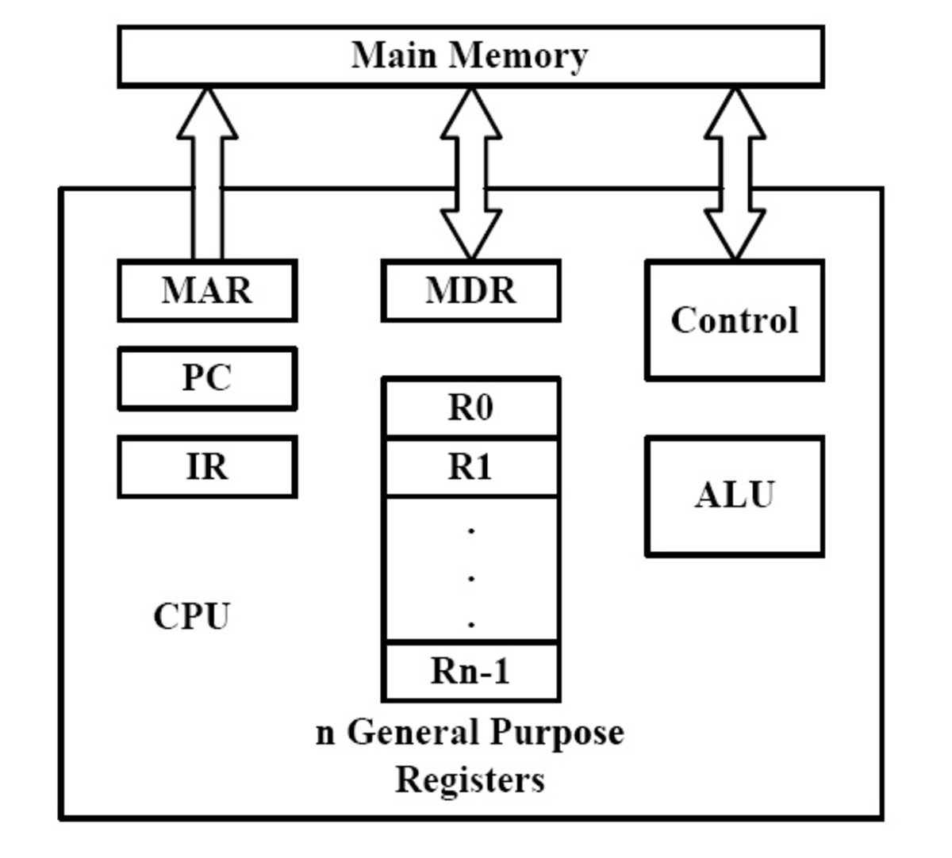
Internal connection between processor and MM

Slide 16
Register Transfer language (RTL)
Symbolic notation used to describe the micro-operation transfer amongst registers is called RTL
Register Transfer means the availability of Hardware Logic Circuits that can perform a stated micro-operation and transfer the result of the operation to the same or another register.
The word Language is barrowed from programmers who apply this term to programming languages.
This programming language is a procedure for writing symbols to specify a given computational process.

Slide 17
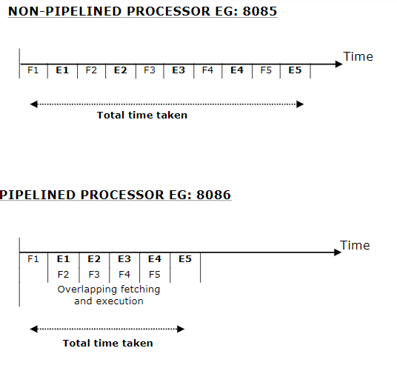

Slide 18
