Slide 1
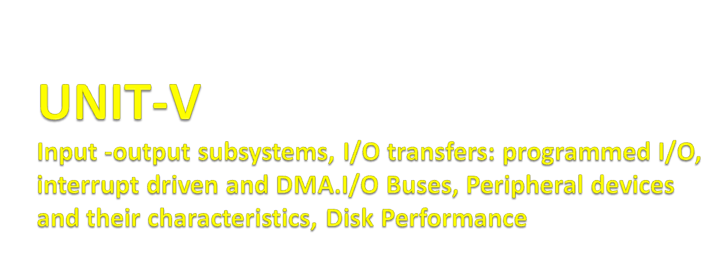

Slide 2
Input / Output Data Transfer
Data from Peripherals have to reach Memory so that the CPU can use it. Similarly, the processed output has to reach peripherals like printer, internet devices, DISK, etc.
Thus, I/O data transfer is about how the three subsystems i.e. CPU, Memory and I/O Controller, are involved in achieving the data exchange with peripherals. The word Data Exchange means successful Data in/Data Out with necessary handshake and coordination.
Data Exchange with a peripheral involves few steps and not straight forward as devices are mostly electromechanical and/or operate at a different speed than CPU and Memory.
The device to be initiated and checked for status whether it is ready for Data Exchange.
The data transfer has to happen at the acceptable capsule and speed of the device using the applicable protocol.
This may happen in more than one sequence, as necessitated.
If the device status is an Error status, it is to be suitably handled.

Slide 3
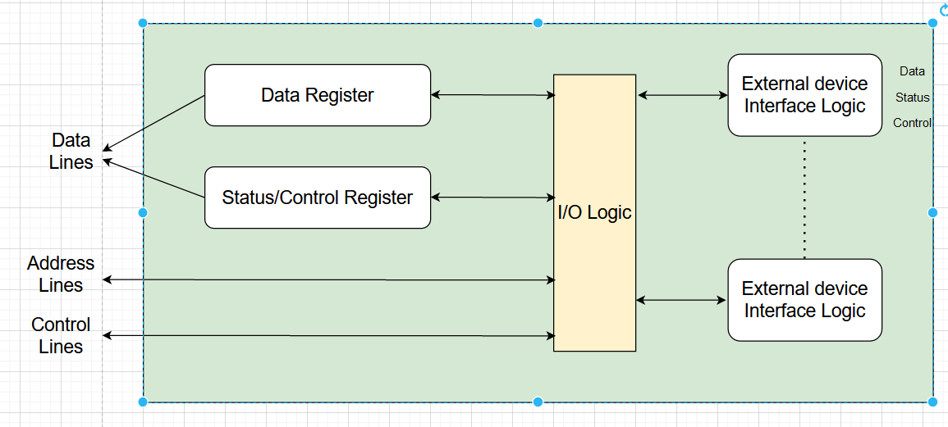
I/O Transfers

Slide 4
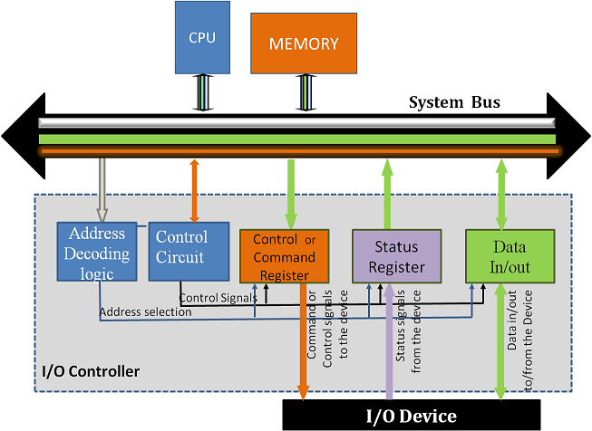
I/O Transfers

Slide 5
Modes of Transfer
We store the binary information received through an external device in the memory unit. The information transferred from the CPU to external devices originates from the memory unit. Although the CPU processes the data, the target and source are always the memory unit. We can transfer this information using three different modes of transfer.
Programmed I/O
Interrupt- initiated I/O
Direct memory access( DMA)

Slide 6
Programmed I/O
Programmed I/O uses the I/O instructions written in the computer program. The instructions in the program initiate every data item transfer. Usually, the data transfer is from a memory and CPU register. This case requires constant monitoring by the peripheral device's CPU.
Advantages:
Programmed I/O is simple to implement.
It requires very little hardware support.
CPU checks status bits periodically.

Slide 7
Interrupt-initiated I/O
In the above section, we saw that the CPU is kept busy unnecessarily. We can avoid this situation by using an interrupt-driven method for data transfer. The interrupt facilities and special commands inform the interface for issuing an interrupt request signal as soon as the data is available from any device. In the meantime, the CPU can execute other programs, and the interface will keep monitoring the i/O device. Whenever it determines that the device is ready for transferring data interface initiates an interrupt request signal to the CPU. As soon as the CPU detects an external interrupt signal, it stops the program it was already executing, branches to the service program to process the I/O transfer, and returns to the program it was initially running.
Working of CPU in terms of interrupts:
CPU issues read command.
It starts executing other programs.
Check for interruptions at the end of each instruction cycle.
On interruptions:-
  Process interrupt by fetching data and storing it.
  See operation system notes.
Starts working on the program it was executing.
Advantages:
It is faster and more efficient than Programmed I/O.
It requires very little hardware support.
CPU does not check status bits periodically.

Slide 8
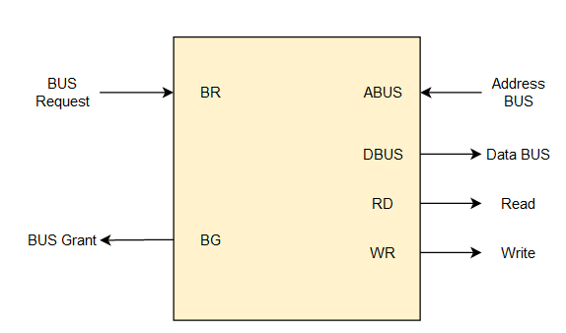
DMA
Direct Memory Access (DMA)
The data transfer between any fast storage media like a memory unit and a magnetic disk gets limited with the speed of the CPU. Thus it will be best to allow the peripherals to directly communicate with the storage using the memory buses by removing the intervention of the CPU. This mode of transfer of data technique is known as Direct Memory Access (DMA). During Direct Memory Access, the CPU is idle and has no control over the memory buses. The DMA controller takes over the buses and directly manages data transfer between the memory unit and I/O devices.
CPU Bus Signal for DMA transfer

Slide 9
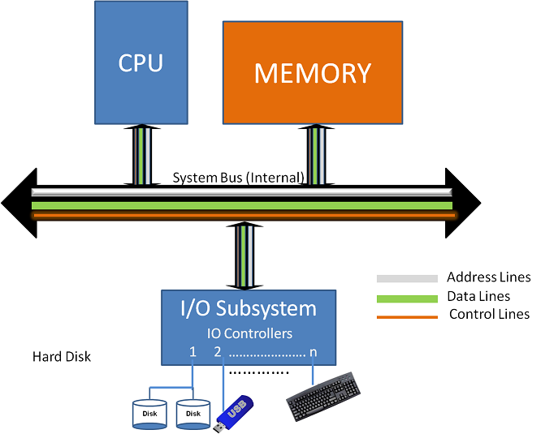
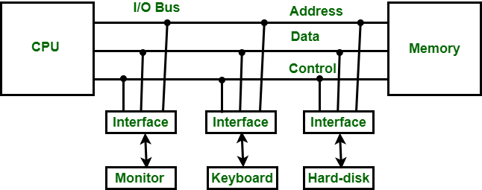
I/O Buses
The I/O bus includes data lines, address lines, and control lines. In any general-purpose computer, the magnetic disk, printer, and keyboard, and display terminal are commonly employed.

Slide 10
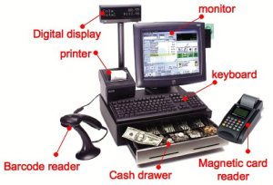
Peripheral devices and their characteristics
Input or output devices that are connected to computer are called peripheral devices. These devices are designed to read information into or out of the memory unit upon command from the CPU and are considered to be the part of computer system. These devices are also called peripherals.

Slide 11
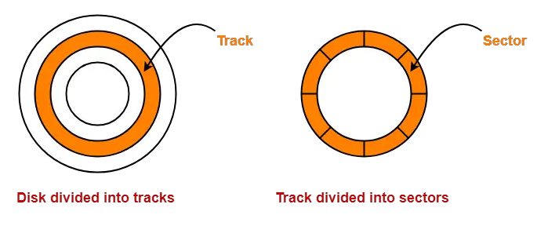
Disk Performance
Magnetic disk is a storage device that is used to write, rewrite and access data.
It uses a magnetization process.
The entire disk is divided into platters.
Each platter consists of concentric circles called as tracks.
These tracks are further divided into sectors which are the smallest divisions in the disk.

Slide 12
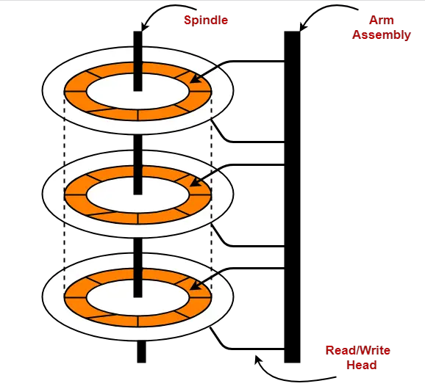
There exists a mechanical arm called as Read / Write head.
It is used to read from and write to the disk.
Head has to reach at a particular track and then wait for the rotation of the platter.
The rotation causes the required sector of the track to come under the head.
Each platter has 2 surfaces- top and bottom and both the surfaces are used to store the data.
Each surface has its own read / write head.

Slide 13
Disk Performance Parameters
The time taken by the disk to complete an I/O request is called as disk service time or disk access time.
Seek time
Rotational latency
Data transfer rate
Controller overhead
Queuing delay
Seek Time:-
The time taken by the read / write head to reach the desired track is called as seek time.
It is the component which contributes the largest percentage of the disk service time.
Rotational latency:-
The lower the seek time, the faster the I/O operation.
The time taken by the desired sector to come under the read / write head is called as rotational latency.
It depends on the rotation speed of the spindle.
Disk access time
= Seek time + Rotational delay + Transfer time + Controller overhead + Queuing delay

Slide 14
data transfer rate:-
The amount of data that passes under the read / write head in a given amount of time is called as data transfer rate.
The time taken to transfer the data is called as transfer time.
It depends on the following factors-
Number of bytes to be transferred
Rotation speed of the disk
Density of the track
controller overhead:-
Speed of the electronics that connects the disk to the computer
The overhead imposed by the disk controller is called as controller overhead.
Disk controller is a device that manages the disk.
queuing delay:-
The time spent waiting for the disk to become free is called as queuing delay.

Slide 15


