Slide 1
Advanced Encryption Standard
By
Kumhar Parash Kumar
S190103

Slide 2
01
03
Transformations
Introduction to AES
02
04
Encryption & Decryption
AES Key Expansion
05
Conclusion & Q/As

Slide 3
Pre-requisites
Symmetric Encryption
Block Cipher
Understanding of Feistel structure
Understanding confusion & Diffusion .
XOR Operation
Left circular shift
Matrix multiplication

Slide 4
Introduction to Advanced Encryption Standard [AES]
Widely used [despite being harder to implement].
symmetric block cipher
NIST in 2001.
Encrypts the data in blocks of 128 bits each.
Key size can be 128/192/256 bits
General Structure
AES Structure:
General Structure
Detailed Structure
AES
Detailed Structure

Slide 5
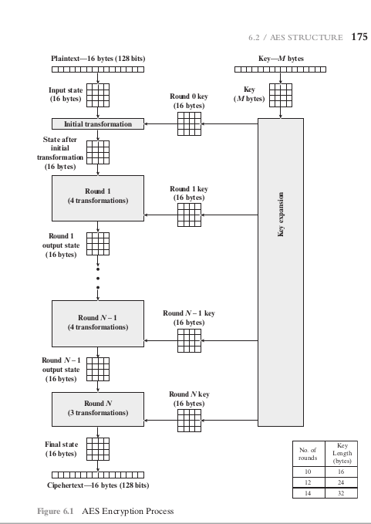
General structure

Slide 6
Advanced Encryption Standard
General Structure
The input to the encryption and decryption algorithms is a single 128-bit block.
This block is depicted as a 4 * 4 square matrix of bytes.
Note that the ordering of bytes within a matrix is by column.
So, for example, the first four bytes of a 128-bit plaintext input to the encryption cipher occupy the first column of the in matrix, the second four bytes occupy the second column, and so on. Similarly, the first four bytes of the expanded key, which form a word, occupy the first column of the w matrix.
This block is copied into the State array, which is modified at each stage of encryption or decryption.

Slide 7
Advanced Encryption Standard
After the final stage, State is copied to an output matrix.
Similarly, the key is depicted as a square matrix of bytes.
This key is then expanded into an array of key schedule words..
Each word is four bytes, and the total keyschedule is 44 words for the 128-bit key.
The cipher consists of N rounds, where the number of rounds depends on the key length: 10 rounds for a 16-byte key, 12 rounds for a 24-byte key, and 14 rounds for a 32-byte key .
The first N - 1 rounds consist of four distinct transformation functions: SubBytes, ShiftRows, MixColumns, and AddRoundKey.
The final round contains only three transformations.

Slide 8
Advanced Encryption Standard
There is a initial single transformation (AddRoundKey) before the first round, which can be considered Round 0.
Each transformation takes one or more 4 * 4 matrices as input and produces a 4 * 4 matrix as output.
Also, the key expansion function generates N + 1 round keys, each of which is a distinct 4 * 4 matrix.
Each round key serves as one of the inputs to the AddRoundKey transformation in each round.

Slide 9
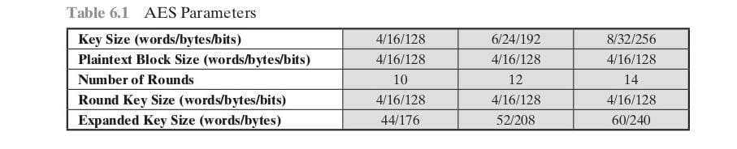

Slide 10
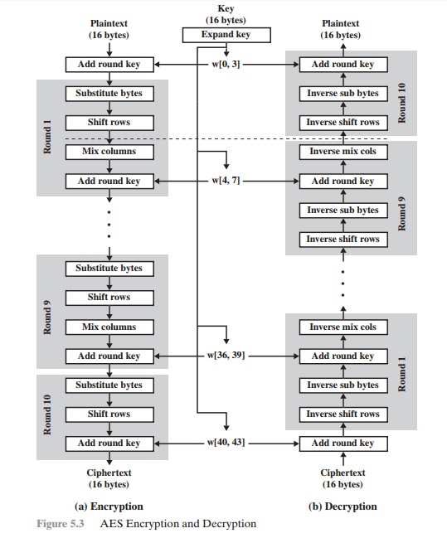
Detailed structure

Slide 11
Advanced Encryption Standard
Detailed Structure
One noteworthy feature of this structure is that it is not a Feistel structure. Recall that, in the classic Feistel structure, half of the data block is used to modify the other half of the data block and then the halves are swapped. AES instead processes the entire data block as a single matrix during each round using substitutions and permutation
The key that is provided as input is expanded into an array of forty-four 32-bit words, w[i]. Four distinct words (128 bits) serve as a round key for each round.

Slide 12
Detailed structure
Begins with an AddRoundKey stage, followed by nine rounds that each includes all four stages, followed by a tenth round of three stages.
Only the AddRoundKey stage makes use of the key.
Each stage is easily reversible. For the Substitute Byte, ShiftRows, and MixColumns stages, an inverse function is used in the decryption algorithm.For the AddRoundKey stage, the inverse is achieved by XORing the same round key to the block, using the result that A ⊕B ⊕ B = A.
As with most block ciphers, the decryption algorithm makes use of the expanded key in reverse order. However, the decryption algorithm is not identical to the encryption algorithm. This is a consequence of the particular structure of AES.

Slide 13
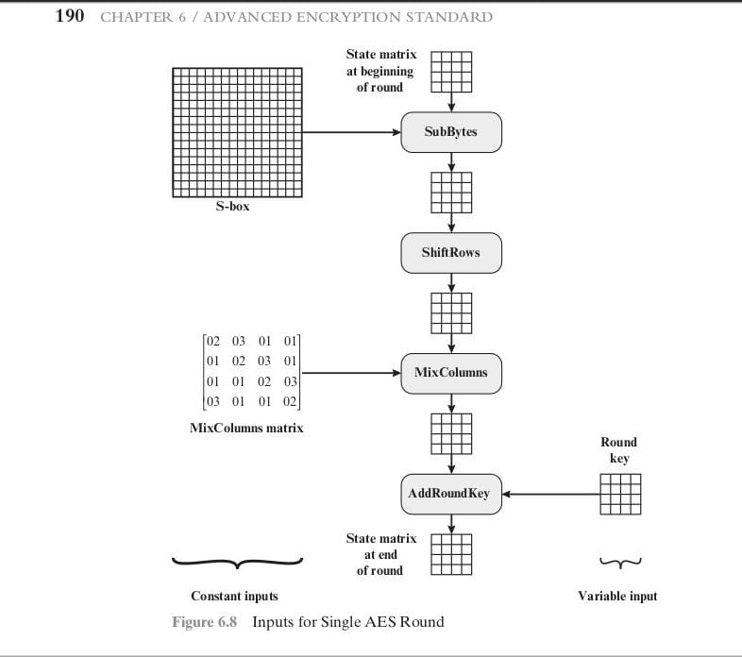
Transformations
Substitute byte
Shift rows
Mix columns
Add round key

Slide 14
Substitute Bytes Transformation
FORWARD AND INVERSE TRANSFORMATIONS
The forward substitute byte transformation, called SubBytes, is a simple table lookup.
AES defines a 16 * 16 matrix of byte values, called an S-box, that contains a permutation of all possible 256 8-bit values.
Each individual byte of State is mapped into a new byte in the following way: The leftmost 4 bits of the byte are used as a row value and the rightmost 4 bits are used as a column value.
These row and column values serve as indexes into the S-box to select a unique 8-bit output value.
For example, the hexadecimal value {95} references row 9, column 5 of the S-box, which contains the value {2A}. Accordingly, the value {95} is mapped into the value {2A}.

Slide 15
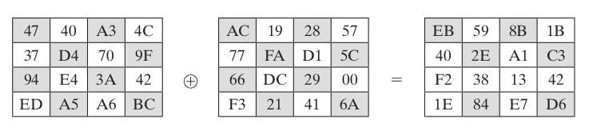
Add Round Key Transformation
FORWARD TRANSFORMATIONS
In the forward add round key transformation, called AddRoundKey,
The 128 bits of State are bitwise XORed with the 128 bits of the round key.
As shown in Figure , the operation is viewed as a columnwise operation between the 4 bytes of a State column and one word of the round key; it can also be viewed as a byte-level operation.
The first matrix is State, and the second matrix is the round key.
AND INVERSE TRANSFORMATIONS
The inverse add round key transformation is identical to the forward add round key transformation, because the XOR operation is its own inverse.

Slide 16
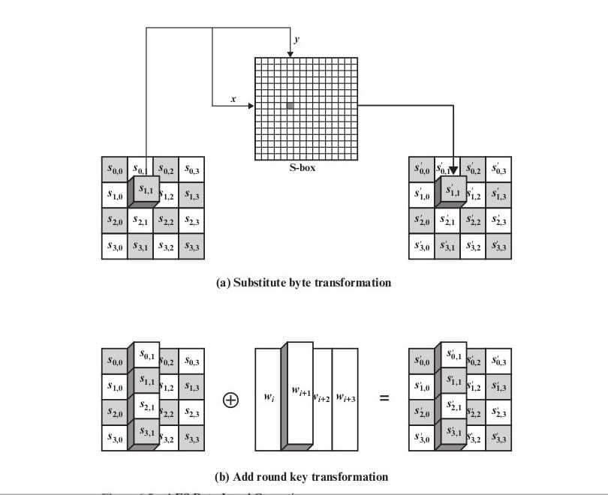

Slide 17
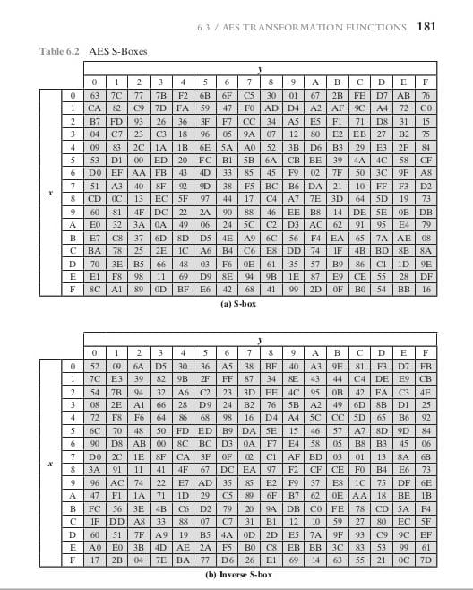

Slide 18
ShiftRows Transformation
FORWARD TRANSFORMATIONS
The forward shift row transformation called ShiftRows.
The first row of State is not altered.
For the second row, a 1-byte circular left shift is performed.
For the third row, a 2-byte circular left shift is performed.
For the fourth row, a 3-byte circular left shift is performed.
INVERSE TRANSFORMATIONS
The inverse shift row transformation, called InvShiftRows, performs the circular shifts in the opposite direction for each of the last three rows, with a 1-byte circular right shift for the second row, and so on.

Slide 19
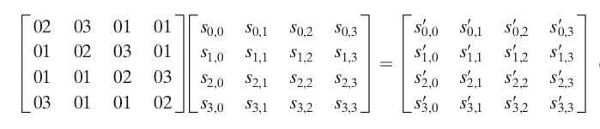
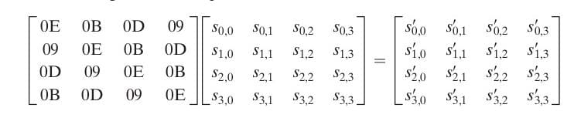
MixColumns
FORWARD TRANSFORMATIONS
The forward mix column transformation called MixColumns.
AND INVERSE TRANSFORMATIONS
The inverse mix column transformation, called InvMixColumns.

Slide 20
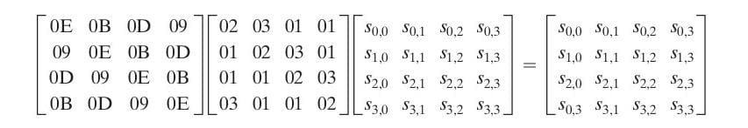
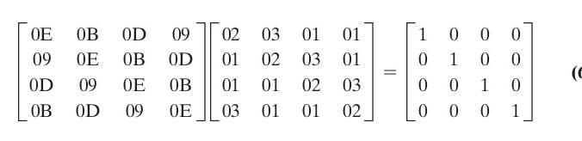

Slide 21
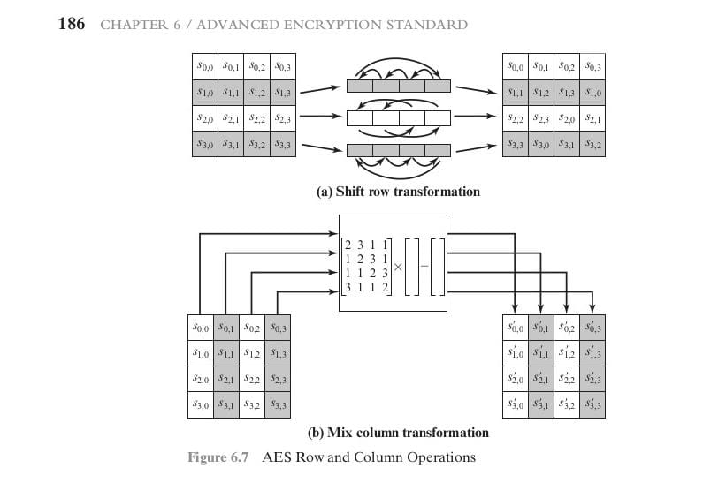

Slide 22
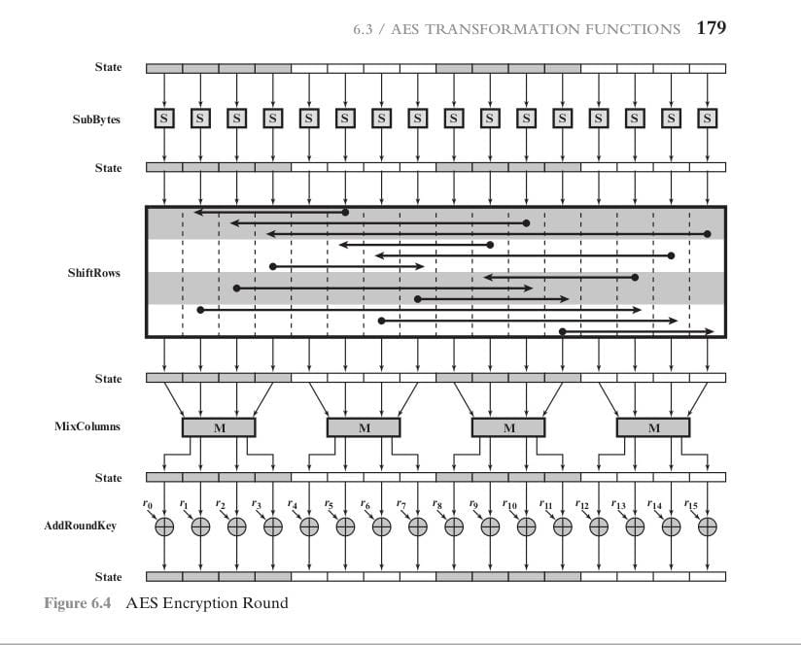

Slide 23
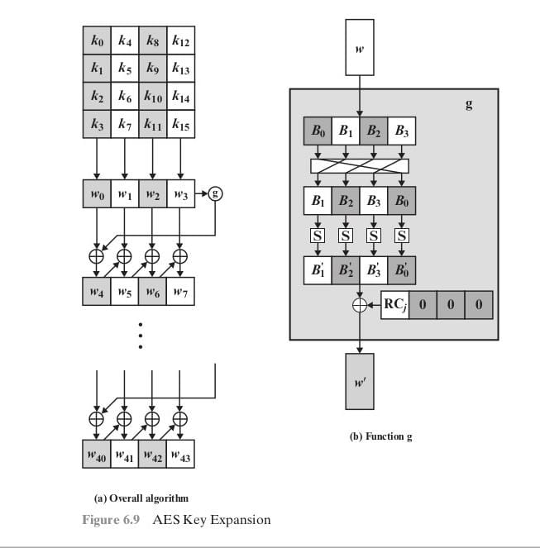
AES Key Expansion
The AES key expansion algorithm takes as input a fourword (16-byte) key and produces a linear array of 44 words (176 bytes).
This is sufficient to provide a fourword round key for the initial AddRoundKey stage and each of the 10 rounds of the Cipher.

Slide 24
AES Key Expansion ALGORITHM
The pseudocode on the next Slide describes the expansion.
The key is copied into the first four words of the expanded key.
The remainder of the expanded key is filled in four words at a time.
Each added word w[i] depends on the immediately preceding word, w[i - 1], and the word four positions back, w[i - 4].
In three out of four cases, a simple XOR is used.
For a word whose position in the w array is a multiple of 4, a more complex function is used. Figure in above slide illustrates the generation of the expanded key, using the symbol g to represent that complex function.
The function g consists of the following subfunctions.
1. RotWord performs a one-byte circular left shift on a word. This means that an input word
[B 0 , B 1 , B 2 , B 3 ] is transformed into [B 1 , B 2 , B 3 , B 0 ].
2. SubWord performs a byte substitution on each byte of its input word, using the S-box .
3. The result of steps 1 and 2 is XORed with a round constant, Rcon[j].

Slide 25
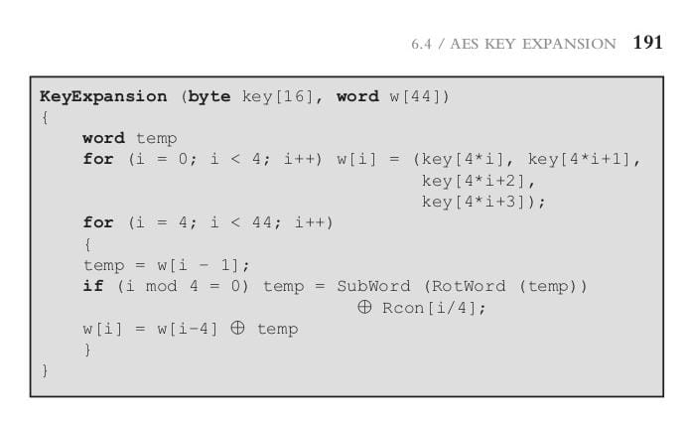

Slide 26
QUICK RECAP
The cipher takes a plaintext block size of 128 bits, or 16 bytes. The key length can be 16, 24, or 32 bytes (128, 192, or 256 bits). The algorithm is referred to as AES-128, AES-192, or AES-256, depending on the key length.
10 rounds for a 16-byte key, 12 rounds for a 24-byte key, and 14 rounds for a 32-byte key.
The first N - 1 rounds consist of four distinct transformation functions: SubBytes, ShiftRows, MixColumns, and AddRoundKey The final round contains only three transformations,Excludes MixColumns.
The AES key expansion algorithm takes as input a four-word (16-byte) key and produces a linear array of 44 words (176 bytes).
References:- Neso Academy videos, CRYPTOGRAPHY AND NETWORK SECURITY PRINCIPLES
AND PRACTICE SEVENTH EDITION by Williams Stallings.

Slide 27
Thank You

