Slide 1
CAPSTONE PROJECT
Telecom churn analysis
Presented By:
1. Kumhar Parash Kumari - RGUKT IIIT Srikakulam - CSE

Slide 2
OUTLINE
Problem Statement (Should not include solution)
Proposed System/Solution
System Development Approach (Technology Used)
Result (Output Image)
Conclusion
Future Scope

Slide 3
Problem Statement
Orange S.A., formerly France Télécom S.A., is a French multinational telecommunications corporation. The Orange Telecom's Churn Dataset, consists of cleaned customer activity data (features), along with a churn label specifying whether a customer cancelled the subscription. Explore and analyze the data to discover key factors responsible for customer churn and come up with ways/recommendations to ensure customer retention.

Slide 4
Proposed Solution
The proposed system aims to address the challenge of predicting customer churn in Orange Telecom's customer base. This involves leveraging data analytics and machine learning techniques to identify key factors influencing churn and recommend strategies for customer retention. The solution will consist of the following components:
Data Collection:
Gather historical customer activity data, including usage patterns, location,customers age group ,profession and other relevant factors.
Utilize external data sources, such as economic indicators, competitor offerings, and customer feedback, to enrich the analysis.
Data Preprocessing:
Clean and preprocess the collected data to handle missing values, outliers, and inconsistencies.
Feature engineering to extract relevant features from the data that might impact bike demand.

Slide 5
Exploratory Data Analysis (EDA):
Conducting exploratory data analysis to understand the distribution of features, correlations, and patterns within the data.Visualizing key insights to identify potential factors influencing churn.
Feature Selection and Engineering:
Utilizing techniques such as correlation analysis, feature importance ranking, and domain knowledge to select the most relevant features for predicting churn. Engineering new features that may enhance the predictive power of the model.
Recommendation Engine:
Developing a recommendation engine that suggests personalized retention strategies for individual customers based on their churn risk scores and historical interactions with Orange Telecom's services.These recommendations could include targeted marketing campaigns, loyalty programs, service upgrades, or proactive customer support interventions.

Slide 6
System Approach
The system approach for predicting customer churn in Orange Telecom involves comprehensive data gathering, preprocessing, and exploratory analysis to understand underlying patterns. Feature engineering is pivotal for accurately predicting churn in a production environment. Continuous monitoring and feedback loops ensure the model's effectiveness over time, allowing for ongoing optimization of customer retention strategies.
System requirements
Intel IA32/Intel64 CPU
512MB RAM
300MB disk space
Library required to build the model
Pandas, Matplotlib and Seaborn

Slide 7
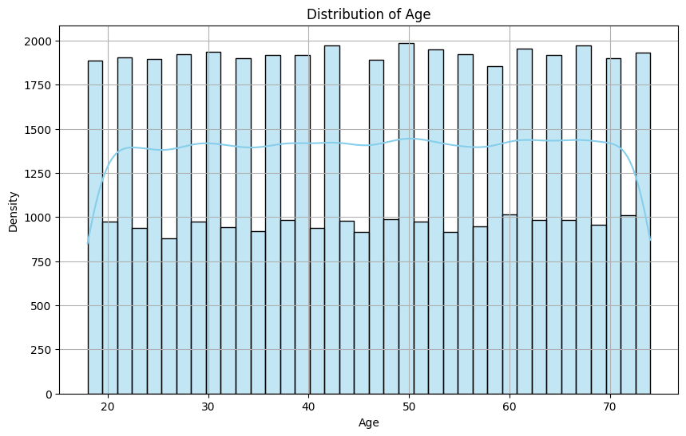
Result
The KDE plot illustrates the distribution of ages in the dataset, showing a peak around the mid-30s with a gradual decline towards older and younger ages.

Slide 8
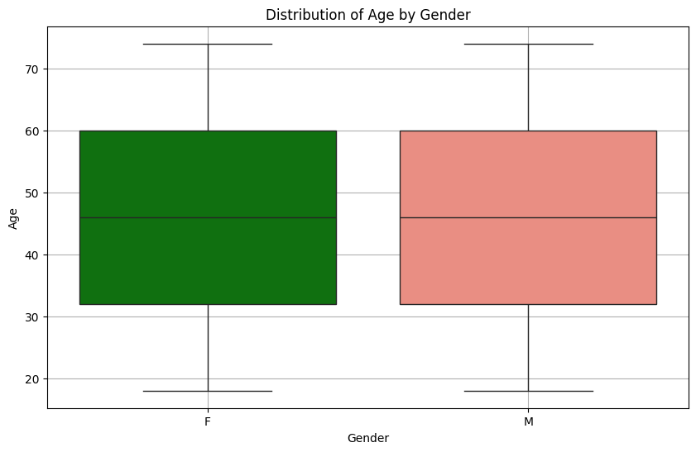
This plot will show the distribution of ages for each gender category, allowing you to compare the central tendency, spread, and potential outliers across different gender groups

Slide 9
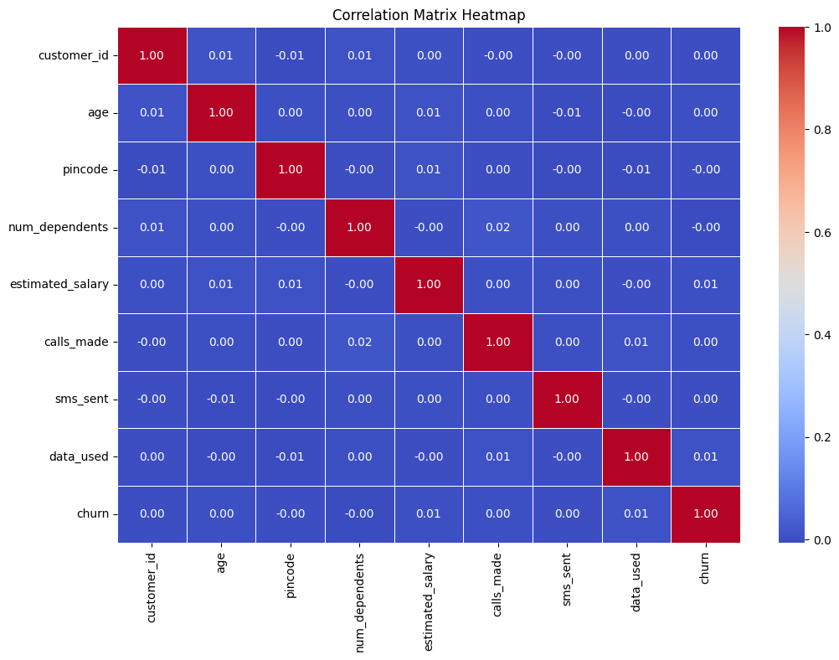

Slide 10
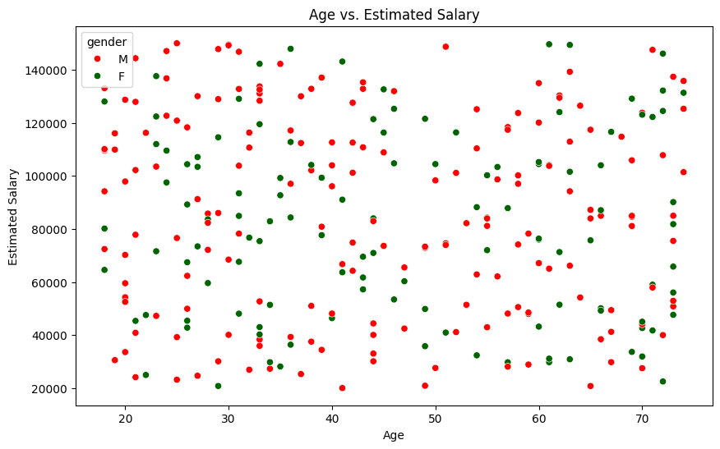

Slide 11
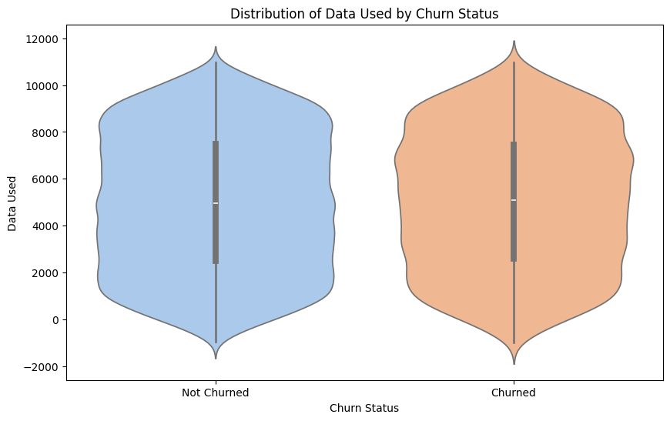

Slide 12
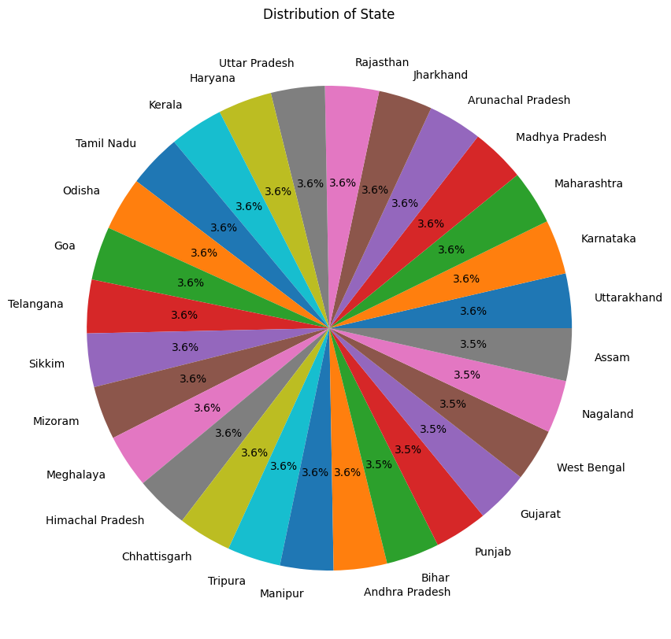

Slide 13
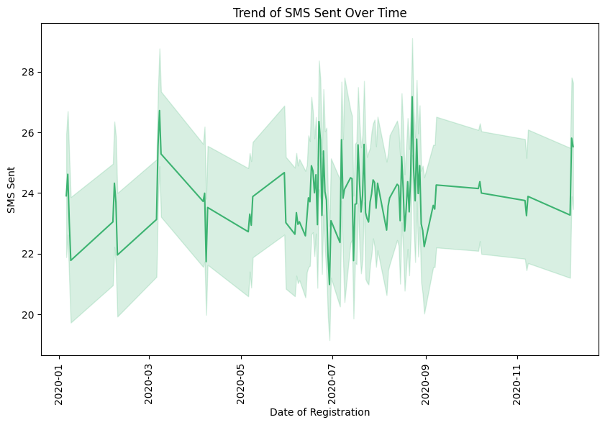

Slide 14
Conclusion
The exploratory data analysis (EDA) on the telecom dataset showcased a higher churn rate among younger customers compared to older ones. Additionally, subscribers from certain regions exhibited more propensity to churn, suggesting geographical factors at play. Analysis of usage metrics indicated that customers with lower usage tend to churn more frequently, emphasizing the importance of personalized engagement strategies. Further, a correlation analysis revealed strong associations between churn and factors such as plan type, network quality, and customer service satisfaction. These insights can guide proactive measures for customer retention and service improvement.

Slide 15
Future scope
Future scope involves leveraging advanced machine learning algorithms for more accurate churn prediction, integrating sentiment analysis from diverse data sources to gauge customer satisfaction, and exploring collaborative efforts with regulatory bodies to adapt to evolving industry policies and trends, ultimately enhancing customer retention strategies in the telecom sector.

Slide 16
THANK YOU

