Slide 1
Submitter Details
Name:
Parashuram V Pawar
Submission Date:
18 September 2026
Solution Name:
PVP Finance Ltd – Loan Application Investigation and Decision Support
Notes:
**INSTRUCTIONS**
Provide some commentary the business problem you are trying to solve, and what value metrics you are trying to impact.
If you need more space, feel free to attach a word document.

Slide 2
What are you building and why?
What business problem are you solving?
What value metrics will this impact?
PVP Finance Ltd needs to investigate loan applications before they move to the next business stage. Manual review requires checking completeness, comparing submitted data with available customer records, investigating discrepancies, and escalating unresolved cases. Because the required investigation varies by case, a fixed linear automation is insufficient.
Target metrics: reduce manual comparison effort and investigation handling time; improve consistency and traceability; route unresolved cases to human review earlier; and maintain auditable outcomes. These are target outcomes for the assessment solution, not measured production benefits.
Notes:
**INSTRUCTIONS**
Provide some commentary the business problem you are trying to solve, and what value metrics you are trying to impact.
If you need more space, feel free to attach a word document.

Slide 3
What You Built
LoanInvestigationAgent
CustomerProfileTool
DocumentAnalysisTool
LoanDocumentAnalysisSkill
Agent Name Here
InvestigationRecordUpdateTool
RiskInvestigationTool
Mozart Orchestrator
Task Bot
API Task
Document Automation
AI Skills
Control Room
Notes:
**INSTRUCTIONS**
For every tool in your agent, drag the appropriate tool type onto the agent diagram
Name your agents and tools.
If you have multiple agents, add one for each agent

Slide 4

Consolidated Technology Options for Solution Patterns
Start Process
Get Work Item
Gather Information
Determine Actions
Perform Actions
Output
Event Listener
In memory from start process
AI Skills to understand content
AI Decision Making
Platform specific package
Platform specific package
Platform specific package
Human In the Loop
Notes:
**INSTRUCTIONS**
Create a visual like this from the options in the following slide. If you have multiple agents, create one of these for each agent.
If your tool is not present, that’s ok! You can still use it, just copy/paste an orange tool shape and fill it in with your specific tool

Slide 5
DocumentAnalysisTool
Loan Application Completeness and Content Analysis
Goal: Analyze the submitted loan application for required-field completeness, internal inconsistencies, and factual risk indicators. The tool uses the LoanDocumentAnalysisSkill for contextual analysis and does not make a final lending approval or rejection decision.
Inputs Required | Description
isApplicationJson | Complete loan application data in JSON format to be analyzed by the tool.
isLoanApplicationId | Unique loan application identifier associated with the investigation.
Tool Selection: Task Bot + AI Skill
AI Skill: LoanDocumentAnalysisSkill
Notes:
**INSTRUCTIONS**
For each tool, follow the Design Framework information documentation requirements.
Document the goal of the tool.
Document the input and output variable names
Document their descriptions
Record your tool selection choice.

Slide 6
Outputs Required | Description
sAnalysisStatus | Analysis result such as COMPLETE or NEEDS_REVIEW.
sMissingInformation | Required application fields identified as missing or unusable; NONE when complete.
sInconsistencies | Internal inconsistencies identified from the supplied application data; NONE when none are found.
sRiskIndicators | Factual indicators identified from the supplied application information.
nConfidenceScore | Confidence score returned for the AI analysis.
sAnalysisSummary | Concise summary of the application analysis.
sToolStatus | Execution status of the tool, such as SUCCESS, INVALID_INPUT, or ERROR.
sToolMessage | Human-readable message describing the tool execution result.

Slide 7
CustomerProfileTool
Existing Customer Profile Verification
Goal: Retrieve PVP Finance Ltd's stored customer profile using the Customer ID when independent verification of submitted customer information is required. The retrieved information provides evidence for further investigation and does not determine loan eligibility.
Inputs Required | Description
sCustomerID | Customer ID used to locate the corresponding stored customer profile.
Tool Selection: Task Bot + Google Sheets Package
Notes:
**INSTRUCTIONS**
For each tool, follow the Design Framework information documentation requirements.
Document the goal of the tool.
Document the input and output variable names
Document their descriptions
Record your tool selection choice.

Slide 8
Outputs Required | Description
bCustomerFound | Indicates whether a matching customer profile was found.
sCustomerName | Customer name stored in the profile.
sEmploymentType | Stored employment type.
nMonthlyIncome | Stored monthly income.
nExistingEMI | Stored existing EMI amount.
nCreditScore | Stored credit score.
nExistingLoanCount | Number of existing loans recorded for the customer.
sCustomerStatus | Stored customer status.
sToolStatus | Tool execution result such as SUCCESS, NOT_FOUND, INVALID_INPUT, or ERROR.
sToolMessage | Human-readable explanation of the lookup result.

Slide 9
RiskInvestigationTool
Loan Application Discrepancy and Risk Investigation
Goal: Compare submitted loan application values with successfully retrieved customer-profile values, calculate factual discrepancies and exposure indicators, and return an investigation-priority assessment to the Agent. The tool does not make a final lending approval or rejection decision.
Inputs Required | Description
nSubmittedMonthlyIncome | Monthly income submitted in the current loan application.
nStoredMonthlyIncome | Monthly income retrieved from the stored customer profile.
nSubmittedExistingEMI | Existing EMI submitted in the loan application.
nStoredExistingEMI | Existing EMI retrieved from the stored customer profile.
nSubmittedCreditScore | Credit score submitted in the application.
nStoredCreditScore | Credit score retrieved from the customer profile.
Notes:
**INSTRUCTIONS**
For each tool, follow the Design Framework information documentation requirements.
Document the goal of the tool.
Document the input and output variable names
Document their descriptions
Record your tool selection choice.

Slide 10
Inputs Required | Description
nExistingLoanCount | Existing loan count retrieved from the customer profile.
nLoanAmount | Requested loan amount.
nLoanTenure | Requested loan tenure.
Tool Selection: Task Bot
Outputs Required | Description
bIncomeMismatchDetected | Indicates whether submitted and stored income values differ.
nIncomeDifference | Absolute difference between submitted and stored income.
nIncomeDifferencePercent | Percentage difference in income using the tool's calculation.
bEMIMismatchDetected | Indicates whether submitted and stored EMI values differ.
nEMIDifference | Absolute EMI difference.

Slide 11
Outputs Required | Description
nEMIDifferencePercent | Percentage EMI difference.
bCreditScoreMismatchDetected | Indicates whether submitted and stored credit scores differ.
nCreditScoreDifference | Absolute credit-score difference.
nExistingEMIRatio | Existing EMI as a percentage of stored monthly income.
sExistingLoanExposure | Existing-loan exposure such as NONE, SINGLE_LOAN, or MULTIPLE_LOANS.
sRiskFindings | Consolidated factual findings generated by the investigation.
nMismatchCount | Number of detected submitted-versus-stored mismatches.
sRiskLevel | Project-defined investigation priority: LOW, MEDIUM, HIGH, or UNASSESSED.
sToolStatus | Execution status such as SUCCESS, INVALID_INPUT, or ERROR.
sToolMessage | Human-readable tool execution result.

Slide 12
InvestigationRecordUpdateTool
Investigation Result Persistence and Audit Update
Goal: Locate the existing loan application record and persist the grounded investigation outcome after all required investigation and human review have been completed. This tool performs persistence only and does not perform investigation or make lending decisions.
Inputs Required | Description
sLoanApplicationId | Unique loan application ID identifying the existing record to update.
sInvestigationStatus | Final investigation processing status, such as COMPLETED.
sAgentRecommendation | Grounded Agent recommendation such as PROCEED or HUMAN_REVIEW.
sHumanReviewRequired | Indicates whether additional human review is required (true/false).
sProcessedAt | Investigation completion timestamp in ISO 8601 format with IST offset.
Notes:
**INSTRUCTIONS**
For each tool, follow the Design Framework information documentation requirements.
Document the goal of the tool.
Document the input and output variable names
Document their descriptions
Record your tool selection choice.

Slide 13
Inputs Required | Description
sErrorStatus | Final processing error status; NONE when no unresolved technical error exists.
sErrorMessage | Error details; NONE when no unresolved technical error exists.
Tool Selection: Task Bot + Google Sheets Package
Outputs Required | Description
sToolStatus | Persistence result: SUCCESS, NOT_FOUND, INVALID_INPUT, or ERROR.
sToolMessage | Human-readable description of the record-update result.

Slide 14
Tool Inventory
LoanInvestigationAgent
Tool Name | Tool Purpose | Technology Selected
DocumentAnalysisTool | Analyzes the submitted loan application for required-field completeness, internal inconsistencies, and factual risk indicators using the LoanDocumentAnalysisSkill. | Task Bot + AI Skill
CustomerProfileTool | Retrieves the stored PVP Finance Ltd customer profile when the Agent requires independent verification of submitted customer information. | Task Bot + Google Sheets Package
RiskInvestigationTool | Compares submitted and stored customer values, calculates factual discrepancies and exposure indicators, and returns an investigation-priority assessment. | Task Bot
InvestigationRecordUpdateTool | Locates the corresponding loan application record and persists the final investigation status, Agent recommendation, human-review requirement, timestamp, and error information. | Task Bot + Google Sheets Package
Notes:
**INSTRUCTIONS**
List each tool used here, putting the name in Tool Name.
But the tool’s goal/description in the Tool Purpose.
Identify the selected technology type.

Slide 15
Design Framework and Solution Patterns
Agent Name Here
Start Process
Get Work Item
Gather Information
Determine Actions
Perform Actions
Output
Human Reviewer (when required)
Human
Technology
Web Trigger / Event Listener
Mozart Orchestrator
AI Skill + Task Bots
AI Decision Making
Task Bots + HITL
Google Sheets Package
Deployment/Execution
Control Room
Control Room
Remote Execution
LoanInvestigationAgent
Remote Execution / Control Room
Remote Execution
Process
Agent
Notes:
**INSTRUCTIONS**
Visualize the solution patterns here by covering who and what is responsible for each stage of the process. Make more purple dots as needed.
Document the appropriate Start Process capability.
Document the Deployment/Execution
Connect the flow visually to show where it’s a process and where there’s an agent using the straight or dashed connected.

Slide 16
Defend Your Solution Pattern
Applying what you learned in Solution Pattern Modelling
How will your solution begin?
Where does it execute?
How are humans involved?
The solution is orchestrated in
Automation Anywhere Control Room
using the Mozart
LoanInvestigationProcess.
The LoanInvestigationAgent and
its Task Bot tools execute remotely
through Automation Anywhere.
The LoanDocumentAnalysisSkill
provides AI-based application analysis,
while Google Sheets is used for
application records and customer-
profile data. Credentials and
connections are managed through
Control Room rather than machine-
specific paths, supporting an
environment-agnostic design.
Human review is invoked only when the
Agent cannot reach a sufficiently
grounded outcome from the available
evidence, such as missing information,
unresolved discrepancies, unavailable
customer-profile verification, or findings
requiring further review. The reviewer
provides additional information through
Human-in-the-Loop, after which the Agent
resumes the investigation. PROCEED
means continue to the next business
stage and is not a loan approval;
HUMAN_REVIEW indicates that
additional human verification is required
and is not a rejection.
The solution begins when a loan application is submitted through the PVP Finance Ltd web form. A Universal Web Trigger receives the application payload, and the listener automation stores the application as a case record. The LoanInvestigationProcess is then started with the Loan Application ID and application JSON. Mozart orchestrates the investigation and invokes the LoanInvestigationAgent, which determines the required investigation actions dynamically.
Notes:
**INSTRUCTIONS**
1) Provide some commentary about how your solution launches, execution locations, and human involvement. Document these as if you were attempting to gain approval to move your solution into production at your organization. Defend the reasoning behind the choices you’ve made.
If you need more space, feel free to attach a word document.

Slide 17
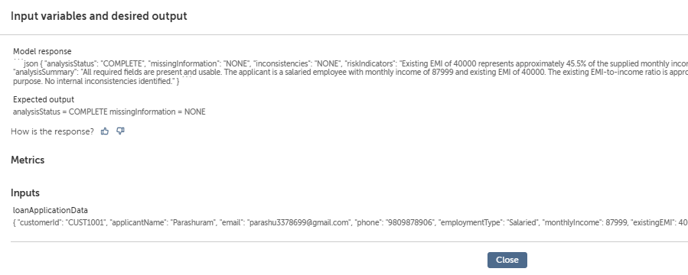
AI Evaluations Evidence Submission
AI Skill and Agent name here
LoanDocumentAnalysisSkill – Complete Input Evaluation
Notes:
**INSTRUCTIONS**
Provide Screenshots of your AI Evals pages for any AI skills you have and for your AI Agent.

Slide 18
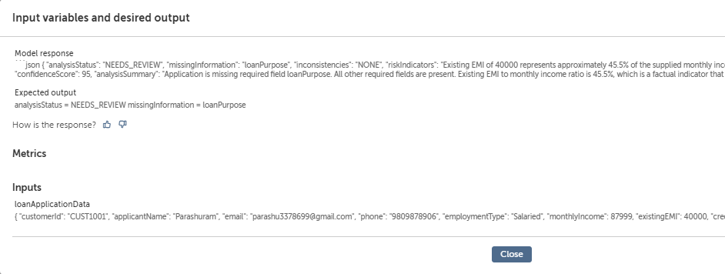
AI Evaluations Evidence Submission
AI Skill and Agent name here
LoanDocumentAnalysisSkill – Incomplete Input Evaluation
Notes:
**INSTRUCTIONS**
Provide Screenshots of your AI Evals pages for any AI skills you have and for your AI Agent.

Slide 19
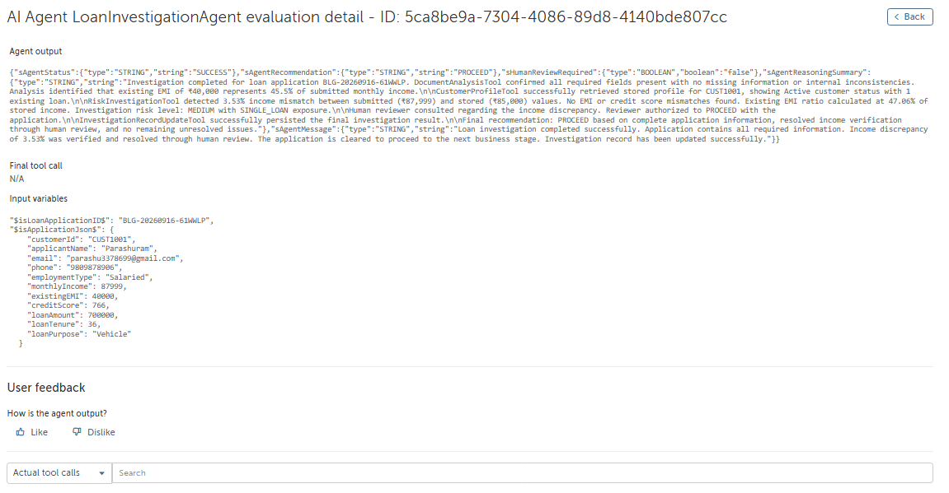
AI Evaluations Evidence Submission
AI Skill and Agent name here
LoanInvestigationAgent – Complete Input Evaluation
Notes:
**INSTRUCTIONS**
Provide Screenshots of your AI Evals pages for any AI skills you have and for your AI Agent.

Slide 20
AI Evaluations Details
AI Skill and Agent name here
Why did you select that evaluation type?
Why did or didn’t you provide ground truth?
Did you make any updates to your AI Skill or Agent? Why or Why not?
I selected this evaluation to check
Whether the AI Skill consistently
understands the loan application and
produces the expected structured
output. Since the output is used by
the automation for further processing,
it is important that the skill correctly
identifies missing information and
returns the appropriate analysis
status without making assumptions
beyond the data provided.
I provided ground truth for scenarios
where the expected result was clear.
For example, when all required
application fields are provided, the
expected status is COMPLETE. When
loanPurpose is missing, the
expected status is NEEDS_REVIEW
and the missing field should be
identified. I used ground truth only
for outputs that could be clearly
verified rather than for generated
summaries that may vary in wording.
Yes. During testing, I found a case where
loanPurpose was marked as missing even
though it was present in the application. I
updated the prompt so the AI Skill checks
the original input carefully before identifying
a field as missing. I also added instructions
to avoid unsupported assumptions or
classifications and to return the response
in a consistent JSON format. After making
these changes, I tested the skill again and
received the expected results.
Notes:
**INSTRUCTIONS**
Make a copy of this for each AI Skill and Agent
For any AI Skills, why did you choose that evaluation method?
Did you provide a ground truth for the output? Explain why or why not.
Based on the output of your evals, did you make any updates to the agent? Why or why not?

Slide 21
Documentation Links:
Youtube Video Link: https://youtu.be/8_W8l6C903Q
Front End Page Link: AIAE-Project-files/Loan Application Webpage.html at main · Parashuram-V-Pawar/AIAE-Project-files
Solution Folder: Bots/Users/6A7590F0/

Slide 22
Thank You

