Slide 1
Introduction to Automation and Selenium
Session-1 By-Anshul Sonpure

Slide 2
Topics that will be Covered
Manual Vs Automation Testing
Overview of Automation Testing and Its Benefits
Introduction to Selenium
Selenium Architecture
Same Origin Policy
Setting up Selenium WebDriver in Eclipse
First Selenium Test Script

Slide 3
Manual Vs Automation Testing
Definition: Manual testing is the process of manually executing test cases and identifying defects in the software application under test.
Advantages:
Human intuition and experience can catch certain types of defects that may be missed by automated tests.
Manual testing can be performed without the need for any additional tools or software.
Disadvantages:
Manual testing is time-consuming and can be prone to errors.
Manual testing is not scalable and cannot be easily repeated.

Slide 4
Manual Vs Automation Testing
Definition: Automation testing is the process of using tools and software to automatically execute test cases and compare actual results with expected results.
Advantages:
Automation testing is faster and more efficient than manual testing.
Automation testing can be repeated and scaled easily.
Disadvantages:
Automation testing requires additional tools and software, which can be expensive.
Automation testing cannot replace the human intuition and experience needed for certain types of testing.

Slide 5
Manual Vs Automation Testing
Definition of automation testing: The process of using software tools to execute pre-scripted tests on a software application before release to production
Benefits of automation testing: saves time and effort, improves accuracy, increases test coverage, enables continuous testing, and reduces the risk of human errors
Introduction to Selenium: a popular open source automation testing framework for web applications, consisting of several components including Selenium IDE, Selenium WebDriver, and Selenium Grid

Slide 6
Overview of Automation Testing and Its Benefits
Key benefits of automation testing: saves time and effort, improves accuracy, increases test coverage, enables continuous testing, and reduces the risk of human errors
Automation testing process: selecting the right tools, identifying test cases to automate, creating test scripts, executing tests, and reporting results
Types of tests that can be automated: functional testing, regression testing, performance testing, and load testing

Slide 7
Introduction to Selenium
How Selenium originated?
The history of Selenium tracks back to the early 2000s. Jason Huggins, an engineer in ThoughtWorks, created a JavaScript module. Its name was JavaScriptTestRunner, for the automation of an internal website. The name Selenium comes from a joke made by Huggins, saying that "you can cure mercury poisoning by taking selenium supplements".
What are the various components of Selenium?
Selenium is not just an automation tool. It is a suite of tools, and each tool in the suite has specific unique capabilities that help in designing and developing of automation framework. All these components can be either used individually or can be paired with one another to achieve a level of test automation.

Slide 8
Introduction to Selenium
What is Selenium IDE?
Selenium IDE is an extension available for both Firefox and Chrome, which has the record and replay functionality available. Selenium IDE also now has the capability of exporting the code in various predefined languages. It also gives the ability to use one test case inside another.
What is Selenium RC?
Selenium RC is a server that acts as a middle man between the user and the browser that needs to interact. RC uses JavaScript to work with browsers while allowing the users to write code in the language of their choice. It was the main version of Selenium for some time. Selenium RC had issues with the One Origin Policy and deprecated in favor of WebDriver.

Slide 9
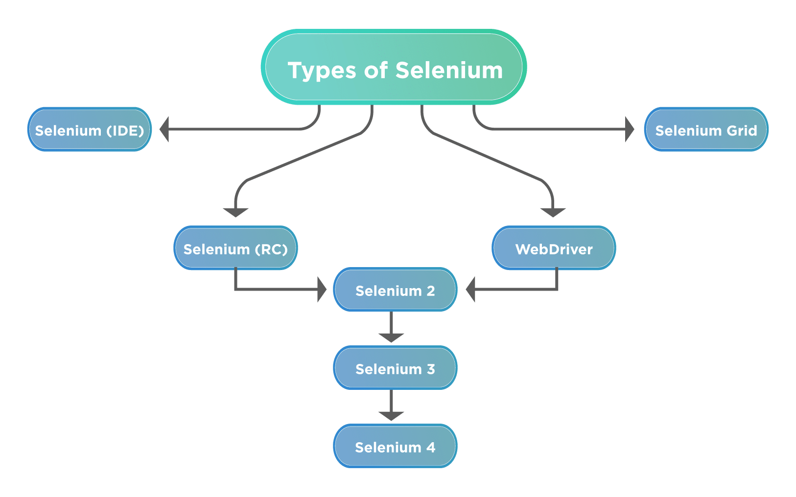
Introduction to Selenium

Slide 10
Introduction to Selenium
What is Selenium WebDriver?
Selenium WebDriver is the most commonly used component of Selenium. WebDriver allows users to write custom code in their language of choice and interact with the browser of their choice, through browser-specific drivers. WebDriver works on the OS level and uses a Protocol called JSONWireProtocol to communicate with browsers.
As shown above, Selenium 2 was the actual implementation of the merger of the WebDriver and RC project. The features of WebDriver and RC were imbibed in version 2 of WebDriver and called as Selenium 2.
Selenium 3 was an upgrade over Selenium 2 in many terms. Selenium 3 became a World Wide Web Consortium (W3C) standard. Selenium RC moved to a legacy package, and many improvements and new features got added to cater to the changing web landscape.
Moreover, Selenium 4 is the new member of the family (selenium latest version) and still in the beta phase for the end-users.

Slide 11
Introduction to Selenium
What is Selenium Grid?
Selenium GRID allows users to run tests on different machines, with different browsers and OS simultaneously, which gives the ability to run tests in parallel, as such saving a lot of time and resources of testing on several machines.

Slide 12
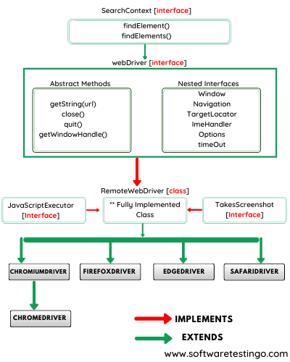
Selenium Architecture
Selenium WebDriver architecture: consists of a language-specific client library, a JSON wire protocol, and browser-specific driver executables

Slide 13
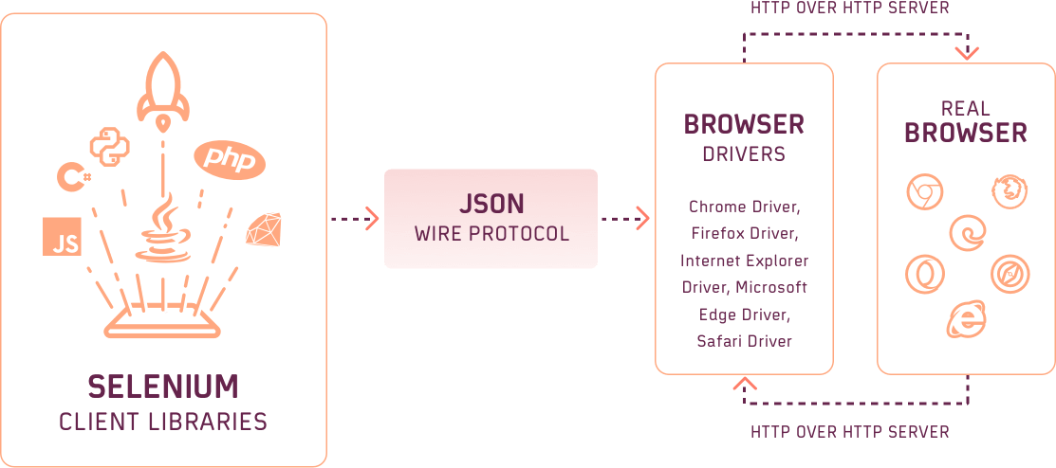
Selenium Architecture
How Selenium WebDriver works: the client library sends commands to the browser driver through the wire protocol, which in turn controls the browser and returns the results back to the client

Slide 14
Same Origin Policy
Definition of Same Origin Policy: a security feature in web browsers that restricts scripts running in a web page from accessing content from other origins (i.e. domains, protocols, or ports)
Same Origin Policy issue: One limitation of Selenium is that it can only interact with web pages that have the same origin as the Selenium script. The "Same Origin Policy" is a security feature in web browsers that restricts scripts running in a web page from accessing content from other origins (i.e. domains, protocols, or ports). For example, if your Selenium script is running on "https://www.example.com", it cannot access content from "https://www.google.com" due to the Same Origin Policy. To work around this limitation, you can use techniques such as cross-domain messaging, server-side proxying, or browser plugins such as CORS Everywhere.
Limitations of Selenium due to Same Origin Policy: Selenium can only interact with web pages that have the same origin as the Selenium script

Slide 15
Setting up Selenium WebDriver in Eclipse
Prerequisites: Java Development Kit (JDK) version 8 or higher, Eclipse IDE, and Selenium WebDriver JAR files
Steps to set up Selenium WebDriver in Eclipse: download and install JDK, download and extract Selenium WebDriver, create a new Java project in Eclipse, add the Selenium WebDriver JAR files to the project build path, and import the required classes in the Java code
Example code for a simple Selenium test script

Slide 16
Writing Your First Selenium Test Script
Steps to write a simple Selenium test script: open a browser, navigate to google search “Selenium tutorial”.
public class MyFirstSeleniumScript {
public static void main(String[] args) {
// Set the path to the chromedriver executable
System.setProperty("webdriver.chrome.driver", "/path/to/chromedriver");
// Create a new instance of the Chrome driver
WebDriver driver = new ChromeDriver();
// Navigate to Google.com
driver.get("https://www.google.com");
// Find the search box element and enter a search query
driver.findElement(By.name("q")).sendKeys("Selenium tutorial");
// Submit the search query
driver.findElement(By.name("q")).submit();
}
}

Slide 17
Conclusion
Definition and benefits of automation testing
Introduction to Selenium and its components
Selenium WebDriver architecture and Same Origin Policy issue
Setting up Selenium WebDriver in Eclipse and writing a simple test script
Next steps: In the next session, we will cover more advanced topics such as handling different types of elements, handling alerts and pop-ups, working with frames and iframes, and using test frameworks such as JUnit and TestNG.
I hope this helps! Let me know if you have any other questions.

