Slide 1
Locators and WebDriver Commands
Session-2 By-Anshul Sonpure

Slide 2
Topics that will be Covered
Introduction to locators and their types
Types of locators (id, name, class name, etc.)
Best practices for selecting a locator
Locating web elements using different locators
Prefered sequence for locators in selenium
Find Element and FindElements in Selenium WebDriver
Difference between FindElement and FindElements
Selenium WebDriver Commands

Slide 3
Introduction to locators and their types
Definition of locators
In Selenium WebDriver, locators play a crucial role in identifying web elements on a webpage. The main objective of web automation is to interact with different elements present on a webpage like text boxes, buttons, links, etc. using programming code. However, in order to interact with these elements, we first need to identify them on the webpage, and this is where locators come in.
Locators are a set of attributes that help identify web elements uniquely on a webpage. These attributes can be based on the element's ID, name, class name, tag name, CSS selector, or XPath, among others. Selenium WebDriver uses these locators to find web elements on a webpage and perform actions on them.
Using locators correctly is essential for the success of any automation project. If a locator is not correctly identified or implemented, the automation test script may fail to find the intended web element, causing the test to fail. This can lead to significant delays in project timelines and can impact the overall efficiency of the testing process.
Therefore, it is essential to understand the importance of locators in Selenium WebDriver and learn how to use them effectively to create robust and reliable test scripts.

Slide 4
Types of locators (id, name, class name, etc.)
There are several types of locators available in Selenium WebDriver, and each one has its unique way of identifying web elements. Here are some of the most commonly used locators:
ID: This is a unique identifier for an element on a webpage. It is often the most reliable locator to use, but not all elements have an ID.
Name: This locator identifies elements by their name attribute. It is useful when an element does not have a unique ID.
Class Name: This locator identifies elements by their class attribute. It is often used when an element has multiple classes.
Tag Name: This locator identifies elements by their HTML tag name, such as 'div', 'p', or 'a'.
CSS Selector: This locator identifies elements using CSS selectors, which allow for more specific targeting of elements.
XPath: This locator identifies elements using an XPath expression. It allows for more complex targeting of elements but can be slower than other locators.
Understanding the different types of locators and when to use each one is crucial for creating reliable test scripts. Choosing the right locator can make test scripts more resilient to changes in the application, making them easier to maintain over time.

Slide 5
Best practices for selecting a locator
When selecting a locator, it is important to consider the following best practices to ensure the reliability and maintainability of your automation tests:
Choose unique and stable locators: Select a locator that uniquely identifies the element and is not likely to change frequently. Avoid using locators that are dynamically generated or based on the element's position on the page.
Prefer ID and name locators: Whenever possible, choose ID or name locators, as they are more reliable and faster than other types of locators.
Use CSS selectors or XPath expressions for complex scenarios: If there is no ID or name available or if you need to target multiple elements with similar attributes, use CSS selectors or XPath expressions.
Avoid using locators based on text or content: Locators based on text or content can be fragile and susceptible to changes, especially if the text is translated or modified.
Use relative locators: When possible, use relative locators that are based on the position of other elements on the page, rather than absolute locators that rely on fixed positions.
By following these best practices, you can create more robust and maintainable automation tests that are less likely to fail due to changes in the application.

Slide 6
Locating web elements using different locators
How to use different types of locators
- By ID: driver.findElement(By.id("username"))
- By Name: driver.findElement(By.name("username"))
- By Class Name: driver.findElement(By.className("radius"))
- By Tag Name: driver.findElement(By.tagName("tagname"))
- By Link Text: driver.findElement(By.linkText("Elemental Selenium"))
- By Partial Link Text: driver.findElement(By.partialLinkText(" Elemental "))
By CSS Selector: driver.findElement(By.cssSelector("css selector"))
# is used with id eg-- #username
. is used with class name eg -- .login

Slide 7
What is the Prefer sequence for locators in selenium
The preferred sequence for selecting locators in Selenium is:
ID - If an element has a unique ID attribute, it is the most preferred and reliable way to locate that element.
Name - If the element does not have an ID attribute, but has a name attribute, that can be used as a locator.
CSS Selector - If neither ID nor name attributes are available, a CSS selector can be used to locate the element based on its attributes.
XPath - If no other locators work, XPath expressions can be used to locate the element, although they are generally slower and less preferred than the other types of locators.
It's important to note that the preference for a specific type of locator may depend on the application under test and the specific scenario, so it's important to be flexible and choose the most appropriate and reliable locator for each situation.

Slide 8
Find Element and FindElements in Selenium WebDriver
Why do you need Find Element(s) command?
Interaction with a web page requires a user to locate the web element. Find Element command is used to uniquely identify a (one) web element within the web page. Whereas, Find Elements command is used to uniquely identify the list of web elements within the web page.
FindElement command syntax:
WebElement elementName = driver.findElement(By.LocatorStrategy("LocatorValue"));
Selenium Find Element command takes in the By object as the parameter and returns an object of type list WebElement in Selenium. By object in turn can be used with various locator strategies such as find element by ID Selenium, Name, Class Name, XPATH etc. Below is the syntax of FindElement command in Selenium web driver.

Slide 9
Find Element and FindElements in Selenium WebDriver
Why do you need Find Element(s) command?
FindElements command syntax:
List<WebElement> elementName = driver.findElements(By.LocatorStrategy("LocatorValue"));
FindElements in Selenium command takes in By object as the parameter and returns a list of web elements. It returns an empty list if there are no elements found using the given locator strategy and locator value. Below is the syntax of find elements command.

Slide 10
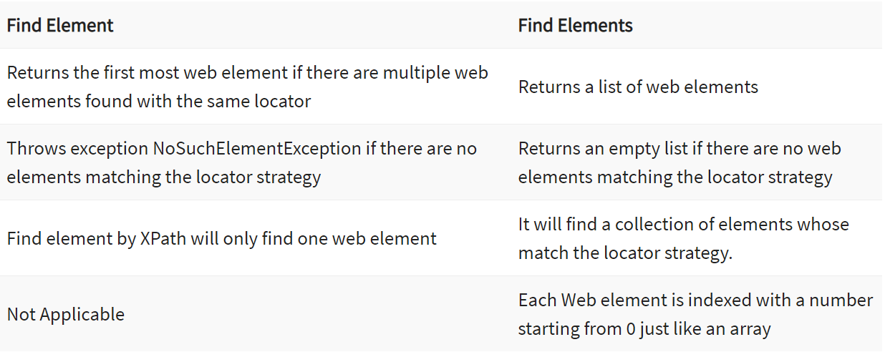
Difference between FindElement and FindElements

Slide 11
Selenium WebDriver Commands
Opening a URL
Using Get method- The driver.get() method is used to navigate to a web page by passing the string URL as parameter. Syntax- driver.get("https://www.google.com");
Using Navigate method- The driver.navigate().to() method does the task of opening a web page like driver.get() method. Syntax- driver.navigate().to("https://amazon.com");
Difference between driver get and driver navigate to methods
driver.get() method is used to open an URL and it will wait till the whole page gets loaded. WebDriver will wait until the page has fully loaded before returning control to your test or script. Now note that if a webpage uses a lot of AJAX on load then WebDriver may not know when it has completely loaded. If you need to ensure such pages are fully loaded then you can use waits. For eg: driver.get("http://www.google.com");
While driver.navigate.to() method navigates to an URL and It will not wait till the whole page gets loaded. It maintains the browser history and cookies, so we can use forward and backward button to navigate between the pages during the coding of Testcase. driver.navigate().to("http://www.example.com");

Slide 12
Selenium WebDriver Commands
Clicking on WebElements
The click() method in Selenium is used to perform the click operation on web elements. The click() method is applied on the webElements identified, to perform the click operation.
Writing in a Textbox
The sendKeys() method can be used for writing in a textbox or any element of text input type.
//Creating a textbox webElement
WebElement element = driver.findElement(By.name("q"));
//Using sendKeys to write in the textbox
element.sendKeys(“HelloWorld!");

Slide 13
Selenium WebDriver Commands
Clearing text in a Textbox
The clear() method can be used to clear the text written in a textbox or any web element of text input type.
//Clearing the text written in text fields
driver.findElement(By.name("q")).clear();
Fetching text written over any web element
In automation, many times we need to fetch the text written over a web element for performing some assertions or debugging. For this, we have getText() method in selenium webDriver.
//Fetching the text written over web elements
driver.findElement(By.id("element123")).getText();

Slide 14
Selenium WebDriver Commands
Navigating backward in a browser
Selenium provides navigate().back() command to move backward in the browser’s history.
//Navigating backwards in browser -- driver.navigate().back();
Navigating forward in a browser
Selenium provides navigate().forward() command to move forward in a browser.
//Navigating forward in browser -- driver.navigate().forward();

Slide 15
Selenium WebDriver Commands
Refreshing the browser
There are multiple ways to refresh a page in Selenium WebDriver- Using driver.navigate().refresh() command
Using sendKeys(Keys.F5) on any textbox on the webpage
Using driver.get(“URL”) with current URL
Using driver.navigate().to(“URL”) with current URL
//Refreshing browser using navigate().refresh()
driver.navigate().refresh();
//By pressing F5 key on any textbox element
driver.findElement(By.id("id123")).sendKeys(Keys.F5);
//By opening the current URL using get() method
driver.get("https://amazon.com");
//By opening the current URL using navigate() method
driver.navigate().to("https://amazon.com");

Slide 16
Selenium WebDriver Commands
Closing browser
Selenium provides two commands to close browsers close() and quit(). The driver.close() command is used to close the browser having focus. Whereas, the driver.quite() command is used to close all the browser instances open.
//To close the current browser instance
driver.close();
//To close all the open browser instances
driver.quit();

Slide 17
Selenium WebDriver Commands
Maxmize a browser
During automation, it’s one of the best practices to maximize the browser in the initial phases (or in the @BeforeTest method in case you are using TestNG as the testing framework). The following command can be used to maximize the browser window.
driver.manage().window().maximize();

Slide 18
QNA
This session covered the basics of locators and WebDriver commands in Selenium.
We learned about the different types of locators, such as id, name, class name, and more.
We explored how to locate web elements using these locators.
We also covered the various WebDriver commands and their usage.
We learned how to navigate between pages using WebDriver commands.
By the end of the session, we created a sample test script to perform basic operations on a web page using locators and WebDriver commands.
Consistent practice and review of the material is necessary to master the usage of locators and WebDriver commands in Selenium.
These skills are essential for any automation tester looking to use Selenium for web UI automation testing.

