Slide 1
Handling WebElements and WebDriver Exceptions
Session-3 By-Anshul sonpure

Slide 2
Topics that will be Covered
XPath in Selenium
Absolute Xpath
Relative Xpath
How to Write Relative Xpath
Types of Xpath
Independent and Dependent Xpath
Synchronization in Selenium
Common Expected Conditions that can be used in Explicit Wait
pageLoadTimeout and scriptTimeout in selenium
FluentWait in Selenium
Chrome Options & Desired Capabilities in Selenium Webdriver
How to Handle Cookies in Selenium WebDriver

Slide 3
XPath in Selenium
What is XPath in Selenium?
XPath is a powerful tool in Selenium for locating elements on a web page that cannot be found by general locators like id, class, name, etc. It is an XML-based query language used to navigate through the HTML structure of the page and find the location of any element using an XML path expression. XPath can be used for both HTML and XML documents and is widely used in automation testing scripts to find specific elements on a web page. With XPath, testers can locate elements even when the general locators are unable to identify them, making it a valuable tool in Selenium automation.

Slide 4
Absolute XPath
In Selenium, XPath can be used to locate elements using a variety of strategies, such as:
Absolute XPath: This specifies the complete path of the element from the root element of the page. It starts with a single forward slash (/) and traverses through all the elements to reach the target element. Absolute XPath is not recommended as any changes in the DOM structure may render the XPath invalid.
Examples for Absolute Xpath:
/html/body/main/div/div/div[2]/div[4]/div/form/table/tbody/tr[1]/td[2]/input
/html/body/main/div/div/div[2]/div[4]/div/form/table/tbody/tr[2]/td[2]/input

Slide 5
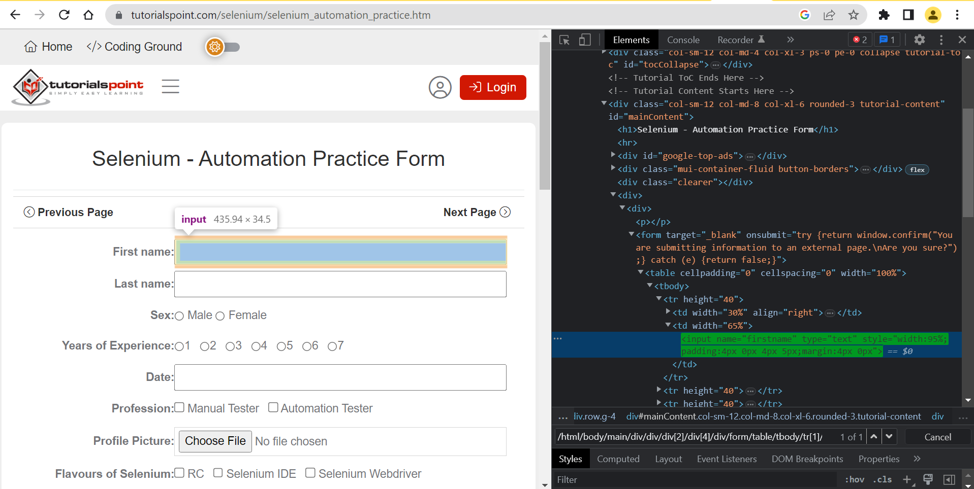
Absolute XPath
/html/body/main/div/div/div[2]/div[4]/div/form/table/tbody/tr[1]/td[2]/input

Slide 6
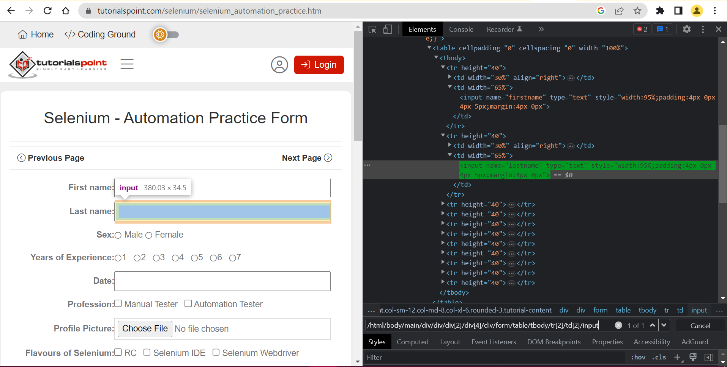
Absolute XPath
/html/body/main/div/div/div[2]/div[4]/div/form/table/tbody/tr[2]/td[2]/input

Slide 7
Relative XPath:
Relative XPath: Relative XPath is a type of XPath that begins searching for elements from the middle of the HTML DOM structure. It starts with a double forward slash (//) and can locate elements anywhere on the webpage, which means that it does not require a long XPath and allows testers to start searching from the middle of the DOM structure. Relative XPath is always preferred over absolute XPath since it does not use a complete path from the root element, making it more flexible and adaptable to changes in the DOM structure.
Syntax for writing Relative Xpath: //tagname[@attribute='value']

Slide 8
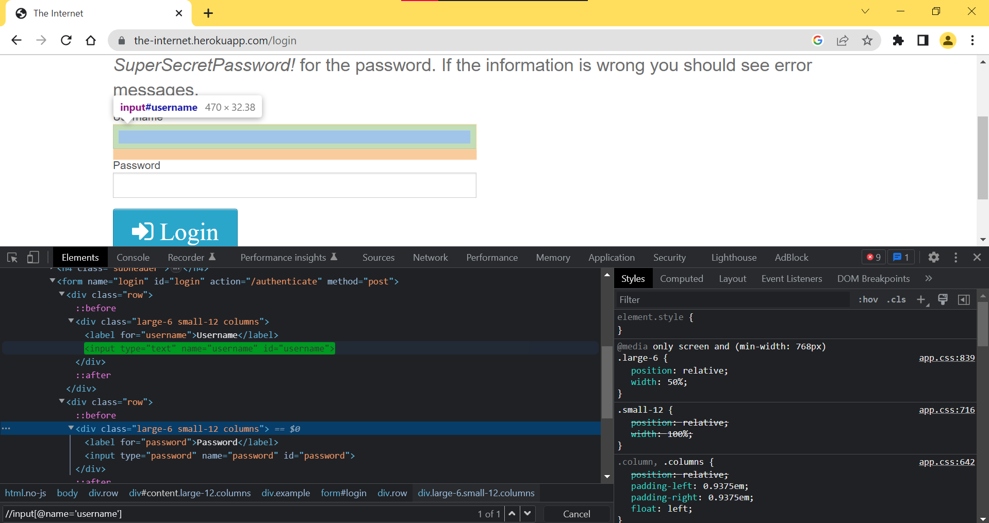
How to Write Relative Xpath
///input[@name='username']
//input[@type='text']
//input[@id='username']

Slide 9
Types of Xpath:
Basic XPath: XPath expression select nodes or list of nodes on the basis of attributes like ID , Name, Classname, etc. from the XML document.
Eg : Xpath=//input[@name='uid']
Contains(): Contains() is a method used in XPath expression. It is used when the value of any attribute changes dynamically, for example, login information. The contain feature has an ability to find the element with partial text
Eg : Xpath=//*[contains(@name,'btn')]
//a[contains(text(),'Elemental Selenium')]
Using OR & AND: In OR expression, two conditions are used, whether 1st condition OR 2nd condition should be true. It is also applicable if any one condition is true or maybe both. Means any one condition should be true to find the element. In the below XPath expression, it identifies the elements whose single or both conditions are true.
Eg : Xpath=//*[@type='submit' or @name='btnReset']
//input[@type='password' and @name='password']

Slide 10
Types of Xpath:
Xpath Starts-with:XPath starts-with() is a function used for finding the web element whose attribute value gets changed on refresh or by other dynamic operations on the webpage. In this method, the starting text of the attribute is matched to find the element whose attribute value changes dynamically. You can also find elements whose attribute value is static (not changes).
For example -: Suppose the ID of particular element changes dynamically like:
Id=” message12″
Id=” message345″
Id=” message8769″
and so on.. but the initial text is same. In this case, we use Start-with expression.
Xpath=//label[starts-with(@id,'message')]

Slide 11
Independent and Dependent Xpath
When the text values of the elements are constantly changing, functions like "contains()", "starts-with()", etc. cannot be used to handle those elements. In these cases, we use nearby unique elements to identify the dynamically changing element. This concept is known as independent dependent XPath.
Steps for locating dependent web element:
Locate the independent web element.
Traverse back till both independent and dependent web element are highlighted. This called the common parent for independent and dependent web element, using /..
Navigate to the depended web element(forward Traverse) and write the xpath for it.
Eg : //td[.=‘Java’]/..//a[.=‘Downloads’]

Slide 12
Synchronization in Selenium
Synchronization in Selenium is the process of making sure that the WebDriver waits for the web page to load completely before performing any actions on it. This is necessary because web pages can sometimes take longer to load due to slow internet connections, heavy traffic, or various other factors. If the WebDriver does not wait for the page to load completely before performing an action, it may encounter errors or fail to perform the desired action.
Synchronization is implemented in Selenium using two types of waits: implicit wait and explicit wait.
Implicit wait: This type of wait is used to tell the WebDriver to wait for a certain amount of time (in seconds) before throwing a "NoSuchElementException". The implicit wait is set once for the entire duration of the WebDriver session and is applied to all elements that the WebDriver interacts with. If the element is found before the specified time, then the WebDriver proceeds to execute the next step of the test. Otherwise, it waits for the specified time before throwing an exception.

Slide 13
Synchronization in Selenium
Explicit wait: While executing scripts, sometimes we may face an exception “Element Not Visible Exception” or “Element Not Intractable”.
This type of wait is used to tell the WebDriver to wait for a certain condition to be met before proceeding with the next step of the test. Explicit wait is applied to a particular element and is used in combination with ExpectedConditions. ExpectedConditions are conditions that are expected to occur on the web page, such as the presence of an element, the visibility of an element, or the ability to click on an element. Once the expected condition is met, the WebDriver proceeds with the next step of the test.
Using synchronization in Selenium ensures that the WebDriver interacts with the web page only when it is fully loaded and avoids errors due to incomplete loading.

Slide 14
Common Expected Conditions that can be used in Explicit Wait
Explicit wait in Selenium is used to pause the test until the expected conditions are met. The expected conditions are nothing but the conditions that should be met before performing any action on the web element. Some of the common expected conditions that can be used in explicit wait are:
Element to be Clickable: This condition is used to wait until the element is clickable. The method associated with this condition is ExpectedConditions.elementToBeClickable(By locator).
Element to be Visible: This condition is used to wait until the element is visible on the web page. The method associated with this condition is ExpectedConditions.visibilityOfElementLocated(By locator).
Element to be Present: This condition is used to wait until the element is present on the web page. The method associated with this condition is ExpectedConditions.presenceOfElementLocated(By locator).
Text to be Present: This condition is used to wait until the text is present in the specified element. The method associated with this condition is ExpectedConditions.textToBePresentInElementLocated(By locator, String text).

Slide 15
Common Expected Conditions that can be used in Explicit Wait
Title to be Present: This condition is used to wait until the title of the web page is present. The method associated with this condition is ExpectedConditions.titleIs(String title).
Element to be Selected: This condition is used to wait until the element is selected. The method associated with this condition is ExpectedConditions.elementToBeSelected(By locator).
These are some of the common expected conditions that can be used in explicit wait. There are several other conditions available in Selenium that can be used as per the requirement.

Slide 16
pageLoadTimeout and scriptTimeout in selenium
In Selenium, pageLoadTimeout and scriptTimeout are two types of timeouts used for managing wait times during web automation.
The pageLoadTimeout is used to specify the maximum time that the driver should wait for a page to be loaded. It prevents the script from waiting indefinitely for a page to load. If the page doesn't load within the specified time, then a TimeoutException is thrown.
The scriptTimeout, on the other hand, is used to specify the maximum time that the driver should wait for an asynchronous script to finish executing. This can be useful for pages that load content dynamically using JavaScript.
Both pageLoadTimeout and scriptTimeout can be set using the manage() method of the WebDriver interface.

Slide 17
FluentWait in Selenium
FluentWait is a type of explicit wait in Selenium 4 that allows the automation script to wait for a certain condition to occur before proceeding further. It is called "fluent" because it provides a more fluent way of expressing the wait condition, as compared to the traditional explicit wait.
FluentWait is used when we need to wait for a certain condition to be fulfilled for a maximum period of time, and it will check for the condition at regular intervals until the maximum wait time is reached or the condition is met. The wait time and polling interval can be customized based on the application's needs.

Slide 18
FluentWait in Selenium
// create a FluentWait instance
Wait<WebDriver> fluentWait = new FluentWait<>(driver)
.withTimeout(Duration.ofSeconds(30))
.pollingEvery(Duration.ofMillis(500))
.ignoring(NoSuchElementException.class);
// wait for an element to be visible
WebElement element = fluentWait.until(ExpectedConditions.visibilityOfElementLocated(By.id("exampleId")));

Slide 19
Syntax for implicitWait and pageLoadTimeout and scriptTimeout
ImplicitWait-
driver.manage().timeouts().implicitlyWait(Duration.ofSeconds(10));
ScriptTimeOut-
driver.manage().timeouts().scriptTimeout(Duration.ofMinutes(2));
pageLoadTimeout-
driver.manage().timeouts().pageLoadTimeout(Duration.ofSeconds(10));

Slide 20
Exceptions in WebDriver
Here are some common issues that may occur when interacting with WebElements in Selenium:
StaleElementReferenceException: This exception occurs when the WebElement has become stale or no longer valid due to a page refresh, navigation, or DOM structure change. It is important to re-locate the element and obtain a new reference before attempting to interact with it.
ElementNotVisibleException: This exception occurs when the element is present in the DOM but not visible on the page. It may be hidden behind another element or require scrolling to become visible. In such cases, you can use the Actions class to perform mouse actions like scrolling or hovering.
NoSuchElementException: This exception occurs when the element could not be found using the specified locator. Double-check the locator strategy and ensure that the element is present on the page.
TimeoutException: This exception occurs when the WebDriver is unable to find the element within the specified timeout period. Increase the timeout value or modify the locator strategy to help locate the element.

Slide 21
Exceptions in WebDriver
ElementNotInteractableException: This exception occurs when the element is visible but not in an interactable state, such as a disabled button or a read-only text field. Check the element's attributes and modify the test script accordingly.
WebDriverException: This is a generic exception that is thrown when there is a problem with the WebDriver instance, such as when the browser is not responding.
InvalidArgumentException: This exception is thrown when an invalid argument is passed to a WebDriver method.
NoSuchWindowException: This exception is thrown when the target window or frame does not exist.
MalformedURLException: This exception in Selenium that is thrown when a URL is not in the correct format or is malformed. This exception occurs when we try to create a URL object from a string, and the URL is not well-formed. A well-formed URL must begin with a protocol (such as http, https, ftp, etc.) followed by a colon and two forward slashes.

Slide 22
Chrome Options & Desired Capabilities in Selenium Webdriver
Chrome Options and Desired Capabilities are two important features in Selenium WebDriver that help to customize the behavior of the Chrome browser during test automation.
Chrome Options
Chrome Options is a class in Selenium WebDriver that allows the automation engineer to configure the browser during test execution. It provides a way to set various browser-specific properties such as disabling extensions, controlling the window size, setting the user agent, and many more. Some of the commonly used Chrome Options are:
Headless mode: It runs Chrome in a headless state, without a graphical user interface, and is useful for faster test execution.
Window size: It sets the size of the browser window during test execution.
Incognito mode: It opens the browser in incognito mode, which means no browsing history or cookies will be saved.
Disable images: It disables the loading of images on the page, which can speed up the test execution.
Disable extensions: It disables the loading of browser extensions during test execution, which can improve the stability of the test.

Slide 23
Chrome Options & Desired Capabilities in Selenium Webdriver
How to use Chrome Options in ChromeDriver:
// Creating an instance of ChromeOptions
ChromeOptions options = new ChromeOptions();
// Adding arguments to disable extensions and pop-ups
options.addArguments("--disable-extensions");
options.addArguments("--disable-popup-blocking");
options.add_argument("--incognito")
// Creating an instance of ChromeDriver with ChromeOptions
WebDriver driver = new ChromeDriver(options);

Slide 24
Desired Capabilities
Desired Capabilities is a class in Selenium WebDriver that allows the automation engineer to set various browser-specific properties such as browser name, browser version, platform, and more. Desired Capabilities are used to configure the WebDriver instance that launches the browser.
Some of the commonly used Desired Capabilities are:
Browser name: It specifies the name of the browser that needs to be launched.
Browser version: It specifies the version of the browser to be used for test automation.
Platform: It specifies the operating system on which the test is running, such as Windows, Linux, or Mac.
Javascript Enabled: It enables or disables the execution of JavaScript on the page during test execution.
Proxy settings: It allows the automation engineer to configure the proxy server settings for the browser during test execution.

Slide 25
Desired Capabilities
How to set desired capabilities in Selenium3:
Setting the browser version:
DesiredCapabilities caps = new DesiredCapabilities();
caps.setCapability("browserVersion", "92.0.4515.107");
WebDriver driver = new ChromeDriver(caps);
Setting the platform:
DesiredCapabilities caps = new DesiredCapabilities();
caps.setCapability("platform", "WINDOWS");
WebDriver driver = new ChromeDriver(caps);

Slide 26
Desired Capabilities
How to set capabilities in Selenium 4:
In Selenium 4, DesiredCapabilities is replaced with Options. The Options interface provides methods to change the properties of the browser such as cookies, incognito, headless, disable pop-ups, add extensions,
ChromeOptions options = new ChromeOptions();
options.addArguments("--incognito");
options.setAcceptInsecureCerts(true);
DesiredCapabilities capabilities = new DesiredCapabilities();
capabilities.setCapability(ChromeOptions.CAPABILITY, options);
options.merge(capabilities);
WebDriverManager.chromedriver().setup();
driver = new ChromeDriver(options);

Slide 27
How to Handle Cookies in Selenium WebDriver
Handling cookies in Selenium WebDriver is an essential task to perform various scenarios such as login, user sessions, and more. The WebDriver interface provides several methods to manage cookies:
Get All Cookies: The getCookies() method is used to retrieve all the cookies available for the current domain. Set<Cookie> cookies = driver.manage().getCookies();
Get a Specific Cookie: The getCookieNamed() method is used to retrieve a specific cookie using its name. Cookie cookie = driver.manage().getCookieNamed("cookie_name");
Add a Cookie: The addCookie() method is used to add a new cookie to the browser's cookie store. Cookie cookie = new Cookie("name", "value"); driver.manage().addCookie(cookie);
Delete All Cookies: The deleteAllCookies() method is used to delete all the cookies available for the current domain.
driver.manage().deleteAllCookies();

Slide 28
Summary for this Session
Locators and WebDriver commands are essential for automation testing using Selenium.
XPath is a syntax or language used to navigate through the HTML structure of a page to find web elements using XML path expressions.
There are two types of XPath: absolute and relative. Relative XPath is preferred because it starts from the middle of the HTML DOM structure and can search elements anywhere on the webpage.
Synchronization is important to ensure that the script waits for the webpage to load completely before interacting with the web elements. This helps to avoid errors and increase the stability of the test scripts.
Explicit wait and implicit wait are two types of waits used for synchronization in Selenium. Explicit wait waits for a particular condition to occur before interacting with a web element, whereas implicit wait waits for a certain amount of time before interacting with the web element.
Chrome options and desired capabilities are used to customize the behavior of the Chrome browser when running test scripts.
Deleting cookies is important when testing web applications to ensure that the test scripts run correctly and do not have any previous session data interfering with the test results.

