Slide 1
Advanced Selenium Topics
Session-5 By-Anshul Sonpure

Slide 2
Topics that will covered
Working with Checkboxes and Radio Buttons
Handling Images
Action Class in Selenium
Select Class in Selenium
Robot Class in Selenium
Alert in Selenium
Handling Web tables in selenium

Slide 3
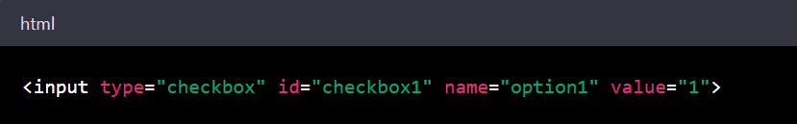
Working with Checkboxes and Radio Buttons
Checkboxes and radio buttons are commonly used UI elements in web applications, and are often used in forms to collect user input. In Selenium, it is possible to locate and interact with checkboxes and radio buttons using WebDriver commands.
To interact with a checkbox using Selenium WebDriver, you first need to locate the checkbox element on the page using a suitable locator such as ID, name, or class name. Once the element is located, you can use the WebDriver command click() to check or uncheck the checkbox as required.
For example, suppose we have the following checkbox HTML code:

Slide 4
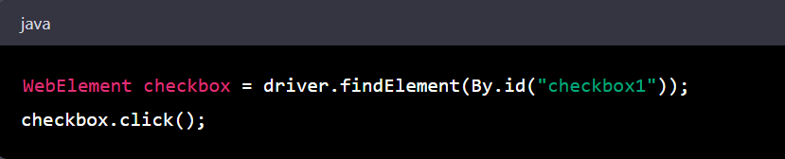
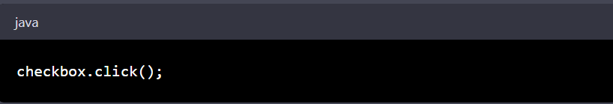
Working with Checkboxes and Radio Buttons
To check the checkbox using Selenium WebDriver, you could use the following code:
To uncheck the checkbox, you can simply call click() again:

Slide 5
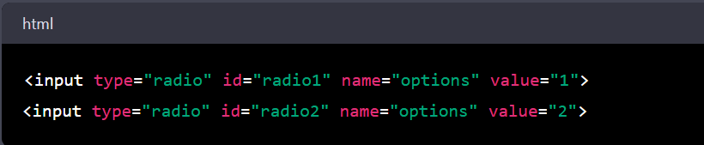
Working with Checkboxes and Radio Buttons
Similarly, to interact with radio buttons in Selenium, you need to first locate the radio button element using a suitable locator. Once the element is located, you can use the WebDriver command click() to select the radio button.
For example, suppose we have the following radio button HTML code:

Slide 6
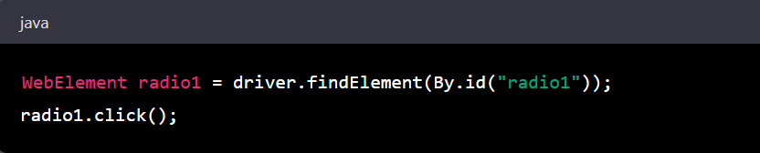
Working with Checkboxes and Radio Buttons
To select the first radio button using Selenium WebDriver, you could use the following code:
To select the second radio button, you would locate it using a suitable locator and call click() on the element as before.

Slide 7
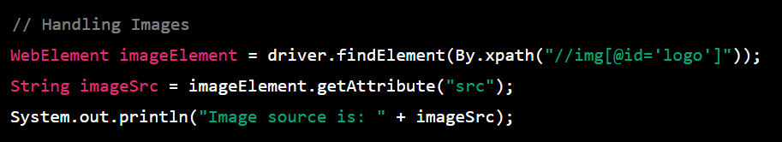
Handling Images
Images can be handled using the WebElement class and its getAttribute() method. To handle images, we need to locate the img tag using one of the locators like id, class name, xpath, etc. and then retrieve the src attribute using getAttribute("src") method. The src attribute value will give us the URL of the image which can be used to validate the image or perform any other operation on the image.

Slide 8
Handling Images
Using .click() method we can click on any image by locating it using unique Xpath or any html attribute.
Using .isDisplayed() method we can verify whether an image is displayed or not.
boolean isdisplayed = driver.findElement(By.xpath("//img[@src='hjkl.jpg']")).isDisplayed();
System.out.println(isdisplayed);
Finding broken links/images:
Identify all the links/images on the webpage using findElements() method.
Get the URL of each link/image using getAttribute() method.
Verify the status of the link/image using HttpURLConnection class.
If the response code of the link/image is not 200, then it is a broken link/image

Slide 9
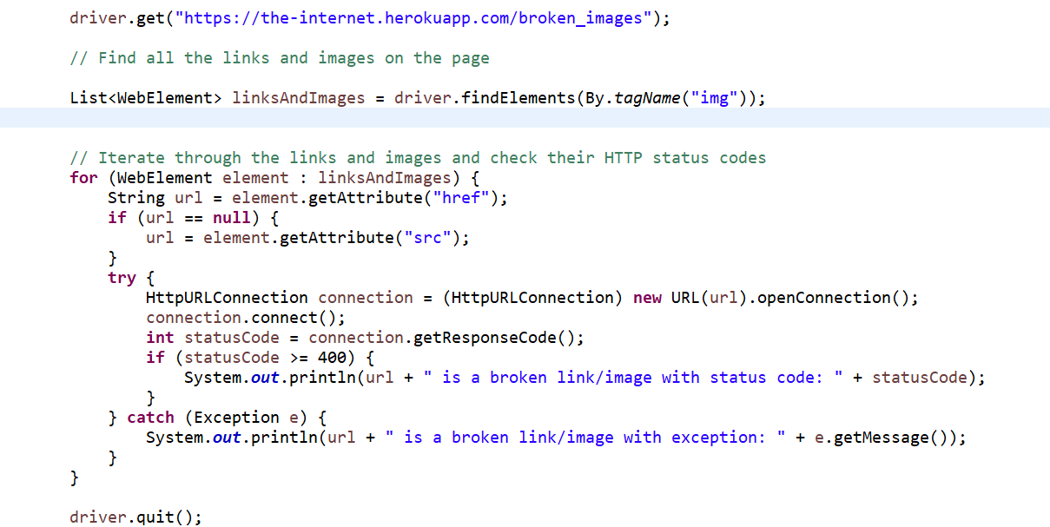
Handling Images

Slide 10
Action Class in Selenium
Handling Mouse Events:
Mouse events like hover, right-click, double-click, etc. can be handled using the Actions class in Selenium. To perform mouse events, we first need to create an object of the Actions class and then perform the required action on the element using the various methods like moveToElement(), contextClick(), doubleClick(), etc.
Some of the commonly used methods present in the Actions class in Selenium:
click() - clicks on a web element
clickAndHold() - clicks on a web element and holds the mouse button down
contextClick() - performs a right-click on a web element
doubleClick() - double-clicks on a web element
dragAndDrop(WebElement source, WebElement target) - drags a web element from the source location and drops it at the target location

Slide 11
Action Class in Selenium
moveToElement(WebElement element) - moves the mouse pointer to the middle of a web element
release() - releases the mouse button after clicking and holding it
sendKeys(CharSequence... keysToSend) - types characters into the currently focused web element or window
build() - generates a composite action containing all the individual actions performed by the Actions class
perform() - performs the composite action built by the build() method.

Slide 12
Select Class in Selenium
Handling Dropdowns:
Dropdowns can be handled using the Select class in Selenium. To work with dropdowns, we need to first locate the select tag using one of the locators and then create an object of Select class by passing the WebElement object of the select tag. The Select class provides various methods like selectByVisibleText(), selectByValue(), selectByIndex() to select the dropdown value based on text, value, or index.
The methods present in the Select class are as follows:
selectByVisibleText(String text): This method is used to select an option based on the visible text of the option.
selectByValue(String value): This method is used to select an option based on the value attribute of the option.
selectByIndex(int index): This method is used to select an option based on the index of the option.

Slide 13
Select Class in Selenium
deselectByVisibleText(String text): This method is used to deselect an option based on the visible text of the option.
deselectByValue(String value): This method is used to deselect an option based on the value attribute of the option.
deselectByIndex(int index): This method is used to deselect an option based on the index of the option.
getOptions(): This method is used to get all the options present in the dropdown.
getAllSelectedOptions(): This method is used to get all the selected options in the dropdown.
isMultiple(): This method is used to check whether the dropdown supports multiple selection or not.
deselectAll(): This method is used to deselect all the selected options in the dropdown.

Slide 14
Robot Class in Selenium
The Robot class in Selenium provides a way to simulate keyboard and mouse events on a web page. This class is particularly useful in cases where the standard Selenium methods cannot perform a specific action.
Following are some of the commonly used methods of the Robot class in Selenium:
keyPress(int keycode): This method is used to simulate a key press event on the keyboard. The keycode parameter specifies the key to be pressed.
keyRelease(int keycode): This method is used to simulate a key release event on the keyboard. The keycode parameter specifies the key to be released.
mouseMove(int x, int y): This method is used to move the mouse pointer to the specified coordinates on the screen.

Slide 15
Robot Class in Selenium
mousePress(int buttons): This method is used to simulate a mouse button press event. The buttons parameter specifies which button to press.
mouseRelease(int buttons): This method is used to simulate a mouse button release event. The buttons parameter specifies which button to release.
mouseWheel(int wheelAmt): This method is used to simulate a mouse wheel event. The wheelAmt parameter specifies the number of units to scroll.

Slide 16
Robot Class in Selenium
mousePress(int buttons): This method is used to simulate a mouse button press event. The buttons parameter specifies which button to press.
mouseRelease(int buttons): This method is used to simulate a mouse button release event. The buttons parameter specifies which button to release.
mouseWheel(int wheelAmt): This method is used to simulate a mouse wheel event. The wheelAmt parameter specifies the number of units to scroll.

Slide 17
Alert in Selenium
In Selenium, an alert is a small pop-up window that appears on the screen to give the user some information or to ask for confirmation or input. To handle alerts in Selenium, we use the Alert interface provided by the org.openqa.selenium package.
There are three types of alerts that can be handled in Selenium:
Simple Alerts: These are basic alerts that contain a message and an OK button. They can be handled using the accept() method of the Alert interface.
Confirmation Alerts: These alerts ask the user to confirm an action. They contain a message, OK and Cancel buttons. They can be handled using the accept() method to confirm the action or dismiss() method to cancel the action.
Prompt Alerts: These alerts ask the user to enter some input. They contain a message, a text box for input, and OK and Cancel buttons. They can be handled using the sendKeys() method to enter input and then accept() method to confirm or dismiss() method to cancel.

Slide 18
Alert in Selenium
The methods present in the Alert interface are:
accept(): Accepts the alert.
dismiss(): Dismisses the alert.
getText(): Gets the text of the alert message.
sendKeys(): Sends the specified keys to the alert prompt.
authenticateUsing(): Authenticates using the specified credentials in case the alert requires authentication.
setCredentials(): Sets the credentials for authentication.

Slide 19
Handling Web tables in selenium
In Selenium, web tables can be handled using the WebElement interface and its methods. Web tables are used to display data in rows and columns, and they are commonly found on web pages that display large amounts of data. The most common types of web tables are static tables and dynamic tables.
Static tables are those that have a fixed number of rows and columns, and the data in them does not change frequently. Dynamic tables, on the other hand, are those that have a variable number of rows and columns, and the data in them may change frequently.
To handle web tables in Selenium, we can use the following methods of the WebElement interface:
findElement(By locator): This method is used to locate a specific element within the table. We can use any of the locators such as ID, name, class name, etc. to locate an element within the table.
findElements(By locator): This method is used to locate multiple elements within the table.

Slide 20
Handling Web tables in selenium
getText(): This method is used to get the text of a specific cell within the table.
getAttribute(String attribute): This method is used to get the value of a specific attribute of a cell or row within the table.
getSize(): This method is used to get the size of the table in terms of rows and columns.
getTagName(): This method is used to get the tag name of the table.
getCssValue(String property): This method is used to get the value of a specific CSS property of the table.
To handle dynamic tables, we may need to first get the number of rows and columns in the table and then loop through each cell to get its value. We can use the getSize() method to get the number of rows and columns in the table and then use a for loop to iterate through each cell and get its value.

Slide 21
Summary
Checkbox and radio button elements can be selected or deselected using the click() method in Selenium.
Images can be clicked on using the click() method as well, or their src attribute can be retrieved for validation purposes.
Dropdown menus can be interacted with using the Select class in Selenium, which provides methods for selecting options based on their index, value, or visible text.
Mouse events such as hovering over an element or performing a drag-and-drop action can be handled using the Actions class in Selenium.
Alerts can be handled using the switchTo() method in Selenium, which allows you to switch focus to the alert and accept, dismiss, or send text to it.
Web tables can be located and interacted with using Selenium's findElement() and findElements() methods, and the data can be retrieved for validation or manipulation purposes. There are two types of web tables: static tables, which have a fixed number of rows and columns, and dynamic tables, which can have a varying number of rows and columns based on user input or data retrieved from a database.

