Slide 1
Advanced Selenium Topics-2
Session-6 By-Anshul SOnpure

Slide 2
Topics that will Covered
Apache POI in Selenium, Classes and Interfaces in POI
Read and Write Data in Excel
JavascriptExecutor in selenium
Take Screenshot in Selenium WebDriver
Handle iframe in Selenium
Handle SSL Certificate in Selenium
Selenium Grid

Slide 3
Apache POI in Selenium
Apache POI is a popular Java library used in Selenium for reading and writing Excel files. It provides a set of classes and methods to work with Excel files, such as XLS and XLSX.
Some key points about Apache POI in Selenium are:
Apache POI supports both reading and writing data to Excel files.
The HSSFWorkbook class is used to represent the Excel workbook, while the HSSFSheet class is used to represent the sheet within the workbook.
The HSSFRow class represents a row within a sheet, and the HSSFCell class represents a cell within a row.
The XSSFWorkbook class is used to represent the Excel workbook in the newer XLSX format.
Apache POI also provides classes to work with formulas, styles, and charts within Excel files.
By using Apache POI in Selenium, test data can be read from Excel files and used in test scripts, or test results can be written back to the Excel file for analysis.
Apache POI can be used to perform data-driven testing in Selenium by reading test data from Excel files.
Apache POI is an open-source library and can be easily integrated into Selenium projects.

Slide 4
Classes and Interfaces in POI
HSSFWorkbook: This class represents an Excel workbook in memory and provides methods for reading, creating, and modifying Excel files.
HSSFSheet: This class represents a worksheet in an Excel workbook and provides methods for working with cells, rows, and columns.
HSSFRow: This class represents a row in an Excel worksheet and provides methods for working with cells in that row.
HSSFCell: This class represents a cell in an Excel worksheet and provides methods for getting and setting the value, style, and other properties of the cell.
HSSFCellStyle: This class represents a style for a cell or a range of cells in an Excel worksheet and provides methods for setting font, background color, borders, and other formatting options.
XSSFWorkbook: This class is similar to HSSFWorkbook but is used for working with the newer .xlsx file format introduced in Excel 2007.

Slide 5
Classes and Interfaces in POI
XSSFSheet, XSSFRow, and XSSFCell: These classes are similar to their HSSF counterparts but are used for working with .xlsx files.
Workbook: This is an interface that defines common methods for working with Excel workbooks, and is implemented by both HSSFWorkbook and XSSFWorkbook.
Sheet, Row, and Cell: These are interfaces that define common methods for working with Excel worksheets, rows, and cells, and are implemented by both HSSFSheet and XSSFSheet, HSSFRow and XSSFRow, and HSSFCell and XSSFCell, respectively.

Slide 6
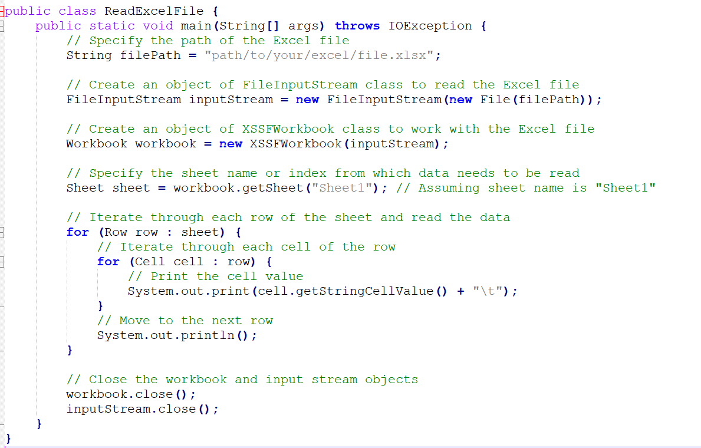
Read Data from Excel

Slide 7
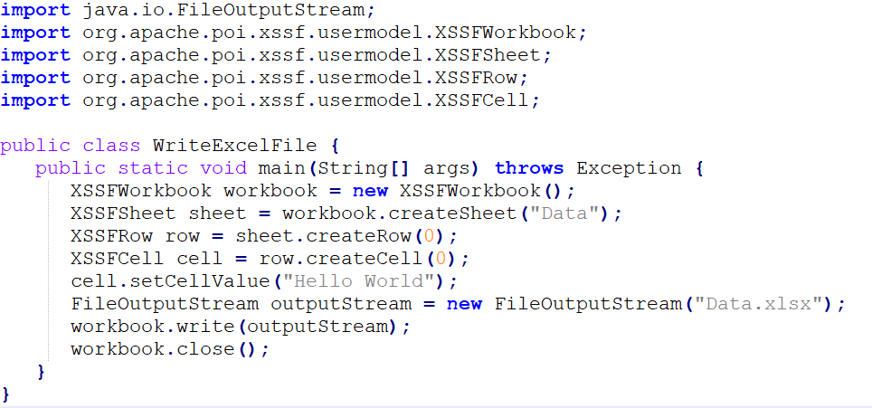
Write data in Excel

Slide 8
JavascriptExecutor in selenium
JavascriptExecutor is an interface in Selenium WebDriver that enables executing JavaScript code directly in the browser. It provides a way to interact with the webpage elements that cannot be done through normal Selenium commands.
Some of the use cases of JavascriptExecutor in Selenium include:
Scrolling the webpage: We can use the JavascriptExecutor to scroll the webpage to a particular element or to a particular position on the webpage.
Clicking hidden elements: Sometimes, the webpage elements may be hidden due to various reasons. In such cases, we can use JavascriptExecutor to click on these elements.
Handling alerts: We can use JavascriptExecutor to handle the alerts that are not handled by the normal Selenium commands.
Setting attribute values: We can use JavascriptExecutor to set the value of attributes of a webpage element.

Slide 9

JavascriptExecutor in selenium
To use JavascriptExecutor in Selenium, we first need to create an instance of it using the WebDriver instance. Here is an example code snippet to scroll down the webpage using JavascriptExecutor:
In the above example, we are creating an instance of JavascriptExecutor using the WebDriver instance 'driver'. We are then using the executeScript() method of JavascriptExecutor to scroll the webpage down by 500 pixels.

Slide 10
Scrolling using Javascript Executor
Scroll down the page using the executeScript() method and passing the window.scrollBy() method as an argument:
// Scroll down the page by 500 pixels
js.executeScript("window.scrollBy(0,500)");
Scroll up the page, pass a negative value to the scrollBy() method:
// Scroll up the page by 500 pixels
js.executeScript("window.scrollBy(0,-500)");

Slide 11
Scrolling using Javascript Executor
We can also scroll to a specific element on the page using the executeScript() method and the scrollIntoView() method. Here's how:
Find the WebElement we want to scroll to:
WebElement element = driver.findElement(By.xpath("//a[contains(text(),'Contact Us')]"));
Use the executeScript() method to scroll to the WebElement using the scrollIntoView() method:
js.executeScript("arguments[0].scrollIntoView();", element);

Slide 12
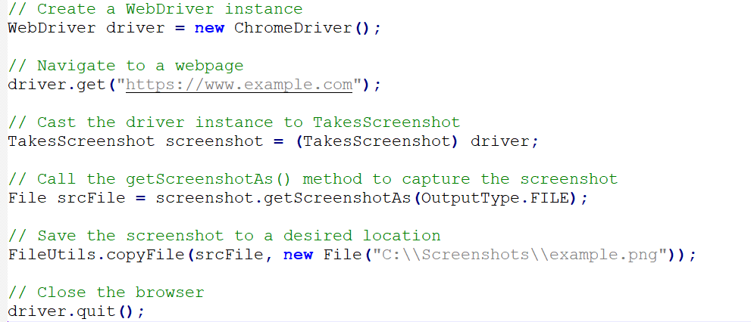
Take Screenshot in Selenium WebDriver
To take a screenshot in Selenium WebDriver using Java, we can use the getScreenshotAs() method provided by the TakesScreenshot interface.
In code, we first navigate to a webpage using the get() method of the WebDriver interface. We then cast the driver instance to TakesScreenshot to access the getScreenshotAs() method. We call the method and pass the OutputType.FILE parameter to capture the screenshot and store it in a File object. Finally, we use the FileUtils class from the Apache Commons IO library to save the screenshot to a desired location.

Slide 13
Handle iframe in Selenium
In Selenium WebDriver, iFrames can be handled using the switchTo() method of the WebDriver class. The switchTo() method allows us to switch between different frames or windows.
To switch to a frame, we need to first identify the frame element using any of the available locators such as ID, Name, or Index. Once we have identified the frame element, we can use the switchTo() method to switch to the frame.
Here is an example code snippet that demonstrates how to switch to an iFrame using the switchTo() method:
//Locate the iFrame element
WebElement frameElement = driver.findElement(By.id("iframe"));
//Switch to the iFrame
driver.switchTo().frame(frameElement);
//Perform actions on elements inside the iFrame
WebElement elementInsideFrame = driver.findElement(By.xpath("//input[@id='username']"));
elementInsideFrame.sendKeys("testuser");

Slide 14
Handle iframe in Selenium
To switch back to the default content, we can use the defaultContent() method of the switchTo() class:
//Switch back to the default content
driver.switchTo().defaultContent();
This will switch the driver back to the main document or parent frame.
To Switch to new Tab:
driver.get(https://www.google.com/);
driver.switchTo().newWindow(WindowType.TAB);
driver.navigate().to(https://www.crmpro.com/);
To Switch to new Window:
driver.get(https://www.google.com/);
driver.switchTo().newWindow(WindowType.WINDOW);
driver.navigate().to(https://www.crmpro.com/);

Slide 15
Handle SSL Certificate in Selenium
When you visit a website with HTTPS protocol, the website will usually present an SSL certificate to verify its identity. However, sometimes Selenium may have difficulty accessing websites with invalid or expired SSL certificates, resulting in errors.
To handle SSL certificates in Selenium, you can use the ChromeOptions class to configure the Chrome driver to ignore SSL errors. Here is an example code snippet:
ChromeOptions options = new ChromeOptions();
options.setCapability(CapabilityType.ACCEPT_SSL_CERTS, true);
WebDriver driver = new ChromeDriver(options);
By setting the ACCEPT_SSL_CERTS capability to true, the Chrome driver will ignore SSL errors and proceed to load the webpage.

Slide 16
Selenium Grid Architecture
What is Selenium Grid?
Selenium grid is the concept of selenium where the code we write is capable enough to run on different machines or virtual machines or cloud, unlike only local systems. For example, sometimes there is a requirement to run a test on google chrome and at the same time tests requires to run on IE, firefox and safari.
Selenium Grid allows parallel testing against various browsers & OS combinations through a Client-Server model. Here, the Server is known as the Hub which has multiple Clients to interact with.
With Selenium Grid, you can connect a server to multiple remote machines which can then be used to run a browser automation script over multiple browser + OS configurations, simultaneously.
Selenium grid follows a hub-node architecture. A hub is a master part and node is like the servant part. In a particular set up, there can be an only hub and multiple nodes.

Slide 17
Selenium Grid Architecture
What Is A Hub In Selenium Grid?
It is the center of the Selenium Grid architecture that manages the network of the test machines. There is only one hub in a network which is assigned to a test of DesiredCapabilities(operating system, browser, browser versions) and then the hub finds the test that matches the given configurations. A Selenium Hub is referred as the server.
What Are Nodes in Selenium Grid?
Nodes are the test machines that execute the test that was earlier loaded on the hub. There can be multiple nodes configured with a different operating system and different browsers. It is not mandatory for the node to run on the same platform on which the hub is running. Selenium nodes are referred as clients connected to a server i.e. a Hub.

Slide 18
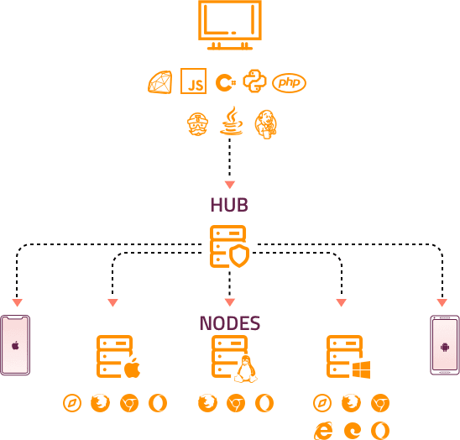
Selenium Grid Architecture

Slide 19
Selenium Grid
Step 1: Download Selenium Server Jar
Download the latest version of Selenium Server Jar file from the official Selenium website - https://www.selenium.dev/downloads/
Once the download is complete, save the file in a directory on your computer.
Step 2: Start the Hub
Open the command prompt or terminal and navigate to the directory where you saved the Selenium Server Jar file.
Type the following command to start the Selenium Grid Hub:
java -jar selenium-server-standalone-x.xx.x.jar hub
Press enter to start the hub.

Slide 20
Selenium Grid
Step 3: Start the Node
Open a new command prompt or terminal window.
Navigate to the directory where you saved the Selenium Server Jar file.
Type the following command to start the Selenium Grid Node:
java -jar selenium-server-standalone-x.xx.x.jar node --detect-drivers true
java -jar selenium-server-standalone-x.xx.x.jar node --detect-drivers true –publish-events tcp://<HubIP>:4442 –subscribe-events tcp://<Hub IP>:4443
Press enter to start the node.

Slide 21
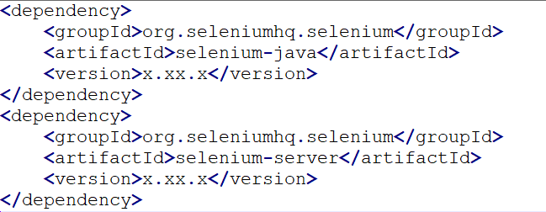
Selenium Grid
Step 4: Write the Test:
Create a new Java project in your preferred IDE.
Add the following dependencies to your pom.xml file:

Slide 22
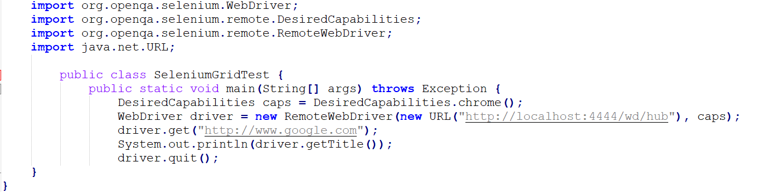
Selenium Grid
Write the test code to connect to the Selenium Grid Hub and execute the test on a remote node.
Replace the URL in the RemoteWebDriver constructor with the URL of the Selenium Grid Hub.
Step 5: Run the Test

Slide 23
Summary
Apache POI in Selenium: We covered how to use Apache POI library to read and write data to Excel files in Selenium. We also discussed the classes and interfaces available in POI.
JavascriptExecutor in Selenium: We learned how to execute Javascript code in Selenium using the JavascriptExecutor interface. We also covered the methods available in JavascriptExecutor.
Take Screenshot in Selenium WebDriver: We discussed how to take screenshots of web pages in Selenium WebDriver using the TakesScreenshot interface.
Handle iframe in Selenium: We covered how to handle iframes in Selenium WebDriver using the switchTo() method.
Handle SSL Certificate in Selenium: We learned how to handle SSL certificate errors in Selenium WebDriver using the DesiredCapabilities class.
Selenium Grid: We discussed what Selenium Grid is and how to set it up, along with complete Java code.

