Slide 1
Selenium3 Vs Selenium4
Session-4 By-anshul sonpure

Slide 2
Topics that will be Covered
Architecture Changes
Capabilities
Find element/elements(s) utility methods in Java
Waits and Timeout
Modifications in the Actions Class
Features Of Selenium 4

Slide 3
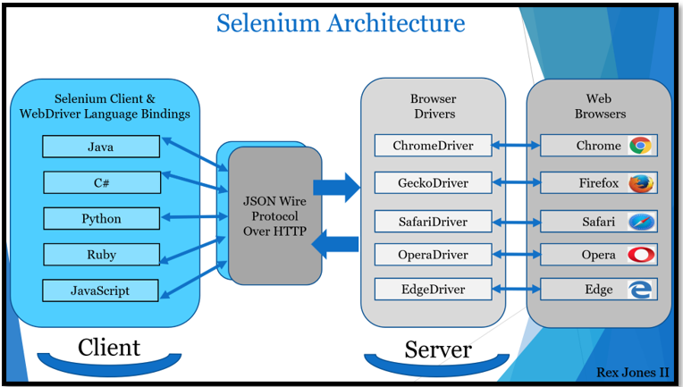
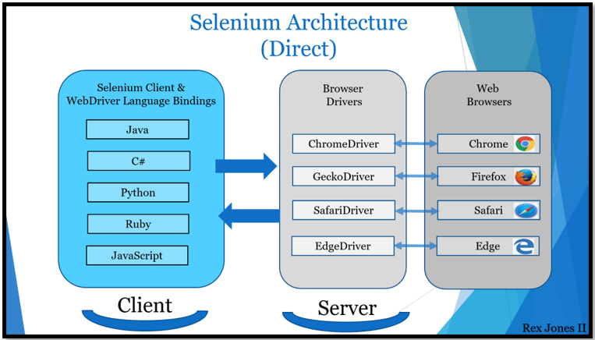
Architecture Changes
The architecture for Selenium 3 includes the JSON Wire Protocol. However, Selenium 4 does not include the JSON Wire Protocol, and that’s the contrast between Selenium 3 and Selenium 4.

Slide 4
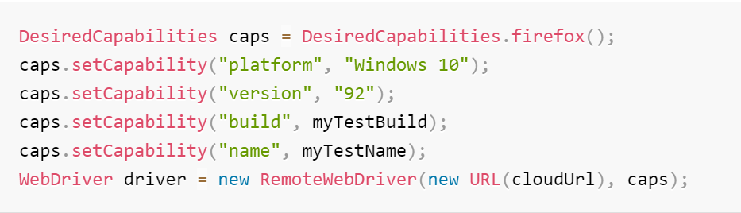
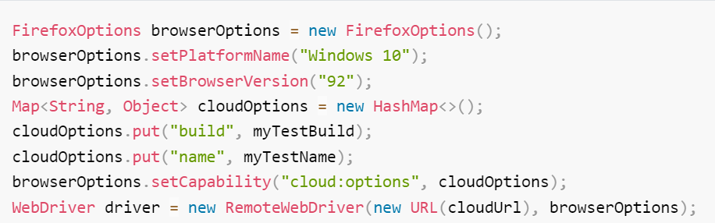
Capabilities
Selenium 3-
Selenium 4-

Slide 5
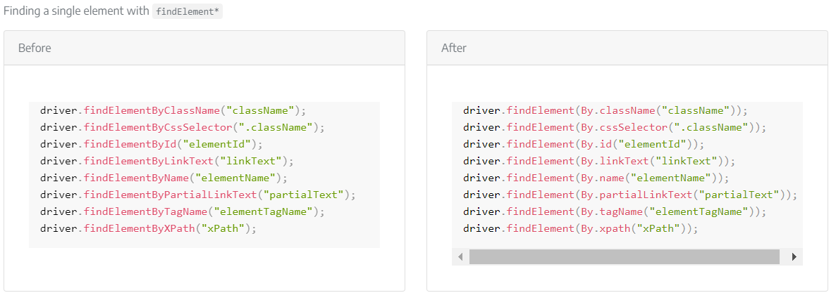
Find element utility methods in Java

Slide 6
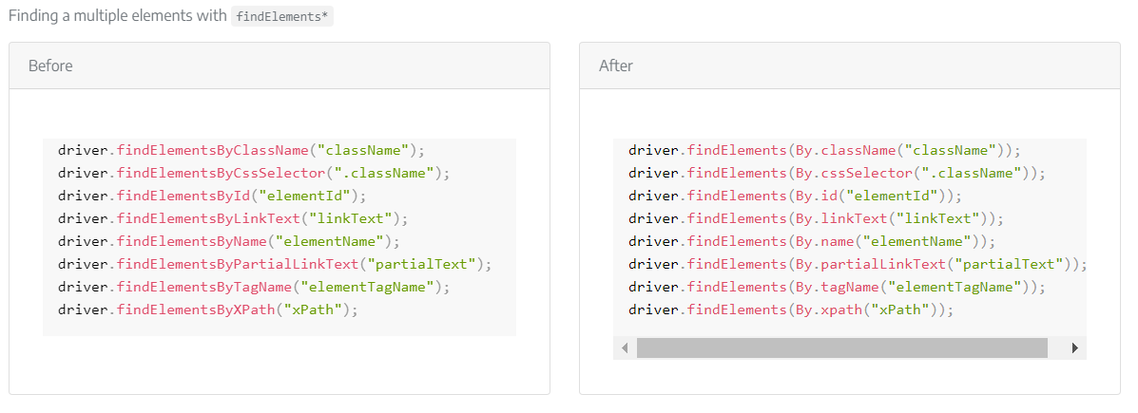
Find element(s) utility methods in Java

Slide 7
Waits and Timeout
The parameters received in Timeout have switched from expecting (long time, TimeUnit unit) to expect (Duration duration).
In Selenium 3-
driver.manage().timeouts().implicitlyWait(10, TimeUnit.SECONDS);
driver.manage().timeouts().setScriptTimeout(2, TimeUnit.MINUTES);
driver.manage().timeouts().pageLoadTimeout(10, TimeUnit.SECONDS);
In Selenium 4-
driver.manage().timeouts().implicitlyWait(Duration.ofSeconds(10));
driver.manage().timeouts().scriptTimeout(Duration.ofMinutes(2));
driver.manage().timeouts().pageLoadTimeout(Duration.ofSeconds(10));

Slide 8
Waits and Timeout
Waits are also expecting different parameters now. WebDriverWait is now expecting a Duration instead of a long for timeout in seconds and milliseconds. The withTimeout and pollingEvery utility methods from FluentWait have switched from expecting (long time, TimeUnit unit) to expect (Duration duration).
Selenium 3 -
new WebDriverWait(driver, 3)
.until(ExpectedConditions.elementToBeClickable(By.cssSelector("#id")));
Wait<WebDriver> wait = new FluentWait<WebDriver>(driver)
.withTimeout(30, TimeUnit.SECONDS)
.pollingEvery(5, TimeUnit.SECONDS)
.ignoring(NoSuchElementException.class);
Selenium 4-
new WebDriverWait(driver, Duration.ofSeconds(3))
.until(ExpectedConditions.elementToBeClickable(By.cssSelector("#id")));
Wait<WebDriver> wait = new FluentWait<WebDriver>(driver)
.withTimeout(Duration.ofSeconds(30))
.pollingEvery(Duration.ofSeconds(5))
.ignoring(NoSuchElementException.class);

Slide 9
Modifications in the Actions Class
Actions class in Selenium is primarily used to simulate input actions from mouse and keyboard on specific web elements (For eg: Left click, Right click, Double click, etc)
In Selenium 4, several new methods have been added to the Actions class:
click(WebElement)
This method is added to Actions class to replace the moveToElement(onElement).click(). It is used to click on a certain web element.
moveToElement(onElement).clickAndHold() →clickAndHold(WebElement)
moveToElement(onElement).contextClick() → contextClick(WebElement)
moveToElement(element).doubleClick() → doubleClick(WebElement)

Slide 10
Features Of Selenium 4
Object Location: Now with Selenium 4, users can achieve the coordinates, dimension, height, width, etc. as the location of the web elements or object.
WebElement logo1=driver.Findelement(By.xpath(“//div[@id=’divLogo’]//img”));
System.out.println(“Height:” +logo.getRect().getDimension().getHeight());
System.out.println(“Height:” +logo.getRect().getDimension().getWidth());
System.out.println(“X Location: “ +Logo.getRect().getX());
System.out.println(“Y Location: “ +Logo.getRect().getY());

Slide 11
Features Of Selenium 4
Relative Locators: These are also known as Friendly Locators, and this functionality is being added to find out the element which is present nearby to other web element or, we can say that it can find the web elements based on GUI location.
below(): Web element located below for the specified element.
toLeftOf() : Target web element which is present to the left of specified element.
toRightOf(): Target web element which is presented to the right of a specified element.
above(): Web element located above for the specified element.
near() : Target web element which is away(approx. 50 pixels) from the specified element.

Slide 12
Features Of Selenium 4
Chrome Dev tools: Chrome driver class extends to Chromium Driver. Chromium Driver class has some predefined methods to access the dev tool.
By using the API, we can perform the following operations:
Enable Network Offline
Enable Network Online
Get Console Logs
Load Insure Web Site

Slide 13
Features Of Selenium 4
Capture screenshot of specific web element: with Selenium 4, users can take the screenshot of a specific web element.
WebElement logo=driver.Findelement (By.xpath(“//div[@id=’divLogo’]//img”));
File file=logo.getScreenshotAs(OutputType.FILE);
File destFile =new File(“logo.png”);
FileUtils.copyFile(file,destfile);

Slide 14
Features Of Selenium 4
Open the new tab on the browser: Now, in Selenium 4, the user can open a URL in a new tab along with the existing tab.
For Example: If the user wants to open 2 URLs in two different tabs at the same time, the user can do that with the Selenium 4.
driver.get(https://www.google.com/);
driver.switchTo().newWindow(WindowType.TAB);
driver.navigate().to(https://www.crmpro.com/);

Slide 15
Features Of Selenium 4
Open a new window on the browser: users can also open the new window on the same browser.
For Example, if the user wants to access two applications in the same browser, the user can now do this.
driver.get(https://www.google.com/);
driver.switchTo().newWindow(WindowType.WINDOW);
driver.navigate().to(https://www.crmpro.com/);

