Slide 1
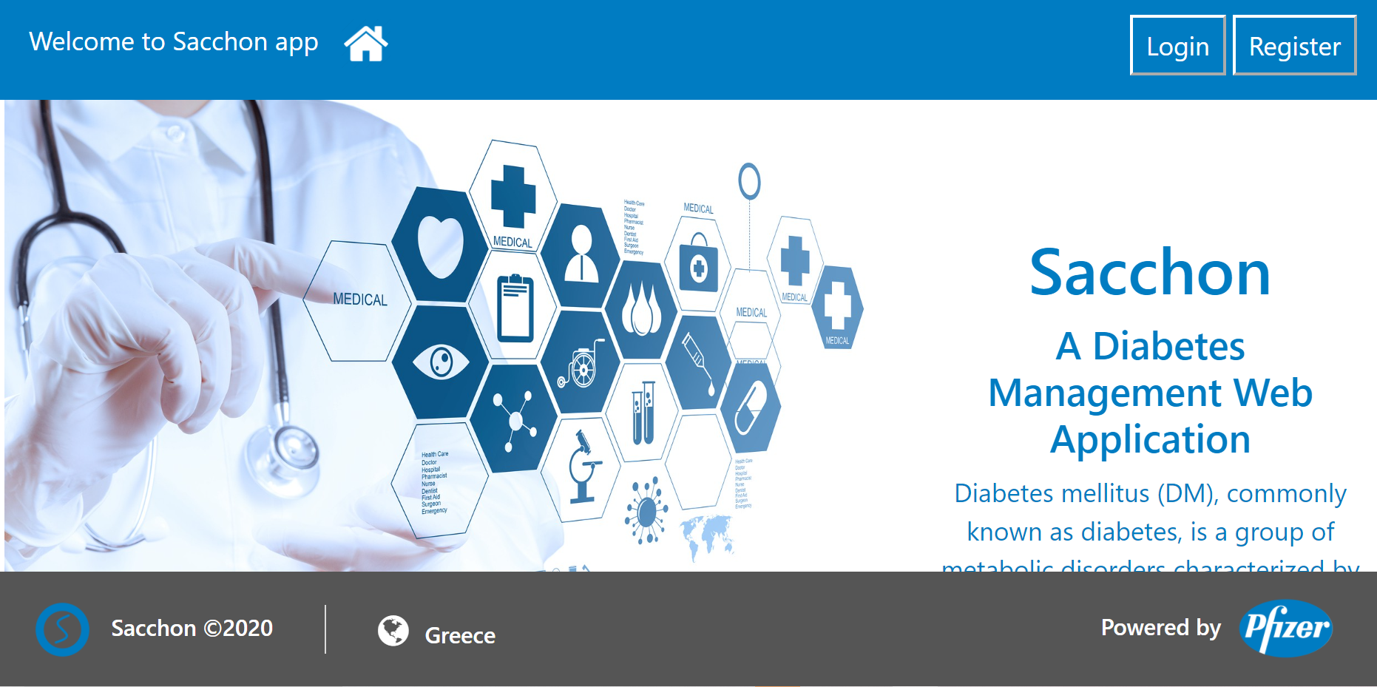
Sacchon
A Diabetes
Management
Web
Application

Slide 2
Our team
Anastasia Triantafillou
Dimitris Dimitriou
Paraskevas Lysikatos
Gioutzino Tzelo

Slide 3
Sacchon
Is a diabetes management web application
Is divided into two distinct subsystems, the Sacchon Rest-API which is the backend and,
The Sacchon Angular App, which is the frontend
The web app consists of three major components
Repository of Medical Data (MediDataRepo)
Doctor Advice Services System (DoctorAdvice)
Reporting Services (Reporter)

Slide 4
Tools
Sourcetree, a free Git desktop client for developers on Windows.
GitHub ,a code hosting platform for version control and collaboration.
Trello , a web-based Kanban-style list-making application.
Microsoft Teams is a proprietary business communication platform developed by Microsoft.
IntelliJ IDEA is an integrated development environment (IDE) written in Java for developing computer software.
Visual Studio Code is a free source-code editor made by Microsoft .
Postman is a popular API client that makes it easy for developers to create, share, test and document APIs.
SQL Server is a relational database management system from Microsoft

Slide 5
How we assigned the work among the team members
Front End
Anastasia Tryantafillou
Paraskevas Lysikatos
Back End
Dimitris Dimitriou
Gioutzino Tzelo
We use Trello to know what's being worked on, who's working on what, and where something is in a process.
We use Microsoft Teams for communication.

Slide 6
endpoints
Return all users: @Get http://localhost:9000/sacchon/users
User Registration: @Put http://localhost:9000/sacchon/users
Check if server is running @Get http://localhost:9000/ sacchon /ping
Νew measurement:@Post@Auth(EMAIL&&PASSWORD) http://localhost:9000/sacchon/measurements
Return all patients:@Get @Auth(EMAIL && PASSWORD) http://localhost:9000/sacchon/patient

