Slide 1




Predicting On-Time
Drone Deliveries
An Explainable AI Solution for Operational Decision Support
Paraskevi Dimitrakou
Notes:
Today I will present an end-to-end machine learning solution that predicts whether a drone delivery will arrive on time. The objective was not only to achieve strong predictive performance but also to develop an interpretable model that can support operational decision-making. I was inspired by the drone delivery case study from the Vodafone assessment centre and wanted to explore it further using real machine learning techniques.

Slide 2









The Business Problem
Healthcare & Logistics Applications
Drone deliveries are growing rapidly across logistics
Medicine delivery to remote communities
Delays reduce customer satisfaction and operational efficiency
Blood and laboratory sample transport
Dispatchers need early visibility of delivery risk
Emergency medical supplies
Better pre-dispatch planning improves on-time rates
Last-mile logistics
Project Objective
Predict whether a delivery will arrive on time before dispatch, enabling proactive operational decisions.
Notes:
To demonstrate the methodology, a public drone-delivery dataset was used. However, the same predictive framework could support healthcare logistics, such as medicine or emergency medical supply deliveries. This aligns well with connected logistics and healthcare applications like those discussed during the Vodafone assessment centre.

Slide 3




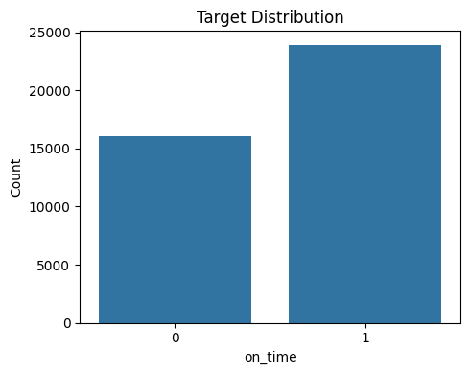

Dataset Overview
40,000
10,000
9
60 / 40
Training deliveries
Test deliveries
Features
On-time / Late split
Key Observations
Mild class imbalance (≈60% on-time, 40% late), requiring no resampling
Clean dataset with no missing values or duplicates
Mix of numerical, categorical, and string-encoded features
Suitable for supervised binary classification
Mix of feature types makes this representative of real operational planning problems
Notes:
The dataset comes from a Kaggle competition on drone delivery prediction. It contains around 40,000 training deliveries and 10,000 test deliveries with 9 features. The target is roughly 60/40 on-time vs late, so it is a balanced binary classification problem. The data is clean with no missing values.

Slide 4
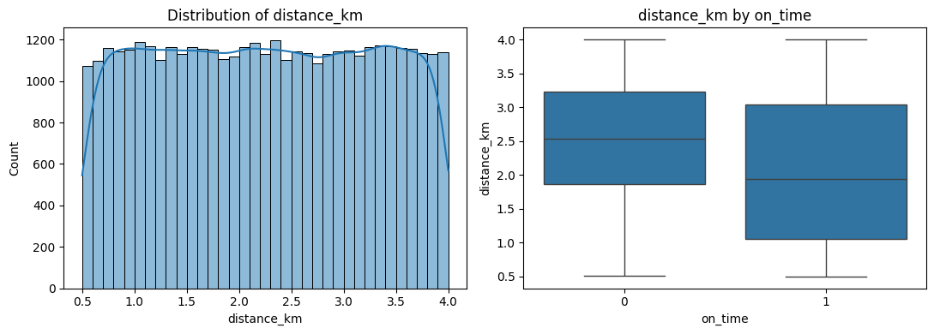
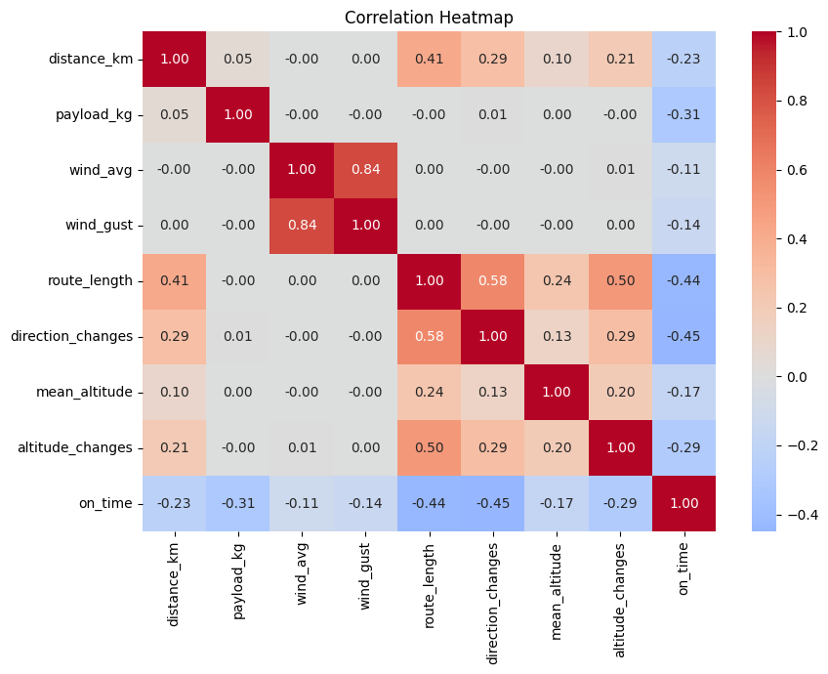
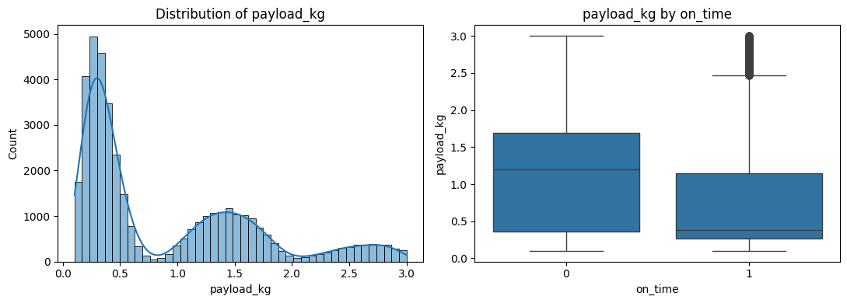
EDA — Numerical Features
Distribution and relationship with on-time delivery for the two original numerical predictors
Key Findings
• Longer distances clearly reduce on-time probability
• Heavier payloads make deliveries harder to complete on time
• wind_avg and wind_gust are correlated (~0.84) but represent different aspects (steady wind vs. gust intensity), so both were retained
Notes:
The EDA starts with the two original numerical features: distance and payload. Both show a clear relationship with the target — late deliveries tend to have longer distances and heavier payloads. The correlation heatmap on the right shows all numerical features including the engineered ones. Wind average and wind gust are correlated at 0.84, but both carry distinct information so we kept both in the model. Route length has the strongest negative correlation with on-time delivery at minus 0.44.

Slide 5
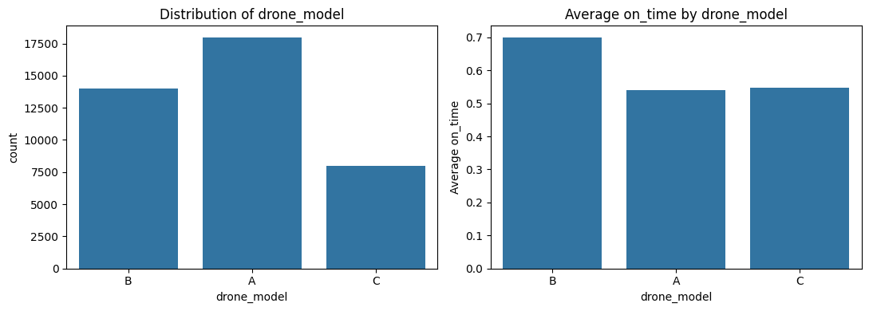
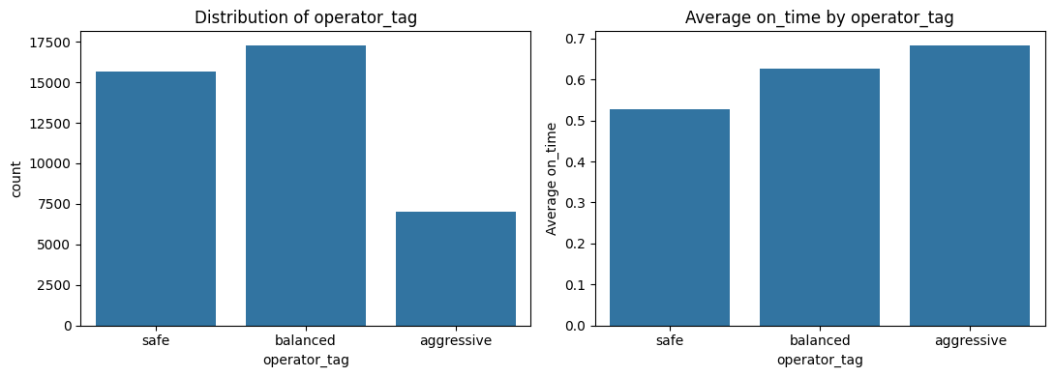
EDA — Categorical Features
Frequency and average on-time rate per category for the two key categorical variables
Drone Model
Three drone models (A, B, C) with roughly equal frequency. Model B shows the highest on-time rate, and this difference persists in the final model's coefficients.
Operator Strategy
Three operator tags: aggressive, balanced, safe. Aggressive operators show the highest on-time rate (68%) and safe the lowest (53%).
Confound Check Passed
Checked whether aggressive operators simply fly shorter/lighter missions — distance, payload, route complexity, and altitude are essentially identical across all three operator groups. The on-time advantage is genuine, not a route-assignment artifact.
Notes:
The two key categorical features are drone model and operator strategy. Drone model B shows the highest on-time rate. Operator tag is the more interesting finding — aggressive operators have the highest on-time rate at 68%, while safe operators have the lowest at 53%. This counterintuitive result was verified: we checked whether aggressive operators simply get assigned shorter or lighter missions, and the answer is no — mission characteristics are essentially identical across all three operator groups. So the effect is genuine.

Slide 6


Feature Engineering
Converting raw string-encoded fields into numerical features the model can learn from
Model-ready
Converts strings into numerical inputs models can process
Original Feature | Example Value | Engineered Features
wind_token | "NE-12/18" | wind_avg, wind_gust, wind_direction
route_turns | "NNESSW..." | route_length, direction_changes
alt_profile | "120-140-120" | mean_altitude, altitude_changes
Signal-rich
Captures operational complexity (route difficulty, turbulence)
Interpretable
Each engineered feature maps to a real-world meaning
Reusable Pipeline
Feature engineering is implemented as a reusable pipeline component, ensuring the same transformations are applied consistently during training and future predictions.
Raw Features
→
Feature Engineering
→
Preprocessing
→
Model
Notes:
One of the strongest parts of this project is the feature engineering. Three raw string columns are parsed into seven numeric features. All this logic lives in a reusable scikit-learn transformer inside the src package, so the exact same code runs in every notebook. This ensures reproducibility and avoids copy-paste errors.

Slide 7


Machine Learning Pipeline
Raw Data
Candidate Models
↓
Logistic Regression
Feature Engineering
Interpretable, direct coefficients
↓
Random Forest
Preprocessing (Impute + Scale + Encode)
Non-linear, ensemble-based
↓
HistGradient Boosting
RandomizedSearchCV (5-fold Stratified)
Captures complex patterns
↓
Model Comparison (Bootstrap CIs)
Validation Strategy
↓
80/20 stratified train-validation split
Validation on Held-Out Set
5-fold stratified cross-validation during tuning
↓
Final Model Selection
1,000 bootstrap resamples for confidence intervals
Preprocessing and feature engineering are performed inside the pipeline, ensuring no data leakage.
Notes:
The full pipeline goes from raw data through feature engineering, preprocessing, hyperparameter tuning with RandomizedSearchCV, to model comparison using bootstrap confidence intervals. Three model families were compared. All preprocessing happens inside the sklearn pipeline, so there is no data leakage. The validation uses an 80/20 stratified split, 5-fold cross-validation for tuning, and 1000 bootstrap resamples for confidence intervals on the final metrics.

Slide 8
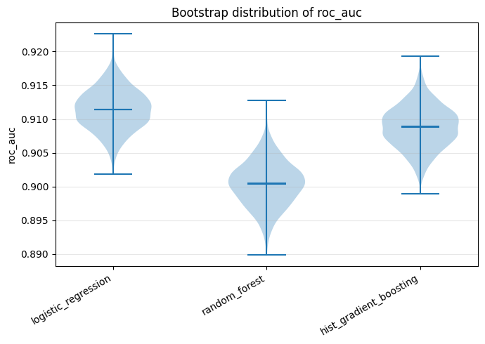
Model Comparison
All metrics reported with 95% bootstrap confidence intervals (1,000 resamples)
Model | ROC-AUC | F1 | Accuracy | PR-AUC
Logistic Regression | 0.911 [0.905, 0.917] | 0.836 [0.828, 0.844] | 0.813 [0.805, 0.821] | 0.944 [0.940, 0.948]
HistGradient Boosting | 0.909 [0.903, 0.915] | 0.845 [0.837, 0.853] | 0.814 [0.805, 0.822] | 0.942 [0.938, 0.947]
Random Forest | 0.900 [0.894, 0.907] | 0.827 [0.818, 0.835] | 0.803 [0.794, 0.812] | 0.937 [0.932, 0.941]
Why Logistic Regression?
Comparable ROC-AUC to HistGB (CIs overlap)
Fully interpretable via coefficients and odds ratios
Computationally efficient to train and deploy
Direct mapping from features to business levers
Both models achieved very similar performance (overlapping CIs). Logistic Regression was selected for its substantially better interpretability while maintaining comparable predictive accuracy.
Notes:
The bootstrap confidence intervals for ROC-AUC overlap heavily between Logistic Regression at 0.911 and HistGradient Boosting at 0.909. The honest claim is that the two models perform comparably, not that one definitively outperforms the other. We select Logistic Regression primarily for its interpretability — it gives direct coefficients and odds ratios that map to actionable business insights.

Slide 9
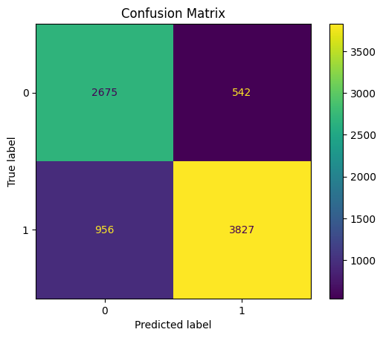
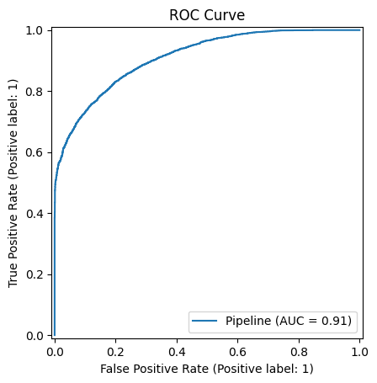
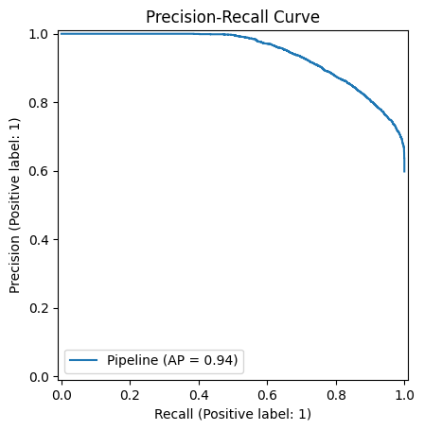

Selected Model — Detailed Evaluation
Logistic Regression evaluated on the held-out validation set (20% of training data, never used during tuning)
Reading the Results
Confusion matrix shows the model's errors are roughly balanced between false positives and false negatives — no strong bias toward either error type
ROC curve (AUC = 0.911) confirms strong discrimination between on-time and late deliveries across all thresholds
PR curve (AUC = 0.944) shows high precision is maintained even at high recall — important for a dispatch decision tool
Notes:
This slide shows the detailed evaluation of the selected Logistic Regression model. The confusion matrix shows the error profile — errors are roughly balanced between false positives and false negatives, which means the model is not systematically biased toward one type of mistake. The ROC curve confirms the 0.911 AUC from the table, and the precision-recall curve shows an AUC of 0.944, meaning high precision is maintained even at high recall levels. This is especially important for a dispatch decision tool where you don't want to approve too many high-risk deliveries.

Slide 10
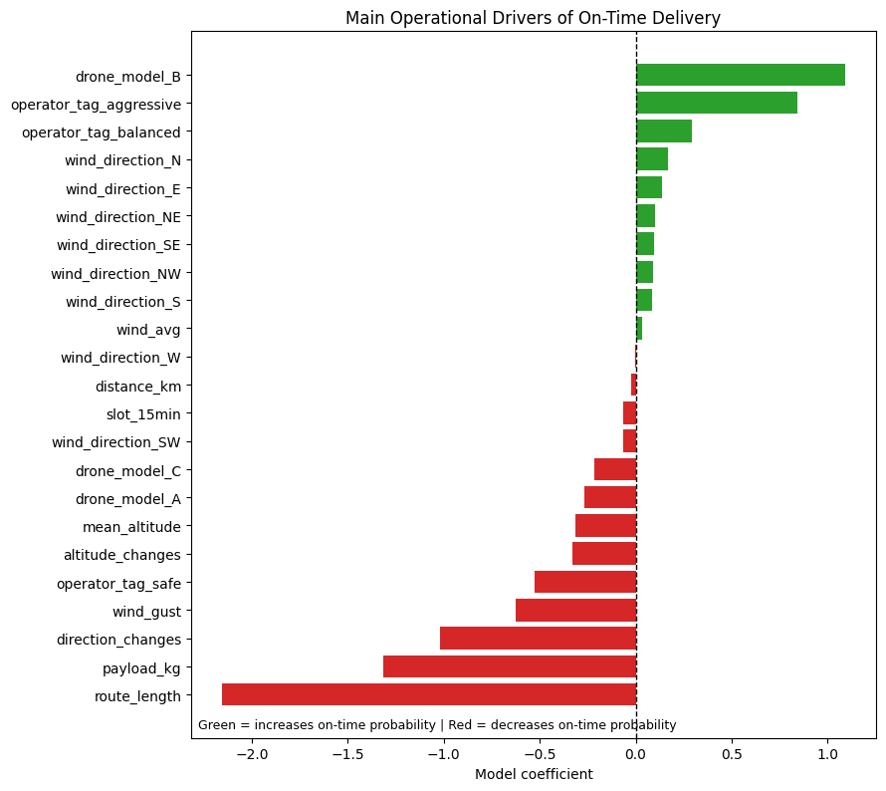
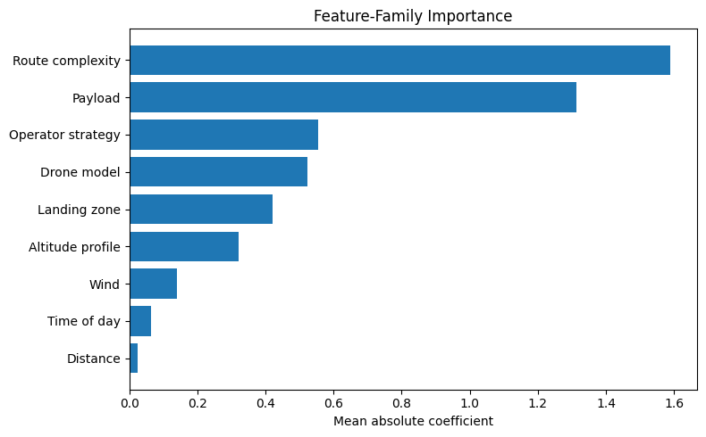


Model Interpretation
Strongest operational drivers of on-time delivery
Coefficients grouped into business categories (mean absolute coefficient per group)
Operational Insights
Landing zones are included in the model for predictive accuracy but excluded from this chart. They represent location-specific effects, not general operational levers.
Route complexity
Wind conditions
Longest and most complex routes have the greatest impact on delivery delays
Payload
Operator strategy
Heavier payloads reduce the probability of arriving on time
Aggressive profiles achieved higher on-time rates
Drone model
Model B demonstrates the highest on-time performance
Notes:
This slide shows two views of the same model. On the left, the individual coefficient plot shows which specific features drive on-time delivery — route length is the single strongest driver, followed by payload and direction changes. On the right, the feature-family importance chart groups these into business categories. Route complexity emerged as the strongest operational driver, followed by payload, operator strategy, and wind. This grouped view is more natural for a manager because it maps directly onto operational levers: route planning, payload limits, drone selection, operator assignment, and weather-based scheduling. Landing zones are included in the model for accuracy but excluded from both charts because they represent hundreds of specific location labels, not general operational levers.

Slide 11

Decision Support Framework
Turning predictions into operational decisions
Predicted Probability | Risk Level | Suggested Action
> 0.80 | Low | Approve delivery normally
0.50 – 0.80 | Medium | Review operational risk factors before dispatch
< 0.50 | High | Consider alternative route, drone, timing, or delivery method
Operational Benefits
Healthcare Application Example
Predict high-risk deliveries before dispatch
Insulin delivery to remote clinics (temperature-sensitive)
Support dispatcher decision-making with data-driven risk estimates
Blood sample transport (30-minute transfusion window)
Improve route planning and drone allocation
Emergency medical supply distribution
Reduce delays and improve customer satisfaction
Vaccine distribution across rural areas
The model is intended to support (not replace) human dispatchers by providing an additional data-driven estimate of delivery risk.
Notes:
Rather than replacing dispatchers, the model acts as a decision-support tool by identifying deliveries that may require additional attention before departure. The three-tier probability table converts raw predictions into actionable dispatch decisions. When discussing medicine delivery, this is an example application of the methodology, not the dataset itself — but it connects naturally to the healthcare logistics themes from the Vodafone assessment.

Slide 12




Conclusions & Future Work
Key Achievements
Future Work
Technical
End-to-end ML pipeline with reusable src/ package
Live weather APIs
Real-time wind and temperature data for dynamic predictions
Explainable Logistic Regression with odds ratios
GPS trajectory data
Robust bootstrap validation (1,000 resamples)
Incorporate actual flight path information
Production-ready, reproducible pipeline
IoT sensor integration
Battery health, motor performance, vibration data
Business
Predicts delivery success before dispatch
Real-time dashboard
Live monitoring of delivery risk for dispatchers
Supports operational decision-making
Continuous retraining
Identifies actionable levers for logistics planning
Model updates as new delivery data accumulates
Applicable to healthcare logistics scenarios
Limitations
Current model was developed using an offline dataset and does not yet incorporate real-time information such as live weather or GPS telemetry
Notes:
This project demonstrates how explainable machine learning can support operational decision-making. While developed using a public drone delivery dataset, the same methodology could be applied to connected logistics scenarios such as medicine delivery, where timely and reliable transportation is critical. Future work could include live weather APIs, GPS trajectory data, IoT sensor integration from the drones themselves, a real-time dashboard for dispatchers, and continuous model retraining as new data comes in.

