Slide 1

IoT based System (UEC715) Presentation
Smart Door Locking System
Team
Submitted to : Dr. Amit Mishra
Students Name and Roll Number:
Riya Khera 102115019
Pratinav Batra 102115004
Pulkit Garg 102115006
Paras Sharma 102115015
Varun Kashyap 102115012

Slide 2
Introduction
Project Overview
IoT Integration: Remote control of the door via a smartphone app using Bluetooth.
Servo Motor Mechanism: A servo motor controls the door latch for precise locking/unlocking.
User-Friendly: Easy-to-use app interface for seamless operation.
Cost-Effective: Affordable, scalable solution suitable for various environments.
Enhanced Security: Eliminates the need for physical keys, reducing risks of tampering, loss, or duplication.
Need Analysis and Scope
Need (Security Concerns): Traditional locks are susceptible to tampering, key duplication, and physical break-ins, creating a need for smarter, more secure locking systems.
Analysis (Convenience): Physical keys are inconvenient, especially in shared spaces or for users with limited mobility, highlighting the need for a more efficient, automated solution.
Scope (Residential and Commercial Use): The system can be applied in various settings, from homes to offices, ensuring broad usability for both personal and professional spaces.
Objectives
Enhance Security: Implement a reliable, tamper-resistant locking mechanism using a servo motor.
Enable Remote Control: Use Bluetooth for wireless, smartphone-controlled access. The system can be applied in various settings, from homes to offices, ensuring broad usability for both personal and professional spaces.
Design an Affordable Solution: Use cost-effective components to ensure accessibility.

Slide 3
Literature Survey
Research Gaps :
Biometric Integration: Lack of research on adding fingerprint or facial recognition to smart locks.
Cloud Connectivity: Limited exploration of cloud-based remote access for better control.
Energy Optimization: Insufficient research on long-term energy efficiency for IoT systems.
Environmental Resilience: Limited focus on making systems reliable in varying weather conditions.
Inadequate Automation: Current systems miss advanced features like suggestions; this project uses Blynk for enhanced control.
Complexity and Accessibility: High costs and complexity hinder adoption; this project ensures a cost-effective, user-friendly solution.
Research Findings for Existing Literature :
Mobile App Control: User-friendly apps are crucial, but more work is needed on cross-platform compatibility and reducing latency.
Servo Motor Control: Servo motors provide precise control for door latches, making them reliable for smart lock systems.
IoT Security: Stronger encryption and secure authentication are needed to protect smart locks from cyber threats.
Bluetooth Communication: Bluetooth is effective for short-range, low-power communication but has range and interference limitations.
Scalability: Scaling smart locks for larger systems and better integration into home automation requires more research.
Energy Efficiency: Power optimization is a challenge; low-power modes and energy harvesting can help improve efficiency.

Slide 4
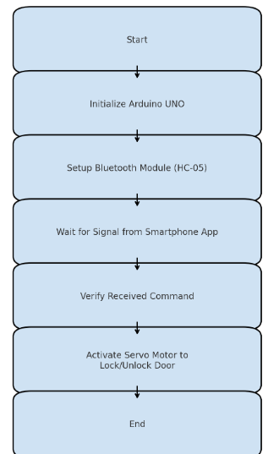
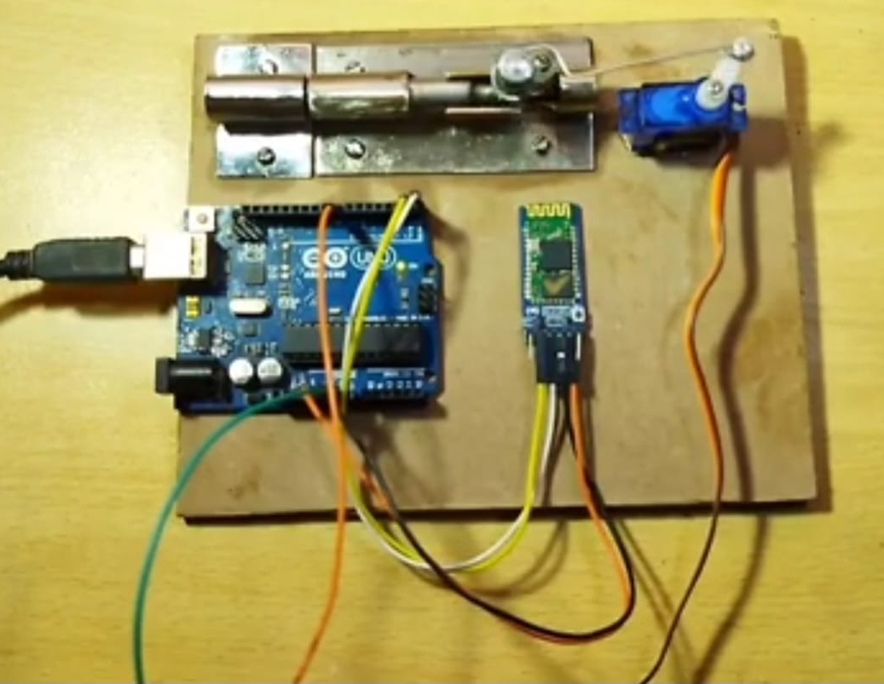
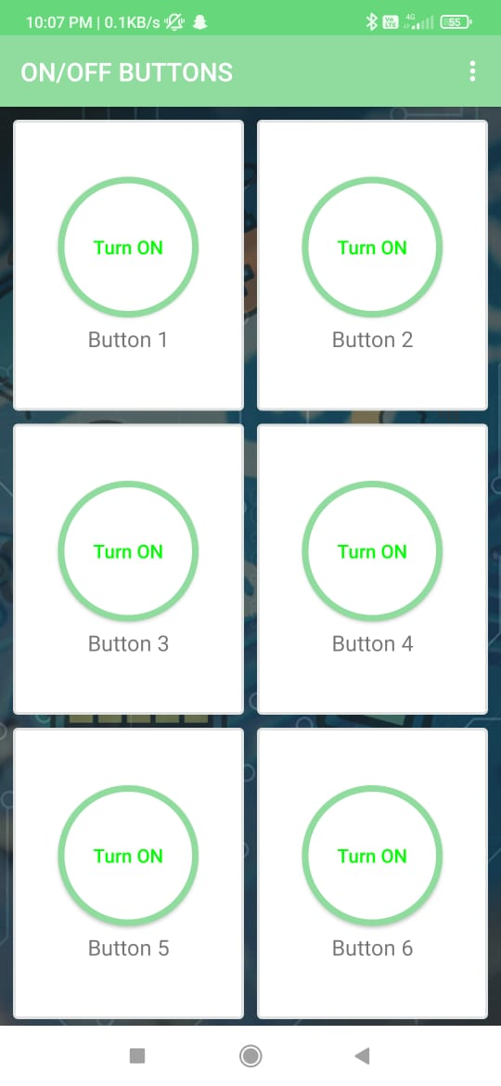
Proposed Approach
Concept Diagram :
Fig: System Architecture
Fig: Hardware Simulation
Fig: UI Interface for Users

Slide 5
Prospective Learning Of The Project
IoT Integration: Gaining hands-on experience with integrating IoT components like Bluetooth, Arduino, and mobile apps for real-time communication.
System Design & Prototyping: Developing skills in designing, testing, and prototyping hardware and software systems, including troubleshooting and optimization.
Programming & Microcontroller Skills: Enhancing knowledge of microcontroller programming, particularly in controlling motors, sensors, and communication modules.
Energy Efficiency: Learning how to design low-power, efficient systems suitable for long-term operation with minimal maintenance.
User Experience Design: Understanding how to create intuitive mobile app interfaces that simplify complex systems for users with various technical backgrounds.
Security Practices: Exploring real-world applications of security in IoT, such as protecting wireless communication and ensuring the physical reliability of the system.

Slide 6
References
[1] https://how2electronics.com/password-based-security-system-arduino-keypad/
[2] Banzi, M., & Shiloh, M. (2014). Getting Started with Arduino. Maker Media, Inc.
[3] https://www.electronicwings.com/sensors-modules/bluetooth-module-hc-05-
[4] https://www.casadarobotica.com/robotica/atuadores/servos/servo-digital-mg996r-15kg-alto-torque-metal-mg996
[5]https://www.flipkart.com/fedus-840-points-bread-board-solderless-piecesb-circuit-test-electronic-components-hobby-kit/p/itm5f21522a188c7?pid=EHKFJZ6MQ8GQTWZF&lid=LSTEHKFJZ6MQ8GQTWZFFADAD5&marketplace=FLIPKART&cmpid=content_electronic-hobby-kit_8965229628_gmc
[6]https://www.amazon.in/ApTechDeals-Jumper-Female-breadboard-jumper/dp/B074J9CPV3
[7] https://materialdepot.in/door-latches
[8]https://robu.in/product/arduino-uno-r3-ch340g-atmega328p-devlopment-board/?gad_source=1&gclid=Cj0KCQiA0fu5BhDQARIsAMXUBOJ3cYS5WW8hQYtwUR0v7Y76t4dN4ZLrq1w_VSZCmm2LarPJxzIx1UQaAiWNEALw_wcB
[9] Singh, N., & Nene, M. J. (2018). "A Review on Security and Privacy Challenges in IoT". International Journal of Computer Applications, 182(40), 1-7.
[10] Raj, P., & Raman, A. C. (2017). Internet of Things: Enabling Technologies, Security and Social Implications. CRC Press.

Slide 7
Thank you

