Slide 1




TITLE – SOIL NUTRIENTS MONITING AND MANAGEMENT
By TEAM - AVENGERS

Slide 2

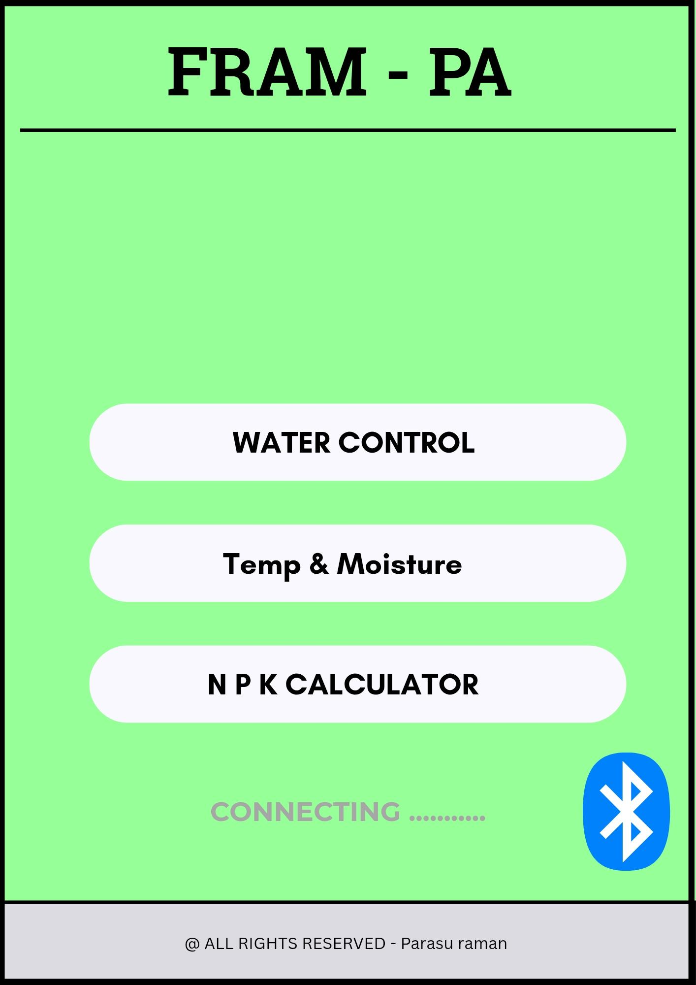
INTRODUCTION
Better Crop Growth: Monitoring these values ensures plants get the right conditions to grow strong and healthy.
Efficient Water Use: Soil moisture data helps avoid over- or under-watering, saving water and protecting roots.
Balanced Nutrition: NPK sensors guide proper fertilizer use, ensuring plants get the nutrients they need without wast
Smart Farming Decisions: Real-time soil data helps farmers choose the best time for planting, watering, and fertilizing.

Slide 3
KEY FEATURES OF THE OUR PROJECT
It’s Calculate the NPK Values to determine the suitable crop for the field
“REAL TIME CONTROL OF IRRIGATION SYSTEM IN THE FARMING AREA USING THE APPLICATION
WITH THE NPK VALUES ,WE CAN DETERMINE THE FERTILIZER REQUIRED

Slide 4
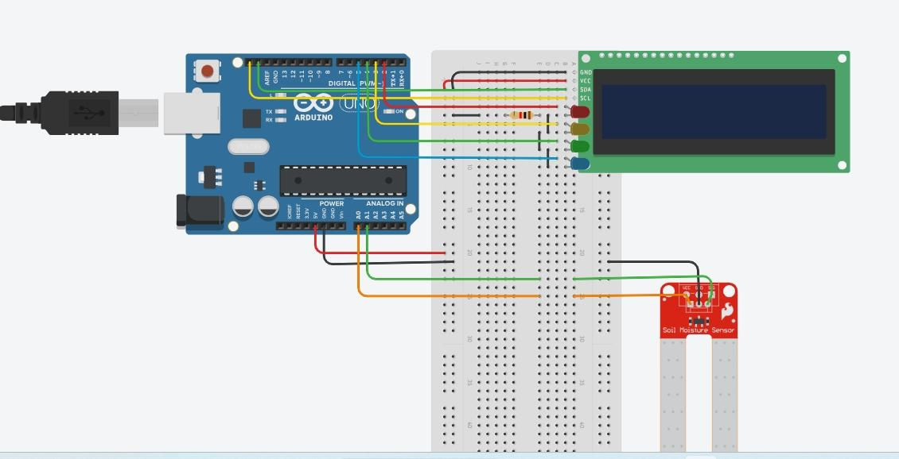
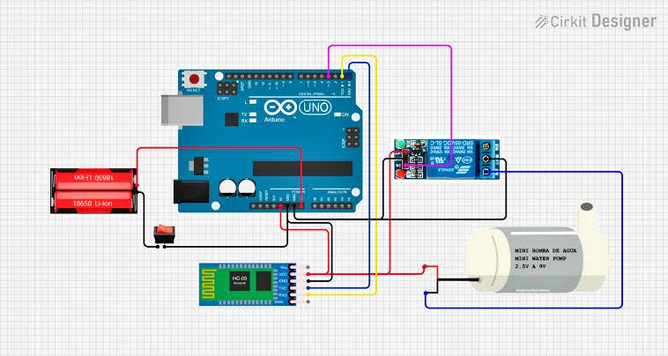
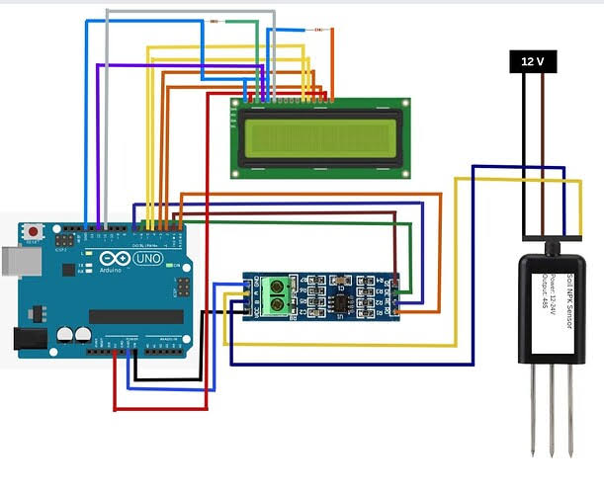
KEY MODULE OF THE PROJECT
MOISTURE AND TEMPERATURE
2. IRRIGATION CONTROL
3.NPK SENSOR

Slide 5
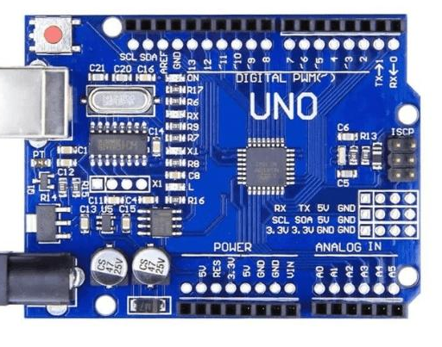
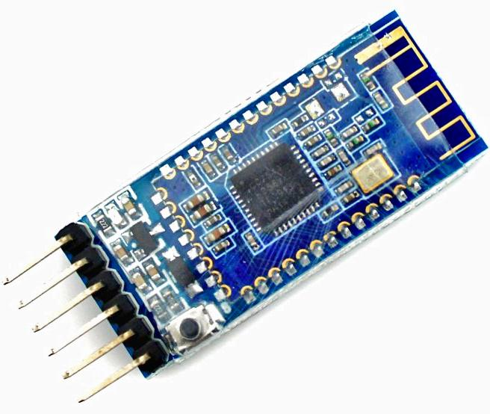
COMPONENTS USED
MAIN COMPONENTS :
Bluetooth sensor - HM10 ( BLUETOOTH -4.1)
Arduino UNO micro-controller
OTHER COMPONENTS :
Temperature sensor - TMP36
Soil sensor – MS 01 with RJ11 Adapter
LCD Display I2C Series
Soil NPK sensor - JXBS-3001 with MAX485 Module

Slide 6
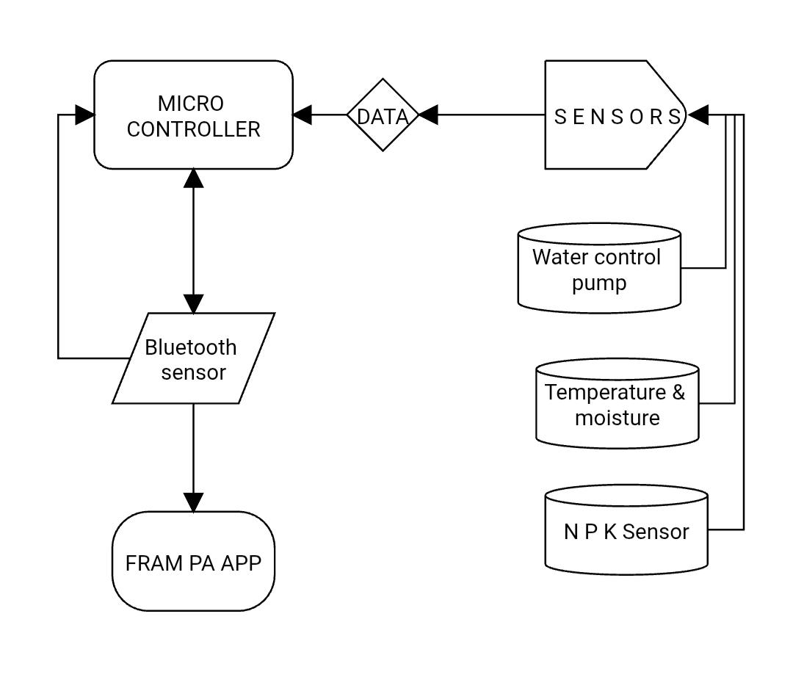
Work flow of the project

Slide 7





Programming ENVIRONMENT
For Virtual Simulation –TINKERCAD.
Use ARDUINO IDE for writing, compiling, uploading codes to ARDUINO micro-controller .
The SPCK EDITOR is used for compiling the HTML, CSS AND JAVASCRIPT for APPLICATION DEVELOPMENT
Bluetooth connectivity is handled using the Web Bluetooth API for local host.

Slide 8
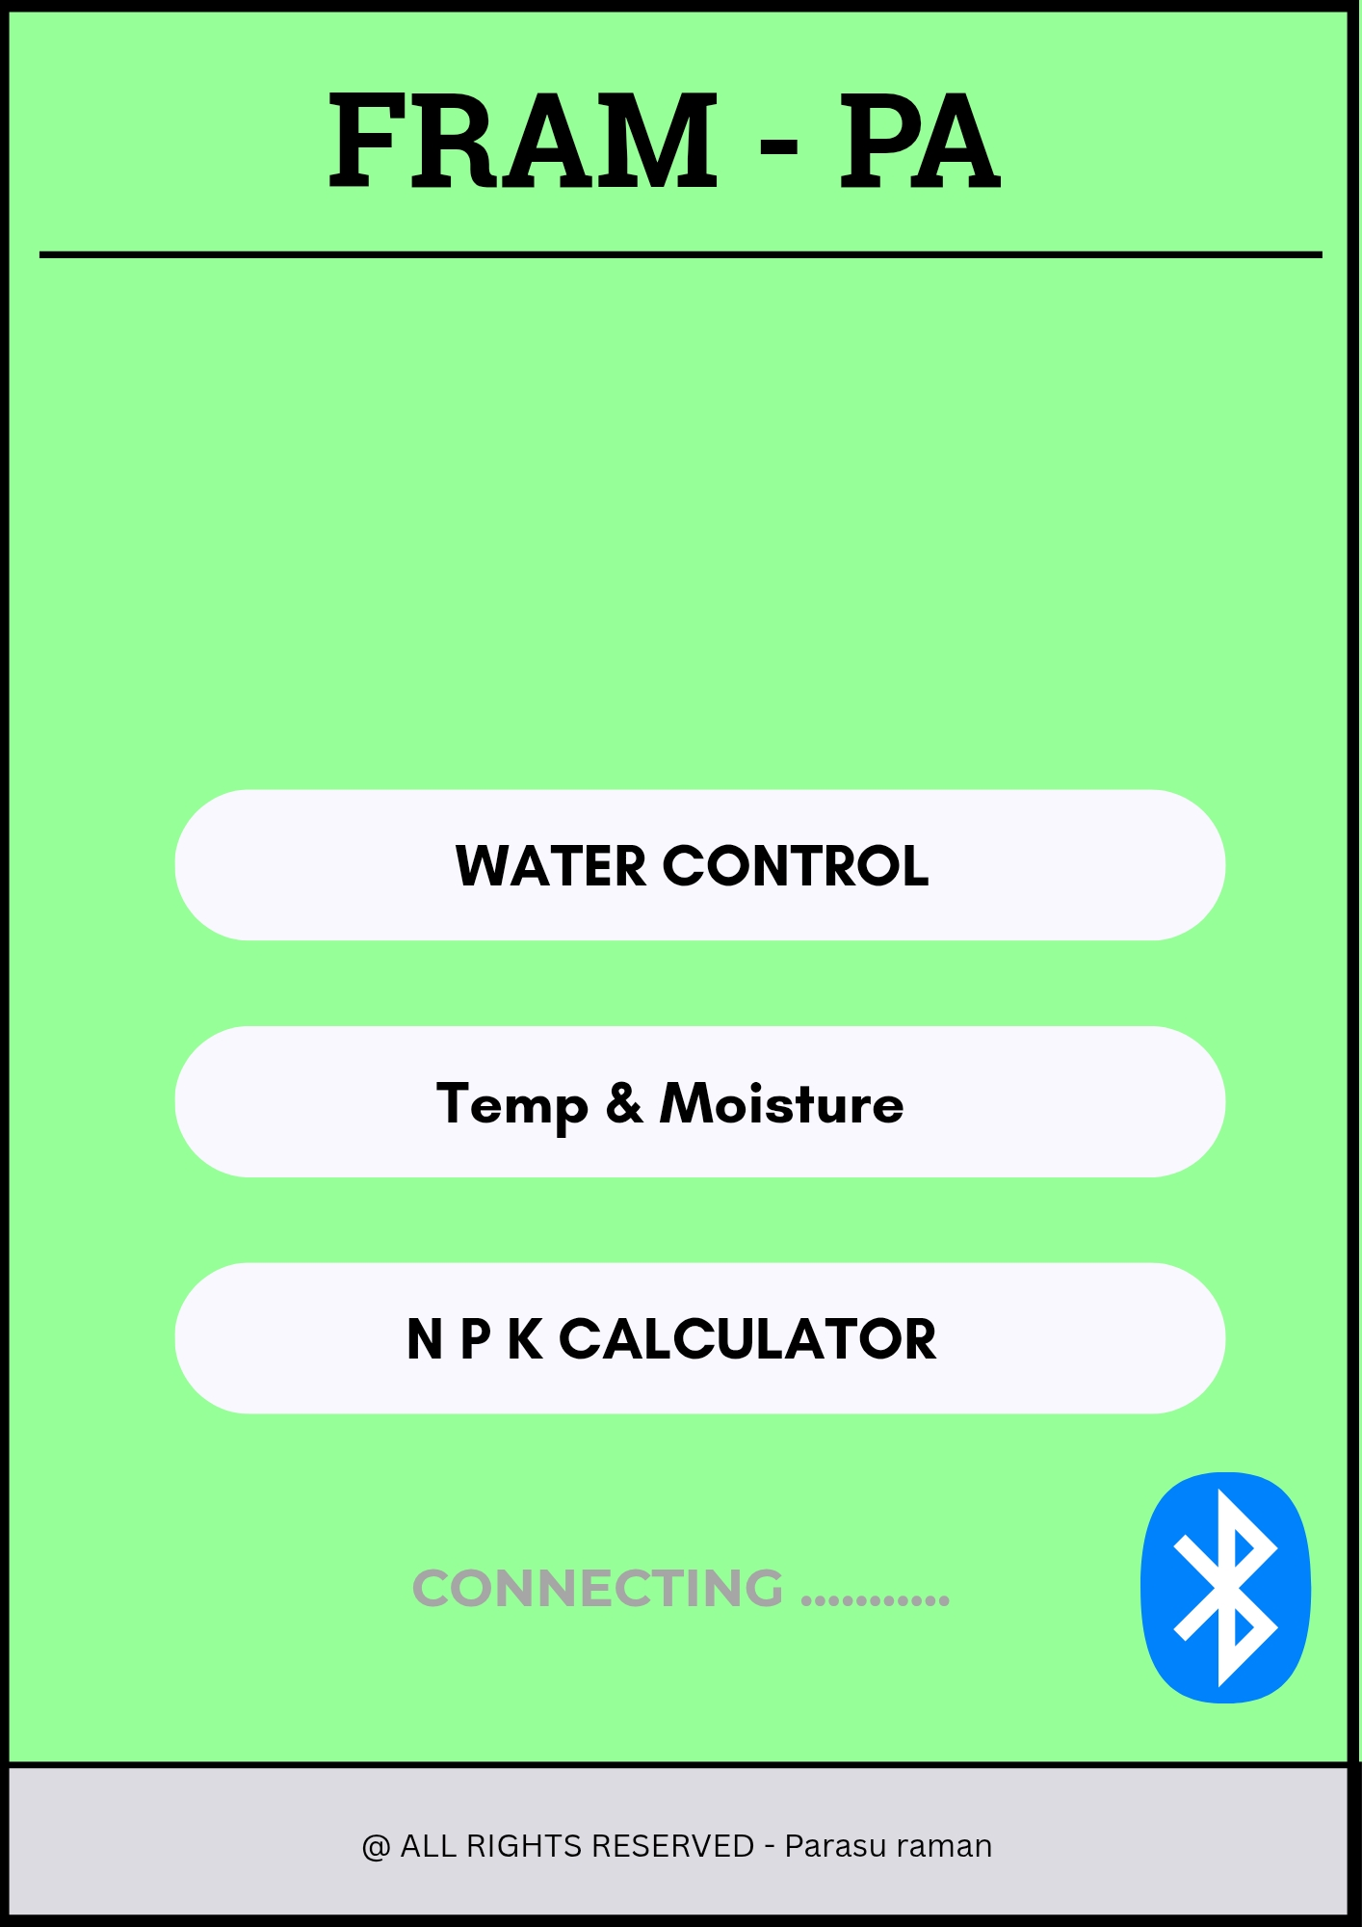
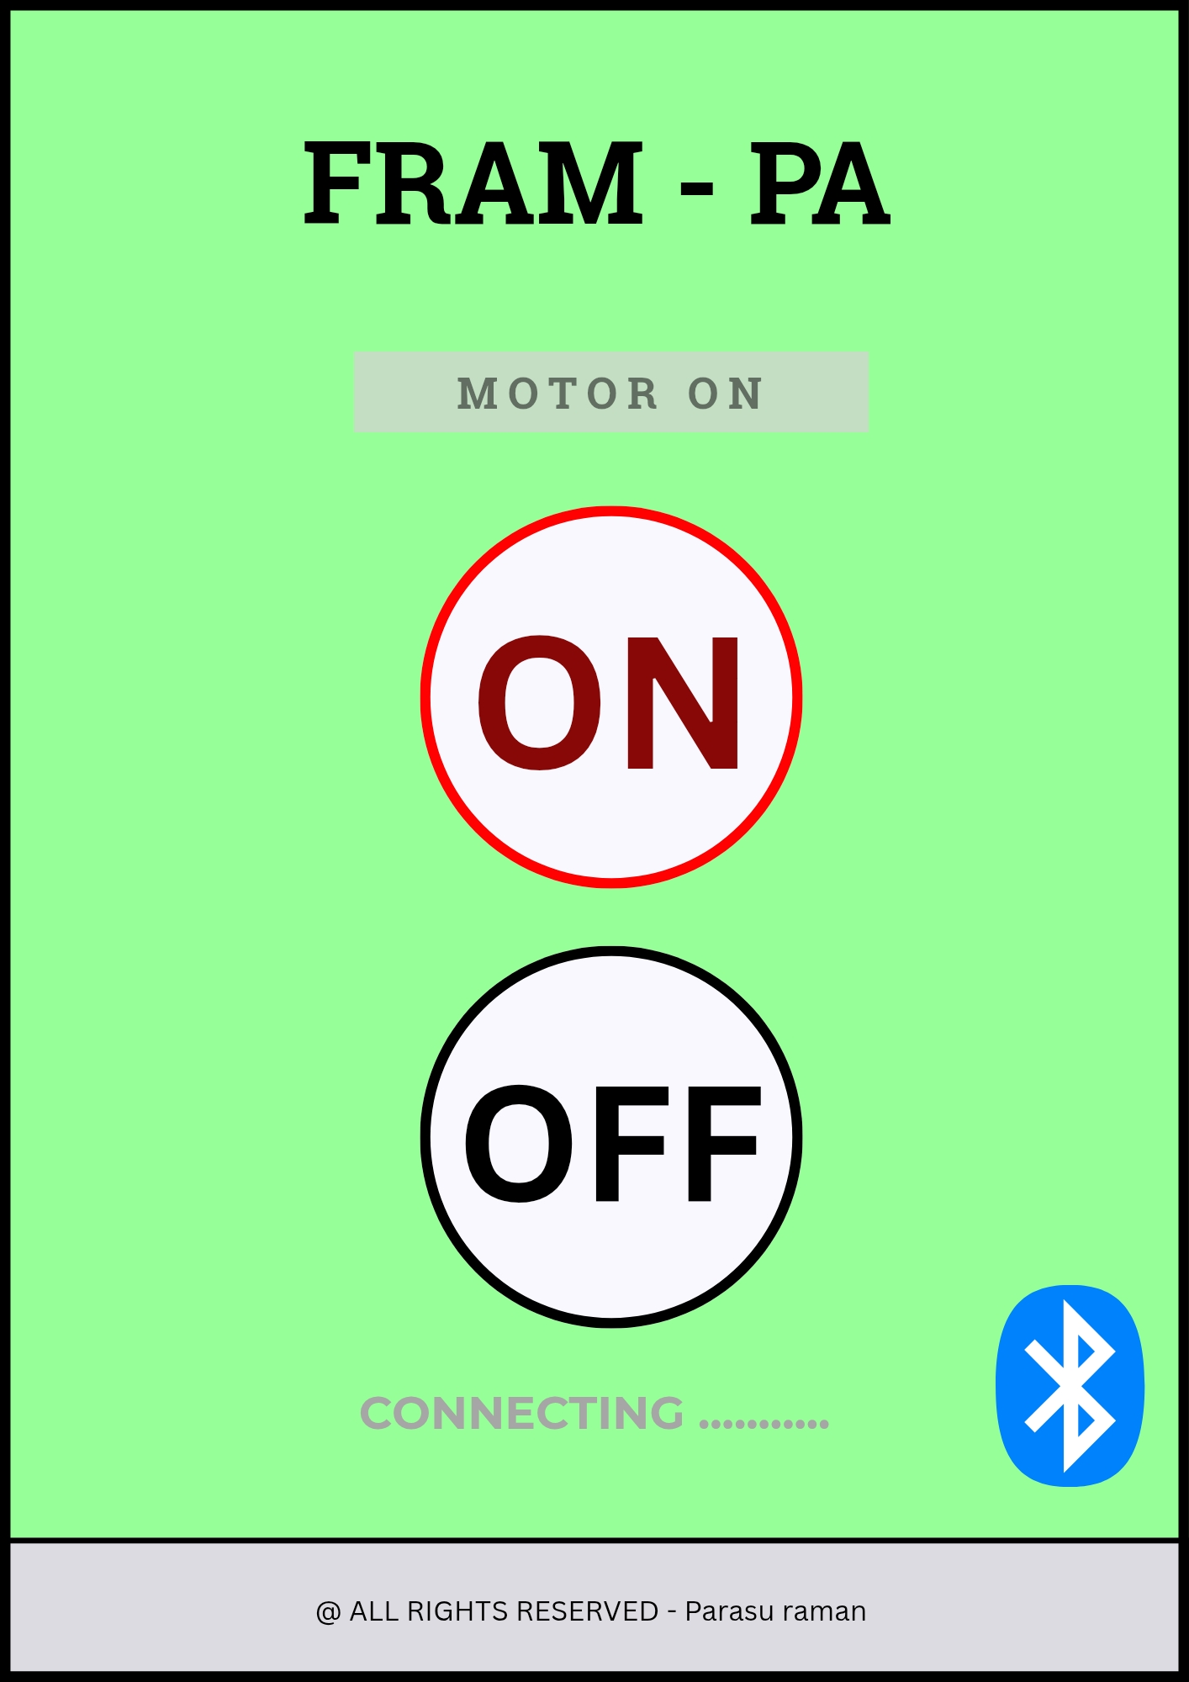
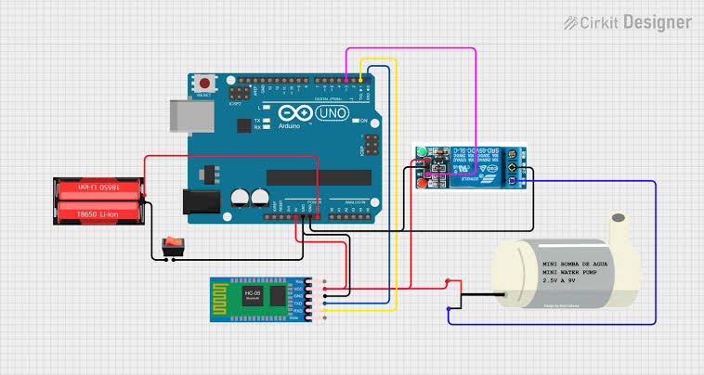
FARM -PA
USER INTERFACE OF THE APPLICATION

Slide 9
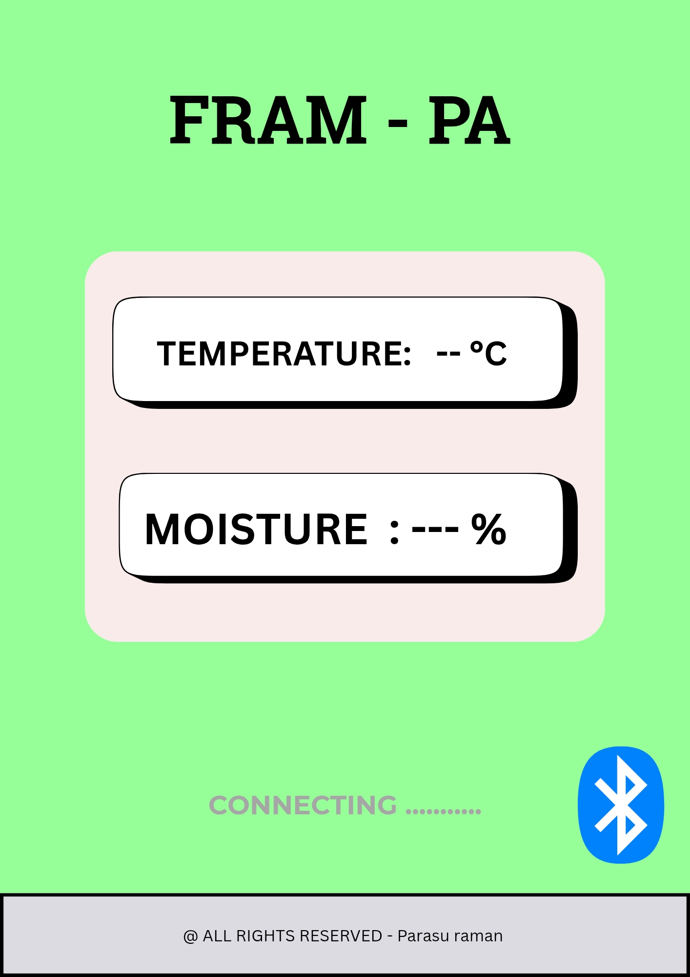
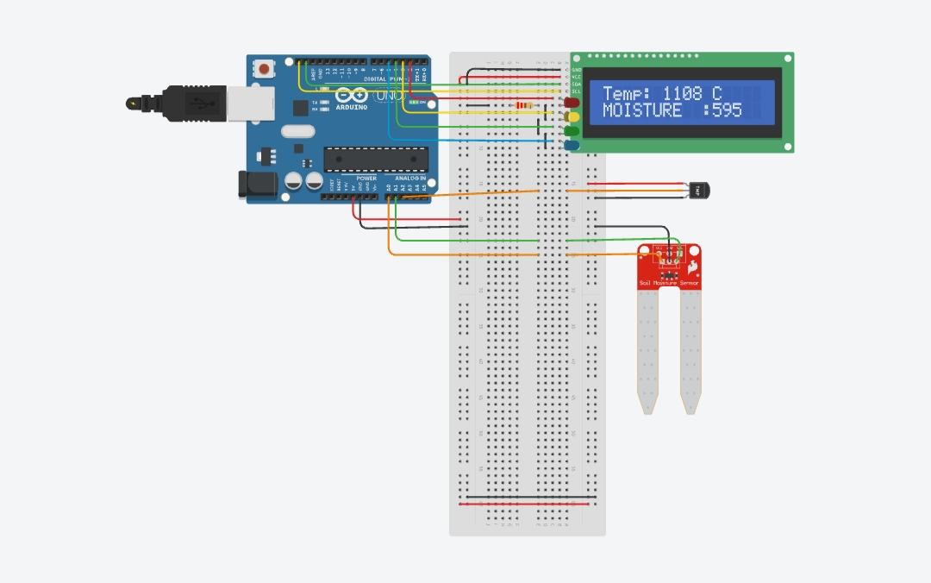
FARM -PA
USER INTERFACE OF THE APPLICATION

Slide 10
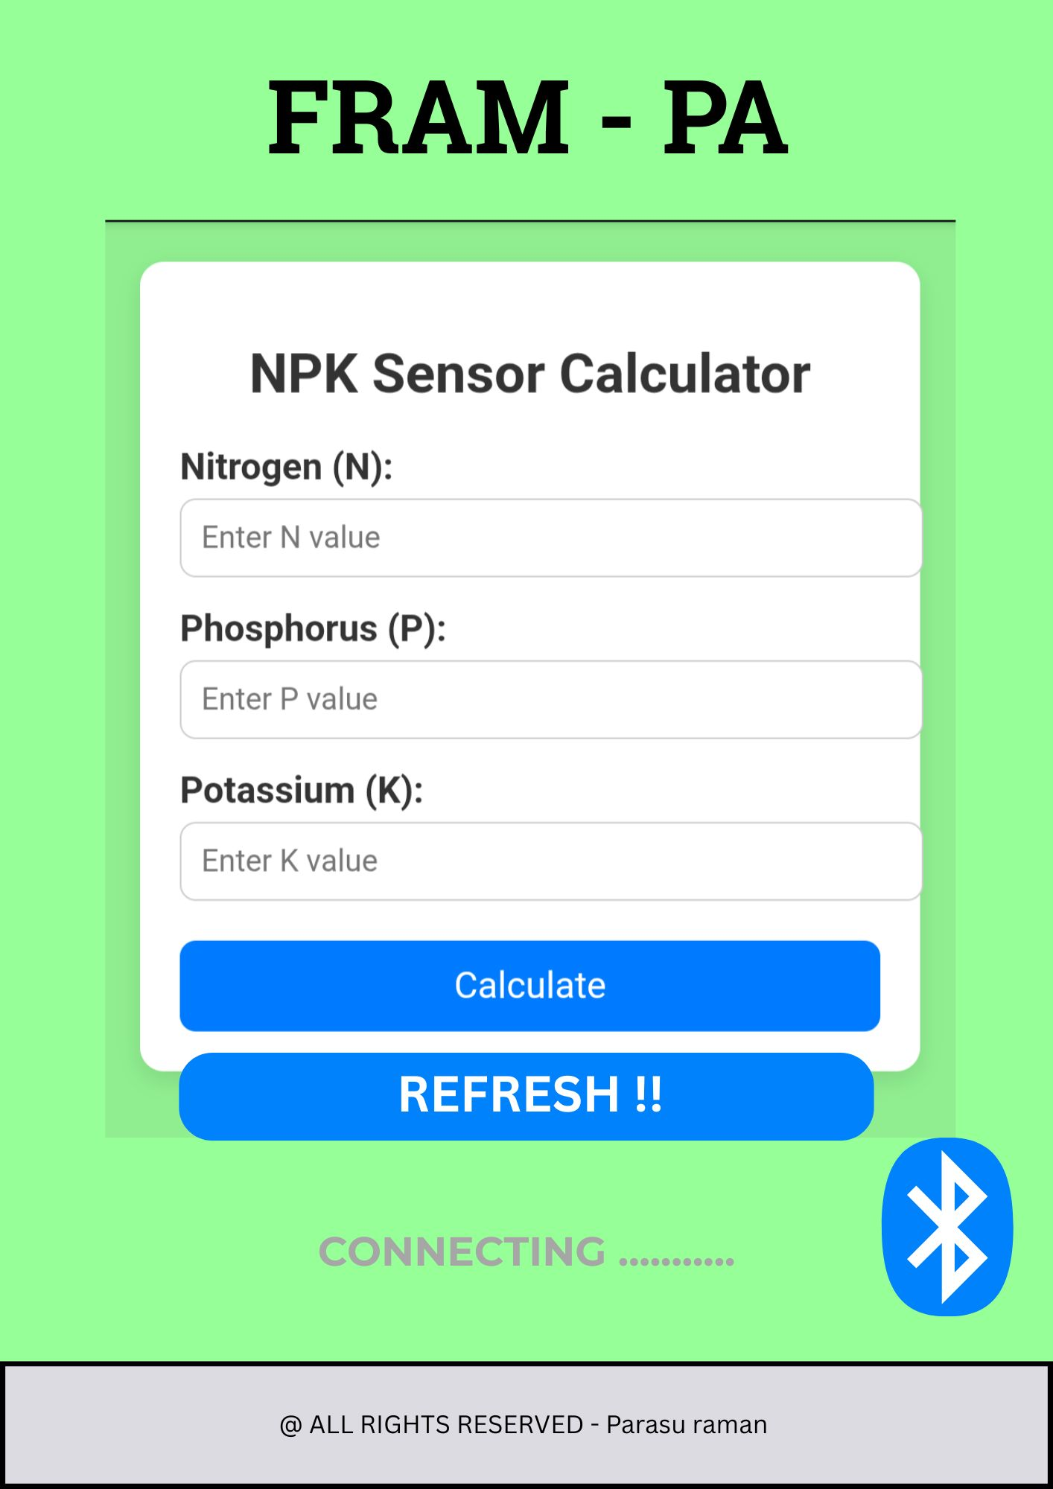
FARM -PA
USER INTERFACE OF THE APPLICATION

Slide 11
BENIFITS OF USING OUR PROJECT
1. Better Crop Growth – Ensures plants get the right nutrients and water. 2. Efficient Fertilizer Use – Reduces waste and saves cost. 3. Smart Irrigation – Prevents over- or under-watering. 4. Healthy Soil – Maintains long-term fertility and balance. 5. Higher Yield – Improves productivity and crop quality. 6. Environmental Protection – Reduces pollution and supports sustainability.

Slide 12
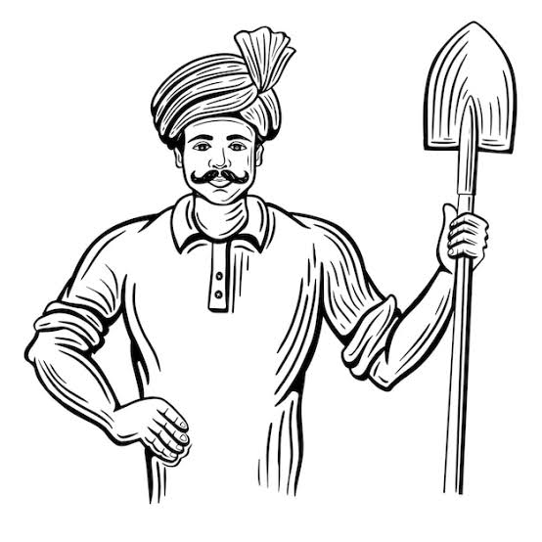
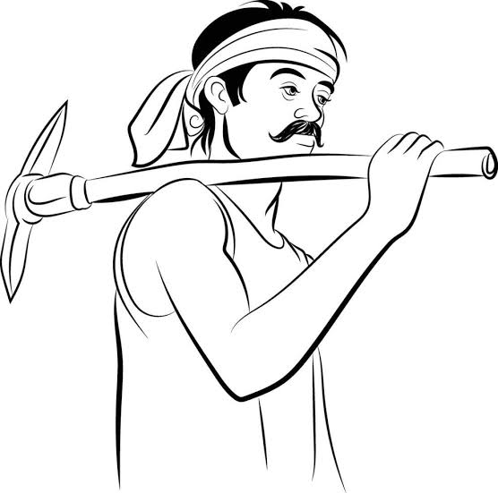
USE CASES
1. Check soil nutrients – Measures NPK (Nitrogen, Phosphorus, Potassium) in real-time. 2. Monitor soil moisture – Helps avoid overwatering or underwatering. 3. Suggest best crops – Recommends crops based on soil condition. 4. Send alerts – Notifies farmers when nutrients or moisture are too low or too high.

Slide 13

1. Expensive Setup – High cost for devices and installation. 2. Poor Internet – Hard to use in areas with weak connectivity. 3. Sensor Issues – Sensors need regular care and calibration. 4. Too Much Data – Hard for farmers to understand all the data. 5. Power Problems – Needs constant power, tough in remote areas.
DRAW BACK

Slide 14
Future Improvements
Cloud Monitoring: Access soil data remotely via the internet.
Weather Integration: Adjust irrigation based on weather forecasts.
Web Dashboard: Let experts view and analyze data online.
Weather Integration: Adjust irrigation based on weather forecasts.
Automated Fertilizer Control: Dispense nutrients based on NPK levels.

Slide 15
Thank you
Team :
G ParasuRaman M.Manikandan K.Saravanakumar R.Selvam K.Azhagu velan

