Slide 1



Operational analysis of a day-care chemotherapy unit
IE301 · TOPIC 1 · FINAL PRESENTATION
Simulation
many linked days of the unit
Evening optimiser
books tomorrow's chairs and doctors
Simulation, evening optimiser and results
Six experiments
120 days each, same patients
Team INFUCINQ
Parav · Sahasra · Siddhesh · Vaibhav · Kartikya

Slide 2

From the Tata Memorial visit to a working model
WHERE WE ARE
What we built
300–400
70–80
2–3 days
A simulation of the unit over many linked days: cycles, unfit patients, rebooking
patients a day at TMH
chairs, slots booked by hand
lost when a slot is missed
An evening optimiser that books tomorrow's chairs and doctors
Six experiments: booking rules, pre-clearance, reserved chairs, nurses, robustness, 24/7; 120 days each
A website that plays any day minute by minute
Demand
Optimiser
Simulated day
Scorecard
8 new patients a day, 5–8 cycles each
arrival times, chair slots, doctors
random stage times, queues, unfit
chairs, doctors, sent home, limits
Repeated every evening, for 30 warm-up + 120 reported days
The model is a generic Indian public unit (20 chairs). TMH is where we observe; every input is a placeholder until TMH data.

Slide 3



Who comes, and what they are told
PATIENT FLOW
Patients are never told a chair time, only when to arrive
Pre-clearance visit
Register
Blood
Lab
Doctor
Leave
day −1
100–200 min
fit or unfit
chemo tomorrow
Same-day patient
Register
Blood + lab
Doctor
Billing + drug
Chair
far + some local
100–200 min
fit or unfit
40–75 min
30 min – 10 h
Pre-cleared patient
Register
Billing
Drug
Chair
local only
10–20 min
25–60 min
30 min – 10 h
Urgent rebook
Standby
No-chair (10%)
Missed a cycle (unfit, then fit; or sent home). Skips the long chair queue. Uses reserved chairs.
Called extra to fill chairs left by no-shows. Seated only after every planned patient.
Injection only: nurse setup, no chair. Known after the doctor review.
Pre-clearance lets the unit know, the evening before, who is fit and how long their drip is.

Slide 4

Inputs and distributions
INPUTS
Stage ranges from Presentation 3 · all placeholders until TMH data
Stage | Range | Distribution | Mean
Arrival vs told time | ±30 min | Triangular | 0 min
Registration | 5–15 min | Triangular | 10 min
Blood draw | 5–10 min | Triangular | 7.5 min
Lab result | 100–200 min | Triangular | 163 min
Doctor review | 15–40 min | Lognormal (median 24.5) | 25 min
Billing / insurance | 10–20 min | Normal (15 ± 2.5) | 15 min
Drug preparation | 25–60 min | Lognormal (median 38.7) | 40 min
Line + pre-meds | 20–40 min | Triangular | 30 min
Infusion | 30 min – 10 h | Drug mix × lognormal drift | Drug mix
Demand
8 new patients a day, 5–8 cycles, 2/3/4 weeks apart
≈ 52 cycles reach their day
40% far · 10% no-chair · 5% no-show
8% unfit · 2% pass away per cycle
Why lognormal
Most reviews and preparations are quick, a few run long. Median = √(low × high); the range covers 9 in 10 patients.
Doctor: √(15 × 40) = 24.5 min
Drug: √(25 × 60) = 38.7 min
Same random numbers for every policy: each rule is tested on exactly the same patients.

Slide 5



What a good day means
OBJECTIVE
Team decision: use chairs and doctors fully; patient waiting is not the goal
Score = 0.60 × chair use + 0.30 × doctor use − 0.10 × share sent home
All three on a 0–1 scale. Chairs and doctors carry 90% of the weight, chairs twice as much as doctors.
Hard limits: a plan that breaks one is out
Overtime
90th-percentile wait
Cycle rule
≤ 30 min past the effective close
≤ 6 h, arrival to drip
every missed cycle given within 3 days
Closing rule
A seated patient always finishes. 18:00 stretches only for far patients; a local patient may use a free chair if they finish before the far patient does. Otherwise: sent home, urgent rebook.
Far patient: may run to 18:20
Local: seated, ends by 18:20
Also: at most 5 patients told the same time; nurses are a variable, the model reports how many are needed.
18:00
18:30 max

Slide 6




The optimiser
FORMULATION
Integer programme, solved every evening for tomorrow (HiGHS, 15-min slots)
Decides
Constraints
Maximises
Each patient's chair slot (internal)
Who is left out of the plan
Doctor slots for same-day reviews and tomorrow's pre-clearance visits
Told arrival = slot − buffer
Chairs ≤ 20; reserved chairs kept for urgent
Nurses: 4 × setups + drips ≤ 4 × N
Doctors: reviews ≤ what 2 doctors can finish
Ends by the close; ≤ 5 told the same time
Never leave out more urgent patients than greedy
0.60 × chair-minutes used
+ 0.30 × doctor minutes used
− 0.10 × patients left out
tiny tie-break: earlier finishes
The buffer Time a patient needs to become ready, set so 8 in 10 are ready by their slot: pre-cleared and urgent 1 h 30 m · same-day 5 h
Checked every constraint re-verified on 20 days (20/20) · equals brute force on 6 small cases (6/6) · never below greedy on its own plan (20/20)
Example: chair slot 11:30, same-day buffer 5 h → patient told to come at 06:30.

Slide 7
Does a better rule beat today's practice?
RESULT 1 · BOOKING RULES
Five ways to tell patients when to come · 120 days each, same patients for every rule
1 Everyone at 08:00 today's practice: all told 08:00, first come first served
2–3 Longest / shortest first longest (or shortest) drips go first; told 1 h before
4 Optimiser same rule, but the evening optimiser picks the best slots
5 Buffer rule told time = chair slot − time needed to get ready
Telling each patient a time based on their own readiness: +9 points chair use and ~22 fewer sent home a day. The simple buffer rule does as well as the optimiser.

Slide 8
Pre-clearance and nurses
RESULT 2 · WHAT THE UNIT CAN CHANGE
Each point = mean of 120 days, buffer rule + optimiser
0% → 60% pre-cleared: sent home 15.6 → 6.0 a day. Chair use barely moves (51%).
Below 6 nurses the unit breaks; above 8 extra nurses change almost nothing.
Best change the unit controls: pre-clear 60% + 7 nurses → 2.9 sent home a day.
Also tested: reserved chairs and standby patients matter little once the pharmacy has 4 hoods (best: 3 reserved, 5 standby). Robustness: the conclusions hold when every input is halved or doubled.

Slide 9

The hidden bottleneck is the pharmacy
RESULT 3 · BOTTLENECK
Found while checking why the cycle rule failed
3 hoods
4 hoods
Why
12%
99.6%
~50 drugs a day × ~40 min = 2,000 hood-minutes; 3 hoods give only 1,800
Urgent patients waited ~4 h 30 m at the pharmacy, missed the close, were sent home again
Reserved chairs (best 16%) and extra nurses did not fix it; one more hood did
20 missed cycles traced end to end: the rebooking logic is correct
of missed cycles given in 3 days
of missed cycles given in 3 days
38
7
sent home a day
sent home a day
Why chair use stays near 51% Demand, not the schedule: 8 new patients a day fill only 6,120 of 12,000 chair-minutes. Idle time is mostly mornings, while same-day patients are still in lab. For 85% use the unit needs ~13 new patients a day, then a 3rd doctor and a 5th hood.
One extra pharmacy hood matters more than extra chairs, nurses or reserved slots.

Slide 10
Where the chair time goes
RESULT 4 · CHAIR TIME
One day: 20 chairs × 10 h = 12,000 chair-minutes · base case, mean of 120 days
51%
34%
10%
5%
6,120 min
4,096 min
Used for treatment
Patient here, not ready yet
Nobody left to seat
No free nurse
Not ready yet: 34%
Nobody left to seat: 10%
No free nurse: 5%
Mostly mornings, while same-day patients are still in lab (~3 h), doctor and pharmacy.
8 new patients a day is not enough to fill 20 chairs.
A chair is free and a patient ready, but every nurse is busy setting up.
Fix: pre-clear patients the day before; faster lab results
Fix: more patients (≈13 a day for 85% use), or fewer chairs
Fix: 7 nurses instead of 6
Chairs mostly wait for patients to become ready. Getting patients ready earlier is the biggest lever.

Slide 11
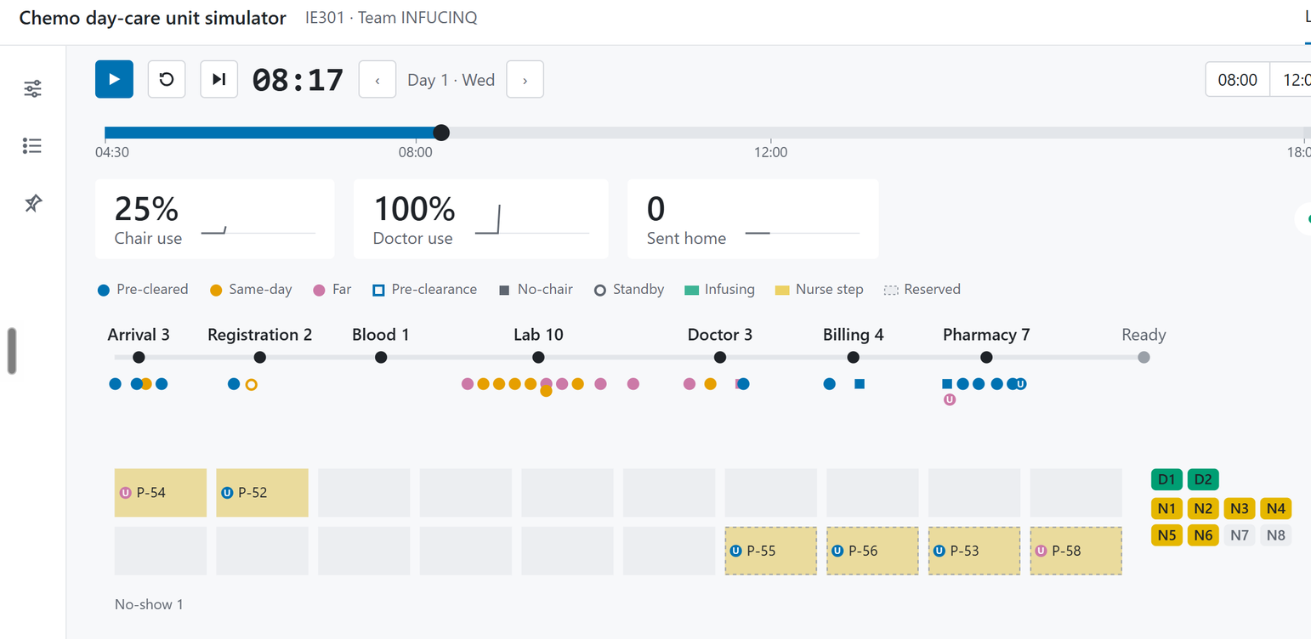


The simulator
LIVE DEMO
Every day the model plays out, minute by minute, in the browser
Live day
Clock, chair use, doctor use, sent home; station queues; 20 chair tiles that fill as the drip runs; doctor and nurse chips
Experiments
All six experiments, each with one chart and a one-line answer
Model
Flow, closing rule, every input with its source; Python and website give identical numbers
https://ie301-infucinq.iitbresume.workers.dev/

Slide 12
Four answers from 120 simulated days
WHAT WE FOUND
+9 pts
2.9
chair use, and ~22 fewer sent home a day, by telling each patient a time based on their own readiness
sent home a day with 60% pre-cleared and 7 nurses: the best change the unit controls
12% → 99.6%
34%
missed cycles given within 3 days, from one extra pharmacy hood
of chair time is lost to patients who are here but not ready: the biggest lever

Slide 13
Thank you
TEAM INFUCINQ · IE301 OPERATIONS ANALYSIS · TOPIC 1
Questions
Parav · Sahasra · Siddhesh · Vaibhav · Kartikya

