Slide 1
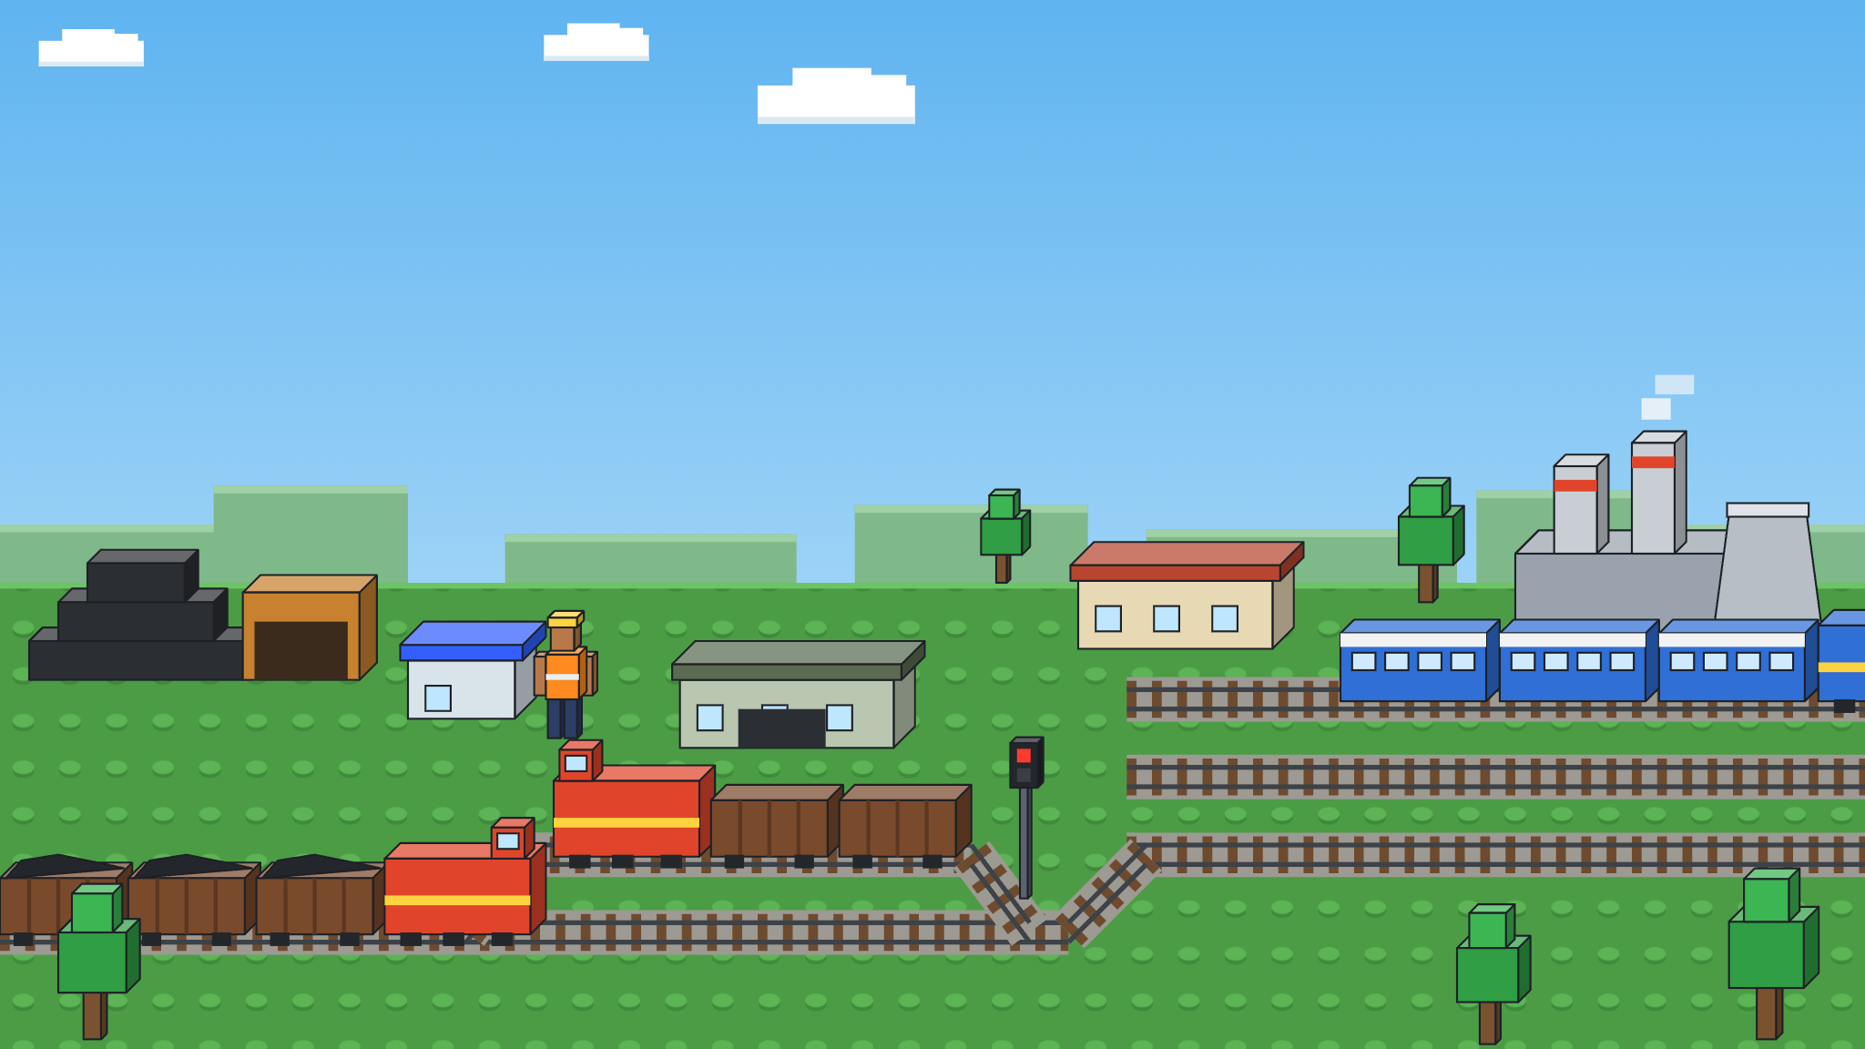
01 · PROBLEM & SYSTEM
The problem
Coal Rake Cycle
A rake's round trip takes far longer than its running time. Where does the extra time go?
Ghugus → Tadali → Chandrapur · Central Railway
1
Single-line crossings
58-wagon BOXN rakes
14 km single line
Closed loop
2
Waiting for a gap to merge at Tadali
3
Expiring clocks: crew 9 h, BPC
Tadali junction
Crew lobby
Exam depot · daylight only
Colliery siding
Main line · 3 tracks
Power plant
Single line · 14 km
Crossing loop
Notes:
Walk the circuit left to right: empty rake loads at the Ghugus siding, runs the 14 km single line (crossing opposing rakes only at loops), waits for a gap between passenger trains to join the Wardha–Balharshah main line at Tadali, unloads at the power plant, and comes back the same way. Every trip needs a loco, a crew inside its 9 h duty limit, a free block and a valid BPC. Context: doubling of Ghugus–Tadali sanctioned July 2026 at Rs 228 crore.

Slide 2
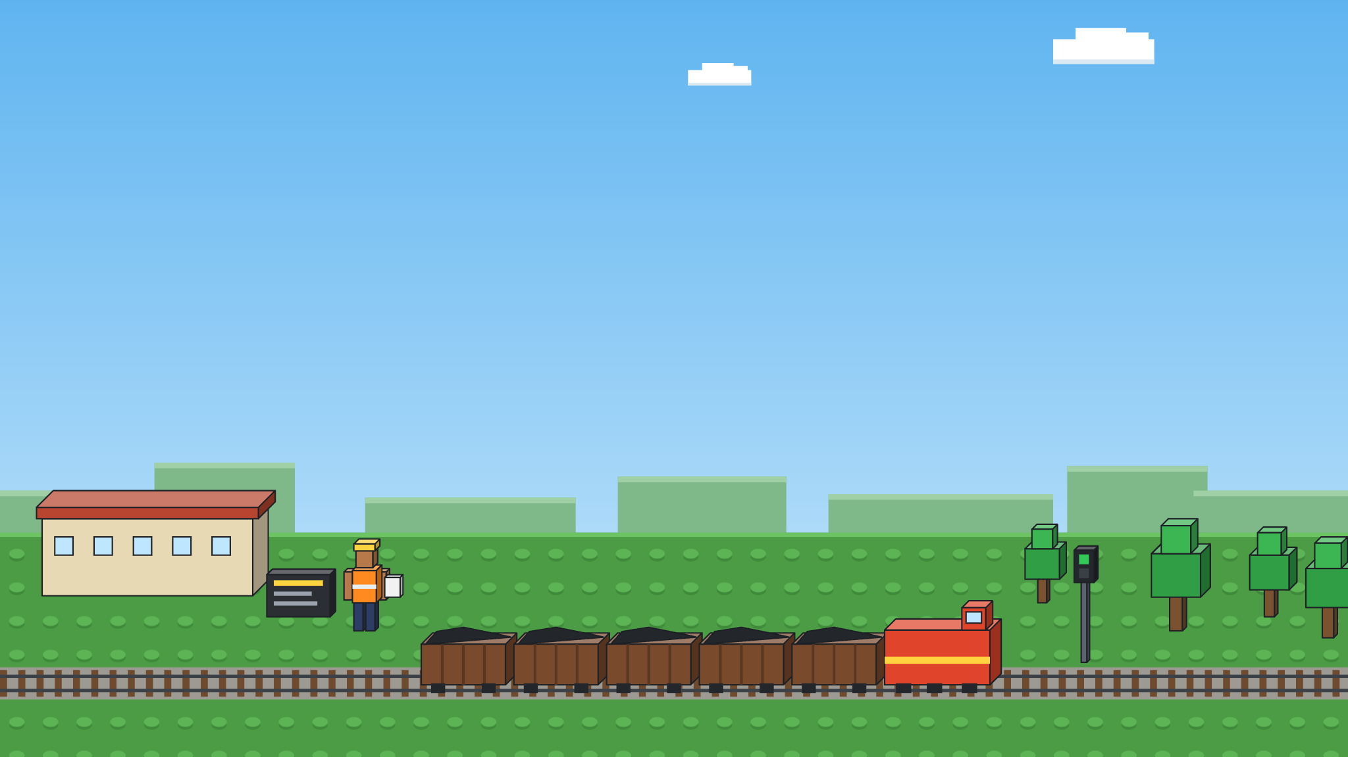



02 · DATA
Where the numbers come from
No record? Expert min / likely / max → Triangular
Central Railway records
Public running status
Staff, sheds & rules
Loading time at siding
Passenger times at Tadali
Crew waiting
10–12 rakes · Gamma / Lognormal
Timetable + daily lateness
~50 events · crew lobby
Block running times
30 days of history
Loco failures
~30 trips each way
Empirical lateness distribution
Shed logs · Exp MTBF
Other trains on single line
Refreshable daily
Exam time
1 month of counts · Poisson
Digital-twin link for next-day paths
~100 man-hours / rake
Main-line run, unloading
Rules
30 trips each · Lognormal
9 h duty (+2) · BPC 6000 km / 30 d
Data access via Prof. Narayan Rangaraj
Notes:
Three routes for input data. Central Railway section records give loading, block running, other-train arrivals, main-line and unloading times. Public running-status history gives passenger timings and lateness at Tadali, which can be refreshed daily (digital-twin idea). Crew lobby, loco shed and depot staff plus the rulebook give crew waits, loco MTBF/repair, examination time and the fixed limits (9 h duty extendable by 2, BPC 6000 km or 30 days). Prof. Narayan Rangaraj is helping with access.

Slide 3
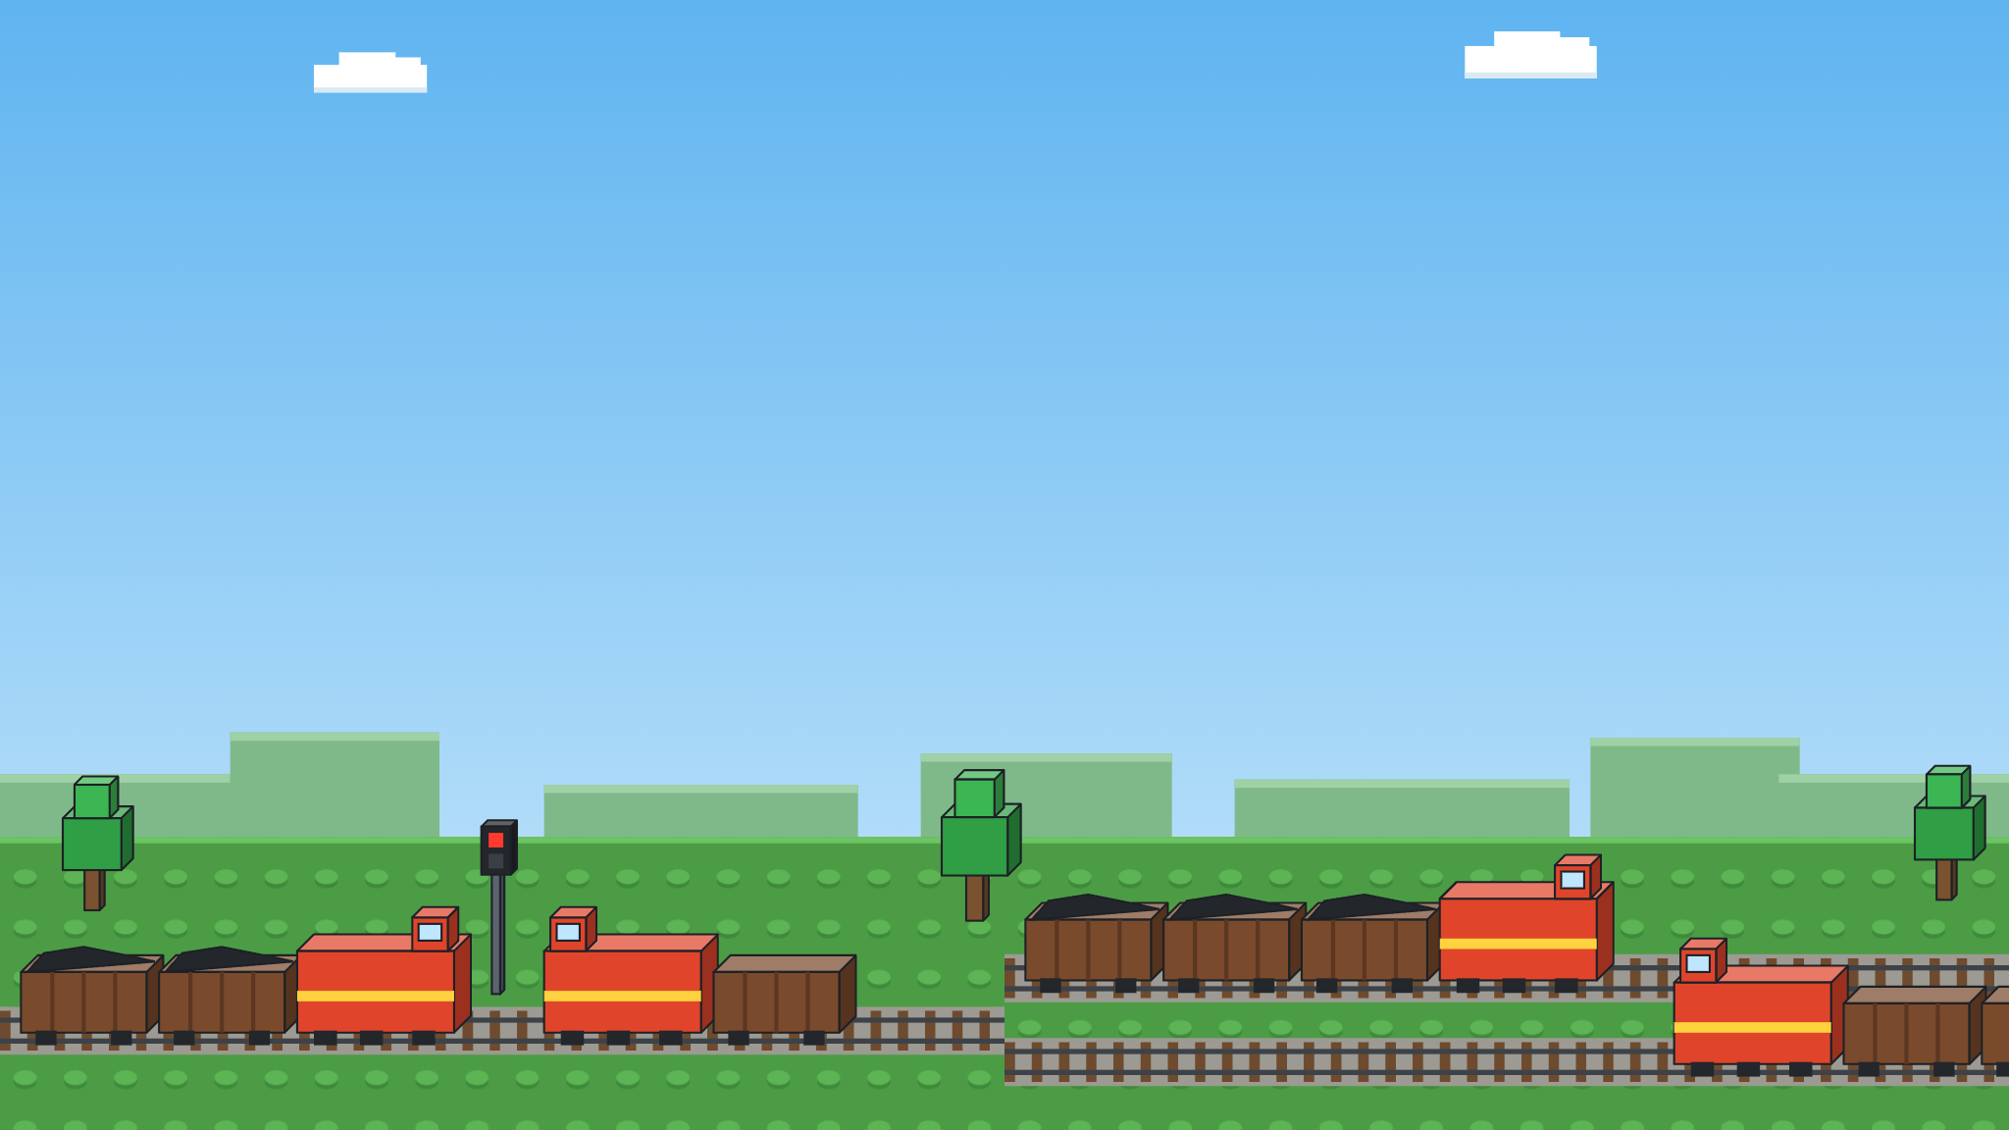





03 · QUESTIONS & OUTPUTS
What we'll test, what we'll measure
Goal: min E[cycle time] with rakes/day ≥ target · 30 days × 30 reps · CRN · 95% CI
What-if scenarios
KPIs
1
Base case — today's practice
Rake cycle time · mean & P90
2
Dispatch — batched vs alternating
3
Tadali slots — reserved paths vs take gaps
split by cause: load, crew, single line, run, merge, relief, unload, exam
4
Crew booking — at loading vs when ready
5
Exam trigger — 3 / 5 / 7 days left vs expiry
Rakes/day & tonnes/day
6
Fleet size — 8 to 20 rakes
Single-line utilization & wait
Queue length at Tadali merge
7
Line doubling — best policy vs ₹228 cr track
Crew expiries per 100 trips
Exam detention, h/rake/month
Doubled: both keep moving
Single line: one rake waits
Notes:
Seven scenarios, each against the base case. The headline comparison is the last one: how much of the cycle-time gain from the Rs 228 crore doubling can the best combination of operating rules recover for free? Main KPI is rake cycle time, split into its components so we can see where time goes. Each scenario: 30 simulated days after warm-up, 30 replications, common random numbers, 95% confidence intervals.

