Slide 1
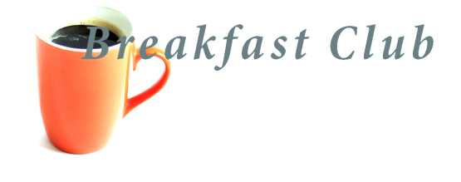
Introducing PyTest
A test framework for Python applications

Slide 2
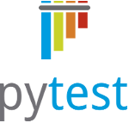
Introducing PyTest
A test framework for Python applications
What is PyTest?
Why PyTest?
Examples from project *****
Q&A

Slide 3
About me
Scott Weatherhogge
Quality Engineer working on the ****** project
I write test code in Python and...PyTest!
Scott.weatherhogge@flukenetworks.com

Slide 4
What is PyTest?
A stand alone program to test Python apps
A replacement for unittest, Python’s built in test framework

Slide 5
Why PyTest?
Easiest to use and most powerful
Widely supported and used
Open source: Extremely active dev community
Flexible: Tons of open source plugins
Good test isolation
Easy resource management
Useful failure reporting

Slide 6
Fixtures: PyTest’s Best Feature
Fixtures to control resources: setup/teardown
Fixtures to control data: parameters
Fixture scope
Examples from project ******

Slide 7
PyTest normally used to test Python apps, like our add.py app
Run with PyTest
test_add.py
add.py

Slide 8
But on project ***** the Python test code is testing the ****** target through ssh
Run with PyTest
test_code.py
****** Target
ssh

Slide 9
More PyTest Features
Works with CI (Continuous Integration)
Hook functions
Plugins
Pyteststress – runs for a certain time
Pytestrandomly – random test ordering
Pytestloop – runs in thread continuously, allows on the fly test fixing/debugging
Pycoverage – test coverage plugin
Pyflaky – reruns failed tests a # of times until they pass

Slide 10
Questions?

Slide 11
Resources
Sites
Detail: docs.pytest.org
Great intro to fixtures:
pythontesting.net/framework/pytest/pytest-fixtures-nuts-bolts/
Podcasts
Test and Code
Python Bytes
Talk Python to Me
Books
Python testing with PyTest, Brian Okken

