Slide 1

Project Presentation
Adaptive Fault-Tolerant Multi-Sensor Fusion
for Real-Time Autonomous Systems
A Project Presentation submitted in partial fulfilment of the requirements for the degree of
BACHELOR OF TECHNOLOGY IN COMPUTER SCIENCE & ENGINEERING
Presented By:
Sundram Kumar Ray [23BECSE52]
Arshiya [23BECSE09]
Parbinder Singh [23BECSE35]
Anupriya [23BECSE07]
Group No. 23G15
Under the Guidance of
Prof. Dinesh Kumar
Professor, Dept. of CSE
Central University of Jammu
Department of Computer Science & Engineering
Central University of Jammu
Rahya-Suchani (Bagla), District Samba-181143, Jammu (J&K)
October 2026
Notes:
Introduce the team and the project. AFTMSF fuses RGB, thermal and LiDAR depth and keeps working when a sensor fails.

Slide 2
Domain Introduction
Research Domain
Research-based artificial intelligence and machine learning system development
Sub-domain: computer vision and autonomous perception
Applications: autonomous vehicles, UAVs, robots, intelligent industrial systems
Core challenge: reliable perception under adverse real-world conditions
Why It Matters
Fog, rain, low light or hardware faults degrade sensors and cause safety failures
No single sensor covers every failure scenario, so heterogeneous fusion is essential
Fusion must keep working when one sensor degrades, not collapse with it
Computer Vision
Deep Learning
Multi-Sensor Fusion
Fault-Tolerant Systems
Autonomous Driving
Notes:
The project sits in AI/ML system development for computer vision and autonomous perception.

Slide 3
Introduction to Multi-Sensor Fusion
RGB Camera
Thermal Infrared
LiDAR Depth
Rich texture and colour
Fails: low light, glare
Heat signatures, works at night
Fails: lacks texture detail
Accurate 3D distance
Fails: sparse, weather-sensitive
Fusion Paradigms
Early Fusion
Late Fusion
Intermediate Fusion
Concatenates raw sensor inputs before feature extraction. Simple, but sensitive to calibration errors and to failure of any one input.
Combines decisions or features from independent networks. Misses cross-modal feature interactions.
Integrates learned features. Best accuracy; AFTMSF uses this with confidence-based weighting.
AFTMSF uses intermediate fusion with cross-modal attention, weighted at runtime by a per-sensor confidence score.
Notes:
Each sensor fails differently; fusion paradigms differ in where the information is combined.

Slide 4
Challenges in Autonomous Perception
Adverse Weather
Low Illumination
Hardware Faults
Rain, fog and snow degrade RGB and LiDAR. Thermal is more robust but also affected at extremes.
RGB cameras fail in darkness. Thermal infrared is the essential complement for night driving.
Sensor malfunction or calibration drift produces unreliable data with no warning to the fusion module.
Partial Occlusion
Real-Time Constraints
Fixed-Weight Assumption
Objects blocked from one sensor remain detectable through the others, if fusion is done well.
Perception must run at ≥ 10 FPS. Large multi-sensor models risk missing the latency budget.
Most fusion models weight sensors the same way regardless of their state at runtime.

Slide 5
Problem Formulation
Formal problem statement
Given N sensor inputs {x₁, …, x_N}, where any xᵢ may be degraded by adverse conditions or hardware faults, design a fusion function F that:
estimates a confidence cᵢ ∈ [0, 1] for each sensor at runtime, without fault labels at inference
weights each sensor's contribution with wᵢ = softmax(c / τ)
keeps detection and segmentation as accurate as possible under partial sensor failure
Individual Sensor Weaknesses
RGB Camera
Thermal Infrared
LiDAR
Fails in low light, glare and heavy rain or fog. Cannot sense heat.
Lacks texture detail. Cannot separate objects at equal temperatures.
Sparse point clouds. Degraded by rain, dust and sensor contamination.
Fixed-weight fusion keeps trusting a sensor after it fails.

Slide 6
Motivation of the Project
Why existing systems fail
Most fusion networks give each sensor a fixed role, whatever its state
Fault detection is usually studied separately from fusion
In our tests, conventional fusion baselines drop to 0% mAP when the RGB camera fails
Safety-critical systems need graceful degradation, not collapse
What this project achieves
Fault detector built into cross-modal attention fusion
Three-signal confidence score with no fault labels at inference
63.85% mAP when the RGB camera fails completely
89.14% mAP@0.5 on KAIST, best of all methods we trained
89.14%
+11.25 pp
mAP@0.5 on KAIST
over the best baseline (Late Fusion)
63.85%
22.2 FPS
mAP with RGB camera failed (baselines: 0%)
on a 6 GB laptop GPU
Notes:
Headline numbers are all re-measured from the trained models in October 2026. The 0% for baselines is under complete RGB dropout.

Slide 7
Existing Systems in Multi-Sensor Fusion
Method | Year | Sensors | Fusion approach | Runtime sensor reliability | Limitation
IAF R-CNN [19] | 2019 | RGB + thermal | Illumination-weighted | Illumination only | Handles day/night, not sensor faults
Bijelic et al. [7] | 2020 | Camera, LiDAR, radar | Entropy-steered | Partial | Built for weather, not hardware failure
CFT [20] | 2021 | RGB + thermal | Cross-modality transformer | No | Attention not tied to sensor health
TransFuser [10] | 2022 | Camera + LiDAR | Transformer | No | No explicit fault detection
BEVFusion [11] | 2022 | Camera + LiDAR | Bird's-eye view | No | High compute; fixed fusion
Wang et al. [12] | 2022 | Various | Fault detection survey | Yes (separate) | Not connected to fusion
Gap: a fault signal that directly controls how much each sensor contributes to the fused features.
Notes:
We compare capabilities here, not scores: published numbers use the full KAIST benchmark (miss rate) or other datasets, so they are not comparable with our subset.

Slide 8
Research Gap Analysis
1
Zhang et al. [1]; Li et al. [2]
No adaptive weight redistribution
Most methods use fixed or pre-computed fusion weights, not weights driven by sensor health at inference time.
2
Wang et al. [12]
No integrated fault detection
Sensor fault detection is studied separately; its output does not steer fusion.
3
Measured in this project
Collapse under sensor failure
Fixed fusion can fail completely when one input fails — our baselines reach 0% mAP under RGB dropout.
4
Kendall & Gal [17]
Combined reliability signals
Reconstruction error, feature variance and prediction entropy are rarely combined into one confidence score.
5
BEVFusion [11]
Edge feasibility
Strong fusion models often need server GPUs; we target a 6 GB laptop GPU.

Slide 9
Objectives of the Project
1
Multi-modal fusion framework
Fuse RGB, thermal infrared and LiDAR depth with ResNet-50 / depthwise-separable encoders and feature pyramid networks.
✓ Achieved
2
Adaptive fusion mechanism
Confidence-gated cross-modal attention (ACAF) that weights each sensor by its estimated reliability at inference time.
✓ Achieved
3
Fault detection and graceful degradation
Three-signal fault detector (reconstruction error, feature variance, prediction entropy) and useful performance when a sensor fails.
✓ Achieved
4
Benchmark evaluation
KAIST, KITTI and FLIR with mAP@0.5 and mIoU; three baselines; eight fault conditions; ablations and speed.
✓ Achieved
All four objectives met — results on the following slides were re-measured in October 2026.

Slide 10
Proposed AFTMSF System
Four components, trained end to end:
1
Modality encoders
ResNet-50 + FPN for RGB and thermal (26.9M each); lightweight depthwise-separable CNN + FPN for depth (3.3M). 256-channel features at 4 scales.
2
Three-signal fault detector
Confidence cᵢ ∈ [0, 1] per sensor from reconstruction error, feature variance and prediction entropy (197,002 parameters).
3
ACAF fusion module
Confidence-gated cross-modal attention: F = Σ softmax(c / τ)ᵢ · CrossAttnᵢ, at 4 feature scales (8.1M parameters).
4
Task heads
FCOS-style anchor-free detection (4.7M) and DeepLabV3+-style segmentation (0.6M). Total: 67.35M parameters.

Slide 11
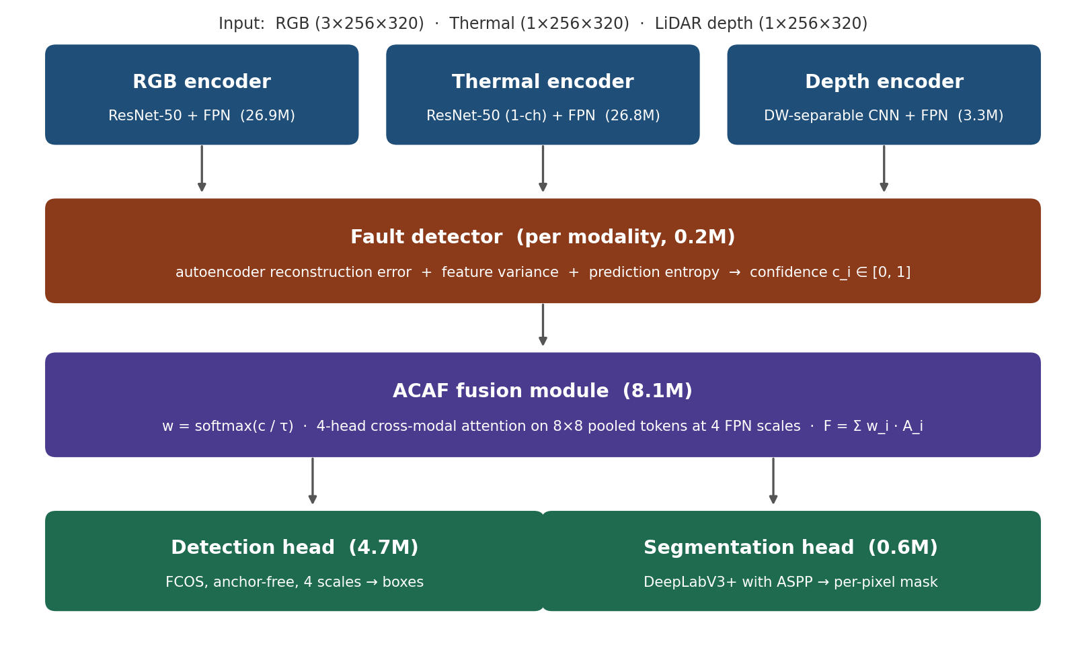
Proposed Architecture
Notes:
Parameter counts in the diagram are measured from the model.

Slide 12
Modality Encoders
Encoder | Backbone | Input | Output | Parameters
RGB encoder | ResNet-50 + FPN | 3-channel RGB | 256-ch FPN × 4 scales | 26,854,464
Thermal encoder | ResNet-50 + FPN (1-channel stem) | 1-channel thermal | 256-ch FPN × 4 scales | 26,848,192
Depth encoder | Depthwise-separable CNN + FPN | 1-channel LiDAR depth | 256-ch FPN × 4 scales | 3,331,168
Depth Encoder Layers
Layer | Type | Output channels | Stride | Parameters
Sparse fill | Dilated convolutions (rates 2, 4) | 1 | 1 | 2,464
Stem | Conv 7×7 + max-pool | 32 | 4 | 1,632
Stages 1–2 | Depthwise-separable × 2 each | 64 / 128 | 4 / 8 | 45,280
Stages 3–4 | Depthwise-separable × 2 each | 256 / 512 | 16 / 32 | 672,640
FPN neck | Feature pyramid network | 256 | 4–32 | 2,609,152
Why so small?
The depth encoder has 8× fewer parameters than ResNet-50, which keeps the RGB + LiDAR model at 43.8M.
Notes:
Parameter counts are measured with the model definition.

Slide 13
Implementation Flow
1
2
3
4
5
6
7
Sensor input
Aligned RGB, thermal or depth images (256 × 320)
Encode
Each sensor → 4-scale FPN features
Fault detector
Confidence cᵢ per sensor
Fusion weights
w = softmax(c / τ), learned τ
ACAF fusion
Cross-modal attention at 4 scales
Two heads
Detection (4 scales) + segmentation
Output
Boxes, mask, c and w to the planner
Training
Inference
Synthetic faults (dropout, noise, occlusion, blur) are injected with p = 0.15; a reliability loss teaches the fault detector.
No fault labels needed. Confidence below 0.15 flags a sensor as faulty; weights change smoothly, not by hard switching.
Notes:
This is the inference data flow, step by step.

Slide 14
System Development Pipeline
Phase 0: Environment
Phase 1: Datasets
Phase 2: Data pipeline
Phase 3: Encoders
Python 3.10 · PyTorch 2.6 · CUDA 12.4 · conda
KAIST · KITTI · FLIR — download, EDA
Loaders · augmentation · fault injection
ResNet-50 · depthwise-separable depth CNN
Phase 4: Fault detector
Phase 5: ACAF module
Phase 6: Task heads
Phase 7: Training
Autoencoder · variance · entropy → cᵢ
Confidence-gated cross-attention fusion
FCOS detection · DeepLabV3+ segmentation
Three stages · AMP · gradient clipping
Phase 8: Fault injection
Phase 9: Evaluation
Phase 10: Visualisation
Phase 11: Delivery
Dropout · blur · occlusion · Gaussian noise
mAP · mIoU · FPS · baselines · ablations
Predictions · confidence · robustness plots
Report · presentation · code on GitHub

Slide 15
Fault Detection Module
Signal 1
Reconstruction error
s⁽¹⁾ᵢ = 1 − σ( 10 · ‖fᵢ − f̂ᵢ‖² / CHW )
A small autoencoder (256 → 64 → 256 channels) reconstructs the features. Unusual input reconstructs poorly.
Signal 2
Feature variance
s⁽²⁾ᵢ = max(0, 1 − 2 · | Var(fᵢ) / (Var(fᵢ) + 1) − 0.5 |)
Dropout gives near-zero variance, noise very high variance; the score peaks in between.
Signal 3
Prediction entropy
s⁽³⁾ᵢ = 1 − H(pᵢ) / log K
A small classifier predicts classes from pooled features; uncertain predictions lower the score.
Combined: cᵢ = Σₘ softmax(λ)ₘ · s⁽ᵐ⁾ᵢ — λ learned; fault flagged if cᵢ < 0.15; 197,002 parameters for two sensors
Notes:
Learned signal weights: RGB 0.23/0.51/0.26, thermal 0.35/0.31/0.34 (reconstruction/variance/entropy).

Slide 16
Adaptive Cross-Modal Attention Fusion (ACAF)
Confidence-gated weights
Parameter | Value
Attention heads | 4
Feature channels | 256
Tokens per sensor | 8 × 8 = 64 (pooled)
Temperature τ | learned: 1.0 → 0.761
FPN scales | 4 (strides 4, 8, 16, 32)
Attention size (finest) | 5,120 × 10,240 → 64 × 128
Parameters | 8,143,364
wᵢ = softmax(c / τ)ᵢ , Σᵢ wᵢ = 1
Cross-modal attention (scale s)
A⁽ˢ⁾ᵢ = softmax( Qᵢ⁽ˢ⁾ [Kⱼ⁽ˢ⁾]ᵀ / √dₖ ) [Vⱼ⁽ˢ⁾]
Fused feature at scale s
F⁽ˢ⁾ = Σᵢ wᵢ · A⁽ˢ⁾ᵢ
Multi-task loss
L = L_det + L_seg + 0.1 · L_rel
L_det = focal + box + centerness; L_seg = 0.5 · CE + 0.5 · Dice; L_rel = MSE(cᵢ, fault label)

Slide 17
Detection and Segmentation Heads
Detection Head (FCOS-style)
Segmentation Head (DeepLabV3+-style)
Design: anchor-free, fully convolutional, one-stage
Input: fused features at 4 FPN scales
Output: class scores, box offsets, centerness
Loss: focal + box regression + centerness
Metric: mAP@0.5
Parameters: 4,736,522
Design: ASPP (dilations 3, 6) + 64-channel decoder
Input: aggregated stride-4 fused feature
Output: per-pixel class map, upsampled
Loss: 0.5 × cross-entropy + 0.5 × Dice
Metric: mIoU
Parameters: 570,498
One forward pass returns detections, segmentation, confidence scores and fusion weights together.

Slide 18
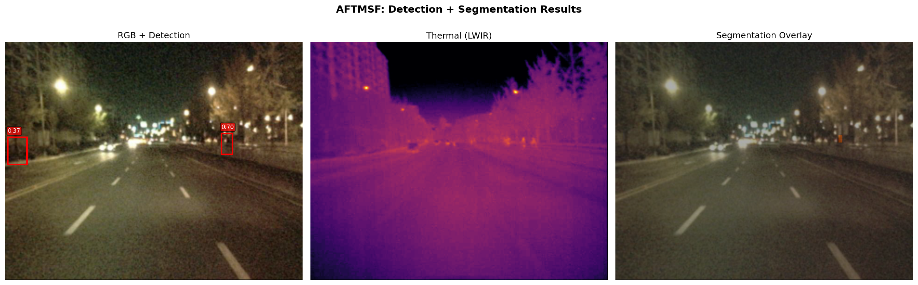
AFTMSF: Detection and Segmentation Results
Night scene (KAIST test): pedestrians are hard to see in RGB, clear in thermal — fusion detects both.
Notes:
A night scene from the KAIST test set. RGB is dark and noisy; the thermal image shows the pedestrians clearly; the model detects both.

Slide 19
Datasets Used
KAIST Multispectral
KITTI Vision Benchmark
FLIR ADAS v1.3
SENSORS
RGB + thermal
SAMPLES
1,374 image pairs (subset)
SPLIT
1,107 / 136 / 131 train / val / test
TASK
Pedestrian detection + segmentation
RESULT
89.14% mAP, 44.28% mIoU
SENSORS
RGB + LiDAR depth
SAMPLES
7,481 training samples
SPLIT
90% train / 10% val (748)
TASK
Pedestrian + vehicle detection
RESULT
21.53% mAP, 22.55% mIoU
SENSORS
RGB + thermal
SAMPLES
9,620 image pairs
SPLIT
8,363 train / 1,257 val
TASK
Person, bicycle, car
RESULT
1.52% mAP† , 16.34% mIoU
† FLIR objects average about 6 × 15 pixels at 320 × 256 — too small for the stride-4 features. All datasets are public for research.

Slide 20
Hardware and Software Requirements
Hardware
Software
Component | Minimum | Used
GPU | NVIDIA, 6 GB | RTX 4050 Laptop, 6 GB
CPU | Intel i5 / Ryzen 5 | Intel Core i7, 13th gen
RAM | 8 GB | 16 GB DDR5
Storage | 200 GB free | 256 GB SSD + 256 GB HDD
OS | Windows 10 / Ubuntu | Windows 11
NVIDIA driver | CUDA 12.x support | 610.62
Library | Version
Python | 3.10.22
PyTorch | 2.6.0 + cu124
torchvision | 0.21.0 + cu124
CUDA runtime | 12.4
OpenCV | 4.11.0
NumPy | 2.2.6
Albumentations | 2.0.7
TensorBoard | 2.19.0
conda (Miniconda) | 26.7.1
Git / GitHub | code published
Notes:
Versions are from the environment rebuilt in October 2026.

Slide 21
Training Configuration
Stage 1: Encoders frozen
Stage 2: Last block unfrozen
Stage 3: Full fine-tune
Epochs (run)
10
Epochs (run)
4 of 10
Epochs (run)
36 (6 + 30)
Learning rate
1 × 10⁻³
Learning rate
5 × 10⁻⁴
Learning rate
1 × 10⁻⁴
Batch size
2
Batch size
1
Batch size
1
Encoders
Frozen
Encoders
layer4, 0.1× LR
Encoders
All, 0.1× LR
Common to all stages
Optimiser
AdamW, weight decay 10⁻⁴
Schedule
Cosine annealing
Precision
FP16 mixed precision
Gradient clipping
ℓ₂ norm 10
Fault injection
p = 0.15 per sample
Loss
L_det + L_seg + 0.1 · L_rel
Notes:
Stage 2 stopped after 4 of 10 planned epochs; Stage 3 was resumed once (6 + 30 epochs). Total 50 epochs.

Slide 22
Project Directory and Implementation
aftmsf/
├── configs/ kaist / kitti / flir .yaml
├── data/ datasets (not in repo)
├── src/
│ ├── datasets/ kaist / kitti / flir loaders
│ ├── models/ encoders, fault_detector, acaf,
│ │ heads, aftmsf_model, baselines
│ ├── losses/ multitask, reliability
│ ├── experiments/ fault, baseline, ablation
│ ├── train*.py, evaluate*.py
│ └── benchmark.py, visualize*.py
├── experiments/ models, logs, results, figures
├── paper/ report + presentation
└── README.md, RUN_COMMANDS.md
Module | Parameters
RGB encoder | 26,854,464
Thermal encoder | 26,848,192
Fault detector | 197,002
ACAF module | 8,143,364
Detection head | 4,736,522
Segmentation head | 570,498
Total (KAIST) | 67,350,042
Total (KITTI, with depth) | 43,835,518
25+ Python modules
Notes:
Code is public at github.com/Parbinder29/ATMSF.

Slide 23
Loss Function
L = (L_focal + L_box + L_ctr) + (0.5 · L_CE + 0.5 · L_Dice) + 0.1 · L_rel
Detection loss
weight 1.0
Focal loss — handles the many background locations
Box regression — predicts box sides from each location
Centerness — down-weights off-centre predictions
Segmentation loss
weight 1.0
Cross-entropy — per-pixel classification
Dice — overlap loss, robust to class imbalance
Reliability loss
weight 0.1
Mean squared error between each confidence cᵢ and its fault label (0.9 healthy, 0.1 faulty) from the synthetic fault injector
Detection loss dominates the total; only the total loss was logged per epoch.

Slide 24
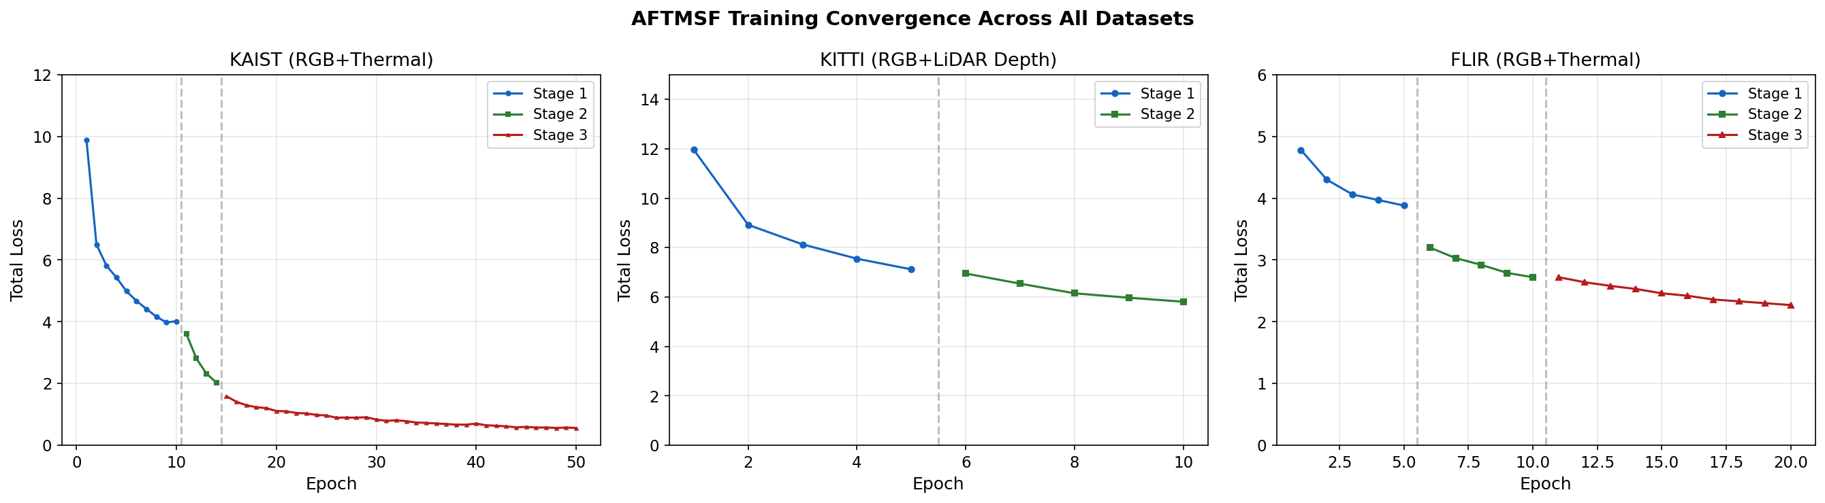
Training Loss Convergence
Dataset | Stage | Epochs | Start | Final | Dataset | Stage | Epochs | Start | Final
KAIST | 1 | 10 | 9.88 | 4.02 | KITTI | 2 | 5 | 6.95 | 5.81
KAIST | 2 | 4 | 3.60 | 2.03 | FLIR | 1 | 5 | 4.78 | 3.90
KAIST | 3 | 36 | 1.59 | 0.559 | FLIR | 2 | 5 | 3.22 | 2.76
KITTI | 1 | 5 | 11.96 | 7.12 | FLIR | 3 | 10 | 2.72 | 2.28
KAIST total loss fell 94.3% (9.88 → 0.559) over 50 epochs.
Notes:
KAIST curves come straight from the TensorBoard logs.

Slide 25
Comparison with Baselines
89.14%
AFTMSF mAP@0.5
+11.25 pp
vs Late Fusion (best baseline)
+19.17 pp
vs RGB Only — the value of thermal
Baselines were trained for 5 epochs without fault injection, so part of the gap comes from training budget.
Notes:
Baselines use the same ResNet-50 + FPN parts. Caveat: they were trained 5 epochs without fault injection; AFTMSF 50 epochs with it.

Slide 26
Robustness: AFTMSF vs Baselines Under Faults
0%
all 3 baselines under RGB dropout
63.85%
AFTMSF under RGB dropout
RGB Only under RGB faults: dropout 0.00, blur 0.00, occlusion 59.86, noise 68.34
AFTMSF is best under all 8 faults.
Notes:
Every method sees exactly the same seeded faults on all 131 test images. RGB Only has no thermal input, so it is shown only for RGB faults.

Slide 27
Fault Injection Results
Sensor | Fault | mAP@0.5 | Δ (pp) | mIoU | Comment
— | None (clean) | 89.14% | — | 44.28% | All sensors healthy
RGB | Dropout | 63.85% | -25.28 | 34.42% | Worst case; thermal keeps the system working
RGB | Blur | 69.83% | -19.30 | 37.64% | Large drop; RGB confidence falls to 0.36
RGB | Occlusion | 78.77% | -10.36 | 44.91% | Moderate; segmentation unaffected
RGB | Gaussian noise | 80.82% | -8.31 | 42.00% | Moderate drop
Thermal | Dropout | 78.20% | -10.93 | 39.87% | RGB compensates
Thermal | Blur | 79.41% | -9.73 | 38.86% | Moderate drop
Thermal | Occlusion | 81.03% | -8.11 | 44.87% | Smallest drop
Thermal | Gaussian noise | 80.61% | -8.52 | 40.47% | Moderate drop
Above 63.85% mAP under every fault — graceful degradation confirmed.
Notes:
Seed 0 makes the Gaussian-noise rows reproducible. Thermal noise is 80.61%, not the 88.00% in the earlier draft.

Slide 28
Ablation Study: Does the Fault Detector Help?
Configuration (clean data) | mAP@0.5 | mIoU
AFTMSF full | 89.14% | 44.28%
Without entropy signal | 89.31% | 45.10%
Without fault detector (equal weights) | 89.20% | 45.55%
Fault | With FD | Without | Δ
RGB dropout | 63.85 | 64.68 | -0.82
RGB blur | 69.83 | 69.92 | -0.09
RGB occlusion | 78.77 | 79.54 | -0.77
RGB noise | 80.82 | 80.93 | -0.11
Thermal dropout | 78.20 | 77.48 | +0.72
Thermal blur | 79.41 | 78.68 | +0.72
Thermal occlusion | 81.03 | 80.93 | +0.10
Thermal noise | 80.61 | 80.35 | +0.26
What this shows
Removing the fault detector changes mAP by less than 1 pp — on clean data and under every fault.
The robustness comes from cross-modal attention plus fault-injection training. Stronger reliability supervision is the next step.
mAP@0.5 (%) under each fault, with and without the fault detector (FD)
Notes:
Inference-time ablation of the trained model (no retraining). The honest finding: robustness comes from the attention fusion and fault-injection training, not from the confidence gating.

Slide 29
Confidence Score Analysis
RGB dropout: 0.717 → 0.389
RGB weight falls 0.59 → 0.49; thermal takes over.
Thermal dropout: 0.429 → 0.603
Thermal confidence rises instead of falling — not yet detected.
Threshold 0.15: none below
Lowest confidence is 0.359 (RGB blur); no sensor is formally flagged.
Smooth re-weighting
w = softmax(c / τ), learned τ = 0.761 — no hard switching.
Notes:
Measured mean confidence on the KAIST test set. The detector reacts correctly to RGB faults but raises thermal confidence under thermal faults — a limitation we report.

Slide 30
Cross-Dataset Generalisation
KAIST (RGB + thermal)
89.14% mAP · 44.28% mIoU · 22.2 FPS
Main benchmark.
KITTI (RGB + LiDAR depth)
21.53% mAP · 22.55% mIoU · 26.0 FPS
Same architecture, depth encoder swapped in.
FLIR (RGB + thermal)
1.52% mAP · 16.34% mIoU · 23.3 FPS
Objects ≈ 6 × 15 px: too small to detect.
Notes:
KITTI uses the Stage 2 model; a 3-epoch Stage 3 run was worse and is not used.

Slide 31
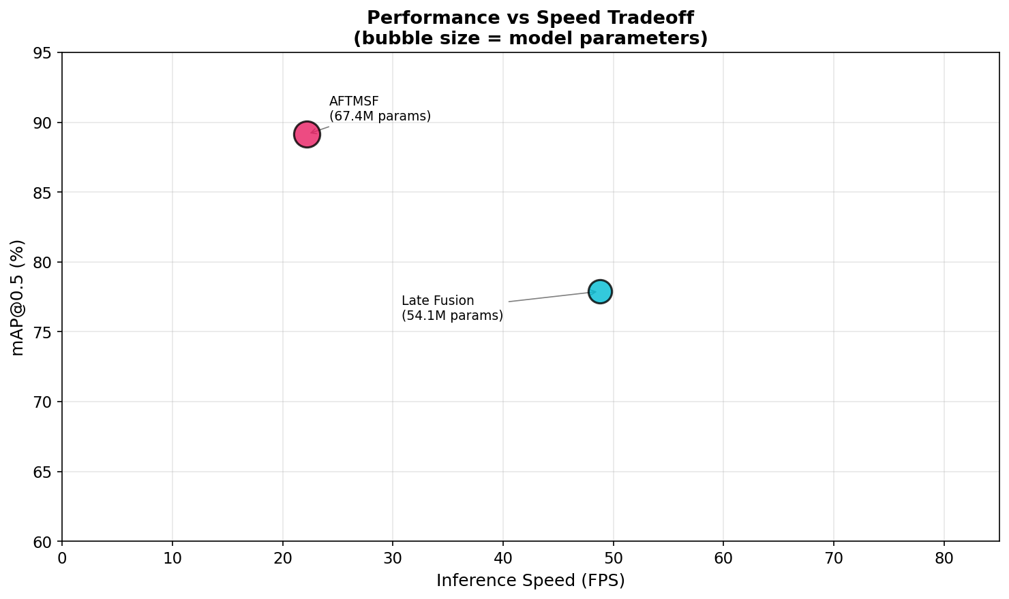
Performance vs Speed Trade-off
Method | mAP@0.5 | FPS | Parameters | Survives RGB failure
RGB Only | 69.97% | 92.7 | 27.3M | No (0%)
Early Fusion | 70.66% | 89.6 | 27.3M | No (0%)
Late Fusion | 77.89% | 48.8 | 54.1M | No (0%)
AFTMSF (ours) | 89.14% | 22.2 | 67.4M | Yes (63.85%)
Trade-off
AFTMSF is the most accurate and the only one that survives sensor failure, but slower: 22.2 FPS meets the 10 FPS target, not the ~30 FPS of high-speed driving. INT8 + TensorRT is the planned fix.
Notes:
FPS: model forward pass, 256 × 320, batch 1, FP32, RTX 4050 on mains power, median of 5 runs (src/benchmark.py).

Slide 32
Limitations of the System
1
Confidence gating has little effect
Removing it changes mAP by < 1 pp; thermal faults raise thermal confidence instead of lowering it.
Impact: High
2
Unequal baseline training
Baselines: 5 epochs, no fault injection. AFTMSF: 50 epochs with it.
Impact: Medium
3
KAIST subset, reduced resolution
1,374 images at 256 × 320 — not comparable with full-benchmark published results.
Impact: Medium
4
FLIR small objects
1.52% mAP: objects ≈ 6 × 15 px, below stride-4 feature resolution.
Impact: Medium
5
Speed and training budget
22.2 FPS (< 30 FPS target); KITTI trained for 2 stages only; single 6 GB GPU.
Impact: Low

Slide 33
Future Work and Enhancements
1
Stronger reliability supervision
Larger L_rel weight, thermal-specific faults in training, calibrated threshold so faults are actually flagged.
2
Fair baselines, full ablations
Train baselines with the same schedule and fault injection; retrain without each component.
Short-term
Short-term
3
Small-object detection
Stride-2 feature level and thermal super-resolution for FLIR-scale objects.
4
Edge deployment
INT8 quantisation + TensorRT for > 30 FPS on embedded GPUs (e.g. Jetson).
Medium-term
Medium-term
5
More sensors and data
4D radar; full KAIST benchmark at native 512 × 640 resolution.
6
Publication
Journal paper with the corrected results, extended ablations and video evaluation.
Long-term
After fixes

Slide 34
Conclusion
89.14% mAP@0.5 and 44.28% mIoU on KAIST — 11.25 pp above the best baseline
63.85% mAP when the RGB camera fails completely; conventional fusion baselines drop to 0%
Best of all methods under all 8 fault conditions; same architecture works for RGB + LiDAR depth (KITTI)
Ablation shows the robustness comes from attention fusion + fault-injection training; the confidence gating is the next thing to improve
Runs at 22.2–26.0 FPS on a 6 GB laptop GPU; all 4 objectives met; code public on GitHub
89.14%
44.28%
63.85%
8 / 8
22.2 FPS
mAP@0.5 KAIST
mIoU KAIST
mAP with RGB failed (baselines 0%)
fault conditions where AFTMSF is best
on RTX 4050 laptop GPU
Code, results and report: github.com/Parbinder29/ATMSF
Notes:
Close with the honest summary: accurate and robust, and we know which part still needs work.

Slide 35
References
[1] H. Zhang, F. Li, S. Zhao, H. Ling, "Multisensor data fusion for autonomous driving: A survey," IEEE T-ITS, vol. 22, no. 7, 2020.
[2] S. Li, L. Liu, X. Lin, B. Meng, "Deep learning for multimodal data fusion: A review," Inf. Fusion, vol. 76, 2021.
[3] S. Hwang et al., "Multispectral pedestrian detection: Benchmark dataset and baseline," CVPR, 2015.
[4] FLIR Systems, "FLIR thermal dataset (ADAS v1.3)," 2018. flir.com/oem/adas/adas-dataset-form
[5] A. Geiger, P. Lenz, C. Stiller, R. Urtasun, "Vision meets robotics: The KITTI dataset," IJRR, vol. 32, no. 11, 2013.
[6] A. Vaswani et al., "Attention is all you need," NeurIPS, 2017.
[7] M. Bijelic et al., "Seeing through fog without seeing fog," CVPR, 2020.
[8] Y. Feng, H. Wang, J. Luo, "Deep multi-modal sensor fusion for autonomous driving: A review," IEEE Access, vol. 8, 2020.
[9] Z. Liu et al., "Swin transformer," ICCV, 2021.
[10] K. Chitta et al., "TransFuser: Imitation with transformer-based sensor fusion for autonomous driving," IEEE TPAMI, vol. 45, no. 11, 2023.

Slide 36
References (continued)
[11] T. Liang et al., "BEVFusion: A simple and robust LiDAR-camera fusion framework," NeurIPS, 2022.
[12] T. Wang et al., "Deep learning-based fault detection for sensor systems: A survey," IEEE Sensors J., vol. 22, no. 5, 2022.
[13] K. He, X. Zhang, S. Ren, J. Sun, "Deep residual learning for image recognition," CVPR, 2016.
[14] T.-Y. Lin et al., "Feature pyramid networks for object detection," CVPR, 2017.
[15] Z. Tian, C. Shen, H. Chen, T. He, "FCOS: Fully convolutional one-stage object detection," ICCV, 2019.
[16] L.-C. Chen et al., "Encoder-decoder with atrous separable convolution for semantic image segmentation," ECCV, 2018.
[17] A. Kendall, Y. Gal, "What uncertainties do we need in Bayesian deep learning for computer vision?" NeurIPS, 2017.
[18] I. Loshchilov, F. Hutter, "Decoupled weight decay regularization," ICLR, 2019.
[19] C. Li, D. Song, R. Tong, M. Tang, "Illumination-aware faster R-CNN for robust multispectral pedestrian detection," Pattern Recognit., vol. 85, 2019.
[20] F. Qingyun, H. Dapeng, W. Zhaokui, "Cross-modality fusion transformer for multispectral object detection," arXiv:2111.00273, 2021.

Slide 37
Thank You
Questions?
Sundram Kumar Ray · Arshiya · Parbinder Singh · Anupriya | Group 23G15
Supervisor: Prof. Dinesh Kumar | Dept. of CSE, Central University of Jammu
github.com/Parbinder29/ATMSF

