Slide 1



Garbage Classification System

Slide 2

Learning Objectives
Understand Waste Classification – Learn types of garbage and the importance of automated sorting.
Image Data Handling – Collect, label, and preprocess garbage images for deep learning.
CNN Fundamentals – Understand CNN architecture for image-based classification tasks.
Model Training – Train and validate a CNN model to classify waste accurately.
Performance Evaluation – Use metrics like accuracy and confusion matrix to assess model performance.
Model Optimization – Apply techniques like data augmentation and dropout to improve results.
Deployment Basics – Implement the model for real-time or application-based predictions.
Sustainability Link – Understand how AI can aid smart, eco-friendly waste management systems.
GOAL
Source :
www.freepik.com/

Slide 3
Tools and Technology used
Programming Language :
Python – Primary language for deep learning and image processing.
Deep Learning Frameworks :
TensorFlow / Keras – For building and training CNN models.
EfficientNetV2B2 – it is a convolutional neural network (CNN) architecture.
Libraries :
NumPy – Numerical computations.
Matplotlib – Visualization of results.
PIL – Image preprocessing and handling.
Development Environment :
Jupyter Notebook / Google Colab – For model development and testing.
Dataset :
Garbage classification dataset available at Kaggle.com.
Model Deployment :
Gardio as front-end interface.

Slide 4
Methodology
Data Preparation
Collect and preprocess garbage images (Garbage Selection Dataset from Kaggle.com).
Model Selection
Load a pretrained CNN (EfficientNetV2B2).
Transfer Learning
Freeze pretrained layers .
Add custom classification layers.
Training
Train the model on the garbage dataset.
Fine-tune if needed for better performance.
Evaluation
Assess model using accuracy, precision, recall, and confusion matrix.
Deployment
Integrate with Gardio interface for real-time image classification.

Slide 5
Problem Statement:
This project aims to develop an automated garbage classification system using the EfficientNetV2B2 architecture and transfer learning. The goal is to accurately classify waste into categories to support efficient and scalable waste segregation. By utilizing a labeled dataset and deep learning, the system helps streamline recycling, reduce manual effort, and promote environmental sustainability.
Garbage classification is challenging due to varied waste types and inconsistencies in disposal. This project tackles these issues using a model that offers both high accuracy and efficiency, with potential deployment in smart bins, recycling units, or municipal systems, aiding cleaner, smarter waste management.

Slide 6
Solution:
Benefits:
Reduces training time — no need to train from scratch.
Leverages learned features from large-scale datasets.
Improves performance, particularly with limited new data.
How Does It Work?
Load a pretrained model (e.g., ResNet, EfficientNet).
Optionally freeze the pretrained layers to retain learned features.
Add new layers tailored for garbage classification.
Train the model on the new dataset, with optional fine-tuning of pretrained layers.
In this project, we aim to develop a sophisticated garbage classification system leveraging the EfficientNetV2B2 architecture. Using a primary labeled dataset of waste images, we build models that automate waste segregation—a crucial step in optimizing recycling and waste management, ultimately aiding environmental conservation.
The goal is to develop an accurate and efficient garbage classification model by applying transfer learning, a technique where a pretrained model developed for one task is reused as the starting point for a related task. Transfer learning allows us to build high-performing models faster by adapting features learned from large datasets (e.g., ImageNet) to the garbage classification task. This approach is especially beneficial when the new dataset is limited, as it improves model accuracy and efficiency by leveraging previously learned patterns.

Slide 7
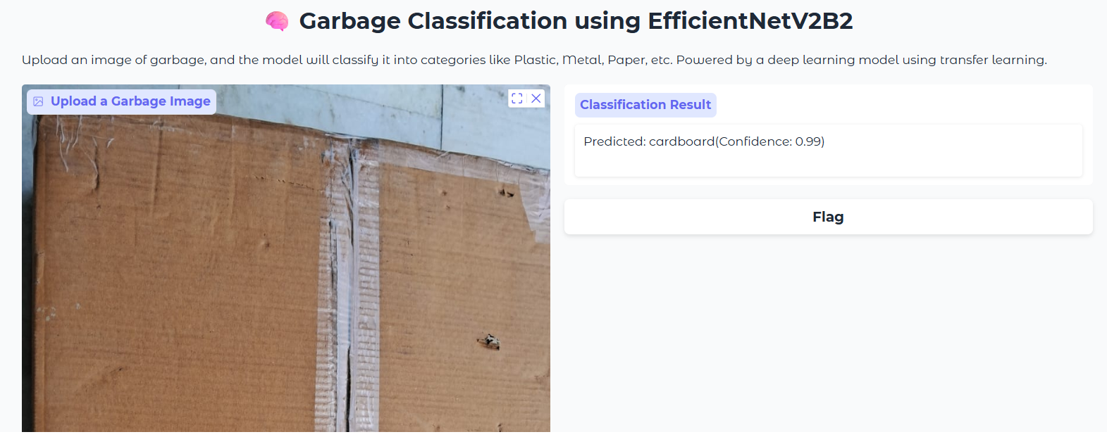
Screenshot of Output:

Slide 8
Conclusion:
In this project, we successfully developed a sophisticated garbage classification system by leveraging the EfficientNetV2B2 architecture combined with transfer learning techniques. Utilizing a well-curated dataset, the model effectively automates waste segregation by accurately categorizing various types of garbage. This automation is a crucial step toward optimizing recycling and waste management, reducing manual sorting efforts, and minimizing environmental impact.
By employing transfer learning, the project benefited from pretrained knowledge on large datasets, enabling faster training and improved performance even with limited data. The resulting model demonstrates strong potential for real-world deployment in smart waste management solutions, contributing to more efficient resource utilization and advancing environmental conservation goals. Overall, this system represents a meaningful advancement in integrating AI for sustainable waste handling.

