Slide 1
Operating System
Monika Dhiman
Assistant Professor, PIET

Slide 2
Unit-1
Introduction to operating system:
Definition,
Functions & characteristics,
Operating system services,
Operating system architecture,
Types of operating system: Batch, Multiprogramming,
Multiprocessing,
Time sharing,
Real time,
Distributed,
System programs and System calls.
Process: Definition, Process states,
Process control block,
Operations on processes,
Inter process communication,
Threading and Multithreading.

Slide 3
Introduction to Operating System
3
An operating system acts as an intermediary between the computer hardware and the user. In short, it is an interface between computer hardware and the user.
The purpose of an operating system is to provide an environment in which a user can execute programs conveniently and efficiently.
The operating system (OS) is a program that runs at all times on a computer. All other programs, including application programs, run on top of the operating system.
It assigns resources such as memory, processors, and input/output devices to processes that need them. The assignment of resources has to be fair and secure.
An operating system is always running in the background to manage and coordinate the use of hardware resources among system and application programs for multiple users.
The OS itself is not only a user interface. Instead, it provides an interface for user interaction, typically through:

Slide 4
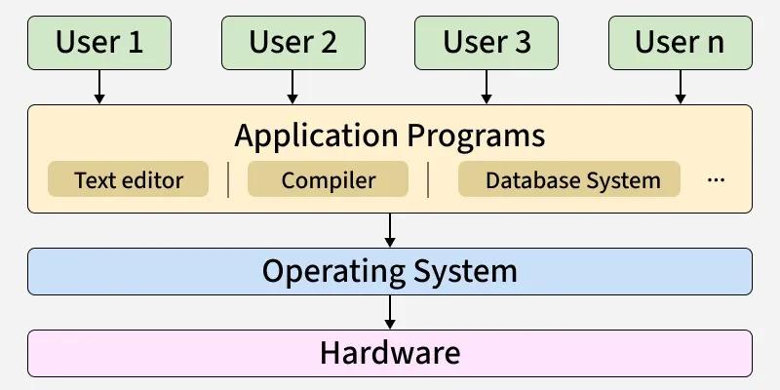
4
Every general-purpose computer consists of hardware, an operating system, system programs and application programs.
The hardware includes CPU, ALU, memory, I/O devices, peripheral devices and storage devices.
The system programs include compilers, loaders, editors and the OS itself.
The application programs are user-level software that perform specific tasks.

Slide 5
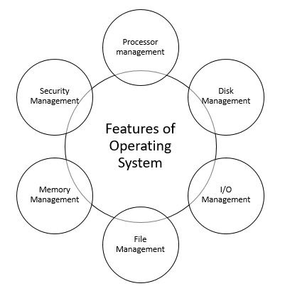

Slide 6
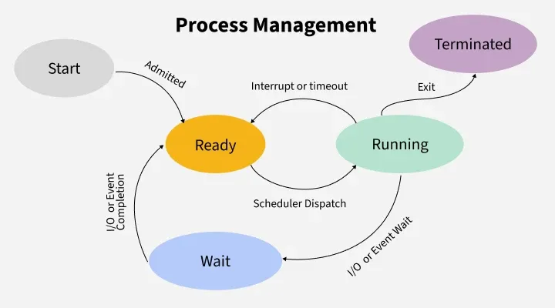
1. Process Management: Process management in operating system is about managing processes. A Process is a running program. The life cycle of process is from the moment program start until it finishes.
Scheduling: Decides which process uses the CPU next (using algorithms like Round Robin or Priority Scheduling).
Synchronization: Ensures orderly execution using locks, semaphores, or monitors to prevent race conditions.
Deadlock Handling: Detects and prevents situations where processes wait forever for resources.
Inter-Process Communication (IPC): Allows processes to exchange data via shared memory or message passing.

Slide 7
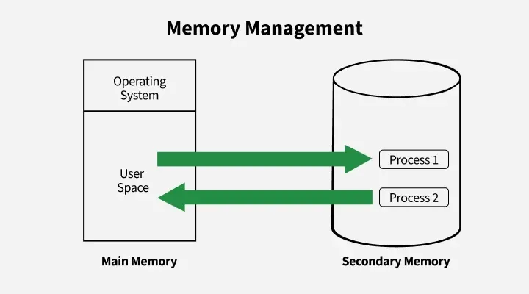
2. Memory Management: Memory management in an operating system controls how data is stored and organized in main (primary) memory and secondary storage, ensuring programs get the memory they need and freeing it when no longer used.
Key Activities in Memory Management:
Allocation & Deallocation: Assigns and frees memory as needed.
Protection: Prevents processes from interfering with each other’s memory..
Virtual Memory: Uses disk space as extra memory to run large programs.
Fragmentation Handling: Reduces wasted space through compaction.
Disk Management: Handles file storage, free space, disk scheduling, and backups.

Slide 8
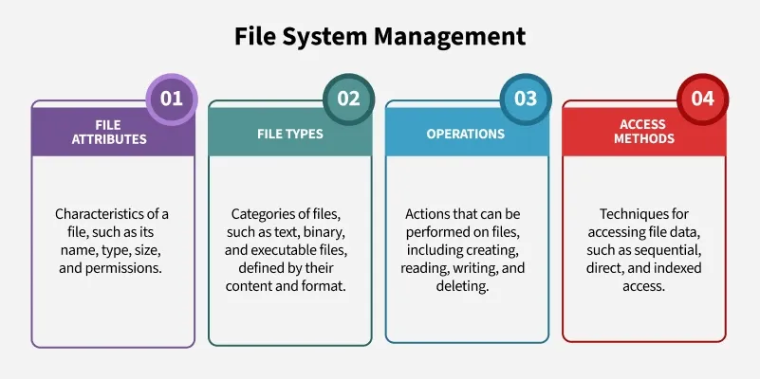
3. File System Management
File management in an operating system organizes and controls how data is stored, named, and accessed on storage devices, making it easy for users to find and use their files.
File System Management includes managing of:
File Attributes: Name, type, size, and permissions.
File Types: Text, binary, and executable files.
Operations: Create, read, write, and delete files.
Access Methods: Sequential, direct, and indexed access for faster retrieval.

Slide 9
4. Device Management (I/O System)
Device management in an operating system controls how the computer communicates with hardware devices like printers or disks, using drivers and techniques to ensure smooth and efficient operation.
Major components in Device Management:
Device Drivers: Interface between hardware and OS.
Buffering & Caching: Temporarily store data to match device speeds and improve performance.
Spooling: Spooling manages data waiting to be processed, particularly in devices like printers. The OS places print jobs in a spool (a temporary storage area), allowing the CPU to continue other tasks while the printer works through the queue.

Slide 10
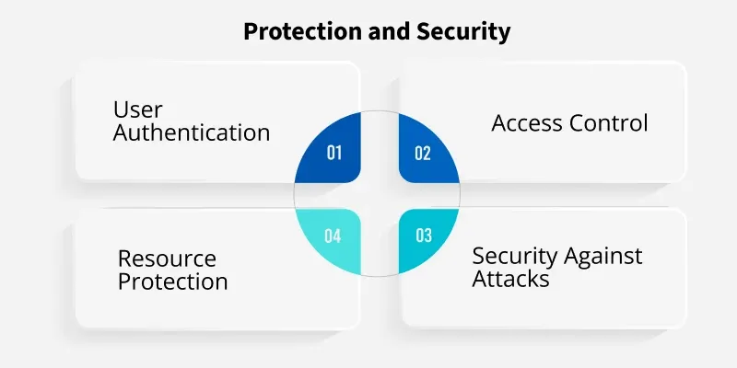
5. Protection and Security: Protection and security mechanisms in an OS are designed to safeguard system resources from unauthorized access or misuse. These mechanisms control which processes or users can access specific resources (such as memory, files, and CPU time). It also ensures that only authorized users can perform specific actions.
The OS protects system resources and user data from unauthorized access and attacks.
Access Control: Limits user and process permissions.
Authentication: Verifies users through credentials (UIDs/SIDs).
Resource Protection: Prevents misuse of files, memory, or devices.
Security: Guards against malware, denial-of-service attacks, and data theft.

Slide 11
Characteristics of Operating System
Multitasking: An OS allows multiple tasks to run simultaneously, enabling users to work on different applications simultaneously. It manages task switching by allocating CPU time to various processes.
Multiprogramming: Multiprogramming measures the OS’s capability to support several programs in memory simultaneously. It keeps the CPU busy and doing something rather than waiting for the next action.
Concurrency: Thus, the operating system enables several processes to run concurrently, allowing some tasks to be conducted simultaneously without causing one process to interfere with another.
Memory Management: It controls the system’s memory, assigns memory space to purposes, efficiently frees it when there is no need, and ensures each application is given adequate memory to function well.
Device Management: The OS manages device communication through device drivers, allowing software to interact with hardware components like printers, hard drives and keyboards.

Slide 12
Characteristics of Operating System
Portability: Many OSs are designed to run on different hardware platforms with minimal modifications, making them portable across various systems.
Real-Time Processing: Operating systems are designed for real-time applications, where processes must be completed within a specific time frame. They are commonly used in embedded systems and industrial applications.
Virtualization Support: The modern Operating system supports virtualization, allowing multiple operating systems to run concurrently on the same hardware, improving resource utilization and flexibility.
Work Management: One of the important characteristics of the operating system is task management. It is also considered an important OS function as it controls all the activities related to handling tasks systematically.
Networking and Coordination: Enables communication between computers over a network and coordinates between software and hardware component.

Slide 13
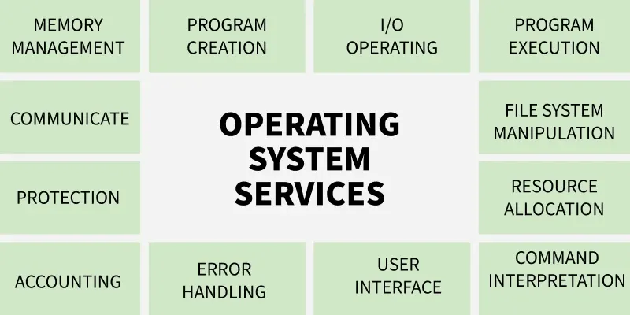

Slide 14
14
1. Program Execution
The Operating System manages program execution by loading programs into memory and scheduling them using algorithms like FCFS, SJF.
Loads programs into memory for execution.
Uses CPU scheduling algorithms (FCFS, SJF, etc.) to decide execution order.
2. Input Output Operations
The Operating System manages all input-output operations and enables communication between users, programs, and device drivers. Manages all input-output operations.
Communicates with hardware through device drivers.
Ensures proper coordination between devices and the system.
3. Communication Between Processes
The Operating System manages communication between processes and enables smooth data transfer among them. It handles both local communication on the same computer and communication across networked systems.
Manages inter-process communication (IPC).
Enables data transfer between processes.

Slide 15
4. File Management
The Operating System manages all file operations by granting programs the required access permissions such as read-only or read-write. It allows users to create, delete, store, and organize files across devices like, floppy disk or pen drives.
Grant's programs file access with permissions like read-only or read-write.
Allows users to create, delete, and organize files.
Manages file storage across devices such as hard disks and pen drives.
5. Memory Management
The OS manages memory like a cricket team manager choosing players. Just as the manager decides whether a player enters the playing 11 or 15 based on performance, the OS checks whether a new program meets the requirements for memory.
It decides how much memory the program needs.
Loads the program into a suitable memory location.
Prevents programs from using unnecessary or extra memory.
6. Process Management
Process management can be understood by imagining the kitchen stove as the CPU and the chef as the Operating System. The chef must cook multiple dishes (programs) and ensures no single dish takes too much time so that every dish gets a fair chance to be cooked. In this way, the OS schedules and manages all programs efficiently to keep the system running smoothly.
CPU is like the kitchen stove where execution happens.
OS (chef) ensures each program gets fair execution time.
Prevents any program from occupying the CPU for too long.
15

Slide 16
16
7. Security and Privacy
Security
The Operating System keeps the computer safe from unauthorized users by adding protective security layers. It defends the system from threats like viruses and hackers through tools such as firewalls and antivirus software. These measures ensure the safety of the computer and its data.
Blocks unauthorized access to the system.
Protects against viruses and malware.
Uses firewalls and antivirus tools for defense.
Privacy
The Operating System helps keep personal information private, similar to locking a door that only you can open. It ensures that sensitive files and data remain hidden from others. In this way, the OS respects user confidentiality and protects important information.
Keeps personal data hidden from others.
Provides access control options like passwords.
Ensures only authorized users can view files.
Protects sensitive information from misuse.

Slide 17
17
8. Resource Management
The Operating System manages how system resources are shared among different processes. It allocates CPU time using CPU Scheduling Algorithms, handles memory management, and controls input-output devices. By deciding which process gets which resource, the OS ensures proper and efficient use of all available resources.
Shares system resources among multiple processes.
Allocates CPU time using scheduling algorithms.
Manages memory and input-output devices.
Ensures efficient and proper use of all resources.
9. User Interface
The Operating System provides a user interface that allows users to interact with the system either through a command-line interface(CLI) or a Graphical User Interface (GUI). In a CLI, the command interpreter executes user-typed commands. A GUI offers a mouse-based window and menu system that makes interaction easier and more visual.
Provides both CLI and GUI for user interaction.
CLI uses a command interpreter to run user commands.
GUI offers windows, icons, and menus for easy use.
Helps users communicate smoothly with the operating system.

Slide 18
18
10. Error Handling
The Operating System detects and handles errors occurring in the CPU, memory, or input-output devices to keep the system stable. It prevents frequent errors, avoids deadlocks, and fixes issues that appear during program execution. A secure OS also acts as a protective layer against external threats or breaches.
Detects and handles CPU, memory, and I/O errors.
Prevents frequent errors and avoids deadlocks.
Fixes issues that occur during task execution.
Provides security measures against external threats and breaches.
11. Time Management
Imagine a traffic light as the Operating System, guiding cars (programs) on when to stop, wait, or move. Red represents the simple queue, yellow is the ready queue, and green means the program is under execution. By switching lights at proper intervals, the OS ensures all programs move smoothly without traffic or delays.
Red light = programs waiting in the simple queue.
Yellow light = programs in the ready queue.
Green light = programs under execution.
OS changes states at proper intervals to ensure smooth program flow.

Slide 19
Operating system Architecture’s
19

Slide 20
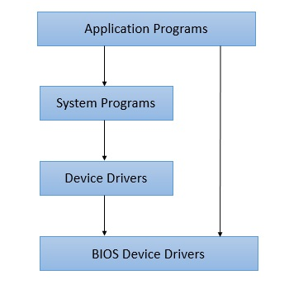
1. Simple Architecture
20
There are many operating systems that have a rather simple structure. These started as small systems and rapidly expanded much further than their scope. A common example of this is MS-DOS. It was designed simply for a niche amount for people. There was no indication that it would become so popular.
Few operating systems have a simple yet powerful architecture, for example, MS-DOS. That would lead to greater control over the computer system and its various applications. The simple architecture allows the programmers to hide information as required and implement internal routines as they see fit without changing the outer specifications.

Slide 21
21
Advantages
Following are advantages of a simple operating system architecture.
Easy Development - In simple operation system, being very few interfaces, development is easy especially when only limited functionalities are to be delivered.
Better Performance - Such a sytem, as have few layers and directly interects with hardware, can provide a better performance as compared to other types of operating systems.
Disadvantages
Following are disadvantages of a simple operating system architecture.
Frequent System Failures - Being poorly designed, such a system is not robust. If one program fails, entires operating system crashses. Thus system failures are quiet frequent in simple operating systems.
Poor Maintainability - As all layers of operating systems are tightly coupled, change in one layer can impact other layers heavily and making code unmanageable over a period of time.

Slide 22
2. Monolithic Architecture in OS
22
The monolithic operating system is a very simple operating system where the kernel directly controls device management, memory management, file management, and process management. This means that all code runs in kernel space, with no separation between kernel and user-level processes.
All of the system's resources are accessible to the kernel. Every part of the operating system is contained within the kernel in monolithic systems. Monolithic architecture-based operating systems were initially introduced in the 1970s.
The main advantage of a monolithic architecture is that it can provide high performance since system calls can be made directly to the kernel without the overhead of message passing between user-level processes.
However, there are also some disadvantages to a monolithic architecture. One major disadvantage is that it can lead to a less secure and less stable operating system. Since all code runs in kernel space, any vulnerabilities or bugs in the kernel can potentially affect the entire system.

Slide 23
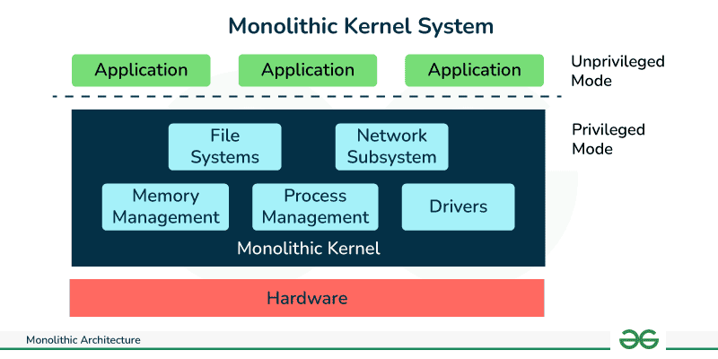
23

Slide 24
Characteristics of Monolithic Architecture
24
Single Executable: The entire application is packaged and deployed as a single executable file. All components and modules are bundled together.
Tight Coupling: The components and modules within the application are highly interconnected and dependent on each other. Changes made to one component may require modifications in other parts of the application.
Shared Memory: All components within the application share the same memory space. They can directly access and modify shared data structures.
Monolithic Deployment: The entire application is deployed as a single unit. Updates or changes to the application require redeploying the entire monolith.
Centralized Control Flow: The control flow within the application is typically managed by a central module or a main function. The flow of execution moves sequentially from one component to another.

Slide 25
25
Advantages
Following are advantages of a monolith operating system architecture.
Easy Development - As kernel is the only layer to develop with all major functionalities, it is easier to design and develop.
Performance - As Kernel is responsible for memory management, other operations and have direct access to the hardware, it performs better.
Disadvantages
Following are disadvantages of a monolith operating system architecture.
Crash Prone - As Kernel is responsible for all functions, if one function fails entire operating system fails.
Difficult to enhance - It is very difficult to add a new service without impacting other services of a monolith operating system.

Slide 26
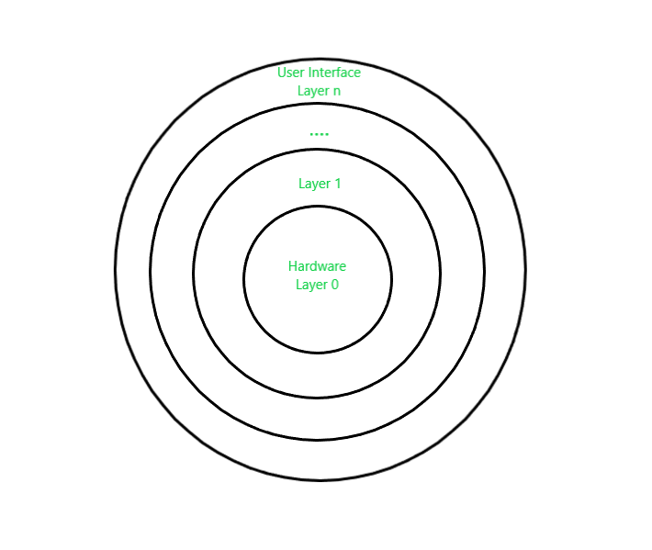
3. Layered Architecture in OS
26
Layered Structure is a type of system structure in which the different services of the operating system are split into various layers, where each layer has a specific well-defined task to perform. It was created to improve the pre-existing structures like the Monolithic structure ( UNIX ).
The whole Operating System is separated into several layers ( from 0 to n ) as the diagram shows. Each of the layers must have its own specific function to perform. There are some rules in the implementation of the layers as follows.
The outermost layer must be the User Interface layer.
The innermost layer must be the Hardware layer.
A particular layer can access all the layers present below it but it cannot access the layers present above it. That is layer n-1 can access all the layers from n-2 to 0 but it cannot access the nth layer.
Thus, if the user layer wants to interact with the hardware layer, the response will be traveled through all the layers from n-1 to 1. Each layer must be designed and implemented such that it will need only the services provided by the layers below it.

Slide 27
27
Advantages :
Modularity : This design promotes modularity as each layer performs only the tasks it is scheduled to perform.
Easy debugging : As the layers are discrete so it is very easy to debug. Suppose an error occurs in the CPU scheduling layer, so the developer can only search that particular layer to debug, unlike the Monolithic system in which all the services are present together.
Easy update : A modification made in a particular layer will not affect the other layers.
No direct access to hardware : The hardware layer is the innermost layer present in the design. So a user can use the services of hardware but cannot directly modify or access it, unlike the Simple system in which the user had direct access to the hardware.
Disadvantages :
Complex and careful implementation : As a layer can access the services of the layers below it, so the arrangement of the layers must be done carefully. Thus with great modularity comes complex implementation.
Slower in execution : If a layer wants to interact with another layer, it sends a request that has to travel through all the layers present in between the two interacting layers. Thus it increases response time, unlike the Monolithic system which is faster than this. Thus an increase in the number of layers may lead to a very inefficient design.

Slide 28
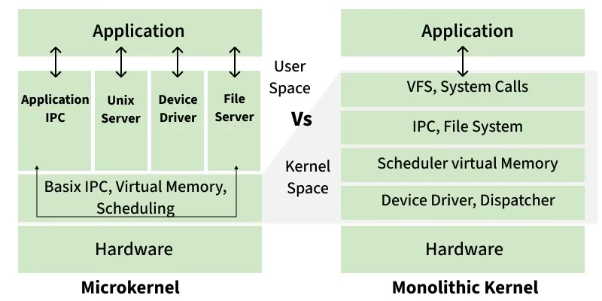
4. Micro-Kernel Architecture in OS
28
Monolithic Kernel, all OS services run in kernel space, enabling high performance but risking stability, whereas a Microkernel runs only essential services in kernel space and others in user space, enhancing modularity and security at the cost of some performance due to inter-process communication overhead.

Slide 29
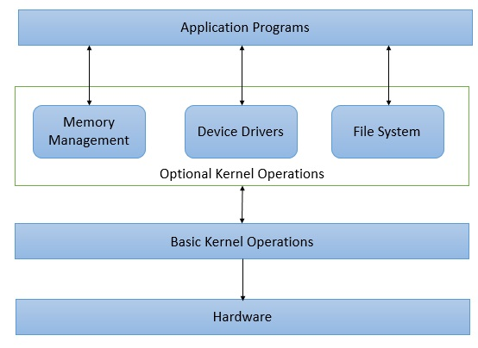
29

Slide 30
30
A microkernel organizes the operating system by keeping only the most essential functions inside the kernel. These include basic process management, communication between system components, and minimal hardware control. All other services are placed outside the kernel in separate user-space programs.
Components such as device drivers, file systems, and network services run as independent processes in user space.
This approach keeps the kernel small, reduces the chance of system-wide failures, and makes the operating system more secure and easier to maintain.
Advantages of Micro-Kernel
Size of Micro-Kernel is smaller, so it is easy to use.
Easy to extend, port Micro-Kernel
Micro-Kernel is less prone to errors and bugs. One such example of this is Mac OS.
Disadvantages of Micro-Kernel
The execution of Micro-Kernel is slower.
Only the most important services are present inside the kernel and rest of the operating systems are present inside system application program.
The communication between client process & services running in user address space is established through message that further reduces the speed of execution.

Slide 31
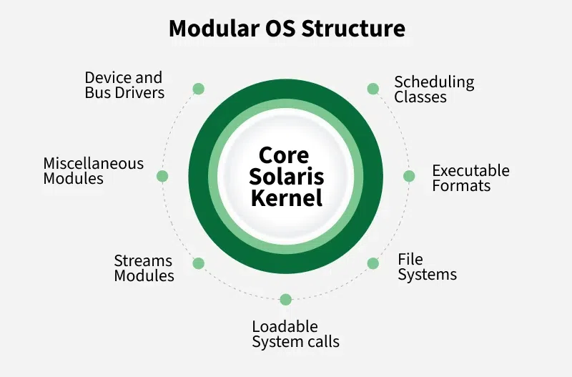
5. Modular Architecture in OS
31
A modular structure uses a kernel that contains only essential core components, while additional services are added as loadable modules during boot or runtime.
It is similar to a layered design because it has defined and protected interfaces, but it is more flexible since modules can communicate freely. This approach is widely used in modern systems such as Solaris.
Kernel contains only core components.
Extra services are added as dynamically loadable modules.
More flexible than layered structure; modules can call any other module.
Used in systems like Solaris.

Slide 32
32
Advantages
Following are advantages of a modular operating system architecture.
High Customizable - Being modular, each module implmentation can be customized easily. A new functionality can be added without impacting other modules as well.
Verifiable - Being modular, each layer can be verified and debugged easily.
Disadvantages
Following are disadvantages of a modular operating system architecture.
Less Performant - A modular architecture operating system is less performant as compared to basic structured operating system.
Complex designing - Each module is to planned carefully as each module communicates with kernal. A communication API is to be devised to facilitate the communication.

