Slide 1
Linux Assignment
Name :- Pardeep Chaurasiya
Employee ID:-1737

Slide 2
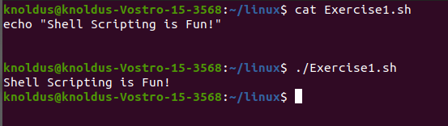
Exercise_1 - Write a shell script that prints “Shell Scripting is Fun!” on the screen

Slide 3
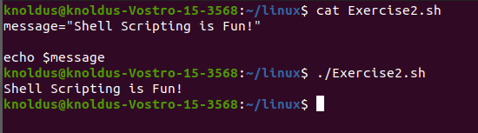
Exercise_2 - Modify the shell script from exercise 1 to include a variable. The variable will hold the contents of the message “Shell Scripting is Fun!”

Slide 4
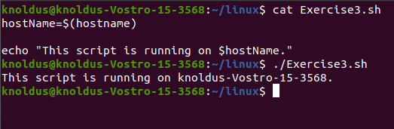
Exercise_3 - Store the output of the command “hostname” in a variable. Display “This script is running on _.” where “_” is the output of the “hostname” command.

Slide 5
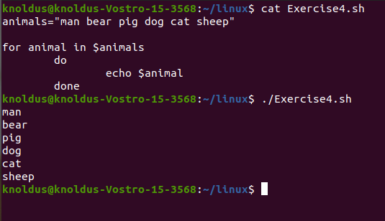
Exercise_4 - Write a shell script that displays “man”,”bear”,”pig”,”dog”,”cat”,and “sheep” on the screen with each appearing on a separate line. Try to do this in as few lines as possible.

Slide 6
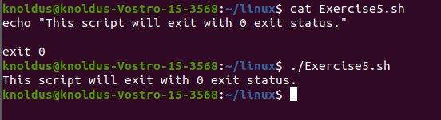
Exercise_5 - Write a shell script that displays, “This script will exit with 0 exit status.” Be sure that the script does indeed exit with a 0 exit status.

Slide 7
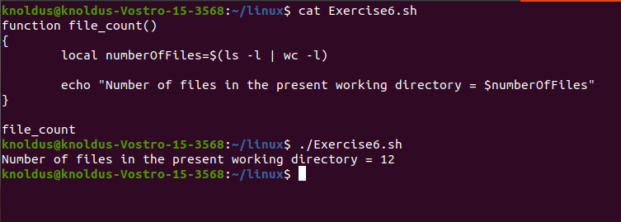
Exercise_6 - Write a shell script that consists of a function that displays the number of files in the present working directory. Name this function “file_count” and call it in your script. If you use variable in your function, remember to make it a local variable.

