Slide 1
ITCS 6155: KNOWLEDGE BASED systems
Group 2
Sourabh Pardeshi • Mihir Vadeyar • Swapnil Bokil • Sahil Deshmukh • Shubham Gandhi

Slide 2
Title : OnPoint Weather Forecast - Machine Learning Pipeline

Slide 3
About the Dataset:
OnPoint Weather is a global weather dataset for business available for any latitutde/longitude point and geographic area such as ZIP codes.
OnPoint Weather provides a continuum of hourly and daily weather from the year 2000 to current time and a forward forecast of 45 days.
Weather has a significant impact on businesses and accounts for hundreds of billions in lost revenue annually.
OnPoint Weather allows businesses to quantify weather impacts and develop strategies to optimize for weather to improve business performance.
The Dataset can be found at https://console.cloud.google.com/marketplace/details/weathersource-com/weather-forecast

Slide 4
Motive:
OnPoint Climatology provides hourly and daily weather statistics which can be used to determine ‘departures from normal’.
To provide climatological guidance of expected weather for any location at any point in time.
The group is trying to learn the underlying cause behind why weather forecasts go wrong and gain a logistical insight about how weather forecasting companies undergo billions of dollars in loss every year.

Slide 5
Target Audience:
Although this project will be primarily focused on analysis/research on the data, it will try to shed some light on the margin of error in weather forecast and the suggested correction measures.
We will use statistics within the dataset to determine the causality in weather forecast errors.
In other words, anyone with an interest in weather forecasts will serve as our target audience.

Slide 6
DOMAIN: Analysis/Forecasting/Optimization
Analysis Tool: BigQuery
Details about BigQuery can be found here –
https://cloud.google.com/bigquery

Slide 7
Data preprocessing:
We are using Weather Source's OnPoint Climatology Data, which is essentially the statistics of weather over time.
Climatology data can be useful in two ways - It allows users to compare weather to what should be ‘normal’ weather for a place and time.
This allows for finding 'Anomalies' in the weather, that is, whether parameters like Temperature, Humidity, Air Pressure etc are 'Departing from Normal’ .
Often it’s the departure from normal that has the biggest influence on consumers and the greater the departure from normal the greater it's effect on customers and consequently, the Business.
For this Project, we are considering United States climatology data for Hourly and Daily weather statistics. Data Columns:

Slide 8
Plan of action:
As we can see in our analysis that the average anomalies in temperature changes are quite significant. Using this metric, we should be able to estimate the rate of error in our actual weather predictions.
We can optimize our predictions using these columns by using some optimization techniques. We are currently planning on using ARIMA (Auto Regressive Integrated Moving Average) based on our time series data to correct our predictions.
After this, we will ingest this data into GCP for querying and EDA.
An alternative to ARIMA would be using Google Cloud Auto ML to train, predict, deploy and serve the model using their REST API.

Slide 9
Research question?
What patterns can we observe in weather forecast errors which we can analyze and debug?
Optimizing these predictions by avoiding such errors in data can possibly save weather forecast companies billions of dollars in revenue.

Slide 10
Evaluating machine learning rules pertaining to the project:
Don’t overthink which objective you choose to directly optimize:
In a time series analysis especially for weather forecasts, there are a large number of factors that affect the weather prediction and although there are a lot of tested foundational machine learning models that we can use to optimize our predictions, it is almost impossible to predict what causes the predictions to go wrong.
We can see this task as a black box in which we don’t know what factors could lead to the forecast going wrong.
But since we have the data in a variety of columns, applying the simplest of metrics to any of the feature columns could give us significant results.

Slide 11
Evaluating machine learning rules pertaining to the project:
The ml objective should be easy to measure and is a proxy for the "true" objective:
The training should be on a simple objective over which we can add a policy layer based on a rather simple logic, for example, even though our final objective is to detect why forecasts would go wrong, instead of focusing on it too much perhaps we could think about why they go right and what causes them to go right.
We can maybe reverse engineer our way towards finding out why our predictions have lower precision.
Look for patterns in the measured errors and create new features:
This one is a bit general in terms of any machine learning model but in our case, we can deduce patterns from our false predictions.
For example, if most of our predictions are false for the month of may, april and january, we can create a new feature column called season which would notify us that rains could be the case even in summer or spring and what percentage of days in summer are falsely predicted to be sunny.

Slide 12
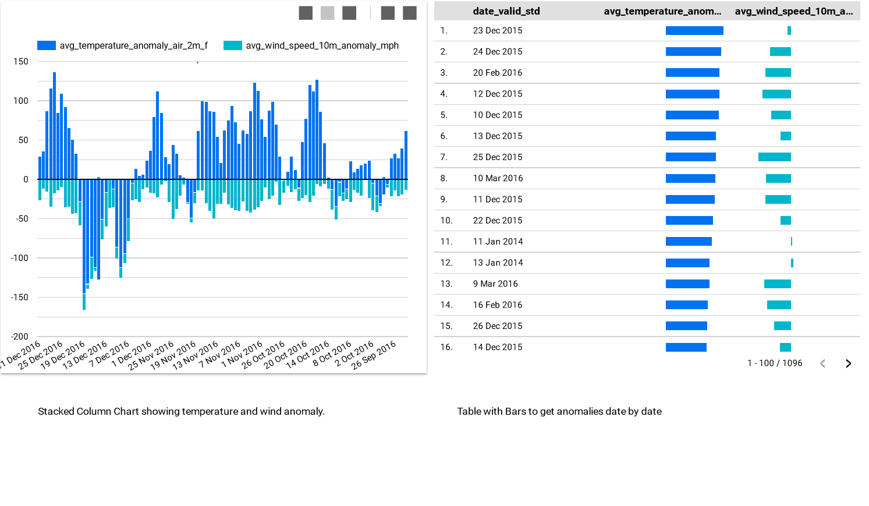
DASHBOARDS

Slide 13
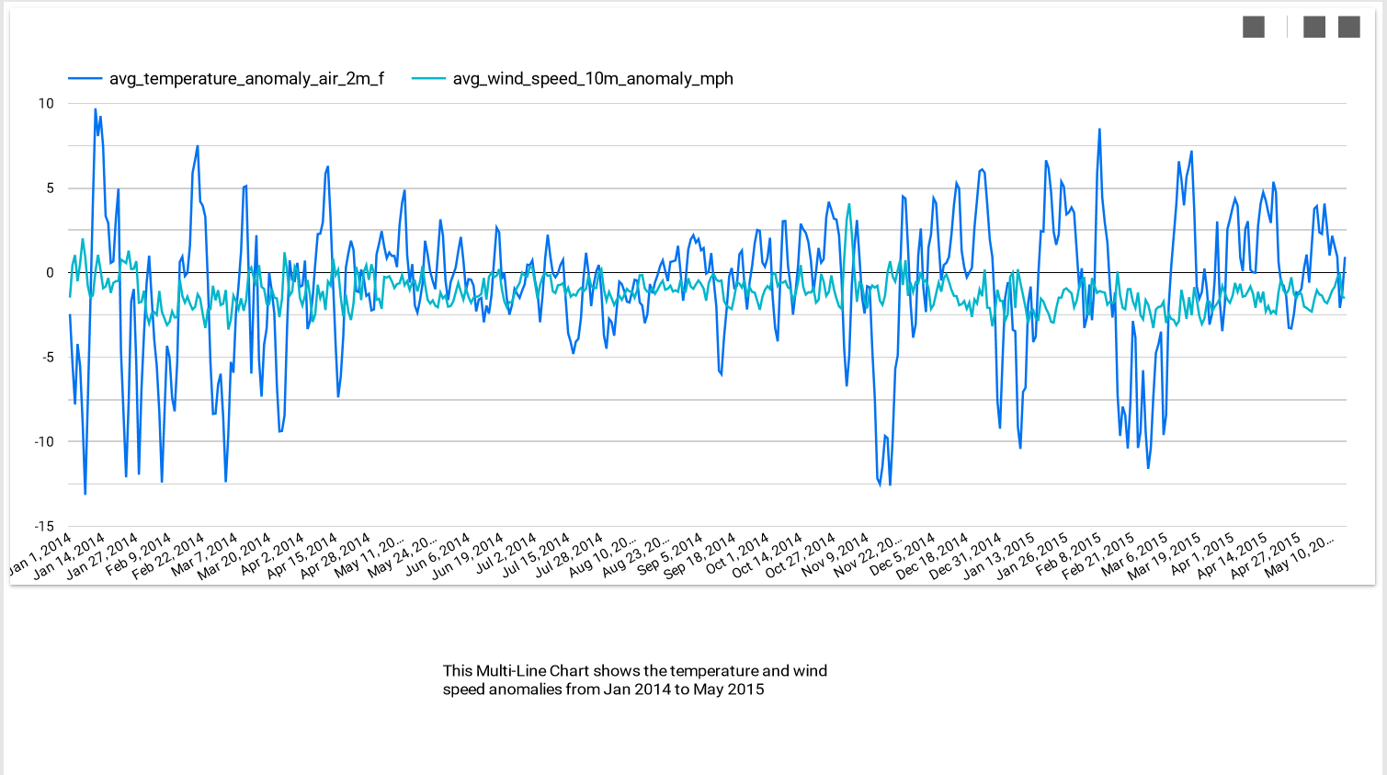
DASHBOARDS

Slide 14
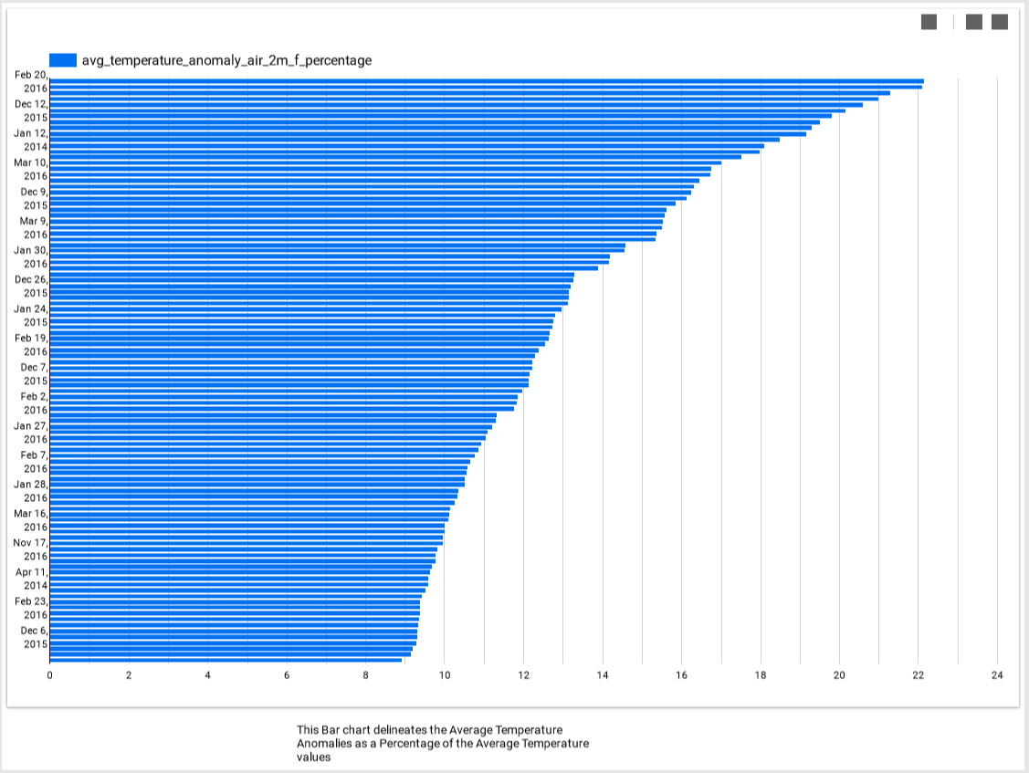
DASHBOARDS

Slide 15
References
[1] Understanding, modeling and predicting weather and climate extremes: challenges and opportunities janasillmann thordis thorarinsdottir noel keenlyside nathalie schaller lisa V. Alexander gabriel hegerl sonia I.Seneviratne robert vautard xuebin zhang francis W.Zwiersi https://www.Sciencedirect.Com/science/article/pii/S2212094717300440
[2] predicting uncertainty in forecasts of weather and climate T N palmer https://iopscience.Iop.Org/article/10.1088/0034-4885/63/2/201
[3] on the reliability of seasonal climate forecasts A. Weisheimer 1,2 and T. N. Palmer 1

