Slide 1
CodonRescore: Annotation-Free Codon-Model Rescoring of Ab Initio Gene Calls
A benchmark on organellar and small prokaryotic genomes
Author 1 · Author 2 · Author 3
Bioinformatics Research Work — Internal Assessment
Notes:
Introduce topic: gene prediction is step one of genome annotation; we benchmark Pyrodigal and propose a lightweight rescoring step. Introduce team members and roles.

Slide 2
Problem and motivation
Gene prediction = first step of annotation; pipelines such as Bakta delegate CDS finding to Prodigal/Pyrodigal.
Self-trained finders can degrade on short, AT-rich, RNA-gene-rich genomes (e.g. chloroplasts).
Deep ORF classifiers (Balrog, ProtiGeno) need large pre-training; labs need a cheap, genome-specific check.
Question: can a codon model trained only on the genome itself clean up a caller's output — and when does it fail?
2/10
Notes:
Errors in the CDS-finding stage propagate to all downstream annotation. Self-training needs enough sequence and may degrade on AT-rich or organellar genomes.

Slide 3
Literature survey (recent work, 2021–2024)
Work | Approach | Limitation for us
Pyrodigal (2022) | Prodigal port; self-training / meta models | Needs ≥20 kb to train
Balrog (2021) | Universal protein model (TCN) | Heavy pre-training
Dimonaco et al. (2022) | Benchmark of gene finders | Organism-dependent accuracy
Bakta (2021) | Annotation pipeline on Prodigal CDS | Inherits CDS errors
ProtiGeno (2023) | ESM-1b embeddings for short ORFs | Lower precision; large model
BRAKER3 (2024) | Evidence integration (eukaryotes) | Needs RNA-seq/protein data
DNABERT-2 (2024) | DNA foundation model | Not tested for gene calling
3/10
Notes:
Seven recent papers plus foundational references; see paper Table I.

Slide 4
Research gap
G1 Self-training on small organellar genomes is not examined in the works reviewed.
G2 Cheap, genome-specific post-hoc rescoring (no pre-training, no annotation) is little explored.
G3 Error anatomy of false positives is rarely reported — where should rescoring intervene?
4/10
Notes:
Gaps are relative to the papers we reviewed, not a claim about all literature.

Slide 5
Datasets (real NCBI records)
Record | Length | GC | CDS (all / eval.) | Role
A. thaliana chloroplast NC_000932 | 154,478 | 36.3% | 85 / 70 | Truth + training
Y. pestis plasmid pPCP1 NC_005816 | 9,609 | 45.3% | 10 / 10 | Truth
Phage phiX174 NC_001422 | 5,386 | 44.8% | 11 / 8 | Truth
C. diphtheriae NCTC11397 | 2,463,666 | 53.5% | no annotation | Scalability only
Scoring: stop-codon + strand match; precision / recall / F1; bootstrap 95% CI. Annotation is used for scoring only — never for training or tuning.
5/10
Notes:
All records are real RefSeq GenBank files; truth = single-exon, non-pseudo CDS. Spliced/pseudo/origin-spanning genes are neutral.

Slide 6
Methodology: CodonRescore
1 Enumerate ORFs (≥90 nt, both strands); seeds = longest, low-overlap ORFs (≥450 nt).
2 3-periodic order-2 Markov coding model vs. genome background → per-codon log-likelihood ratio S.
3 Threshold τ: 2-fold cross-fitted Youden cut-off, held-out seeds vs. shadow-frame ORFs.
4 Re-score caller output: prune short calls with S<τ (<300 nt); rescue uncalled ORFs with S≥τ (≥120 nt).
Applied to Pyrodigal single mode (self-trained) and meta mode (pre-trained).
6/10
Notes:
Three stages: seeds, model+threshold, rescoring. Parameters fixed a priori.

Slide 7
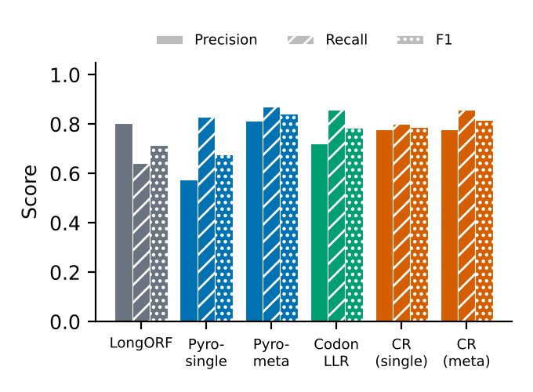
Results — chloroplast genome (70 evaluable genes)
Method | Prec. | Rec. | F1
Pyrodigal single | 0.574 | 0.829 | 0.678
Pyrodigal meta | 0.813 | 0.871 | 0.841
CodonRescore (single) | 0.778 | 0.800 | 0.789
CodonRescore (meta) | 0.779 | 0.857 | 0.816
Single mode: 43 false positives → 16 after rescoring.
F1 95% CIs overlap (0.59–0.75 vs 0.72–0.85).
Also: pPCP1 and phiX174 — Pyrodigal-meta best; CodonRescore not applicable on phiX174 (too few seeds).
7/10
Notes:
Single-mode Pyrodigal over-calls (43 FP). CodonRescore: 43→16 FP, F1 0.678→0.789. Meta mode is strong (0.841) and CodonRescore does not improve it (0.816). CIs overlap.

Slide 8
Critical analysis
Of 43 single-mode false positives: 38 < 300 nt, 24 overlap tRNA/rRNA genes, none shadow a true protein gene.
All methods find every gene ≥600 nt; differences are in the 25 genes <300 nt.
Rescue step hurts: 0 of 10 rescued ORFs true in meta mode; order-2 model is too weak for rescue.
Threshold is brittle: lowering τ by 0.1 drops F1 below 0.44; conservative is safer.
Only 70 truth genes → differences mostly not significant; no hyper-parameter tuning was done.
8/10
Notes:
Honest reading: partial repair of a weak caller, no gain over a strong one; small sample.

Slide 9
Proposed research extension
Validate on many annotated organelle genomes + bacterial chromosomes for statistical power.
Richer scorer: hexamer / higher-order Markov, start-site and RBS features.
Protein-level evidence: protein / DNA language-model embeddings (ESM-1b, DNABERT-2) as rescoring features.
Calibrated classifier instead of a single Youden cut-off; prune-only variant.
Head-to-head with Balrog and ProtiGeno; extend to spliced genes and eukaryotic pipelines (BRAKER3 ideas).
9/10
Notes:
Future work: more genomes, richer models, protein-level evidence, shared benchmark with Balrog/ProtiGeno.

Slide 10
Conclusion
Benchmarked Pyrodigal on real organellar / small genomes against RefSeq annotation.
CodonRescore (annotation-free) cuts false positives of self-trained Pyrodigal 43 → 16 (F1 0.678 → 0.789).
No improvement over pre-trained meta mode (0.816 vs 0.841) — and evidence is limited by 70 genes.
Practical advice: prefer pre-trained/conservative settings on organelle genomes; distrust short, low-scoring calls near RNA genes.
Manuscripts prepared in IEEE and Springer LNCS formats; code and results provided.
10/10
Notes:
Take-home message and team contributions.

