Slide 1

Vel Tech Rangarajan Dr. Sagunthala R&D Institute of Science and Technology
School of Computing
Department of Computer Science and Engineering
10211CS224 / FULL STACK APPLICATION DEVELOPMENT
PROJECT REVIEW : MILESTONE PROJECT – 2
Date: 24-04-2026
Event Registration Management Portal
SDG: 4 – Quality Education
Presented By:
T. PARDHA SARADHI – VTU26578 – 23UECS0896
Courses Handling Faculty:
Dr. S. Manohar- Assistant Professor

Slide 2
INTRODUCTION
Campus events play a crucial role in enhancing student engagement and skill development
Colleges organize various events like technical fests, cultural programs, workshops, and seminars
Managing these events manually becomes difficult as the number of participants increases
Traditional methods like paper-based tickets and offline registrations are inefficient
This system provides a centralized digital platform for managing all campus events
Students can easily view event details, register, and book tickets online
Organizers can efficiently manage event data, track registrations, and monitor participation
1
2
3
4
5
6
7
8
9

Slide 3
PROBLEM STATEMENT
Manual ticket management leads to delays and inefficiency as handling registrations manually is slow and difficult to manage.
Lack of a centralized system causes confusion since event information is scattered and not easily accessible.
Tracking registrations becomes complicated because maintaining accurate participant records manually is difficult.
There are high chances of errors and data duplication since manual data entry can lead to inconsistencies.
Students do not receive real-time updates which causes them to miss important notifications or changes.
Communication between organizers and participants is poor as there is no proper system to share updates efficiently.
1
2
3
4
5
6
7
8
9

Slide 4
OBJECTIVES
1
To develop a centralized event management system where all campus events and related activities are managed efficiently in a single platform.
To simplify the ticket booking process for students by providing an easy and quick online registration and booking system.
To provide a user-friendly interface that ensures smooth navigation and usability for both students and administrators.
To enable real-time updates and secure data management so that users receive instant notifications and data is safely stored.
2
3
4
5
6
7
8
9

Slide 5
PROPOSED SYSTEM
Description of the Solution: The proposed system is a web-based application that allows students to view available campus events, register, and book tickets through an online platform. It provides separate access for users and administrators, where students can easily participate in events and administrators can efficiently create, update, and manage event details using a centralized system.
1
2
3
4
How It Solves Existing Issues: The system eliminates the need for manual paperwork by automating the entire event registration and ticket booking process, thereby reducing time and effort. It also provides a centralized platform where all event-related information is available, ensuring better accessibility, accurate data management, and real-time updates for users.
5
6
7
8
Advantages Over Current Systems: Compared to traditional manual systems, the proposed system is faster, more efficient, and user-friendly, as it simplifies the overall event management process. It also enhances data security, reduces errors, and ensures that all records are maintained digitally in an organized and reliable manner.
9

Slide 6
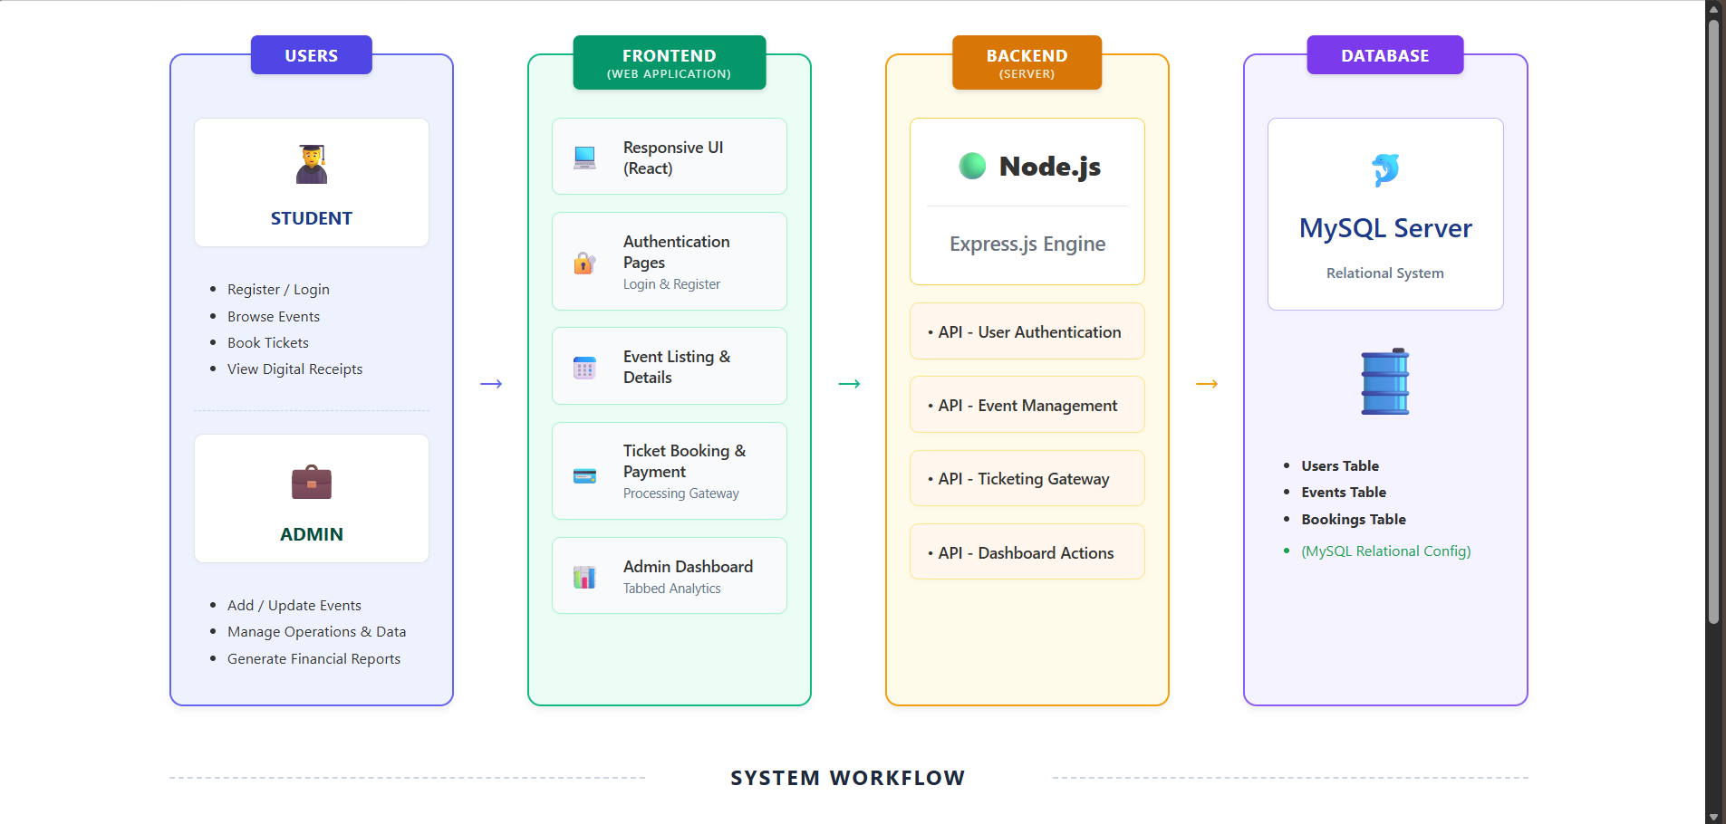
PROPOSED SYSTEM ARCHITECTURE
Input: The system receives input from users such as students and administrators through actions like registration, login, browsing events, and booking tickets, where details like user information, event selection, and booking requests are provided to the system.
1
2
3
4
Processing: The backend processes user requests using Node.js and Express.js by handling authentication, managing events, and processing bookings, while interacting with the database to validate and store the required data.
5
6
Database: The database stores all essential data including user details, event information, and booking records in an organized manner using Xamp, ensuring secure storage, easy retrieval, and efficient data management.
7
8
9
Output: Output includes event listings, registration confirmations, admin reports, and notifications. It provides users with the final results and updates generated by the system.

Slide 7
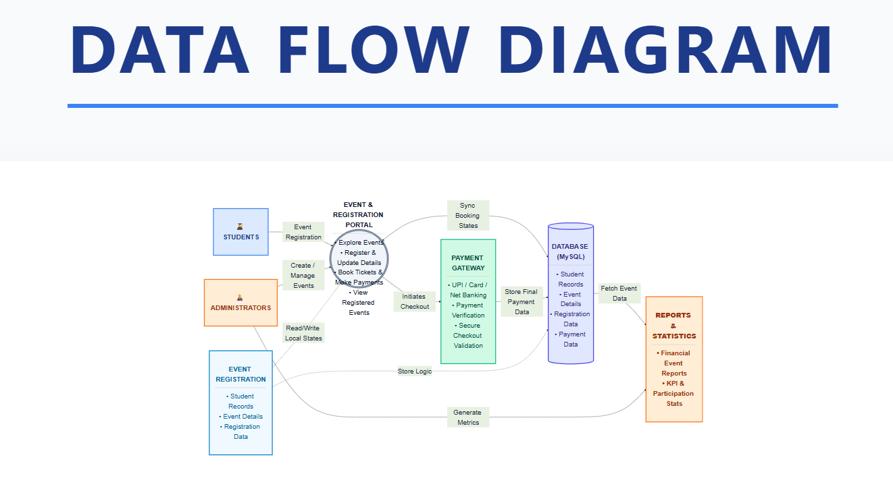
WORKFLOW
1
2
3
4
5
6
7
8
9
Data Flow: The Data Flow Diagram shows how information moves through the Academic Campus Event and Registration Portal. Students register for events, and administrators manage event details. The system processes this data, stores it in the database, and generates outputs such as confirmations, notifications, and reports.

Slide 8
TECHNOLOGIES USED
1
Frontend: React.js (App.jsx, main.jsx) was used to build the user interface and manage components, CSS (App.css, index.css) was used for styling, and Vite was used as the build tool for faster development and rendering.
Backend: Node.js (backend/server.js) was used for server-side execution, and Express.js was used to handle API routes such as user authentication, event management, and ticket booking operations.
Database: MySQL Server was used to store and manipulate live event details alongside student registration data securely natively.
Tools: Visual Studio Code was used as the primary coding editor, and Node Package Manager (npm) was used to configure and track dependencies.
Software Requirements: A modern web browser (Google Chrome/Edge), a local Node.js engine installed for executing the backend framework, and a standalone instance of MySQL Server running in the background.
2
3
4
5
6
7
8
9

Slide 9
MODULE DESCRIPTION
Module 1: User Authentication Handles user registration and login functionality for both students and administrators. It ensures secure access by validating user credentials before allowing access to the system.
Module 2: Event Management Handles creation, updating, and display of event details. Administrators can add new events, edit information, and manage event listings efficiently.
Module 3: Ticket Booking Allows students to browse events and book tickets by selecting desired events. It ensures proper validation and stores booking details securely in the system.
Module 4: Database Management Manages storage and retrieval of user data, event details, and booking information. Ensures data consistency, accuracy, and secure database operations.
1
2
3
4
5
6
7
8
9

Slide 10
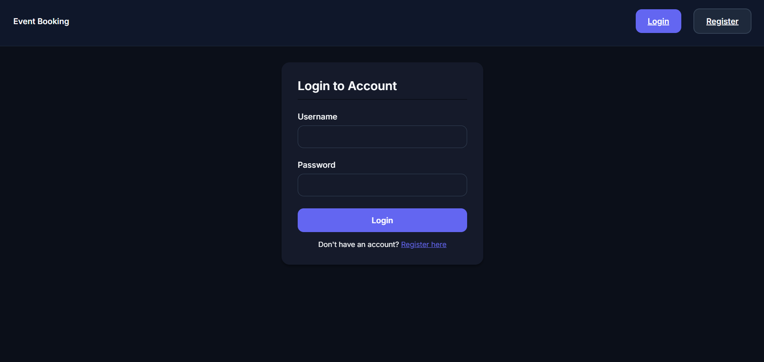
IMPLEMENTATION SCREENSHOTS
1
Login Screen:
2
3
4
5
6
7
8
9

Slide 11
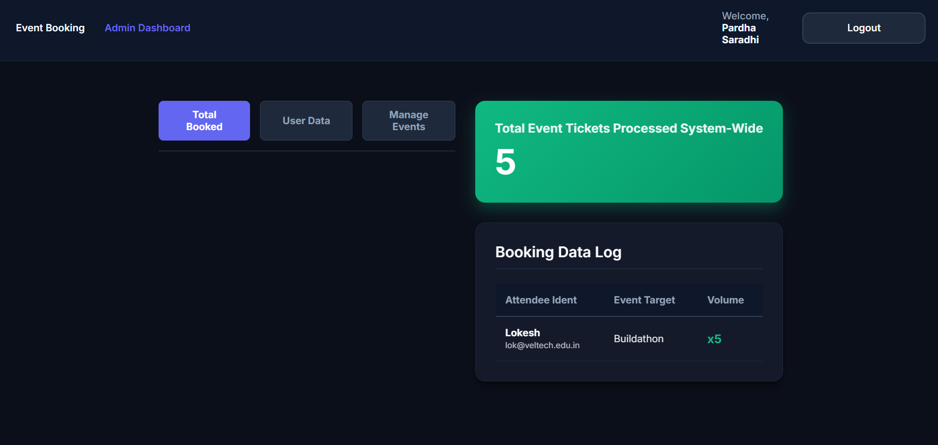
IMPLEMENTATION SCREENSHOTS
1
Admin Perspective:
2
3
4
5
6
7
8(A)
9

Slide 12
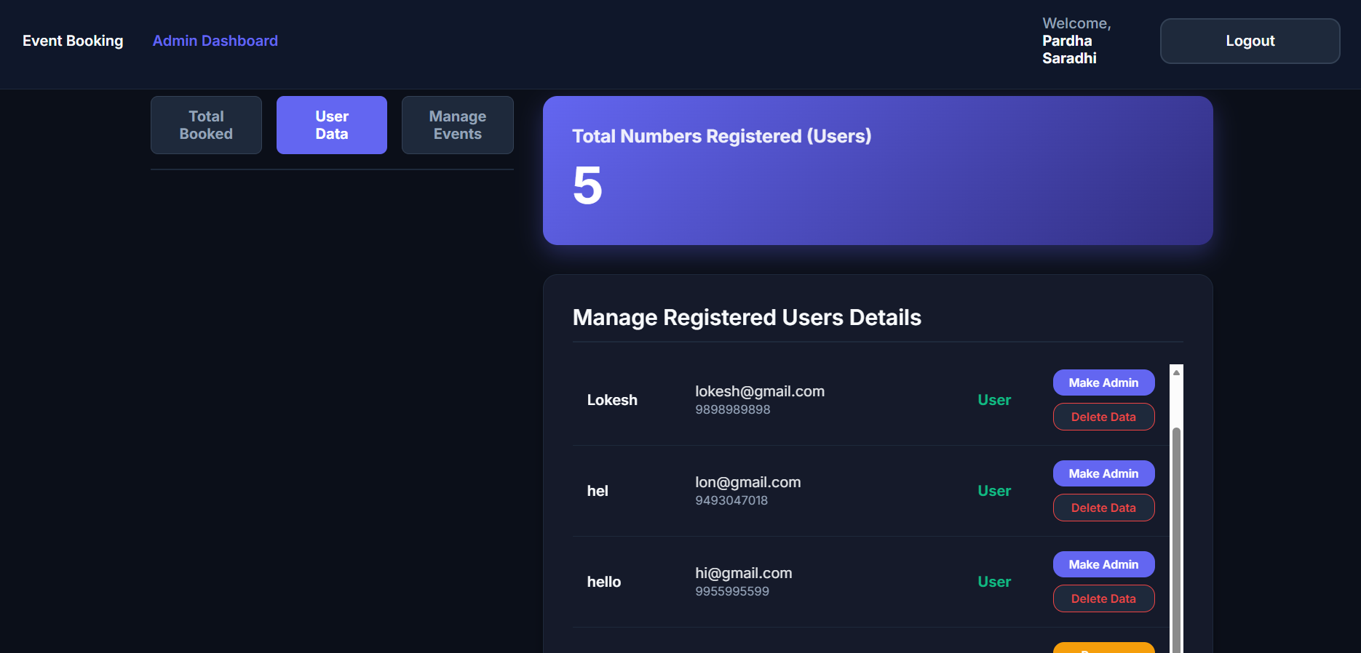
IMPLEMENTATION SCREENSHOTS
1
Admin Perspective:
2
3
4
5
6
7
8(B)
9

Slide 13
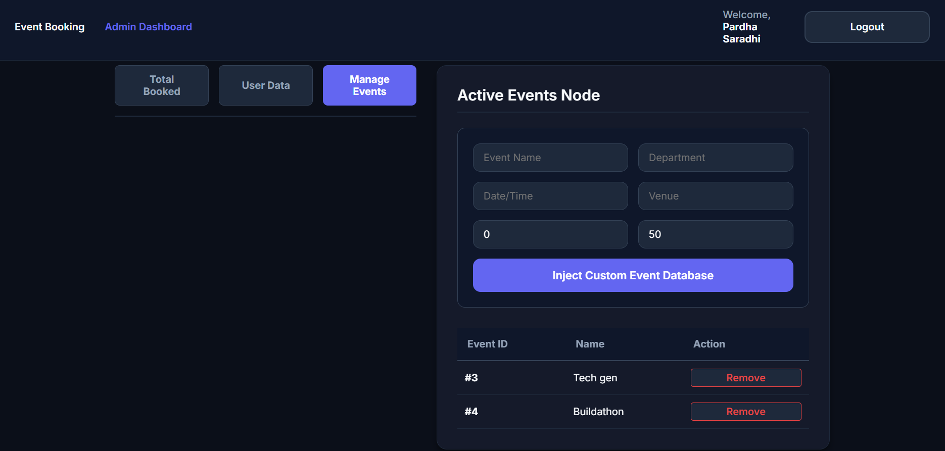
IMPLEMENTATION SCREENSHOTS
1
Admin Perspective:
2
3
4
5
6
7
8(C)
9

Slide 14
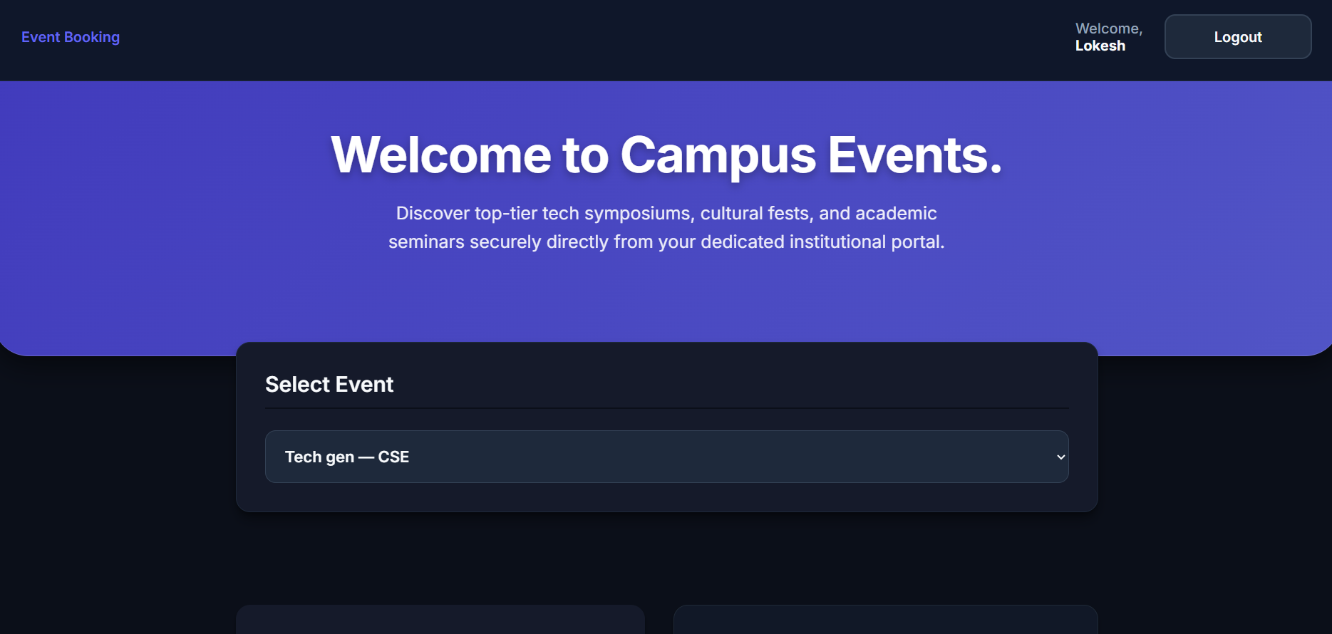
IMPLEMENTATION SCREENSHOTS
1
User Perspective:
2
3
4
5
6
7
8(C)
9

Slide 15
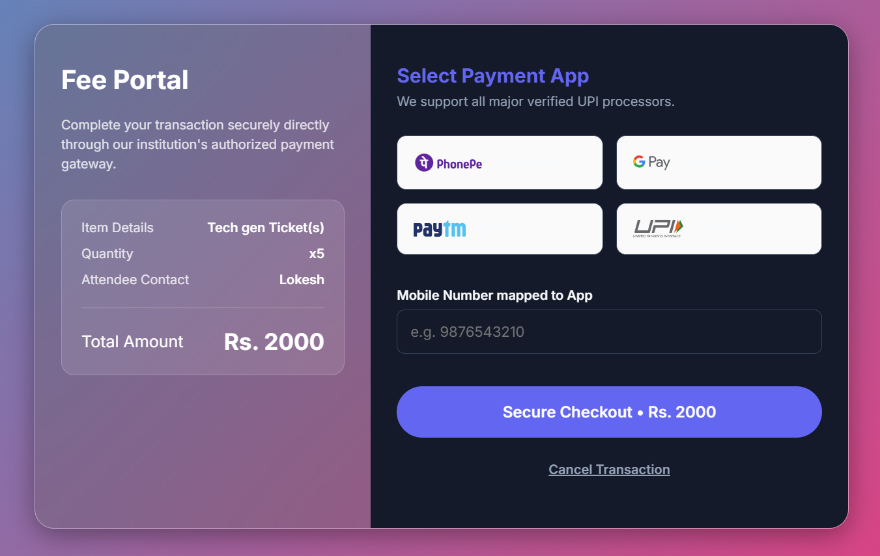
IMPLEMENTATION SCREENSHOTS
1
User Perspective:
2
3
4
5
6
7
8(C)
9

Slide 16
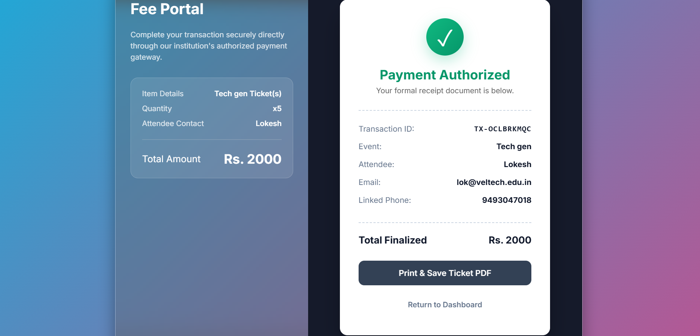
IMPLEMENTATION SCREENSHOTS
1
User Perspective:
2
3
4
5
6
7
8(C)
9

Slide 17
ADVANTAGES & LIMITATIONS
ADVANTAGES
Centralized platform for managing all campus events in a single, organized system.
Quick and easy ticket booking process that saves time compared to manual registration.
Reduces manual work and paperwork by automating the entire booking process.
Minimizes data entry errors through validation and structured input handling.
Provides real-time updates and instant booking confirmations to users.
Smooth and interactive user experience using React without page reloads.
1
2
3
4
5
6
7
LIMITATIONS
Requires stable internet connection for accessing and using the system.
Limited scalability, making it less suitable for large-scale or high-traffic events.
No online payment integration, restricting use for paid event bookings.
Basic security features without advanced authentication or encryption.
Depends on local server setup like XAMPP or Node for deployment.
No notification system such as email or SMS alerts for users.
8
9

Slide 18
Thank you

