Slide 1
Team Androids
Business Entity Resolution · 10 million records, 1.7 million businesses
PKT
MT
PH
Pardheev Krishna Tammineni
Monika Tammineni
Pallam Hemachand
Notes:
[Smile and look at the camera.] Hello, everyone. I'm Pardheev, and together with Monika and Hemachand, we are team Androids. Today I will show you how we matched almost ten million messy records against 1.7 million businesses while checking only a tiny fraction of the possible pairs. [click]

Slide 2
The Scale Challenge
Each of almost 10 million records must find its one business, or none, among 1.7 million.
which one, or none?
🏢
🏢
🏢
🏢
🏢
🏢
US
India
France
9,969,589 records
0 labels
1,732,544 businesses
incoming, to be linked
the reference list
6.7 trillion possible same-country pairs
7.10 per business candidates we keep: under 2 in every million pairs
Notes:
Almost 10 million incoming records arrive from three countries: the US, India and France. Each one belongs to one of 1.7 million known businesses, or to none, and we have to decide which. Comparing every record with every business in its own country would mean 6.7 trillion pairs, far too many for any model. [point to the thin orange bar] Our final candidate list keeps only about 7 per business, fewer than two pairs in every million. And there is a twist: France came with zero training labels. [pause] So this talk answers two questions: how do we find those seven, and how do we decide which one, if any, is right? [click]

Slide 3
Meet Three Records
Real records are messy, and the metric punishes every wrong link.
↻ we will meet them again
Legacy Marketing Enterprises (Inc)
(no address)
📄 US
विजय एंटरप्राइजेज प्राइवेट लिमिटेड
24/11, Mumbai, महाराष्ट्र
(Vijay Enterprises Private Limited)
📄 India
TQ COMITE SARL
2 R SUZANNE LENGLEN, NANTES
📄 France
no address: only the name
Hindi script, short address
no labels in France
Score, per business (F0.5): a wrong link costs more than a missed one.
Notes:
Let me introduce three real records from the test set; they will come back at the end. [point to each card in turn] The American one, Legacy Marketing Enterprises, has no address, so the name is our only clue. The Indian one is written in Devanagari, and its address is just a house number, 24/11, and Mumbai. The French one, TQ Comite SARL in Nantes, comes from the country with no labels. [pause] And the scoring is strict. The metric, F0.5, weighs precision above recall and is averaged per business, and a business with no true records scores a full point only if we link nothing to it. So one wrong link can turn a perfect one into a zero, which is why we built everything precision first. [click]

Slide 4
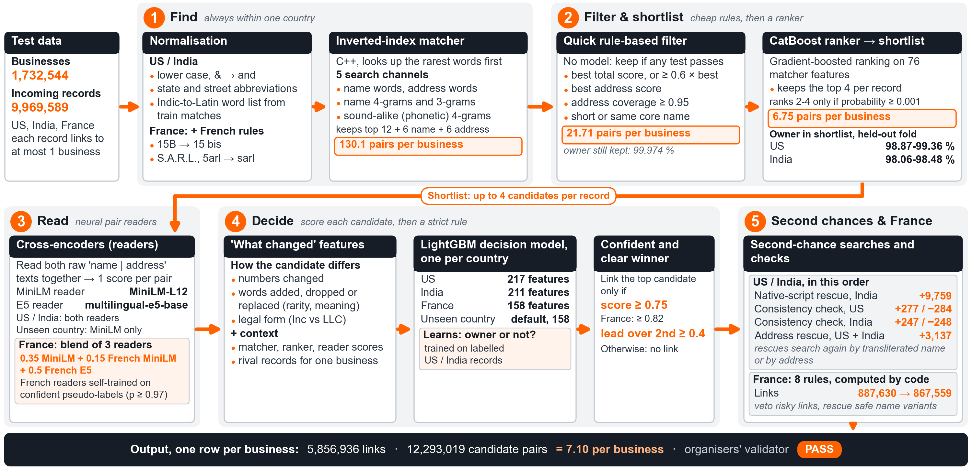
Pipeline Architecture
Five zones per country, from cheap to expensive.
1 Find
2 Filter
3 Read
4 Decide
5 Second chances
Cheap steps first; costly models read only the shortlist.
Runs separately per country.
Notes:
Here is the whole pipeline. It runs separately per country and moves from cheap to expensive in five zones: find, filter and shortlist, read, decide, and second chances. [sweep your hand from left to right] I will light up one zone at a time, and then zoom in on the four ideas that made the difference. [click]

Slide 5
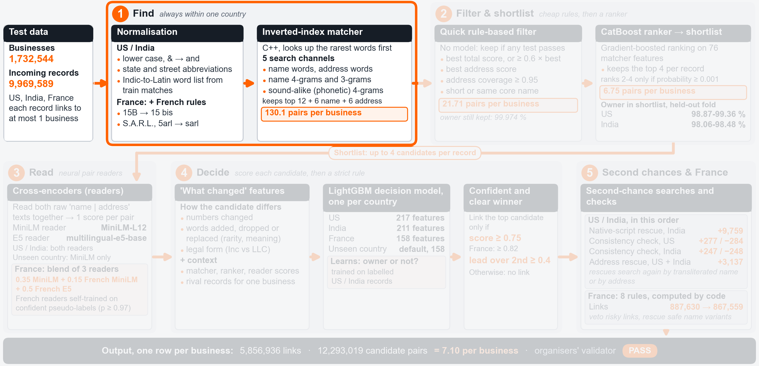
Architecture: Find
We clean the text, then look up businesses that share rare words, letter pieces or sounds.
1
Find
Typos and abbreviations still find their business.
Notes:
Zone one is Find. We first clean the text, so that in France, for example, 15B becomes 15 bis. Then a fast inverted index written in C++, which works like the index at the back of a book, looks up businesses that share rare words with the record. It keeps separate lists for name words, address words, short letter pieces and how a name sounds, so a typo still finds its business. [click]

Slide 6
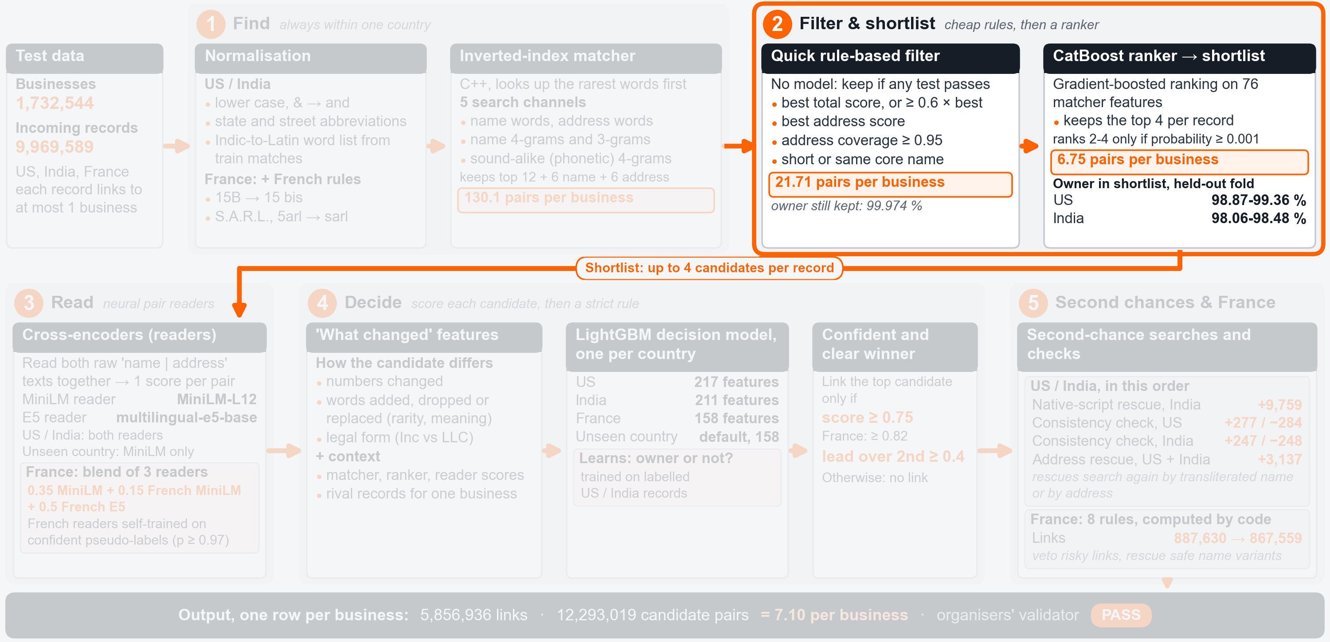
Architecture: Filter
A quick rule and a ranker cut the list to at most 4 candidates per record.
2
Filter & shortlist
The shortlist is all the expensive models ever see.
Notes:
Zone two is Filter and shortlist. A quick rule-based filter, with no model, drops candidates that are clearly weaker than the best one, but keeps special cases such as an almost perfect address match. Then a CatBoost ranker, a gradient-boosting model, orders the rest, and we keep at most four candidates per record. That shortlist is all the expensive models ever see. [click]

Slide 7
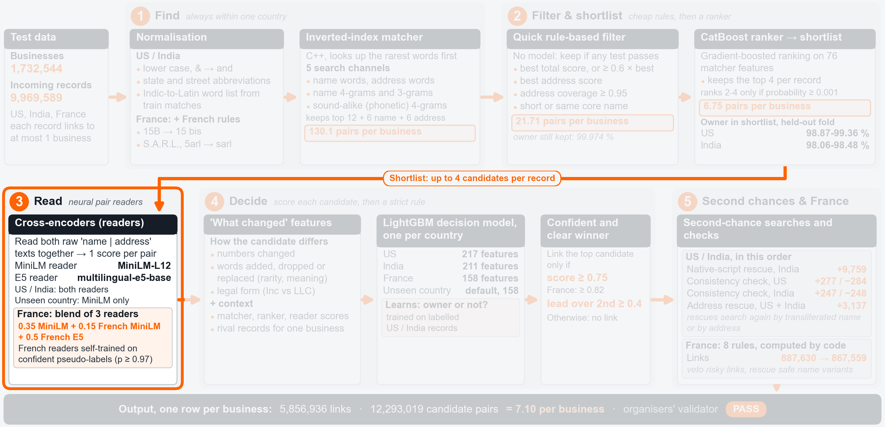
Architecture: Read
Cross-encoders (we call them readers) read the record and each candidate side by side.
3
Read
Reading both names together catches Inc vs LLC.
Notes:
Zone three is Read. Here we use cross-encoders, small language models that read the record and the candidate together, side by side, and give one match score; we call them readers. Because they see both texts at once, they notice details like Inc becoming LLC. We fine-tuned two multilingual readers, MiniLM and E5, and France gets two extra French ones. [click]

Slide 8
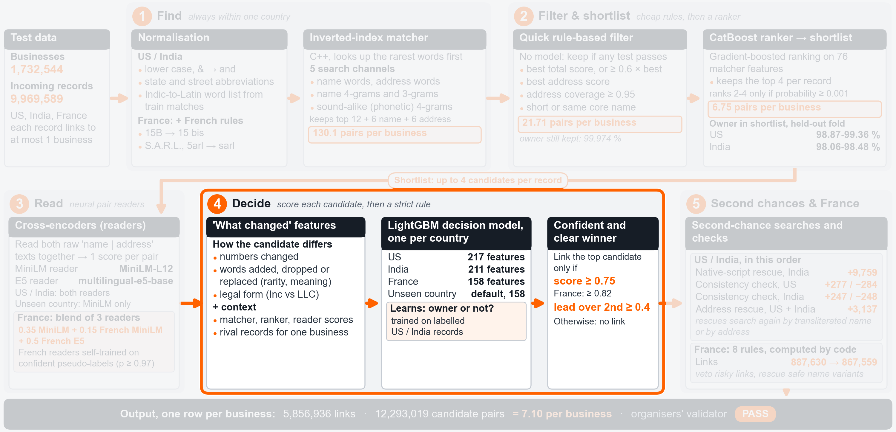
Architecture: Decide
We link only a confident, clear winner.
4
Decide
Score ≥ 0.75 and ≥ 0.4 ahead of the runner-up.
Notes:
Zone four is Decide. For every candidate we describe exactly what changed between the two records, and a LightGBM decision model, one per country, turns that into a probability. Then the rule is simple: link the best candidate only if it is confident, at least 0.75, and a clear winner, at least 0.4 ahead of the runner-up. Otherwise the record stays unlinked. [click]

Slide 9
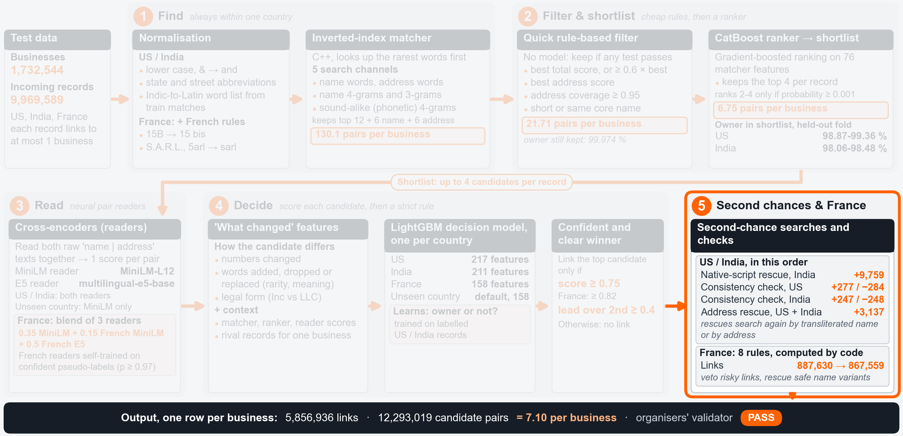
Architecture: Second Chances
Unlinked records get a second search, and France gets its own rules.
5
Second chances & France
Second searches add missed links; France rules block risky ones.
Notes:
Zone five is second chances and France. Two extra searches revisit records that are still unlinked, a per-business consistency check adjusts the bar slightly when a business already has other links, and France gets its own rules, computed by code. [click]

Slide 10
Blocking: the Funnel
The expensive models read only about 7 candidates per business, so cost grows in a straight line.
All same-country pairs
6.7 trillion pairs
Scaling to billions
US
India
France
Index lookup
about 130 per business
today: one index per country
Quick rule-based filter
21.7 per business
Shortlist: up to 4 per record
6.75 per business
Final list, + second chances
7.10 per business
next: smaller pieces by state or postcode, run in parallel
Notes:
Now let's zoom in on the four ideas, starting with the funnel. [point down the bars] The index lookup gives about 130 candidates per business. The quick rule cuts that to about 22 at almost no cost: the true business survived for 99.97 percent of held-out records. The shortlist brings us to 6.75, and the second-chance searches add a few more, so we end at 7.10 per business. The price is small: the shortlist still holds the true business for roughly 99 percent of US and 98 percent of Indian records. [pause] This is also our answer for billions. At most four pairs per record reach the expensive models, so the cost grows in a straight line. Today we split the index by country; at that scale we would split it by state or postcode and run the pieces in parallel. [click]

Slide 11
What Changed
We describe every candidate by exactly how it differs from the record.
📄 Record: Legacy Marketing Enterprises (Inc)
Legacy Marketing Enterprises LLC
legal form changed
Legacy Marketing Industries Inc
1 word replaced
Also counted: numbers changed, words added or dropped.
Reader scores
+ “what changed”
+ lead over rivals
⚙ LightGBM
decision model,
one per country
Link if confident AND a clear winner
≥ 0.75
score
≥ 0.4
lead
Notes:
The second idea is the heart of our model. Most matchers describe a candidate only by how similar it is, but we also describe exactly what changed. [point to the chips] Did a number change, and by how much? Were words added, dropped or replaced, and how rare are they? Did the legal form change, say from Inc to LLC? We learned this from the training data: true records of a business tend to lose information, by dropping a digit or a suffix, abbreviating, or transliterating. These features, the readers' scores and each candidate's lead over its rivals go into the decision model, about two hundred features per country. [click]

Slide 12
Second-Chance Searches
When the first search misses the right business, unlinked records get a second search.
↻ Names in Indian scripts
+9,759
links
विजय एंटरप्राइजेज
vijay enterprises
search the same state
scoring model
🔗
word list learned from training matches
↻ Search again from the address
+3,137
links
rare house no. + rare street word
quick filter
scoring model
🔗
Notes:
The third idea is a second chance. Some records are missed not because the model is unsure, but because the first search never found the right business. [point to the top lane] An Indian name in Devanagari can send the first search to the wrong places. So a word list learned from training matches turns it into Latin spelling, and we search again within the same state, which added 9,759 links. [point to the bottom lane] The second search starts from the address, from a rare house number and a rare street word, and it added 3,137 links in the US and India. Both only touch still-unlinked records, so they never undo a link. [click]

Slide 13
France: Zero Labels
With no French labels, our readers taught themselves, and rules computed by code add caution.
Readers score French pairs
Keep only very sure pairs (match or no match)
☑ France rules computed by code
Same address, one name word swapped for a common word
→ no link
Business’s street missing from the record’s address
→ no link
≥ 97 %
sure of a match
Fine-tune French readers
Mix 1 : 1 with labelled US + India pairs
Stricter bar: 0.82 instead of 0.75
Notes:
The fourth idea is France, where we had no labels at all. [point to the loop] So we let the readers teach themselves. We kept only the French pairs our models were most sure about, matches at least 97 percent sure and clear non-matches, and fine-tuned two French readers on them, mixed one to one with labelled US and Indian pairs so they would not forget what they knew. France also uses a stricter bar: 0.82 instead of 0.75. [point to the rules box] On top, we added careful rules computed by code. For example, when the address is the same but one name word was swapped for a common word, we do not link. [click]

Slide 14
Training and Selection
We tested changes on businesses the models had never seen.
10
folds
Businesses split into 10 folds (each business’s records stay together)
0
1
2
3
4
5
6
7
8
9
train ranker + readers
train decision models
orange folds: hidden test, in turn
1 Score it on a hidden fold
2 New readers: written checks
✓ Keep or drop
Some later choices and the final pick also used public-leaderboard scores.
Notes:
How did we avoid fooling ourselves? [point to the ten boxes] We split the businesses into ten folds, and every record travels with its business. The ranker and readers learn on folds zero to five, and the decision models on folds six to nine, so they never learn from scores of a model trained on the same records. To test a change, we hid fold eight or nine, retrained without it, and measured the exact competition metric there. Most settings, like the 0.75 bar, stayed only if they helped on the hidden fold. New readers also faced written pass-or-fail checks. [pause] One honest note: some later choices, and the final pick among our files, also used public leaderboard scores. [click]

Slide 15
Handling Edge Cases
Businesses with no records, unseen countries and noisy spellings each get a cautious default.
∅
🌐
Aa
No matching record
Unseen countries
Noisy spellings
Link only on a clear win.
Default route built like France. Untested.
Clean-up, letter pieces, sounds, second chances.
100,087 businesses left with no link, on purpose
Notes:
There are three edge cases to cover. First, a business with no true records scores a full point only if we link nothing to it, so we link only on a clear win, and 100,087 businesses end up with no link at all. Second, an unseen country takes a default route built like France, with a model trained without that country's labels and the stricter bar. Honestly, this route is untested, because the test set had no such country. Third, noisy spellings are handled by the cleaning rules, the letter-piece and sound lists and the two second-chance searches. [click]

Slide 16
Example: the US
No address: the legal form and one word decide.
Legacy Marketing Enterprises (Inc)
(no address)
📄 US
decision model score, Inc →
0.965
1 Find
2 Shortlist
3 What changed
4 Read & score
5 Decide
Similar names found; no address to help
Top 4 kept: Inc, LLC, PC, Industries
LLC, PC: legal form; Industries: one word
Inc scores highest; the others far lower
Confident and clear winner → linked
🔗 Linked to Legacy Marketing Enterprises Inc, Windsor, CT
Notes:
Now let's go back to our three records. The American one has no address. [point along the steps] The shortlist holds four businesses with nearly the same name: Enterprises Inc, Enterprises LLC, Enterprises PC, and Industries Inc. The features see that LLC and PC changed the legal form, Industries replaced a word, and Inc changed nothing. The decision model gives Inc 0.965 and the best other only 0.089, so it is confident and a clear winner, and we link the record to the Inc in Windsor, Connecticut, and to nothing else. [click]

Slide 17
Example: India
A Devanagari name is found by its second-chance search.
विजय एंटरप्राइजेज प्राइवेट लिमिटेड
24/11, Mumbai, महाराष्ट्र
📄 India
(Vijay Enterprises Private Limited)
second-chance model score →
0.99994
1 Find
2 Shortlist & score
3 Decide
4 Second chance
5 Confirm
Same-name businesses found, but in other places
All 3 score near zero
Not confident → left unlinked
Read as ‘vijay enterprises’, searched in Maharashtra
Only one with house no. 24/11 → linked
🔗 Linked to Vijay Enterprises Private Limited, Ghatkopar, Mumbai
Notes:
The Indian record is in Devanagari. [point along the steps] The shortlist holds three businesses called Vijay Enterprises Private Limited, in Agra, Satara and Byculla, but nothing ties them to this address, and all three score below one in a hundred thousand. So it stays unlinked, and the second chance begins. The word list turns the name into vijay enterprises, the address gives Maharashtra, and the new search finds ten such businesses there and keeps five. Only one has the same house number, 24/11, in Ghatkopar, and the second-chance model gives it 0.99994. [pause] So the link is added. [click]

Slide 18
Example: France
A confident link is vetoed, because abstaining is cheaper than a wrong link.
TQ COMITE SARL
2 R SUZANNE LENGLEN, NANTES
📄 France
0.9998 → veto
1 Find & shortlist
2 French readers
3 Decide
4 France rule check
5 Veto
2 kept: same address, or same name
French readers reject the same name in Pessac
Confident and clear winner: TQ Parents, Nantes
'Parents' became 'Comite' at the same address
Rule vetoes the link → left unlinked
✗ Left unlinked; both candidates stay in the candidate file
Notes:
Finally, here is the French record, TQ Comite SARL in Nantes. [point along the steps] The search finds 16 candidates, and the quick filter keeps two. One has exactly the same name but sits in Pessac, another city; our original reader liked it, but the French readers rejected it. The other, TQ Parents SARL, is at exactly the same address, and the decision model gives it 0.9998. But at the same address, the common word comite has replaced parents, and our French rule vetoes exactly that. [pause] So we link nothing, because under F0.5 abstaining is cheaper than a wrong link. Test labels are private, so these examples show how we decide, not whether each call was right. [click]

Slide 19
Results and Learnings
0.9913 on the public leaderboard, with hidden-fold scores in the same range, and honest limits.
0.9913
public F0.5, final file
Hidden-fold F0.5 (fold 9 / fold 8)
US 0.9912 / 0.9915
India 0.9900 / 0.9903
France no labels, so no fold score
0.9906
0.9826
0.9682
✓ Worked: describing exactly what changed
→ Next: untouched check fold, small French label set
first baseline
first decision model
France adapted
final
Limits We never had a fully untouched test of the final file: the hidden folds also helped set our thresholds. France relied on self-training and on rules designed after looking at unlabelled test records, and we kept the French E5 reader although it failed 2 of its 4 written checks. The public leaderboard helped us pick the final file.
Notes:
Where did this get us? Our final file scores 0.9913 on the public leaderboard, up from 0.968 for our first baseline, and on hidden folds close versions of our US and Indian decision models score between 0.990 and 0.992. [pause] What worked best was studying how true records differ from their business before building features. [point to the limits box] Now let me state our limits plainly. We never had a fully untouched test of the final file, because the hidden folds also helped set our thresholds. France relied on self-training and on rules designed after looking at unlabelled test records, and we kept the French E5 reader although it failed two of its four written checks. Next time, we would keep an untouched validation fold from day one and label a small French sample. [click]

Slide 20
Thank you
Questions
Team Androids
6.7 trillion possible pairs → 12.3 million candidates · public F0.5 0.9913
Notes:
To sum up, we keep about seven candidates per business, make one careful decision per record, and link nothing whenever we are not sure. That is how 6.7 trillion possible pairs became a score of 0.9913. Thank you, and we would love to hear your questions.

Slide 21
Full Pipeline Architecture
Backup · the complete diagram
Notes:
Backup slide for questions, not part of the talk. The full pipeline with all five zones lit, for zooming in during Q&A.

Slide 22
Funnel in Numbers
Backup · every step of the search, per business
Step
Pairs
Per business
All same-country pairs
6,724,569,566,212
-
Index lookup (blocking study, 25 Sep)
-
130.1
Quick rule-based filter
37,614,782
21.71
Shortlist (top 4 per record)
11,687,317
6.75 (derived)
Candidate file (+ second-chance searches)
12,293,019
7.10
Filter cost: true business kept for 99.974 % of held-out records; fold-9 F0.5 0.990117 → 0.990086.
Recall on train fold 9: index 99.37 % US / 98.51 % India; shortlist at least 98.87 % / 98.06 %.
Per record: 1.23 candidates; 1.17 reach the readers (derived).
Notes:
Backup slide for questions. The funnel step by step. The filter costs almost nothing: the true business survives for 99.974 percent of held-out records. The shortlist keeps the true business for at least 98.87 percent of US and 98.06 percent of Indian records on train fold 9.

Slide 23
Held-Out Scores
Backup · F0.5 on hidden folds, without records touching the scored fold
Decision model, as measured
Fold 9
Fold 8
India: final recipe with 3 of its 5 seeds, consistency check
0.990046
0.990298
US: the same 3-seed model, consistency check (the final US model trains on US rows only and adds 6 features)
0.991212
0.991545
France recipe tried on US / India data at the France threshold (a stand-in check, not a French score)
0.990508 / 0.989467
0.990977 / 0.989850
Fold 9 scored by fits on folds 6-8, fold 8 by fits on 6, 7 and 9. Excludes second-chance searches and France rules.
Public score of each adopted upload: 0.968212 → 0.969966 → 0.970125 → 0.982561 → 0.990556 → 0.990621 → 0.990676 → 0.990748 → 0.990788 → 0.990881 → 0.990934 → 0.991114 → 0.991300
Notes:
Backup slide for questions. Held-out F0.5 of the US and India decision models on folds 9 and 8, scored by fits that never saw records of the scored fold. The France recipe row is a stand-in check on US and India data, not a French score. These numbers exclude the second-chance searches and the France rules.

Slide 24
Written Checks
Backup · the French E5 reader failed 2 of 4 checks; kept for the best public score
French E5 reader: check
Result
Outcome
US / India quality within tolerance
AUC 0.998544 vs 0.998570
pass
Agreement with held-out French pseudo-labels
0.999206 (needed 0.98)
pass
Generated labelled French test set
best F0.5 0.910516 vs 0.914964
fail
Expected gain must be safely positive
pessimistic −0.0001806
fail
Change
Evidence
Decision
Quick rule-based filter
fold-9 F0.5 0.990117 → 0.990086
kept
US / India decision models refit on folds 6-9
public 0.990621 → 0.990676
kept
France decision model refit
public 0.990726 vs 0.990748
dropped
Second French self-training round
public 0.991277 vs 0.991300
dropped
Larger XLM-R reader
development tests
dropped
Notes:
Backup slide for questions. The French E5 reader passed two of its four written checks and failed two. We kept it because the file that contained it had our best public score. Its own effect is not isolated, because the same upload also added the five-seed decision models, and we say so openly in the limits.

Slide 25
US Example in Detail
Backup · No address: legal form and one word separate four candidates
“Legacy Marketing Enterprises (Inc)” · no address
US. Test labels are private: this shows how the pipeline decides, not whether it is right
Names that differ by legal form or one word
4 kept by the ranker
1 Shortlist
Inc → LLC, Inc → PC: legal form
Enterprises → Industries: one word replaced
No address
2 Changes
Enterprises Inc, Windsor CT
0.965022
Enterprises PC, Joshua Tree CA
0.088664
Industries Inc, Louisville TN
0.000088
Enterprises LLC, Irondequoit NY
0.000007
3 Decision model
0.965022
≥ 0.75
lead 0.876
≥ 0.4
→ link the Inc only
4 Decide
Consistency check keeps the link
Second-
chance search not needed (already linked)
5 Checks
Linked
Legacy Marketing Enterprises Inc, Windsor, CT
6 Output
Notes:
Backup for questions. The US record has no address, so only the name separates the four shortlisted businesses. The identical Inc business scores 0.965022, the PC business 0.088664, Industries 0.000088 and the LLC business, which the ranker had placed second, 0.000007. The best clears 0.75 with a lead of 0.876, so exactly one link is made, and the per-business consistency check keeps it.

Slide 26
India Example in Detail
Backup · A Devanagari name the Latin index could not place
विजय एंटरप्राइजेज प्राइवेट लिमिटेड · 24/11, Mumbai, महाराष्ट्र
India. Latin reading: Vijay Enterprises Private Limited · 24/11, Mumbai, Maharashtra
3 × “Vijay Enterprises Private Limited”
Agra (UP), Satara, Byculla
Ranker top probability 0.0028
1 Shortlist
Agra
1.9e-6
Satara
6.9e-6
Byculla
7.2e-6
2 Model
All below 0.75
→ unlinked
goes to the second-
chance search
3 Decide
Word list from training matches:
विजय → vijay
एंटरप्राइजेज → enterprises
Legal words dropped
vijay enterprises, Maharashtra
4 Search key
10 businesses with that name in Maharashtra → top 5
Ghatkopar, house no. 24/11: 0.99994
Next (Bhandup West): 0.0000191
5 Second-chance model
0.99994
≥ 0.88
lead 0.99992
≥ 0.3
→ link added
6 Output
Notes:
Backup for questions. The Latin index finds three Vijay Enterprises Private Limited businesses, in Agra, Satara and Byculla, but nothing ties them to this address; all score below one in a hundred thousand and the record stays unlinked. The second-chance search turns the name into Latin letters with a word list learned from training matches, searches vijay enterprises in Maharashtra and finds ten businesses. The Ghatkopar one is the only candidate with house number 24/11; the second-chance model scores it 0.99994 against 0.0000191, and the link is added.

Slide 27
France Example in Detail
Backup · No labels: French readers, then rules computed by code
“TQ COMITE SARL” · 2 R SUZANNE LENGLEN, NANTES
France. No labels: the French readers are self-trained on confident pseudo-labels
Search 16 → quick filter keeps 2
TQ Parents SARL, Nantes (ranker 0.9991)
TQ Comite SARL, Pessac (0.0420)
1 Shortlist
2 Readers
Nantes
0.999837
Pessac
0.000098
3 Model
Accept TQ Parents
0.999837
≥ 0.82
lead 0.999740
≥ 0.4
4 Decide
Same no. 2 and street (match 100)
One word swapped: “parents” → “comite”
Second rule agrees
→ link vetoed
5 France rules
Record unlinked
Both businesses stay in the candidate file
6 Output
Score
Nantes
Pessac
MiniLM
7.5000
7.1250
Fr. MiniLM
8.9375
−1.9219
Fr. E5
10.8125
−10.8125
Blend
9.3719
−3.2008
Blend = 0.35 MiniLM + 0.15 French MiniLM + 0.5 French E5 reader
Notes:
Backup for questions. France has no labels. The identical name in Pessac gets plus 7.1 from the general MiniLM reader, but both French readers reject it and the blend gives minus 3.2. The decision model accepts TQ Parents SARL at the same address with 0.999837. A France rule then fires: same house number and street, and the name differs by one word, parents to comite. A second rule agrees, the link is dropped, and no later rule adds it back. Test labels are private, so this shows how the pipeline decides, not whether it is right.

