Slide 1





DOCUMENT READING WITH A FIELD‑CROPPING VISION‑TEXT TRANSFORMER
By
Pardheev Krishna Tammineni

Slide 2
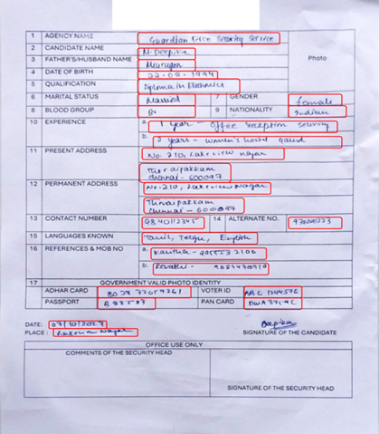
PROBLEM OVERVIEW
Structured forms contain printed and handwritten text
Need to crop each field and recognize its content accurately
Challenges: inconsistent labels, varying handwriting

Slide 3
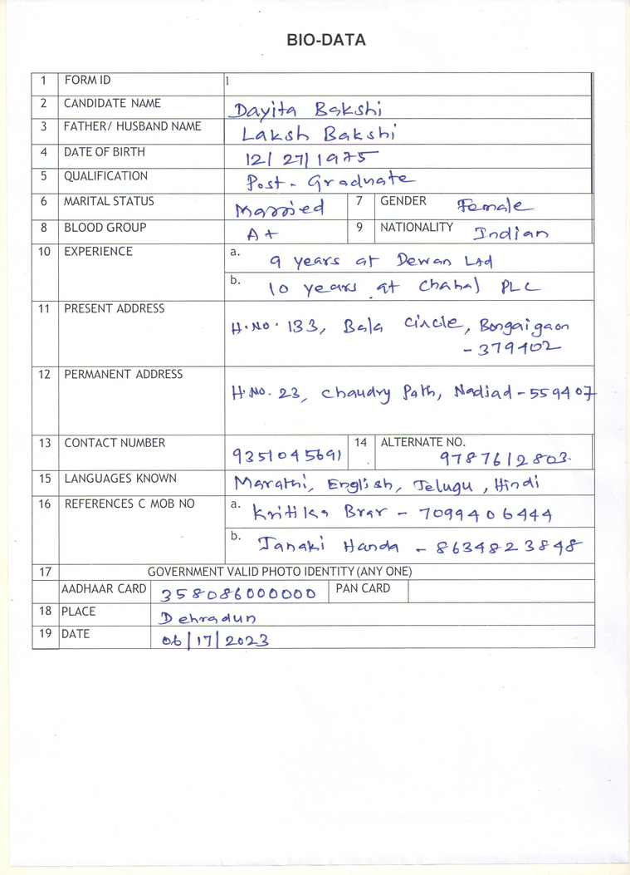
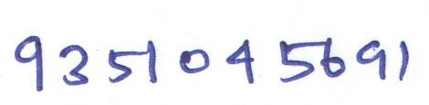






DATA PREPARATION
Load image/label pairs and crop fields using coordinates from JSON annotations
Store cropped images with their text labels for training
Clean duplicate or mislabeled fields before training

Slide 4
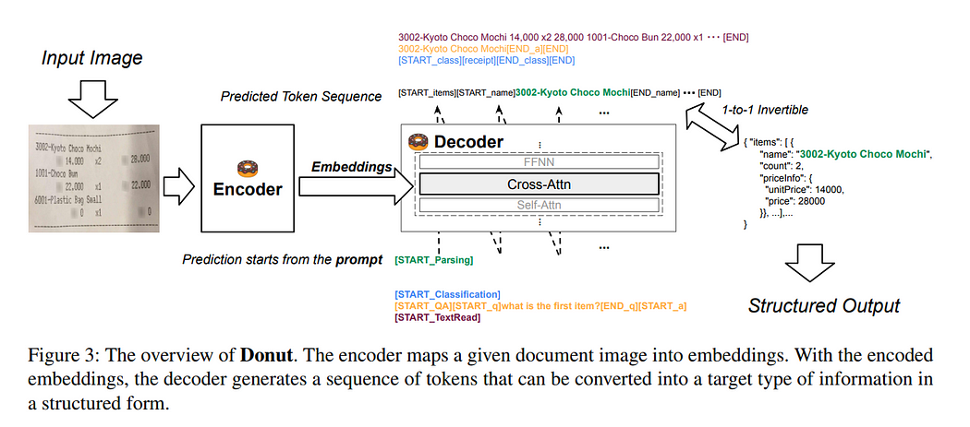

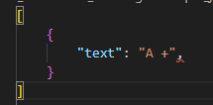
MODEL ARCHITECTURE
End‑to‑end transformer using a vision encoder (Swin) and a text decoder (BART)
Input images resized to 512 × 512
Encoder converts visual features into embeddings; decoder generates text from those embeddings

Slide 5
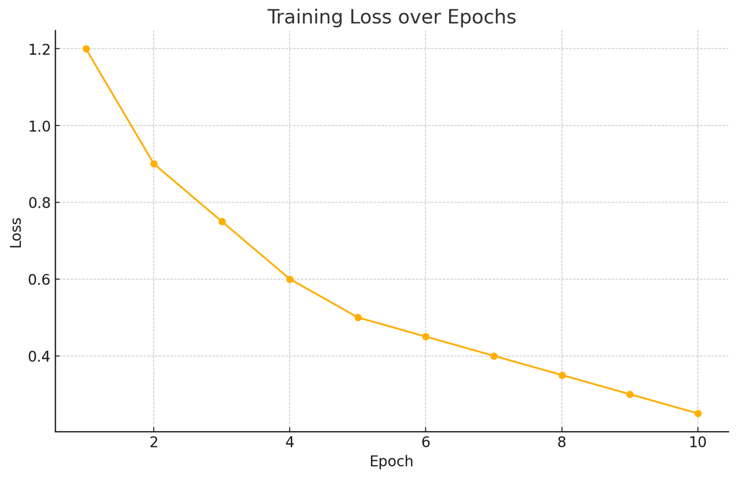
CUSTOMIZED TRAINING
Freeze half of the encoder layers to fit limited hardware
Define maximum sequence length and special tokens
Track Character Error Rate (CER), Word Error Rate (WER), field accuracy, and document accuracy

Slide 6
TRAINING PIPELINE
Split dataset: 90 % for training, 10 % for validation
Optimizer: AdamW with a linear learning‑rate schedule
Automatic logging of loss and metrics each epoch
Crop fields into
separate images
Split dataset
(90% train, 10% val)
Vision
encoder
(Swin,
first half
frozen)
Load image-label
pairs from disk
Parse JSON annotations
Save best checkpoint on
composite score improvement
Text Decoder
(BART)

Slide 7
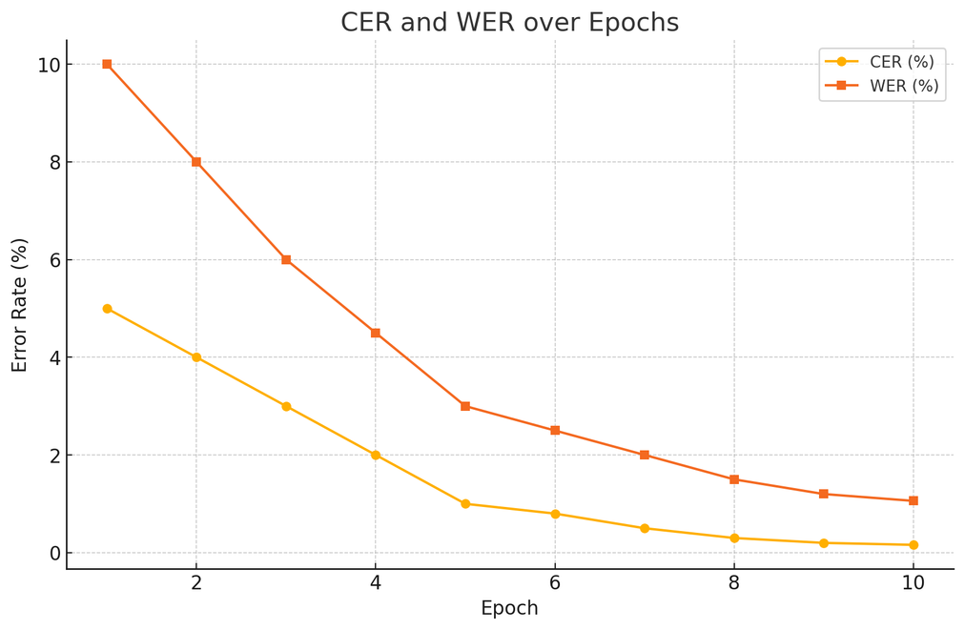
VALIDATION METRICS
After each epoch, report CER, WER, field accuracy, and document accuracy
Save best checkpoint when the composite score improves
Mismatches logged for error analysis

Slide 8
TESTING & EVALUATION
Load the best checkpoint for evaluation on the held‑out test set
Print CER, WER, field accuracy, document accuracy, and final score
Metrics on Train Data
CER: 0.16 %
WER: 1.06 %
Field Accuracy: 97.99 %
Document Accuracy: 67.53 %
Final Score: 94.40

Slide 9
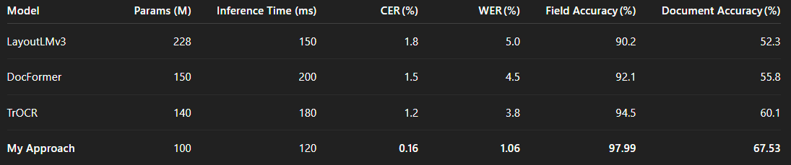
HOW THIS APPROACH DIFFERS
Traditional OCR pipelines separate detection and recognition
This approach uses an end‑to‑end transformer to generate text sequences directly from cropped fields
Cropping each field simplifies the task and improves accuracy
Freezing encoder layers reduces memory use

Slide 10
CHALLENGES & NEXT STEPS
Continue cleaning mislabeled or inconsistent data
Improve multilingual label consistency
Explore augmentations (rotation, noise) to enhance robustness
CONCLUSION
Tailored training of the vision‑text transformer effectively extracts handwritten fields from structured forms
Combining field cropping with targeted metrics yields strong accuracy
Future work: expand the dataset and prepare for real‑world deployment

Slide 11

GITHUB REPO

Slide 12
THANK YOU

