Slide 1

Introduction to Microsoft Power Platform
Trainer: Dhruv

Slide 2

What is Microsoft Power Platform ?
Microsoft Power Platform is a low-code platform for rapidly building customized end-to-end business solutions. It consists of five product areas: Power Apps, Power Automate, Power BI, Power Virtual Agents, and Power Pages. Each area can be used individually or together. United by the underlying Microsoft Dataverse technology, all areas are designed for a connected experience to achieve your business goals, whether it's creating analytics, process automation, or data-driven productivity applications.
The platform's low-code approach enables everyone in an organization—from frontline workers to professional developers—to participate in the development of business solutions that drive positive business outcomes. Developers can collaborate with citizen developers to enhance business solutions and solve complex requirements by using the platform's various extension capabilities with code. Thanks to a native integration with Azure, developers can use their cloud development skills to extend Microsoft Power Platform with different Azure services. With a low-code integrated development approach, business goals can be achieved faster and frees up time for the developers.

Slide 3
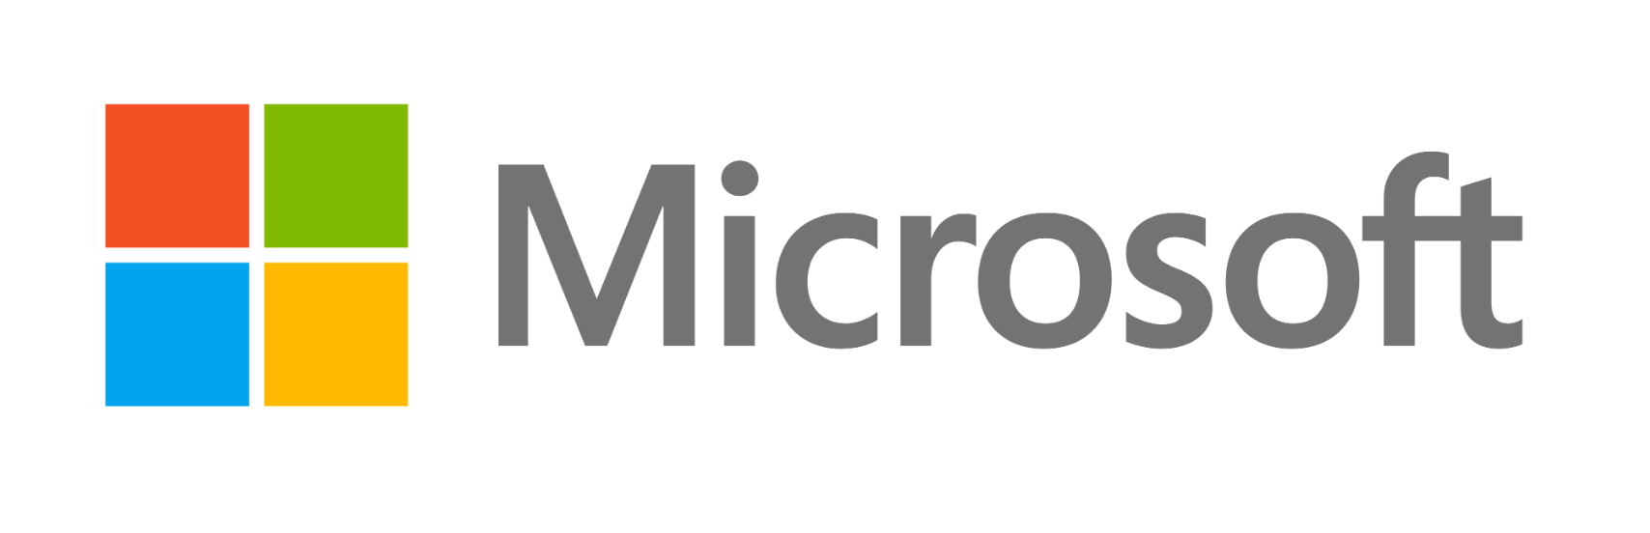
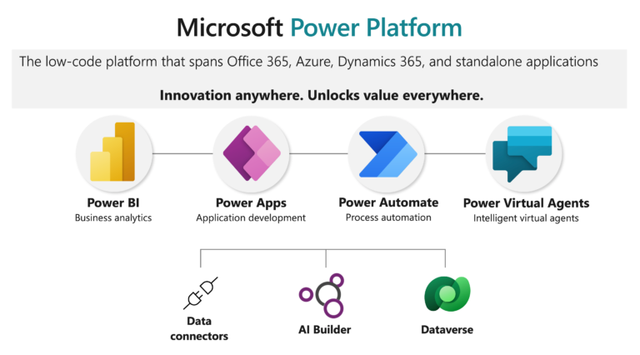

Slide 4
What is Microsoft Power Apps ?
Power Apps is an initiative by Microsoft that lets you quickly build and share powerful low-code applications. It’s a suite of apps, services, and data platforms that enables rapid application development to build custom apps based on business requirements.
You can quickly create custom business apps that connect to your business data either on-premises (Excel, Office 365, SharePoint, and more) or data platform (common data source for apps) or
Power Apps at its core is a platform as a service that enables you to create applications that run on any mobile device or browser. The purpose behind developing Power Apps is to make users build applications with new capabilities without having coding expertise. Microsoft touts an initial visual design for PowerApps, with drag-and-drop functionality.
Power Apps has connections with various Microsoft-based and third-party applications, including SharePoint, SQL server, and OneDrive in the Office 365 productivity suite and Google Docs, Dropbox, Dynamics CRM, and Oracle.

Slide 5
Microsoft PowerApps Features
Easy integration with other Microsoft services: One of the primary reasons for using Power Apps is that it’s easily connectable with other Microsoft services like Excel, OneDrive, SharePoint, etc.
User-friendly Interface: Power Apps supports a user-friendly interface. With this, you can build an app easily, even if you don’t have any development experience. Create interfaces that can perform CRUD operations
Canvas Apps and Model-driven Apps: There are two ways by which you can develop apps in Power Apps - Canvas and Model-driven Approach. You can design an app just by dragging and dropping elements onto a canvas. With model-driven apps, much of the layout is determined and designated by the components you add.
Cloud Connectivity: It’s extremely easy to connect to cloud services like SQL, Dropbox, Google Drive, etc., with Power Apps.
App creation and sharing: Supports an easy drag-and-drop interface for the creation of apps. You can easily share with anyone you want with Power Apps.
Cost-effective: If you want to develop rich business applications but can’t afford developers, start using this fantastic tool. Power Apps is cost-effective.
Common Data Service (CDS): CDS allows you to store and manage data securely used by business apps. Data within CDS is stored in the form of entities. An entity is a set of records that stores data similar to a table in a database. CDS for Apps contains a set of legal entities that cover typical scenarios. You can still create custom entities particular to your company and populate them with data using Power Query. Developers use Power Apps to build rich apps using this data.

Slide 6
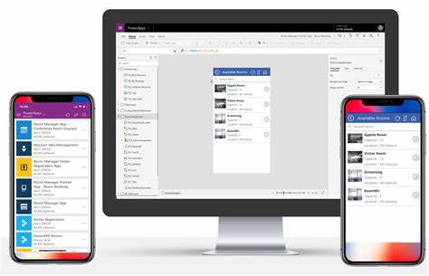
What is a Power Platform For Power Apps?
Microsoft Power Platform comprises the Power BI, Power Apps, and Flow. These three services provide tools to manage the data of any enterprise process.
Power BI is used to display and analyze the data. It’s a real-time, interactive data visualization BI tool.
PowerApps are used to modify data. It builds apps with less code in no time for the web, Android & iOS devices.
Microsoft Flow is used to automate data. It offers powerful workflow automation with the no-code approach and easy integration.

Slide 7
Canvas apps
Provides the Power Apps maker with complete control over the pixel-perfect screen contents and navigation between multiple screens. Canvas applications use different connectors to work with data and services. Canvas applications can be embedded into SharePoint, Teams, Power BI, and Dynamics 365 applications.
Key developer extensibility points
Build custom UI components using Power Apps component framework
Create custom connectors to communicate to your external data sources and services. A custom connector is a wrapper around a REST API and can be created using tools like Azure Functions and Azure API Management
Model-driven apps
Data-driven applications that are built on top of Microsoft Dataverse. Other data sources and services can be used by model-driven applications by embedding a canvas application.
Key developer extensibility points
Build custom UI components using Power Apps component framework
Implement client business logic using JavaScript and the client API
Build HTML web resources

Slide 8
Power Automate
Power Automate is used to automate tasks and orchestrate activities across various services that use integrated or custom connectors. Using Power Automate you can create cloud flows or desktop flows.
Type | Description
Cloud flows | Can be triggered manually, configured to run when specific events occur, such as when a record is created, or scheduled to run at a specific time. Power Automate is built on top of Azure Logic Apps but offers unique integration with Microsoft Power Platform.
Desktop flows | Used to automate repetitive interactive tasks on the web or the desktop.

Slide 9
Power Automate is a simple tool that allows you to automate any task. Now, this task can be simple as sending an email out every morning, or it can be very complex, like upload some document to a file system when you enter something. The best thing about it is that tasks can go between any application. For Example, you can have a task that takes an email from Outlook and puts it onto Twitter where you have a task that basically reads, likes messages, finds keywords, and then sends you an email based on that. There are hundreds of different connectors that Power Automate has like Twitter, YouTube, Slack, Gmail, One Drive, Google Drive, etc. And if connectors don't exist then power automate allows you to connect to your application using third-party API tools. You can also have tasks not only with these applications but also on your desktop or website. Some tasks can have interruptions from people, so Power Automate has something called approval's where in between your task flows you can actually get approvals from people. So if you're automating an invoice flow, for example, you can have the flow, seek approval from a person, before it gets paid out at the invoice amount, which is over a thousand dollars. You can also actually have a flow, take control of your mouse on your desktop, move files around, open any application, and the same thing with the website. In a nutshell, it allows you to streamline and automate any workflow that you have. It is a platform on Microsoft Cloud for creating what laws to interact with people as well as the other systems. It is a web-based interface, so you just need the browser, open the browser, design your workflow, save it on the cloud and you're good to go. It is built for business users. This platform is not targeting developers, although developers use it quite a lot, it is designed in a way that developers can easily learn it and work with it.
It offers three core elements which are Triggers, Actions, and Connectors.

Slide 10
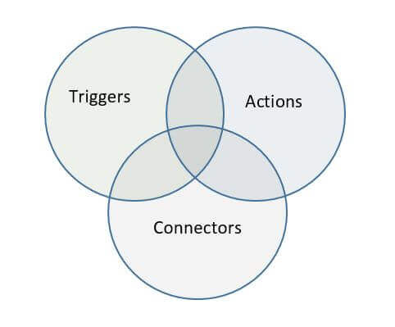
Triggers : Triggers are basically the starters. It's like a push a button to initiate or start the workflow.
Actions : Everything that a workflow in power automate does for us is coming through actions so one workflow can have one trigger to start with.
Connectors: Whenever this workflow wants to interact with any external service like email server, like coming into service, like power apps, like any other system, we are working with connectors. These are open doors to other systems.
Features Of Power Automate
Easy to use : There's no code required and it has a very simple design. It's very similar to using PowerPoint or Excel. It's so accessible to people and if you do know how to code that, you can do some very complex things.
Comprehensive : You can connect to hundreds of connectors that they have so you can have tasks between Slack and Gmail, Salesforce, and text messaging. You can basically support everything in power automate. Finally, it has something called UI Flow, which allows you to perform the robotic process automation on your desktop and which is very powerful.
Powerful : It's very powerful. You can create some complex logic in your workflows and can also have conditions in your workflows. There are loops to iterate between workflows. It allows you to add user's intervention to the workflow.
Scalable : You can easily share it with people. You can also monitor it and share it with all the colleagues in your businesses and all your colleagues in your company.

Slide 11
Power Pages
Power Pages is a secure, enterprise-grade, low-code software as a service (SaaS) platform for creating, hosting, and administering modern external-facing business websites. Low-code makers can rapidly design, configure, and publish websites that seamlessly work across web browsers and devices. Professional developers can extend these capabilities to address advanced business requirements.
Key developer extensibility points
Custom web page templates built with HTML, CSS, and Liquid
Extend site integration with Dataverse with the portals Web API
Use Visual Studio Code and the Power Platform CLI to enable metadata editing and CI/CD (Continuous Integration/Continuous Deployment) of site configurations

Slide 12
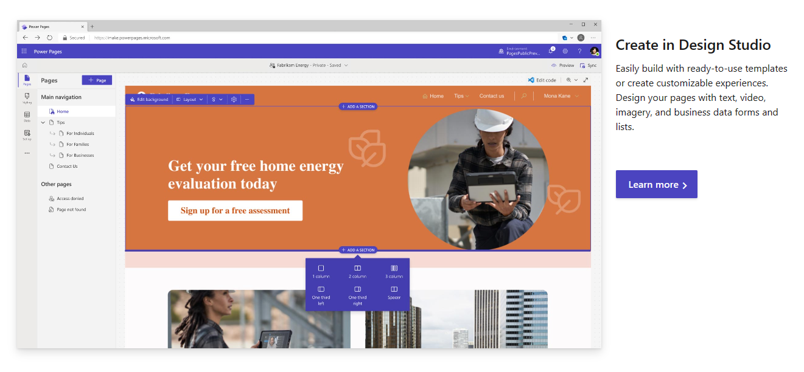

Slide 13

Power Virtual Agents
Power Virtual Agents lets you create powerful chatbots that can answer questions from your customers, other employees, or visitors to your website or service. Power Virtual Agents is built on Microsoft Bot Framework and provides a low-code experience to build and manage chatbots.
Key developer extensibility points
Build Bot Framework Skills
Extend your bots with Bot Framework Composer

Slide 14
Characteristics Of Power Virtual Agents
Power Virtual Agents are flexible chatbots with artificial intelligence (AI) at your disposal.
PVA allows employees to create their own bots. It enable personnel to concentrate on difficult requests and high-value interactions by automatically resolving common customer and internal concerns.
PVA using a guided, no-code graphical interface, so you can quickly create your own virtual agents, robust chatbots, without the need for engineers or data scientists.
It eliminates the time delay between when a user reports an issue and when the bot is updated to reflect it so it improve customer satisfaction by resolving issues more quickly.
You can use hundreds of prebuilt connectors to connect Power Virtual Agents to the goods and services you use every day.
With Power Virtual Agents you can monitor and continuously improve chatbot performance with AI- and data-driven insights presented in an easy-to-understand dashboard.
Microsoft Power Virtual Agents is a SaaS offering which offers a low code/no code way of building intelligent chatbots.

Slide 15
Benefits Of Power Virtual Agents
Get started in seconds: It allows you to easily sign up, create your chatbot, and embed it into your website with just a few clicks. There is no infrastructure to maintain or complex systems to deploy.
Empower your teams: enabling them to easily build chatbots without the need for coding, or AI expertise.
Simple to build – With its no-code interface, anyone can build and deploy their own chatbot, regardless of technical capability.
Integration: Power Virtual Agents are also integrated with the other tools within the Microsoft Power Platform such as Power Automate.
Reduce costs by easily automating common inquiries and allowing human agents to focus on more complex issues.
Improve customer satisfaction: It eliminates the time delay between when a user reports an issue and when the bot is updated to reflect.
Enable rich, natural conversations: The powerful conversational AI capabilities of Microsoft enable your end users to have rich multi-turn conversations that quickly guide them to the right solution. And, unlike most products on the market, no retraining of AI models is required. Simply provide a few brief examples of the topic you want the chatbot to handle, construct the conversation using the graphical editor, and your chatbot is ready to handle customer requests. You can even test your changes in the test pane in real time!

Slide 16
Conclusion
Power Virtual Agents empowers teams to easily create powerful bots using a guided, no-code graphical interface without the need for data scientists or developers. It easily integrates bots with hundreds of apps and services using prebuilt connectors and allows the ability to create custom workflows with Power Automate, enabling bots to take action on behalf of customers.

Slide 17
Dataverse
Dataverse is a cloud scale data store that builds on Microsoft's data technologies and abstracts away data management complexity from the app maker. It lets you securely store and manage data that is used by business applications. Business data within Dataverse is stored within a set of data tables. Role-based security allows businesses to control access to the data tables and even individual records for different users within your organization. Developers can extend or customize Dataverse functionality by adding custom business logic. You can define calculated table columns, business rules, workflows, and business process flows to ensure data quality and drive business processes.
Key developer extensibility points
Create plug-ins, similar to event handlers, that customize or extend Dataverse data processing with custom business logic (code)
Use webhooks and Azure Service Bus to integrate with external systems
Extend the Dataverse API with your own custom API that implements your business logic
Use virtual tables to integrate data stored in external systems into Dataverse without replicating the data

Slide 18
Need for Dataverse
Data is the building block of the modern business landscape. All operations ranging from product marketing to development are centered on the contours of data. Data is generated from a wide variety of sources: applications, services, and even SaaS applications. This huge repository of data needs to be collected, segregated, explored, analyzed and visualized to be harnessed for the good of the organization. Different types of data require different storage and analysis media. This means that you cannot analyze or store unstructured data the same way you analyze and store structured data. Consequently, rigorous data infrastructure is needed to harness the different types of data from different sources so that they could be put to use in the business scenario.
Microsoft Dataverse is the one-stop destination for harnessing a broad variety of data being generated across different domains throughout the globe. It provides a flexible, scalable, and secure SaaS platform for thorough data handling. Moreover, its simplistic UI renders it extremely easy to leverage and integrate with other data platforms and solutions like Power.

Slide 19
Why Use Dataverse?
All data types supported
Microsoft Dataverse supports all kinds of data, from files, images, blobs to relational databases and data lakes. Dataverse comes with a pile of enterprise-ready services like table automation, and multi-platform integration that facilitate its purpose.
App Integration
Dataverse is often integrated with other Microsoft technologies like Power Apps for workflow automation. This is extremely useful if the data collected and analyzed in Dataverse shall be used to drive certain enterprise pipelines. Dataverse is already integrated with prominent Microsoft solutions like Dynamics 365, MS Excel, Power BI, Azure Data Factory, etc. However, it also provides a REST API, developer SDK, and a bot-based app alternative for increased functionality.
Security and Compliance
Microsoft Dataverse is built on Azure and leverages Azure’s authentication and security features like Active Directory for encryption and authenticated access. It divides data access on the basis of two models: manager and position. The security features also permit row-level and column-level sharing.
Microsoft Dataverse is a trusted SaaS data platform. All the concerned data adheres to regulatory compliances and is validated by audits and certifications.

Slide 20
Dataverse Databases
Dataverse is known for creating standardized databases which further contain tables. A Dataverse database is a cloud-based unit instance that stores data in standardized structures called tables. A table is a collection of multiple rows containing both standard and custom data. Logical columns help in handling specific aspects of the data in the rows. Multiple database instances can be created in Dataverse to store business data. Tables are extendable and customizable to adhere to business needs. These integrated business solutions can be shared with multiple partner organizations for collaborative data analysis.
Dataverse databases can support complicated data models. Tables can hold millions of items, and storage in each instance of a Microsoft Dataverse database can be extended to about 4 TBs of data, per instance(1TB=1024GB). The amount of data that is available in an instance of Dataverse is based upon the number and types of licenses the data-handlers have been issued with. Data storage is mutually pooled by all the license holders and can be shared. However, in case of an outage, additional resources could be purchased accordingly.
There are two main categories of tables.
1. Standard- Standard tables have a pre-defined layout and structure. They are created for every instance of Dataverse databases. More columns could be added to any standard table, but columns could be deleted only from custom tables.
2. Complex– Complex tables have complex workflows and pipelines, and intricate server-side business logic.

Slide 21
Features of Dataverse
1) Security->Dataverse uses Microsoft Azure’s Active Directory(AD) to ensure authenticated access and regulates data security by imposing multi-factor authentication(MFA). Azure AD allows for authentication down to the minutest blocks of the instance (rows and columns) to ensure purely authentic access to data. Auditing capabilities are also provided by Microsoft Dataverse.
2) Logic->Dataverse allows consumers to integrate logical inputs to their business data for directional processing. These logical rules are consistent for every purpose, ranging from redundancy detection to workflow automation.
3) Data->Dataverse is a platform that offers optimum data flexibility and scalability to model to validate business data. This allows data maximum portability and flexibility. In simpler words, this means that it can be modeled as per the wishes of the user.
4) Storage->Dataverse provides Azure’s fully-scalable storage facilities to the clients. This means that storage is fully-managed from the cloud end and users don’t need to be concerned about outages. Azure’s in-built services help moderate the cloud-spend to provide customized services.
5) Integration->Dataverse ensures interconnectivity with multiple interdisciplinary services that would help improve the quality of data and enable resilient data handling and management. APIs, eventing, and web-hooks help support business data.

Slide 22
Thank You !!

