Slide 1
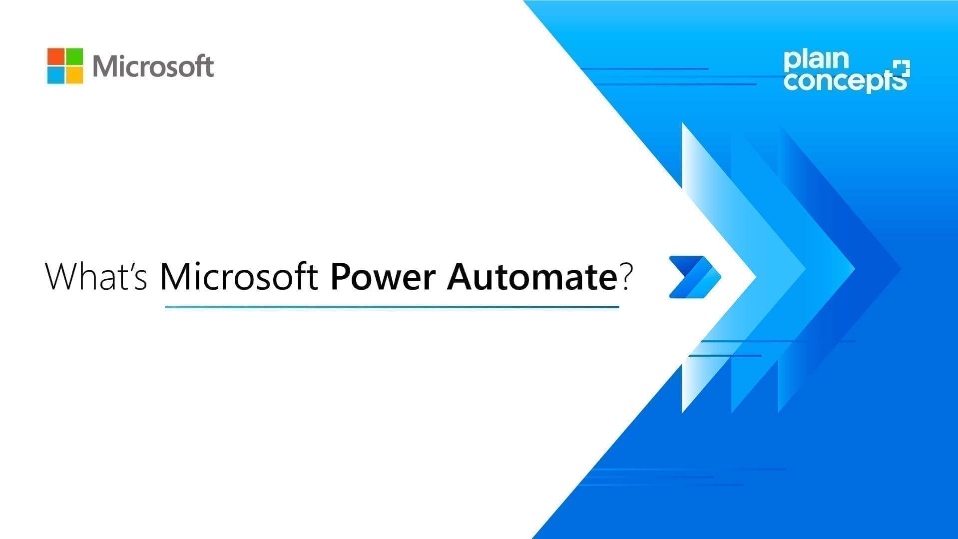

Slide 2
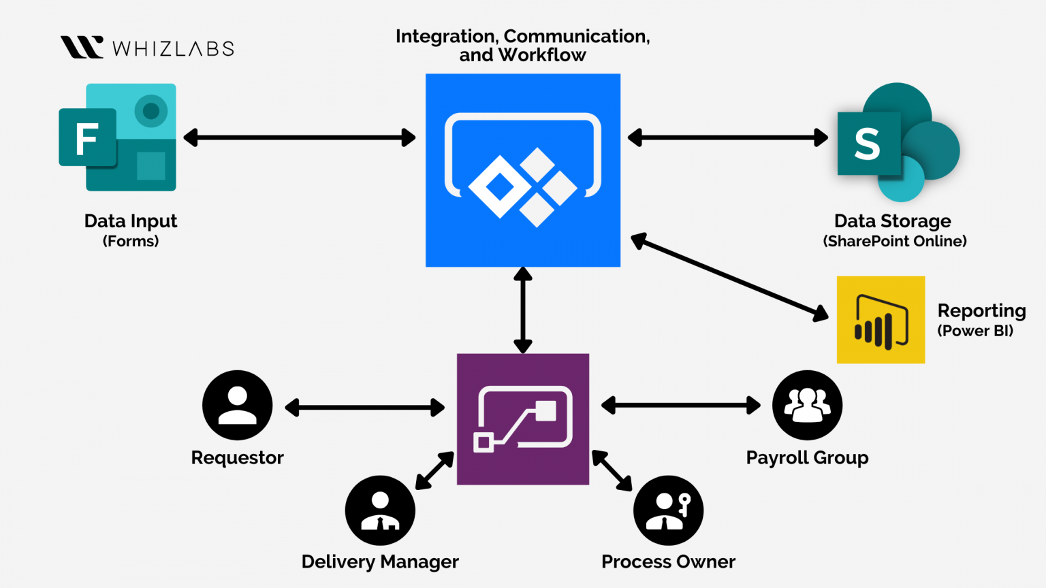

Slide 3
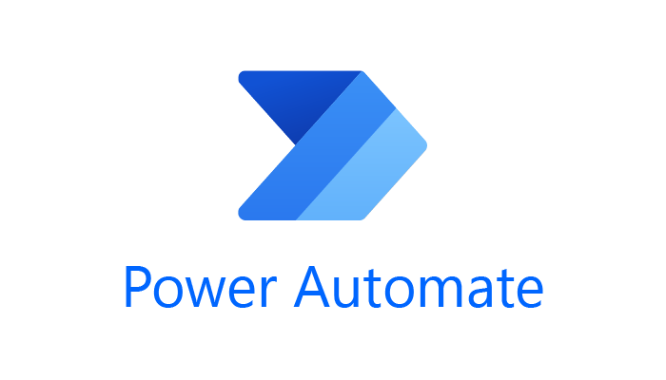
Microsoft Power Automate is a comprehensive, integrated automation platform with advanced digital process automation (DPA), robotic process automation (RPA), and process mining capabilities. With the power of low-code and AI, you are in the driver’s seat to securely automate your organization at scale.
Microsoft Power Automate boosts user productivity, allowing them to put intelligent workflows to use with minimal effort. Using pre-built connectors, users can build time-saving workflows that can do anything from individual tasks to large-scale systems with seamless integrations.
These secure workflows also include cloud-based functionality such as data loss prevention, identity, and access management services. With the ability to automate time-consuming manual tasks with built-in AI capabilities, there’s more time to focus on strategic, high-value opportunities in the business. The main advantage of this platform is that it’s built for integration on a broader ecosystem of services that leverage automation, which in return gives your organization a head start on hyperautomation. It also offers low-code AI, enabling any user to leverage these capabilities within their automated solutions.

Slide 4
Microsoft Power Automate was created not only for citizen integrators and IT members, but it was also made for non-technical business users in mind. This puts automation tools in the hands of every employee, empowering people to create their own solutions within an easy-to-use platform.
As an advanced integration tool, Microsoft Power Automate connects to over 1,000 out-of-the-box data sources, such as Google Sheets, Twitter, Dynamics 365, SharePoint, Salesforce, and OneDrive.

Slide 5
How Does Microsoft Power Automate Work?
Automations are either started manually, scheduled, or triggered by an action. These automations, called Flows, can occur in the cloud (Cloud Flows) or locally to a device or VM (Desktop Flows). While Cloud Flows run in remote Microsoft datacenters (the same ones as Azure) and don’t require an interface, Desktop Flows are accomplished through a more traditional robotic process automation (RPA) capability. The cloud- and desktop-based solutions are built to work together and address the many diverse needs of organizations.

Slide 6
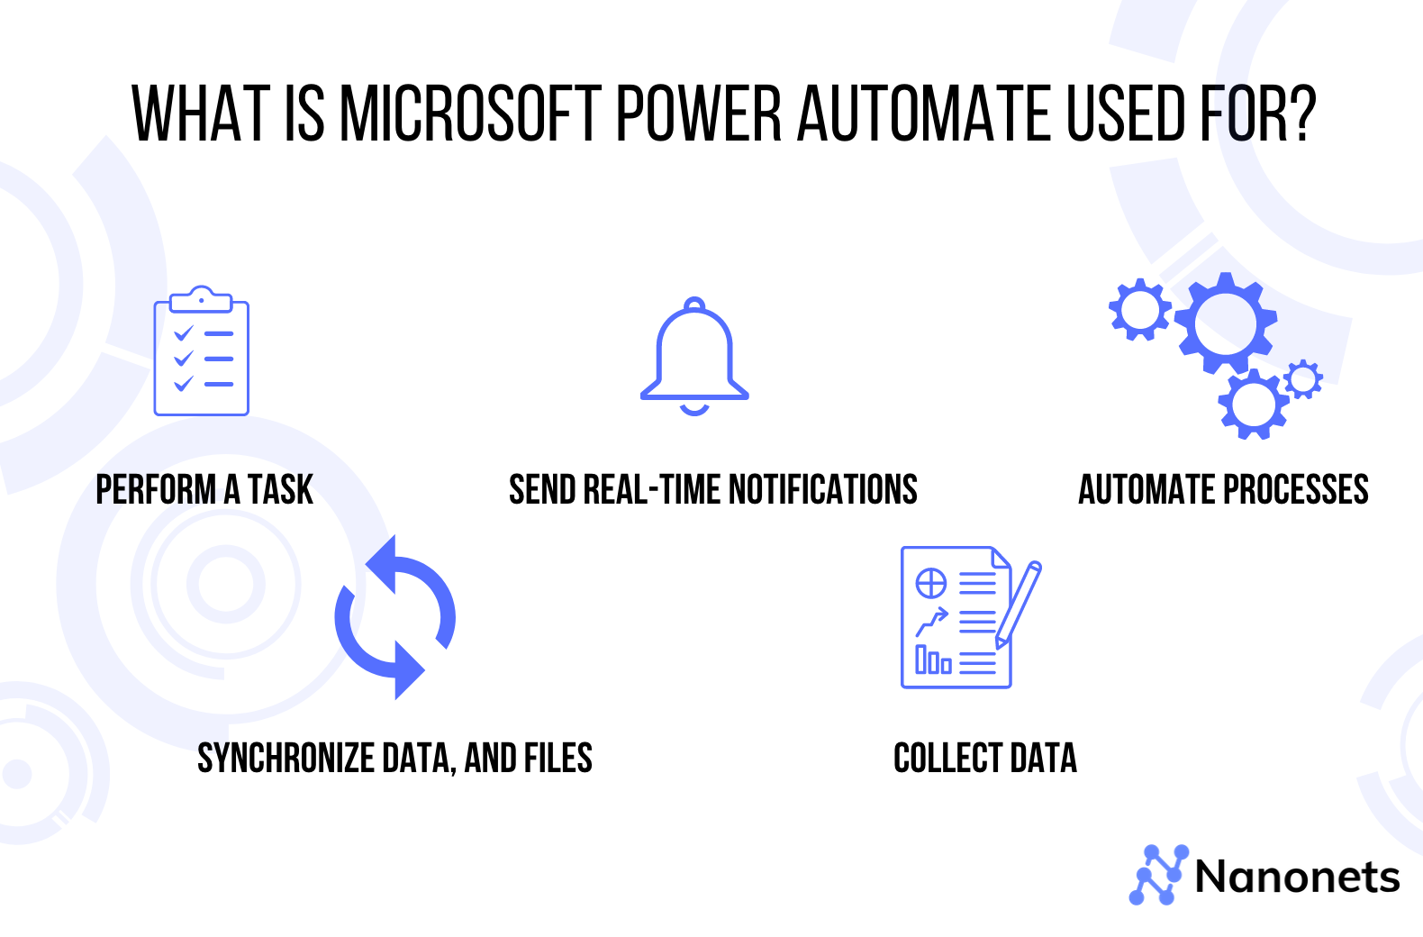

Slide 7
Here are the automation tools inside of Power Automate:
Cloud Flows: Automations managed from your web browser that can be started manually, triggered, or scheduled. These are the best method to incorporate third-party cloud services, APIs, and AI Builder
What is Power Automate Cloud Flow Designer
Cloud Flow Designer

Slide 8
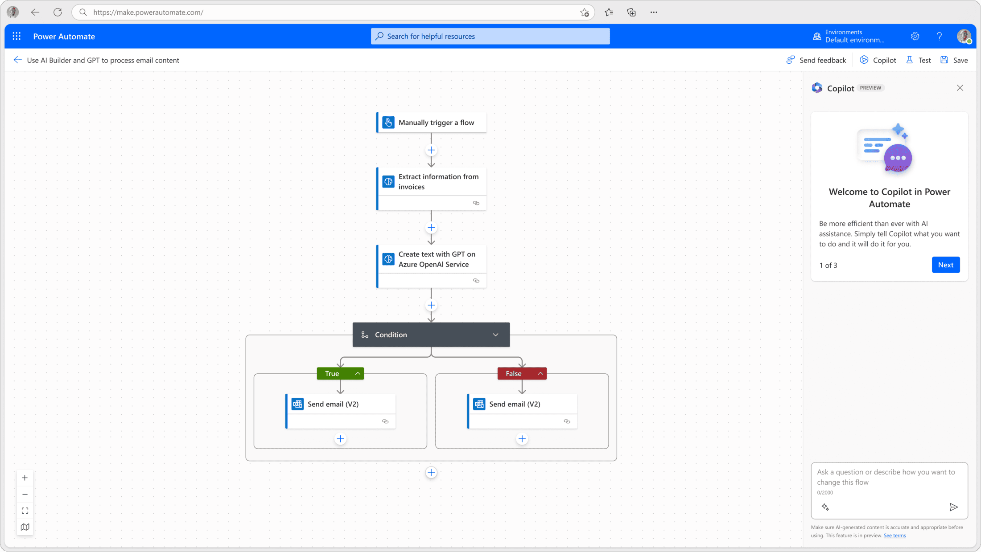

Slide 9
AI Builder:
A highly advanced, AI and machine-learning-based optical character and image recognition tool that can be incorporated into solutions to extract, categorize, and process files. Though this isn’t technically a piece of Power Automate, it is a feature unique to the Power Platform and can easily be incorporated into Flows.

Slide 10
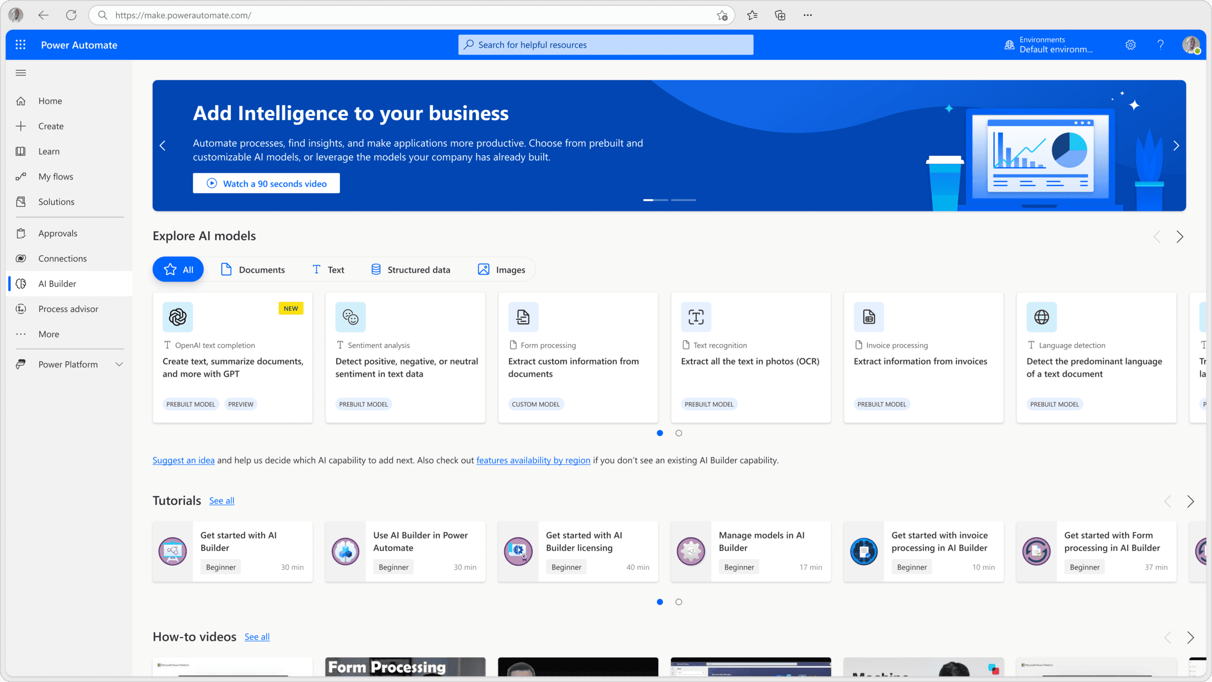

Slide 11
Desktop Flows:
With this flow, users can automate an interface on a desktop or VM by recording their screen, and the visual flow designer will automate mouse and keyboard clicks. Desktop Flows are dependent on the interface of the device or VM they are running on and are considered Power Platform’s “pure RPA” solution. Anything you can’t solve with Cloud Flows can be solved through Desktop Flows; some good examples include intricate data manipulation and legacy technology like green screens. Desktop Flows can be triggered or automated via Cloud Flows through their Unattended Add-On functionality.

Slide 12
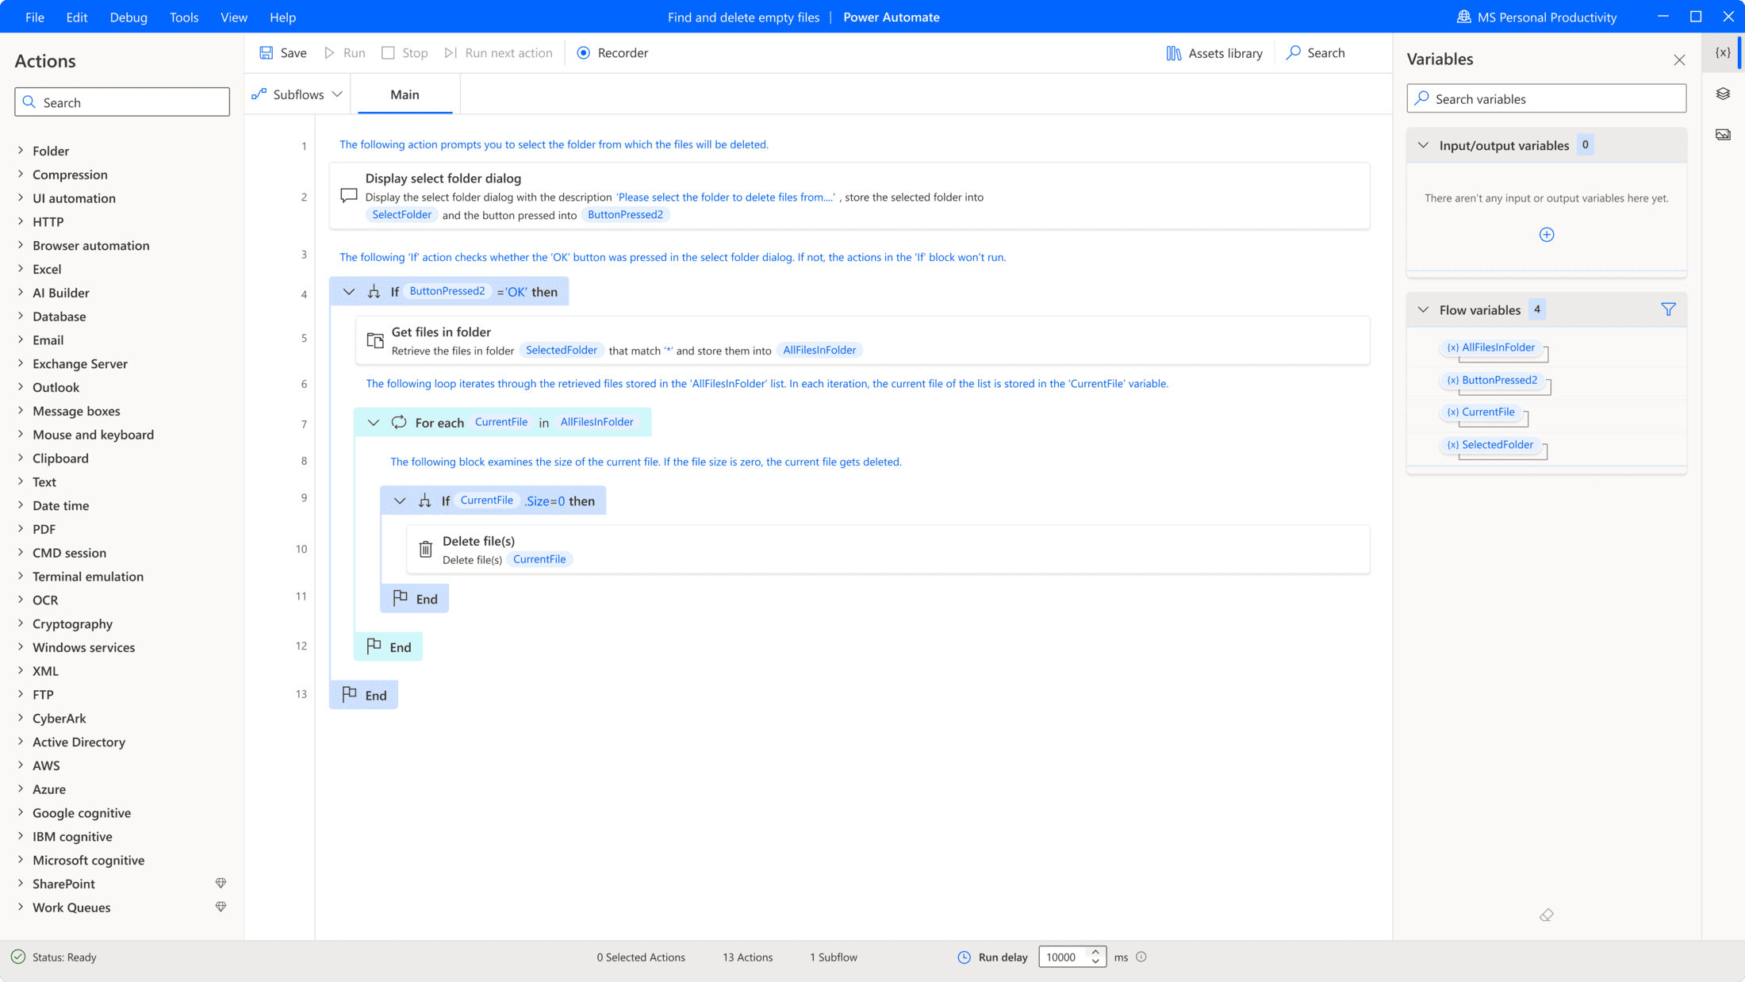

Slide 13
Business Process Flows: A method to automate people processes. Display the required steps for a specific business scenario via a model-driven app to a user every time it occurs. Cloud flows can be incorporated into these steps as well. For example, when a user marks a stage of the Business Process flow “complete”, an automated email is sent to their manager for approval. This allows your users to focus more on the quality of their work and interactions and less on the nitty-gritty details.
Process Advisor: Feed Power Automate and other process data into this tool to discover bottlenecks, efficiencies, and new automation opportunities you might not have thought of.

Slide 14
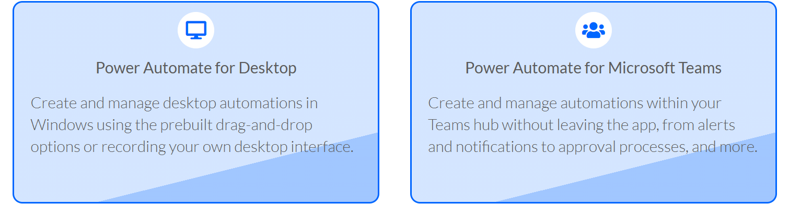
Automate Anytime and Anywhere
In addition to web and desktop, Microsoft Power Automate’s diverse solution suite allows you to expand your automation capabilities to Microsoft Teams and mobile devices.

Slide 15
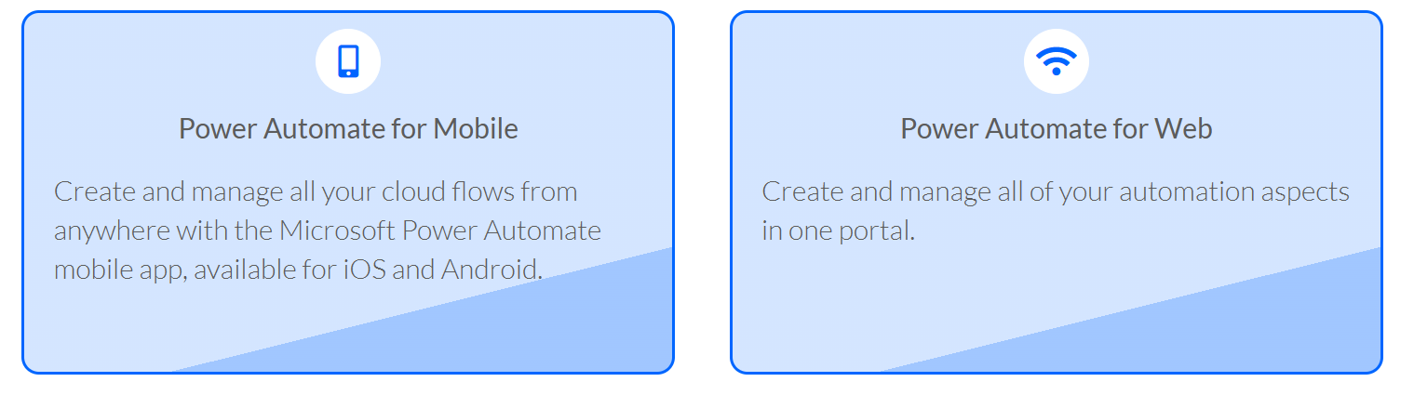

Slide 16
Automation Just Got Easier with AI
Power Automate released the Describe it to Design it feature, which allows users to create flows by describing them in natural language.
This feature makes it faster and easier to create flows, and flows created using this feature are more likely to be used.
In addition to Describe it to Design it, Power Automate is also adding two new features:
Copilot, an AI-powered assistant that helps users build and improve flows. Copilot is a natural language processing (NLP) model that can understand and respond to user queries. It can help users with tasks such as finding the right actions to use in a flow, troubleshooting errors, and suggesting improvements.
Create text with GPT, which is a new action that allows users to generate text using AI (GPT-3 language model). This can be used for various tasks, such as creating content, generating responses to customer feedback, and extracting information from documents.
These new features make Power Automate even more powerful and easy to use, and they help businesses automate more of their processes. They are available in preview now, and they will be generally available later this year.

Slide 17
A systematic approach to manual tasks
With its seamless integration with robust technologies, Microsoft Power Automate makes it easy to automate manual tasks to help businesses reduce effort and errors.
Power Automate Platform Highlights:
Hundreds of pre-built actions and templates with a user-friendly interface
Ease-of-integration with AI Builder
Provides a solution for whatever technology you’re trying to automate
Native connection with Microsoft apps & tools
Over a thousand pre-built connectors and ease of custom connector creation
Scheduled, triggered, and manual automations
Integrated error handling
According to a Forrester’s Toal Economic Impact of Microsoft Power Automate study, Power Automate drives business transformation and has the results to show for it. Of the surveyed companies, Forrester saw a 199% ROI over the course of 3 years, which equated to $1.4 million in worker time savings.
Power Automate is a robust, enterprise-grade tool for your industry needs. The platform excels in many areas and that list continues to grow. Microsoft has proved Power Automate to be a well-designed, and accessible tool for automation solutions that can empower both technical and non-technical professionals to create automations.
This platform’s simple-to-complex automation capabilities securely streamline workflows across various departments, and all of this is managed through a single pane of glass. With the ability to automate repetitive, manual tasks, users can focus on the strategic aspect of their daily operations.

