Slide 1
CAPSTONE: Customer Profitability Analysis
June 2024

Slide 2

What is Customer Profitability ?
Customer profitability is all about figuring out how much money a customer brings in compared to how much it costs to get and keep them.
This analysis enables businesses to make critical strategic decisions, including:
Tailoring customer service activities based on customer profiles.
Customizing marketing strategies based on customer profiles.
Implementing initiatives to sustain or boost customer profitability, which may involve transforming unprofitable customers into profitable ones.

Slide 3
Dataset Overview
Dataset has 9 Tables
Business Units Table: Describes different business units, including their divisions and executive IDs.
Date Table: Contains temporal data such as years, periods, dates, and quarters for time-based analysis.
Scenario Table: Outlines different scenarios for comparison, typically actual versus budget.
Facts Table: Primary table consists of all the Transactions that were made.
Product Table: Identifies various products offered by the business.
Customers Table: Profiles customers by their names, locations, industries, and countries/regions.
Industry Table: Categorizes industries with corresponding IDs and images.
Executive Table: Lists executives with their respective IDs and images.
State Table: Provides information on states including their codes, regions, and names.

Slide 4
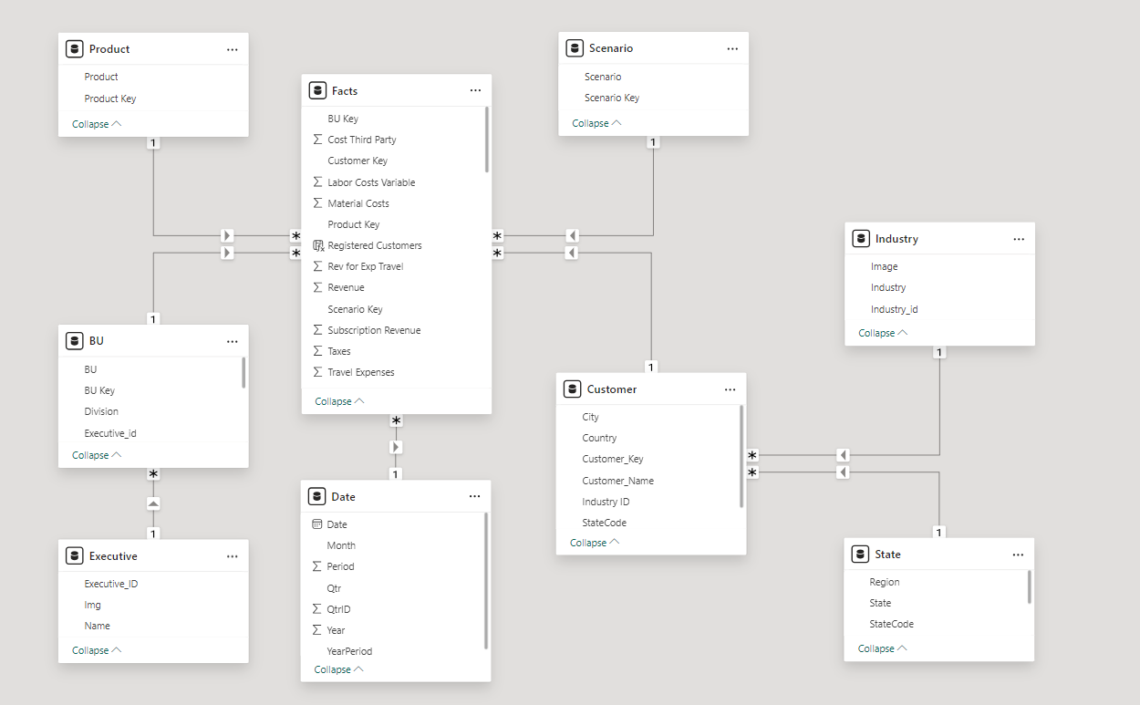
Data Model
Snowflake schema extends the star schema by breaking down dimension tables into subdimensions, offering a structured approach that enhances data integrity and reliability.

Slide 5
Data Transformations
Removal of data:
✓Removed Postal Code from customer table.
✓Removed Image column from Industry and executive table.
Changing Data type of the data:
✓Changed the datatype of YearPeriod column to Number from Date.
✓Changing revenue and cost related column datatype into currency with decimals.
✓Changed Customer Key to text to remove blank in visuals.
Rename columns of data:
✓In customer table renamed the customer to Customer_Name.
✓In customer table renamed Country/Region to Country.
✓Renamed Industry column to Industry_id in Industry table.
✓In executive table renamed executive column as Executive_ID.
✓In State table renamed state column as StateCode.

Slide 6
Analysis & Visualization

Slide 7
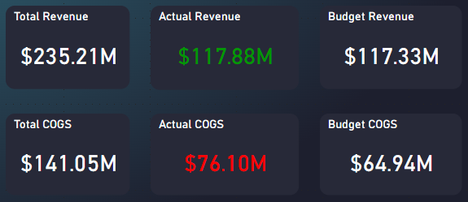
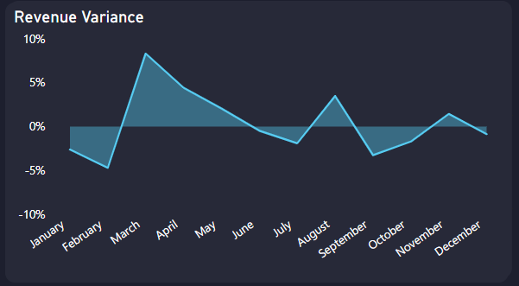
Revenue Variance
Dataset consists of two distinct scenarios: Actual and Budget.
Actual revenue represents the real revenue generated by the company, whereas budget revenue reflects the estimated revenue amount.
Actual COGS represents the actual costs incurred by the company in producing or acquiring the goods sold, while Budget COGS reflects the estimated or projected costs associated with the goods sold.
In March, there is a significant revenue variance of 8.29%, indicating that actual revenue surpassing budget revenue, distinguishing it from other months.

Slide 8
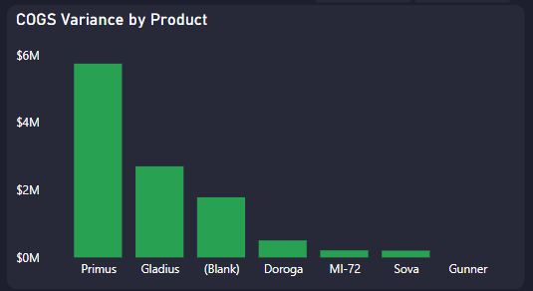
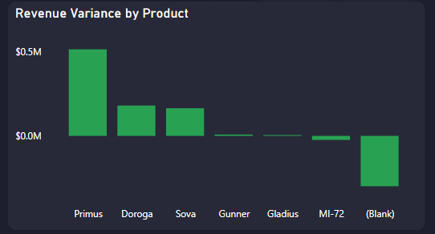
Primus product exhibits the highest COGS variance, followed by Gladius, (Blank), Doroga, MI-72, Sova, and Gunner.
Primus product demonstrates the highest positive revenue variance and (Blank), which experiences the highest negative revenue variance.
When the COGS variance is higher for a product like (Blank) but the revenue variance is negative, it suggests that despite the higher variability in the cost of goods sold, the product's revenue is decreasing.
This scenario could indicate inefficiencies in cost management or pricing strategies for the (Blank) product, leading to reduced profitability despite fluctuations in production costs.

Slide 9
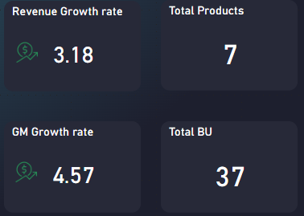
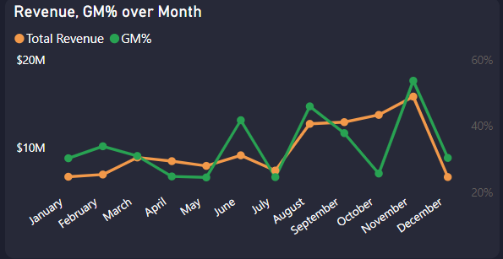
Revenue Analysis
The dataset comprises 37 business units. Among these, 26 are currently active, with 14 business units demonstrating revenue generation.
Total YOY Revenue Growth rate is 3.18% and YOY Gross margin Growth rate is 4.57%.
The dataset contains information on a total of 7 distinct products offered by the company.
The decrease in GM% in October and July could be due to seasonal shifts affecting customer demand or market conditions, leading to sales volume or pricing fluctuations, impacting the gross margin.

Slide 10
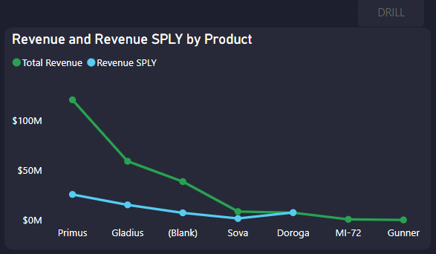
In 2013, sales occurred from August to December, involving products Primus, Gladius, (Blank), Sova, and Doroga.
In 2014, the products included Primus, Gladius, (Blank), Sova, Doroga, MI-72, and Gunner.
The "Blank" product, despite being unidentified, is generating significant sales. Identifying this product could enable targeted marketing and activities to further enhance its growth.
Select a Product and Click on DRILL Button to get detailed analysis of that product.

Slide 11
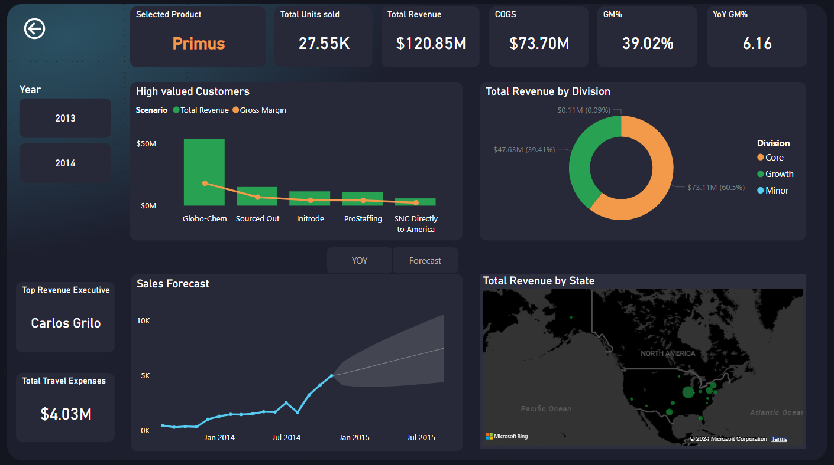
Product Drill Through Page
Forecasting for product sales, assuming market conditions remain the same, shows a visual trend of gradual increase over time for Primus Product.

Slide 12
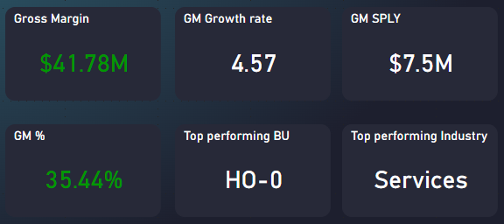
Profit Analysis
Gross Margin Related KPI’s are shown below
The Core Division is driving significant growth, contributing the largest share to the overall increase in revenue and profitability.
While the Services industry generates the most revenue, industries like Insurance, Materials, Finance, Semiconductor, Telecom, and Industrial contribute the highest Gross Margin percentages, highlighting their profitability.
Some products like Primus have higher revenue but lower Gross Margin% due to many additional costs. In contrast, the product Gunner, despite generating less revenue, achieves a higher Gross Margin% because of minimal costs.

Slide 13
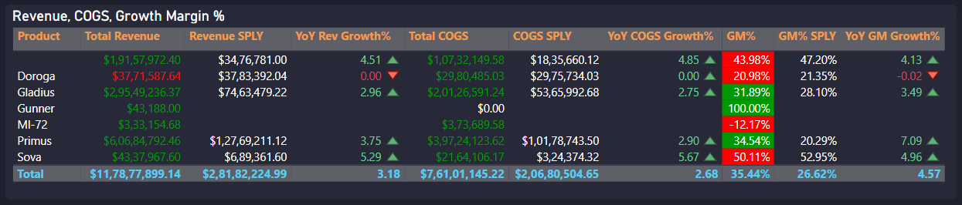
COGS Analysis
In 2013, Sova achieved a profit margin of 52.95%. However, in 2014, despite being the fourth highest revenue generator among all products, its profit margin is lower than the previous year's percentage.
In 2014, Doroga's revenue is lower than the previous year's, leading to a decline in revenue growth%. Although COGS is lower than last year, which is positive, it negatively impacts the gross margin.
Increased production costs in October, ahead of the holiday season, contribute to higher COGS. Despite this, profit% rises from November due to the revenue surge during the holiday period.

Slide 14
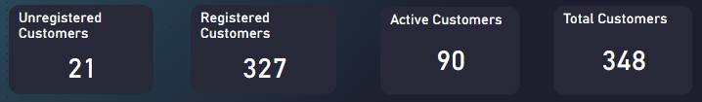
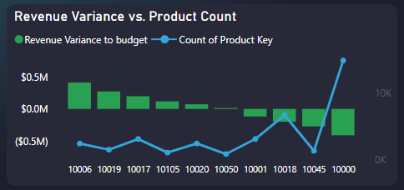
Customer Analysis
Among the total customer base of 348, 90 customers are currently active, engaging with the company's products or services.
Of these, 327 are officially registered customers, indicating a formal association with the business.
Surprisingly, 21 customers, although unregistered, actively contribute to revenue, underscoring their significance despite lacking formal registration.
Customer 10006 exhibits a positive revenue variance despite purchasing fewer products, whereas customer 10000, with nearly 15k products sold, experiences negative revenue variance. This suggests differing patterns in sales efficiency or product profitability between the two customers.

Slide 15
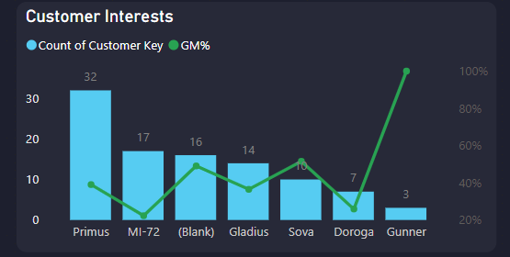
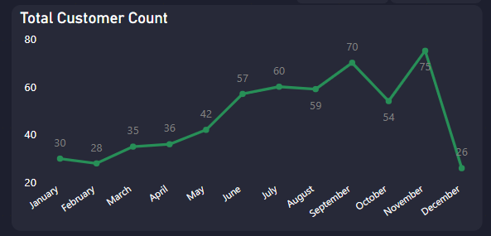
Most customers prefer purchasing Primus products, while Gunner and Sova products yield higher gross margins despite having fewer customers.
This indicates potentially higher profitability and demand for Gunner and Sova products despite their lower customer base.
There is a higher level of customer interest observed in the Core Division compared to other divisions.
The visual displaying customer count by month indicates a higher footfall in November, attributed to the holiday season, while October experiences a lower count.

Slide 16
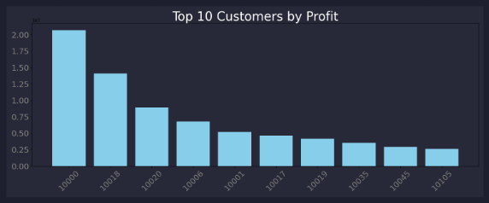
Created a visual of the "Top 10 Customers by Profit" using Python in Power BI, which highlights the customers contributing the most to our profitability. This visual provides a clear ranking, allowing us to focus on maintaining and enhancing relationships with these key customers.

Slide 17
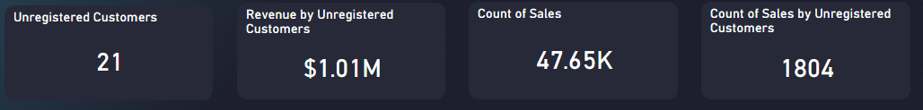
Unregistered Customers Analysis
Although totaling only 21, unregistered customers contribute significantly, generating $1.01M in revenue from 1804 sales out of 47k total sales. This underscores the potential value of unregistered customer engagement despite their smaller numbers.
These customers exhibit a preference for MI-72, Gunner, and Sova products, primarily within the Minor Division, all originating from the (Blank) region.
Identifying the (Blank) region and having data on these customers could significantly enhance revenue generation in the future by enabling targeted marketing strategies and personalized offerings tailored to their preferences and behavior.

Slide 18
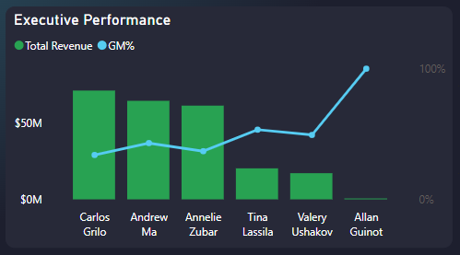
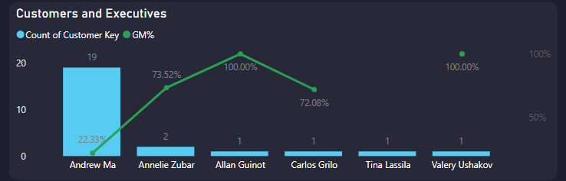
Executive Analysis
Out of 9 executives, only 6 are active. Among them, Carlos Grilo and Andrew Ma are top performers, generating high revenue but with lower profit margins.
In contrast, Allan Guinot, the least performer in terms of sales, achieves a 100% gross margin.
Most of the unregistered customers are managed by Andrew Ma.
Carlos manages majority of the customers from the North region, while Andrew oversees customers from the East region.

Slide 19
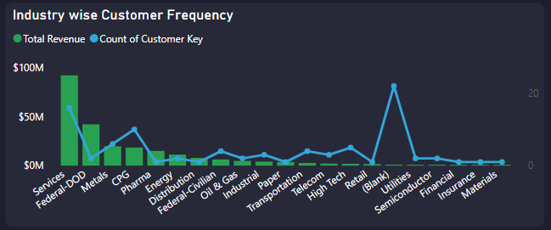
Most of the customers are interested in purchasing from the (Blank) industry, which generates less revenue.
Additionally, Andrew's performance is predominantly tied to this industry.
Andrew's major revenue comes from the Primus product and the Core Division.

Slide 20
Insights
Revenue Growth Trends:
Revenue experienced significant growth starting in July, indicating a positive sales trend.
Product Performance:
The Primus product generates the most revenue, followed by Gladius, Sova, and Doroga.
Dorogo's sales experienced a sudden decline in 2014, warranting further investigation into the cause.
Cost Analysis:
COGS variance is more pronounced for the Primus product, suggesting potential cost management challenges.
Actual costs exceeded budgeted costs, negatively impacting Gross Profit, requiring cost optimization measures.
Seasonal Revenue Variance:
Higher Revenue Variance observed in Q1 and Q2, attributed to non-holiday months, indicating seasonal sales patterns.
Product Portfolio Analysis:
Primus product demonstrates the highest positive revenue variance, while (Blank) experiences the highest negative revenue variance, suggesting varying performance across product lines.

Slide 21
Customer Insights:
Globo-Chem emerges as the top customer, indicating a significant revenue contributor.
Unregistered customers are generating $1M in revenue, suggesting untapped potential for customer registration and engagement strategies.
Geographical and Industry Trends:
Majority of revenue and sales originate from the USA, indicating a strong market presence.
Unregistered customers primarily belong to the Minor division, highlighting a segment with growth opportunities.
Insurance and Materials industries exhibit higher Gross Margins despite lower revenue, indicating potentially lucrative sectors.
Executive Performance:
Carlos is the top executive contributing the highest sales, while Allan demonstrates the highest profit margin, suggesting effective sales strategies and cost management.
Surprisingly, Andrew, the second top executive, exhibits comparatively lower sales in the North region, necessitating regional sales strategy adjustments.

Slide 22
Recommendations
Analyze product performance; discontinue or reposition underperforming items like (Blank) and Doroga to prioritize higher-performing products like Primus and Gladius.
Optimize costs, especially for high-variance products like Primus, through measures such as renegotiating contracts, streamlining production, and managing inventory efficiently.
Create seasonal marketing campaigns for peak months like November; offer holiday-themed promotions and bundled deals to maximize sales opportunities
Regularly monitor KPIs, analyze data for insights, and adapt strategies for sustainable growth.
Develop targeted marketing campaigns to convert unregistered customers into registered ones. Offer incentives or discounts to encourage registration and repeat purchases.
Implement customer segmentation strategies to tailor products and services to specific customer needs, increasing customer satisfaction and loyalty.
Explore opportunities for geographical expansion beyond the USA to diversify revenue streams and tap into new markets with growth potential.
Evaluate regional sales strategies to address performance disparities, such as Andrew's lower sales in the North region. Provide additional training or resources to improve regional sales performance.
Provide additional training and support to executives to enhance sales performance and strategic decision-making. Encourage collaboration and knowledge sharing among executives to leverage best practices and drive growth.

Slide 23
Role Management
Name | North | South | East | West | Central
Dasari.sandeep@brillio.com | NA | NA | NA | NA | Read Access
Yasaswini.Desu@brillio.com | NA | NA | Read Access | NA | NA
Shaik.Kareem@brillio.com | Read Access | NA | NA | NA | NA
Karishma.Shaik1@brillio.com | NA | Read Access | NA | NA | NA
Gnapthika.T@brillio.com | NA | NA | NA | Read Access | NA

Slide 24

Thank you

