Slide 1
OBE Implementation
Module-1:Programlo
Submitted By
R. Sri Pardhu [AP22110010372]
Y. Santhosh [AP22110010388]
R. Meghana [AP22110010347]
M. Mose [AP22110011441]

Slide 2
Introduction to Project
Our University (herewith considered as SRM-AP) is going to implement OBE(Outcome Based Education) in their university and you are assigned in the project to develop a CURD(Create,Update,Retrieve and Delete) windows and mobile application using JAVA programming and Android studio for the same.

Slide 3
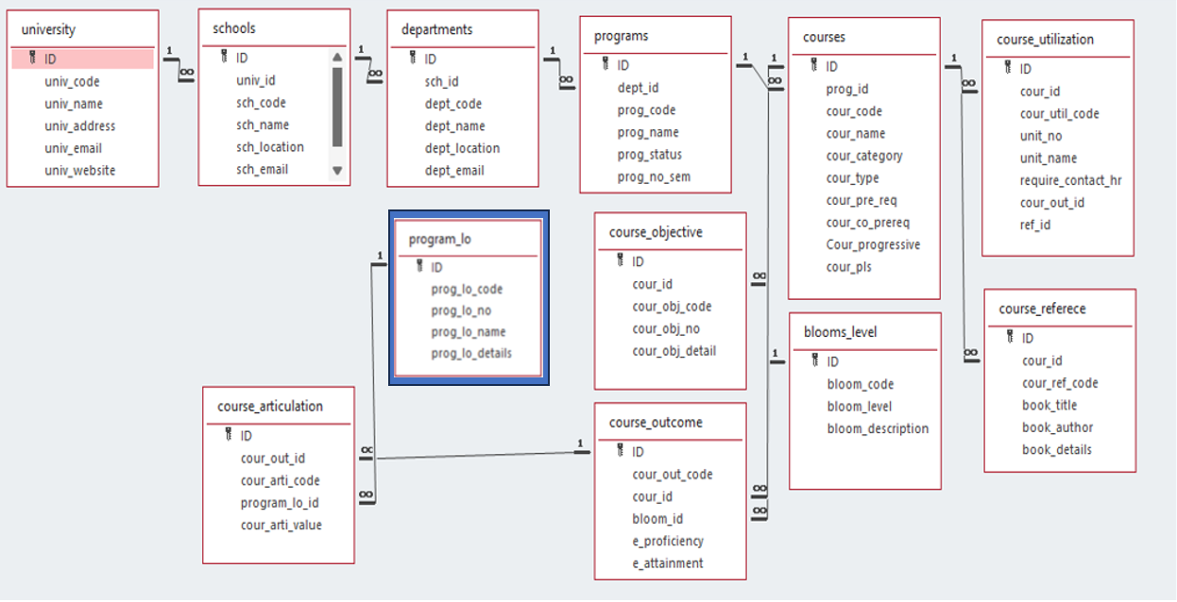
Architecture Diagram

Slide 4
Module Description : University Setting
This module is used to create,Update,Retrieve,Delete(hereafter known as CURD) details of the module and storing the details in the mysql table.

Slide 5
Programs:Field/table details
Field Name | Data type
ID | integer
proglo_code | String
proglo_number | integer
prog_name | String
proglo_details | String

Slide 6
Program_level_objective:Programming Details
File name: Programlo
Function/method name
Create: AP22110010372_programlo _create
Update:AP22110010372_programlo_update
Retrieve: AP22110010372_programlo _retrive
Delete: AP22110010372_programlo _delete

Slide 7
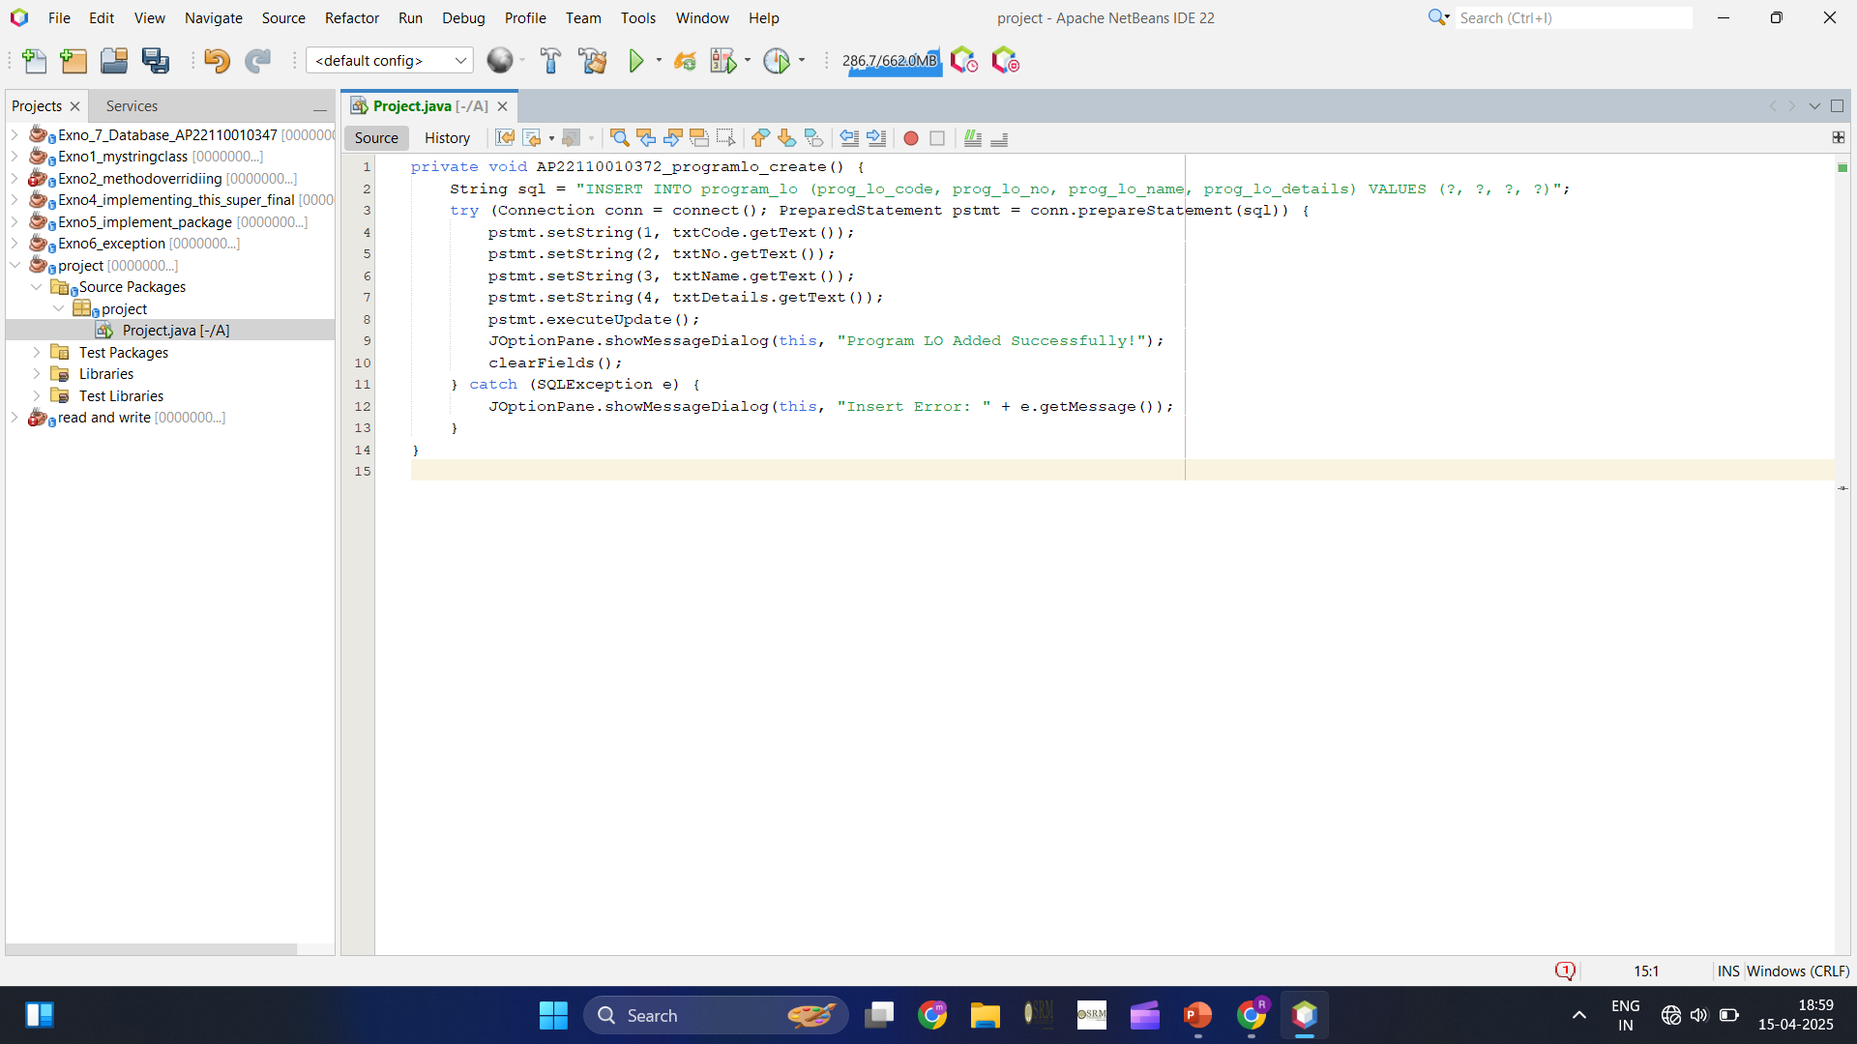
Sample Source Code
a.] Create:

Slide 8
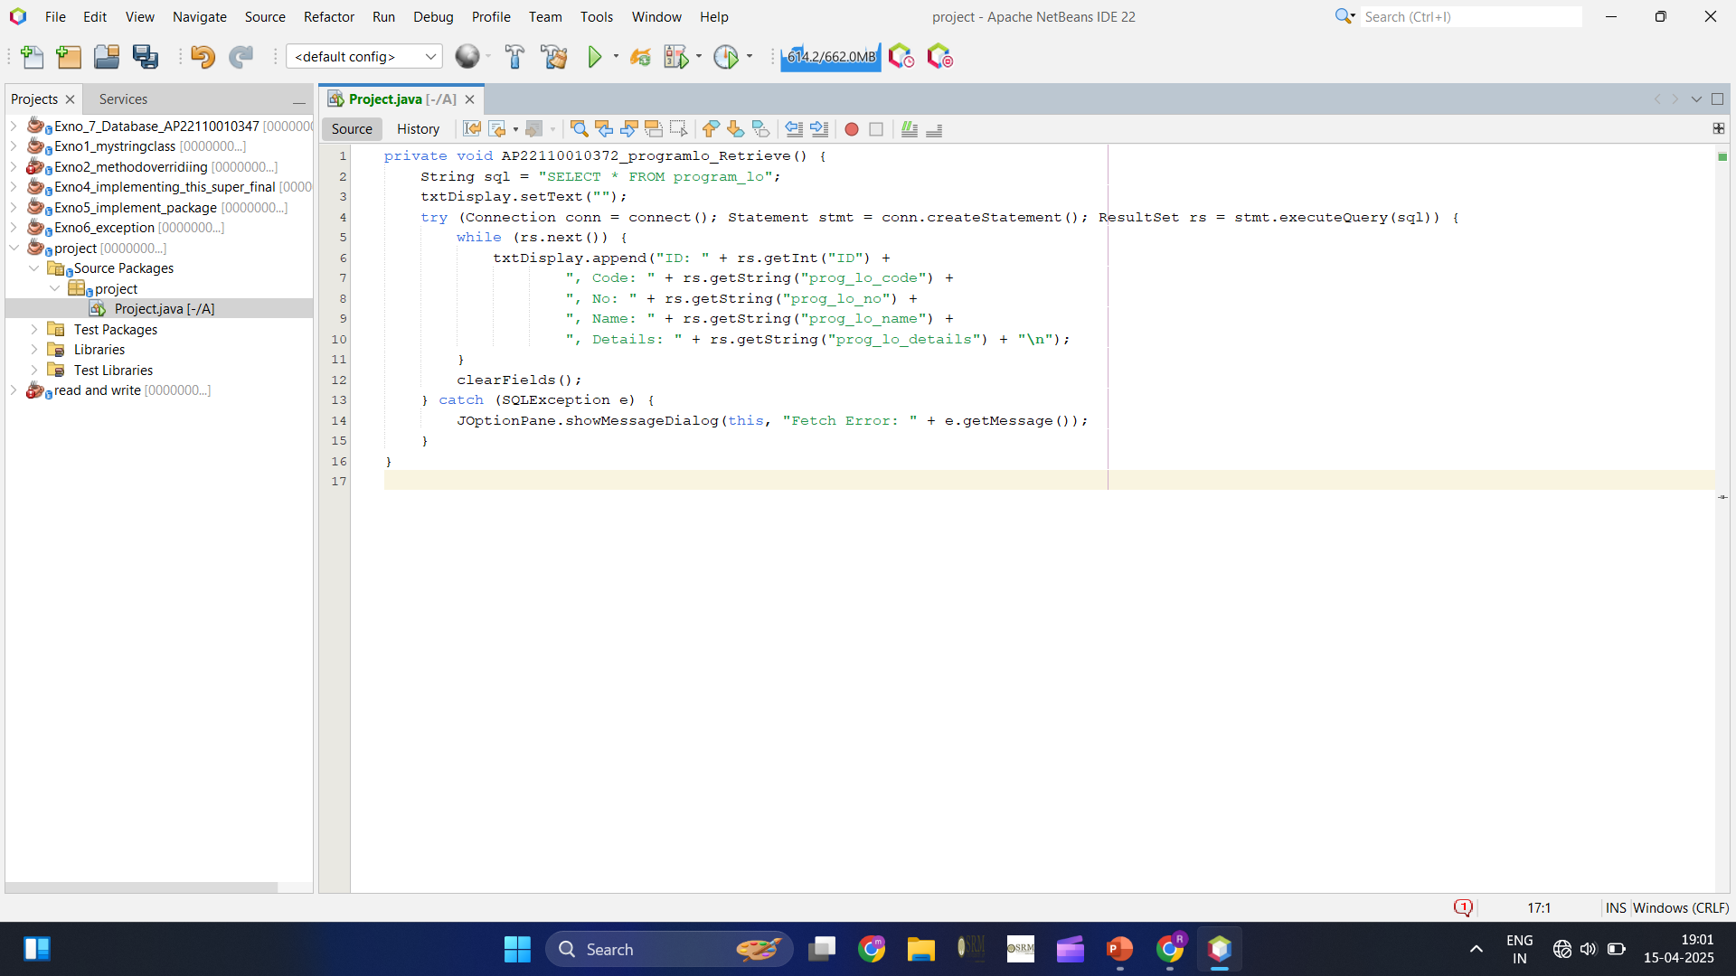
b.] Retrieve:

Slide 9
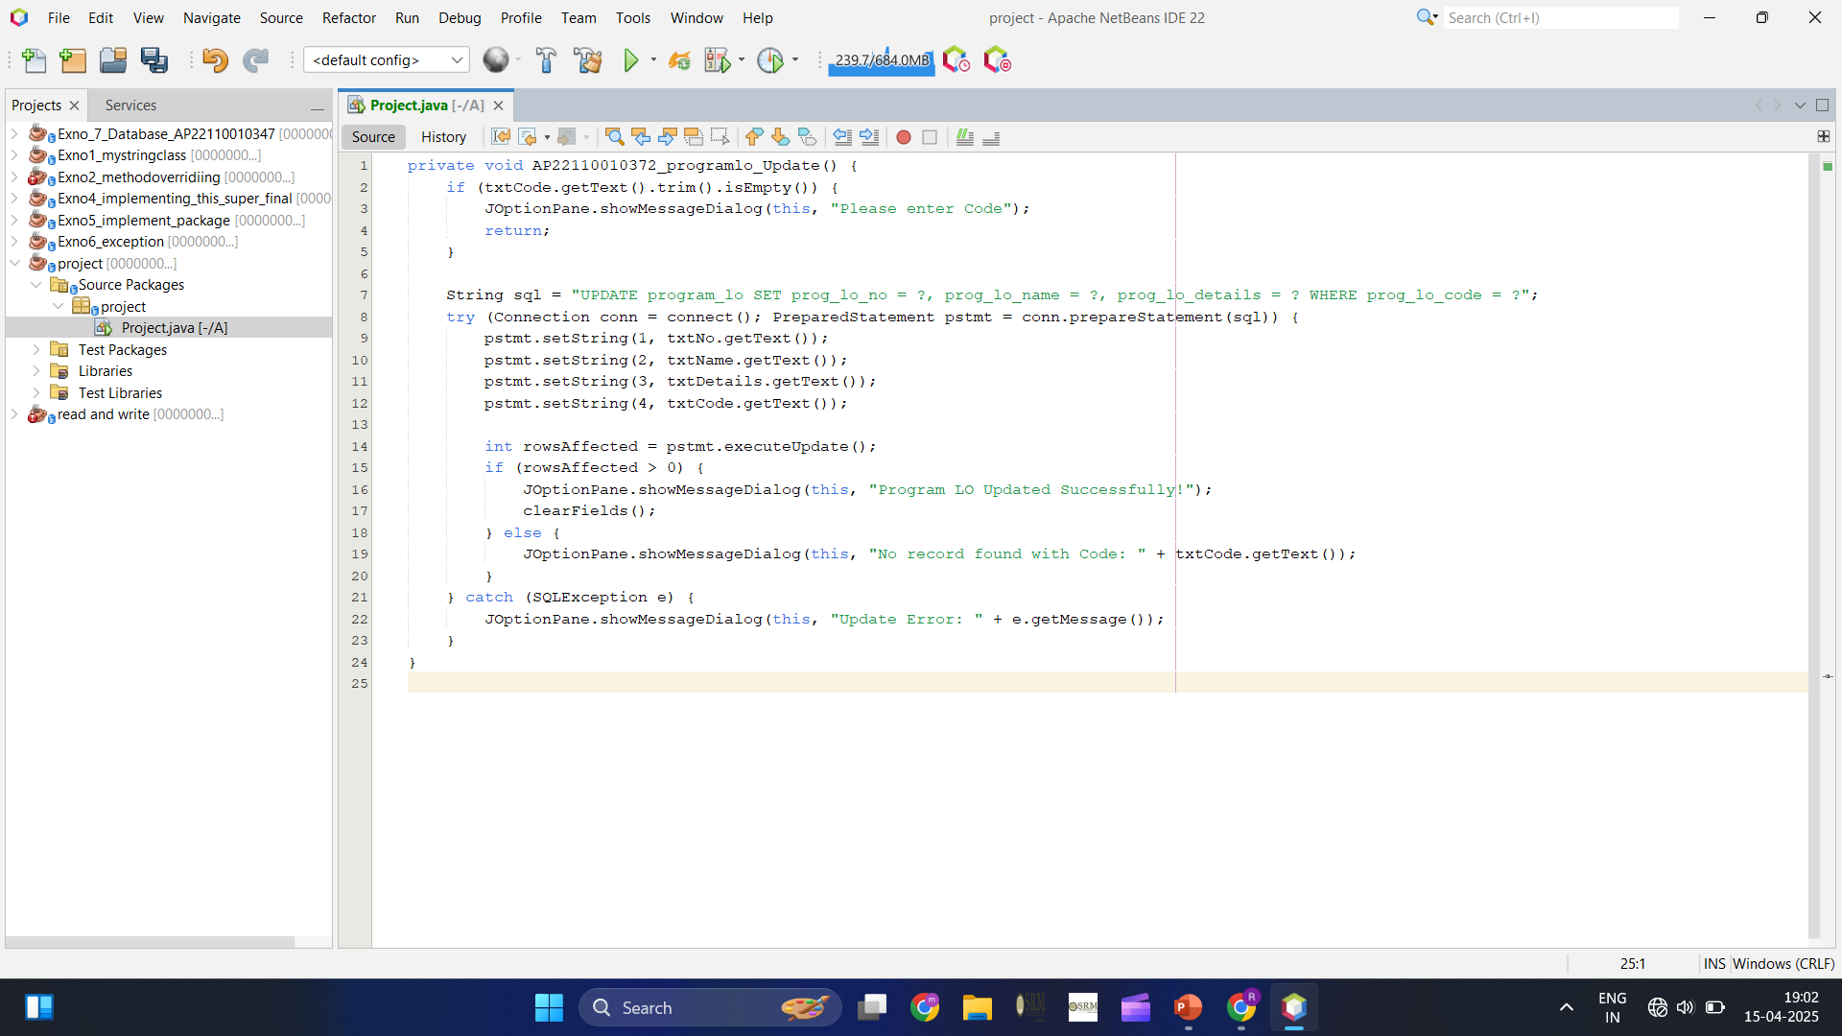
c.] Update:

Slide 10
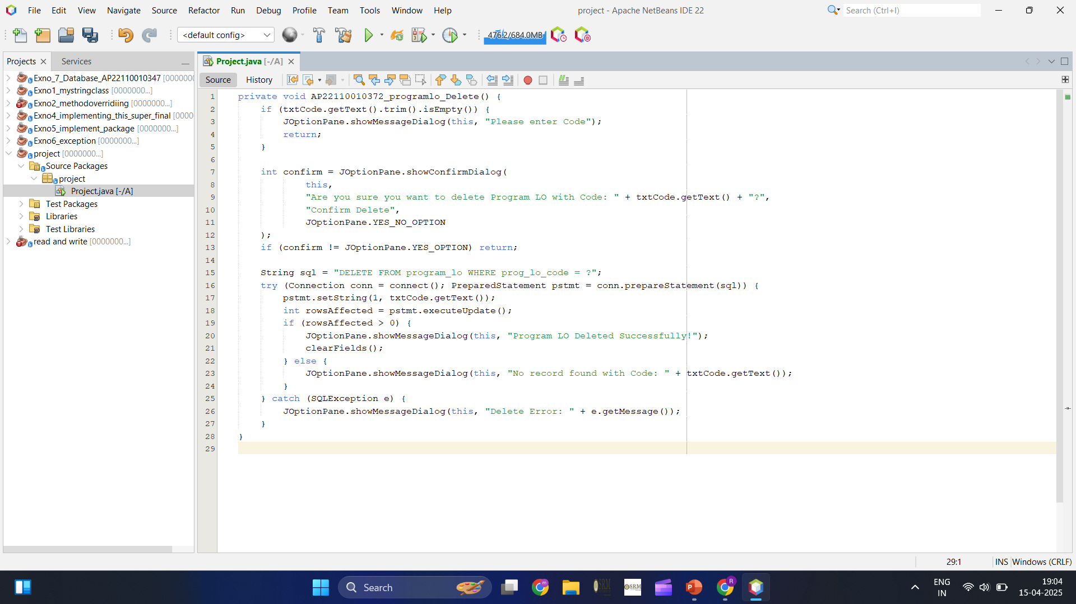
d.] Delete:

Slide 11
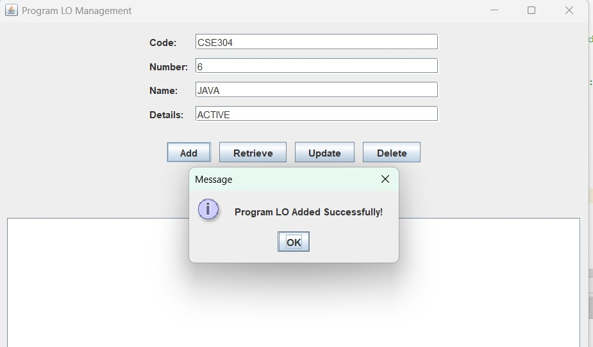
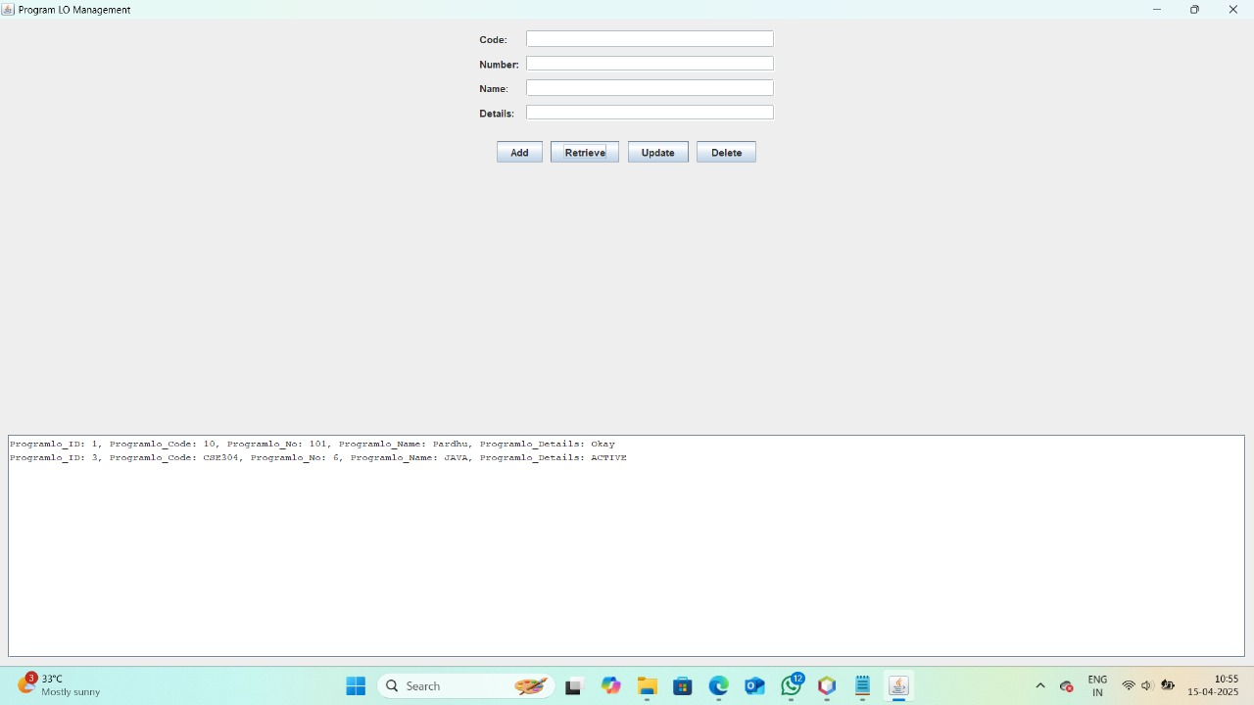
Sample Screen Shots
Create: Retrieve:

Slide 12
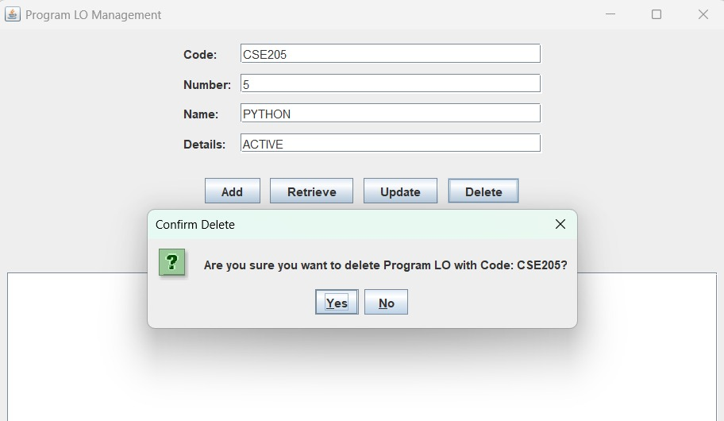
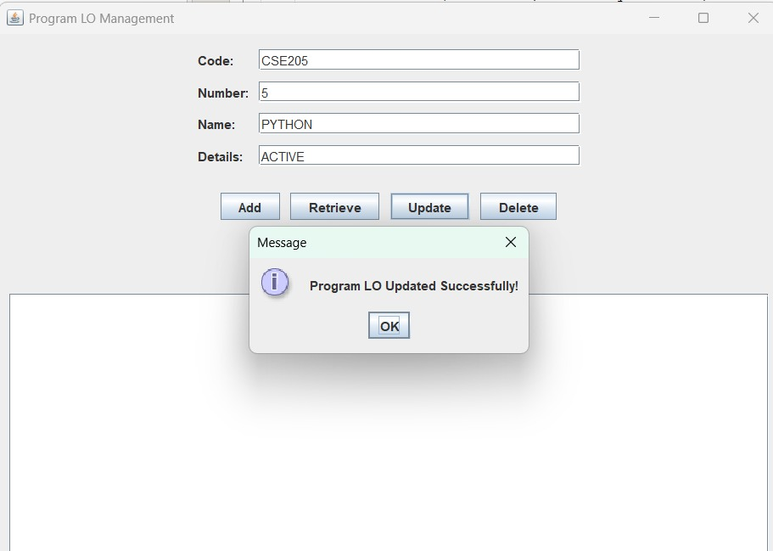
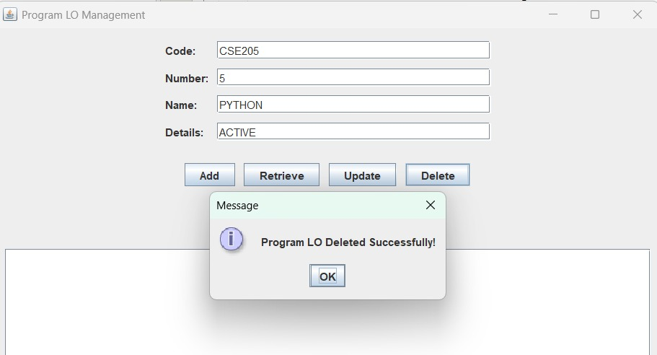
Sample Screen Shots
Update: Delete:

Slide 13
Conclusion
This project successfully implements CRUD (Create, Read, Update, Delete) operations in a Java Swing application using SQLite. The program allows users to manage program records by adding, viewing, updating, and deleting data through a simple graphical interface. The java file combines both database handling and GUI design, making it a compact and efficient solution. The use of JTable ensures that users can easily view and modify records.
Overall, this project provides a basic yet functional database management system that can be improved with additional features like search, validation, and enhanced UI in the future.

Slide 14
Thank You

