Slide 1


NBKR Institute of Science & Technology Quiz Game Using C and Data Structures
B. Pardha Manoj Reddy
B. Vijay Kumar
B. Hajarath babu
C. Sandeep
- Guided by Sivanraj

Slide 2
Introduction
An interactive C-based quiz game to test and reinforce data structure concepts.
It Uses arrays and linked lists for question handling and answer recording.

Slide 3
Objectives
Reinforce data structure knowledge
Provide gamified learning experience
Cover arrays, stacks, queues, trees, graphs

Slide 4
Problem
Students struggle with abstract data structure concepts.
Traditional methods fail to engage effectively.
This project provides an interactive solution.

Slide 5
Design
Text-based UI in C
Arrays store questions
Linked list records answers
Random selection of questions

Slide 6
Inputs
User starts quiz by selecting a level
Inputs answers to 5 questions at each level
Responses recorded dynamically

Slide 7
Outputs
User receives questions and inputs answers
If enough correct answers are given, user progresses to the next round
Total 3 rounds: Easy, Medium, Hard
If failed at any stage, quiz ends

Slide 8
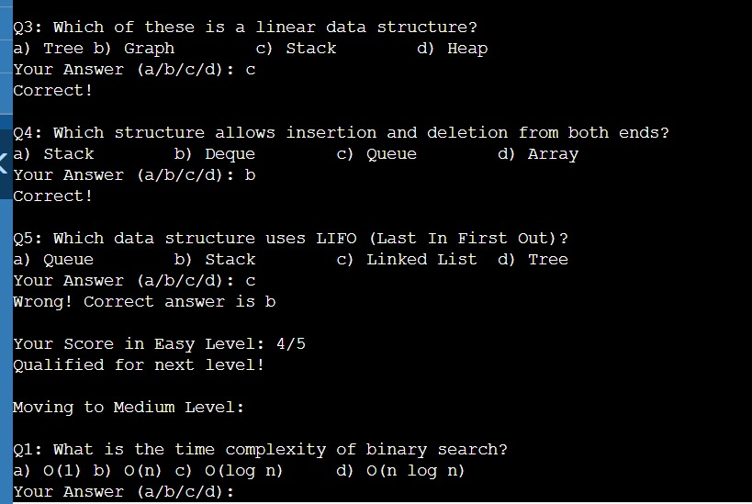
Some Images of outputs

Slide 9
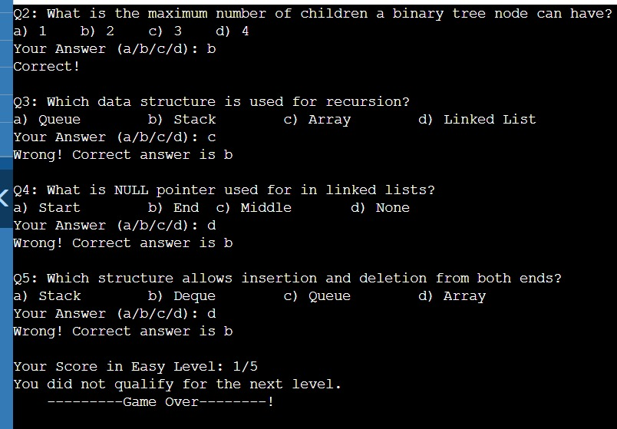

Slide 10
“Any Queries ?”
Feel free to ask any questions about the project!!

Slide 11
THANK YOU!!
We appreciate your time and attention!

