Slide 1


IDEA CREATION ON : FOOD FINDER CS-ALPHA BATCH NUMBER-04
NAMES OF THE TEAM MEMBERS WITH ROLL NUMBERS :
B.BHAVANA - 2311CS040020
A.VAISHNAVI - 2311CS040014
E.VIVEK - 2311CS040050
K.PARDHU - 2311CS040089
G.SADHVIK - 2311CS040062 DEPARTMENT OF CSE(CS)
MALLAREDDY UNIVERSITY
UNDER THE ESTEEMED GUIDANCE OF : HYDRABAD
MS.V.NAGA HEMA KUMARI

Slide 2
TITLE : FOOD FINDER
SUB TITLE: UNLIMIT FAVOURITE FOOD

Slide 3
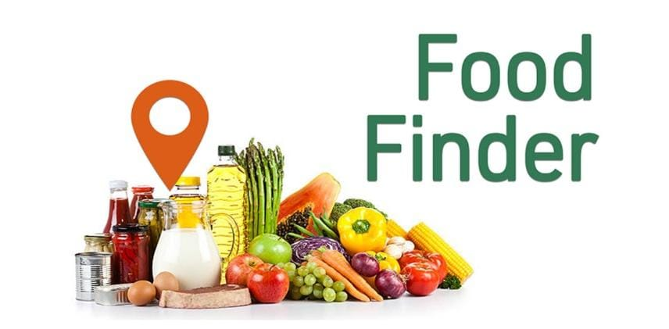
APP OVERVIEW AND PRESENTATION
Abstract
Objectives
Existing system
Proposed system
introduction
Flow chart
Architecture diagram

Slide 4
Algorithm
Screen shot of Login and signup page
Screen Shot Of Menu Page, My Orders Page
Screen Shot of Order Details Page, FFN Page
Screenshot of view log page, About Us Page
App security
Future updates
System requirements
Conclusion
References

Slide 5
ABSTRACT
The Food Finder abstract could focus on developing a mobile app that utilizes location-based services to help users discover nearby restaurants, cafes, and food options. It aims to enhance user experience by incorporating features such as reviews, ratings, and personalized recommendations, creating a seamless and efficient tool for finding and enjoying diverse culinary experiences. The Food Finder abstract envisions a mobile application designed to simplify the process of discovering and selecting dining options. Leveraging GPS technology, the app aims to provide users with real-time information about nearby restaurants, cafes, and eateries. Users can access detailed profiles of each establishment, including customer reviews, ratings, and relevant information about the menu. The app will prioritize user preferences by incorporating personalized recommendation algorithms, taking into account past dining history and user-defined preferences. A user-friendly interface ensures a seamless experience, allowing users to effortlessly explore diverse culinary offerings within their vicinity. Key features include a robust search functionality, filters based on cuisine, price range, and dietary preferences, as well as the ability to make reservations directly through the app. The Food Finder abstract underscores the commitment to enhancing the dining experience by combining convenience, variety, and user-centric design.

Slide 6
OBJECTIVES
Efficient Discovery: Enable users to find nearby restaurants quickly.
Personalized Recommendations: Offer tailored suggestions based on user preferences.
Comprehensive Information: Provide detailed profiles including menus, reviews, and ratings.
User-Friendly Interface: Ensure an intuitive and easy-to-navigate app design.
Real-Time Updates: Offer current information on restaurant status and promotions.
Search and Filters: Implement robust search and filter options for refined choices.
Reservation Integration: Allow users to make reservations within the app.
Community Engagement: Foster user interaction through reviews and recommendations.
Scalability: Design the app to accommodate future growth.
Feedback System: Incorporate a mechanism for user feedback and continuous improvement.

Slide 7
EXISTING SYSTEM
Detailed profiles for each restaurant, including photos, menus, operating hours, and contact information. Integration with restaurant websites and online ordering platforms.
Integration with maps for easy navigation to selected restaurants. Geo-location features help users find nearby dining options.
Users receive notifications for new restaurants, promotions, or personalized recommendations. Reminders for upcoming reservations or special offers.
Data analytics to track user behavior and preferences. Insights to help restaurants understand customer trends and improve their offerings.

Slide 8
PROPOSED SYSTEM
Implement an intelligent recommendation system based on user preferences, history, and real-time data. Utilize machine learning algorithms to continuously improve and personalize recommendations.
Incorporate AR features to allow users to view restaurant information and ratings through their device's camera in real-time. Enable virtual exploration of restaurant interiors and menu items.
Implement a feature for users to track and manage their dietary preferences, allergies, and health goals. Provide personalized restaurant recommendations based on users' health profiles.

Slide 9
INTRODUCTION
Food Finder is a user-friendly mobile application designed to simplify your dining experience. Whether you're craving a specific cuisine, searching for nearby restaurants, or looking for special deals, Food Finder helps you discover and connect with a diverse range of dining options. With intuitive search features, user reviews, and real-time updates, it's your go-to tool for navigating the culinary landscape and satisfying your taste buds. This innovative app goes beyond just locating restaurants; it's a personalized gastronomic guide tailored to your preferences. Explore curated recommendations, view enticing menus, and make informed decisions with user ratings and reviews. From trendy eateries to hidden gems, Food Finder is your passport to a world of flavors, ensuring every dining experience is a delightful discovery. Let your cravings lead the way as you embark on a journey through the diverse and delectable options at your fingertips.

Slide 10
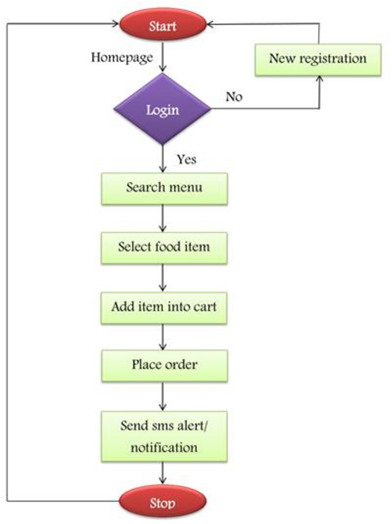
FLOW CHART

Slide 11
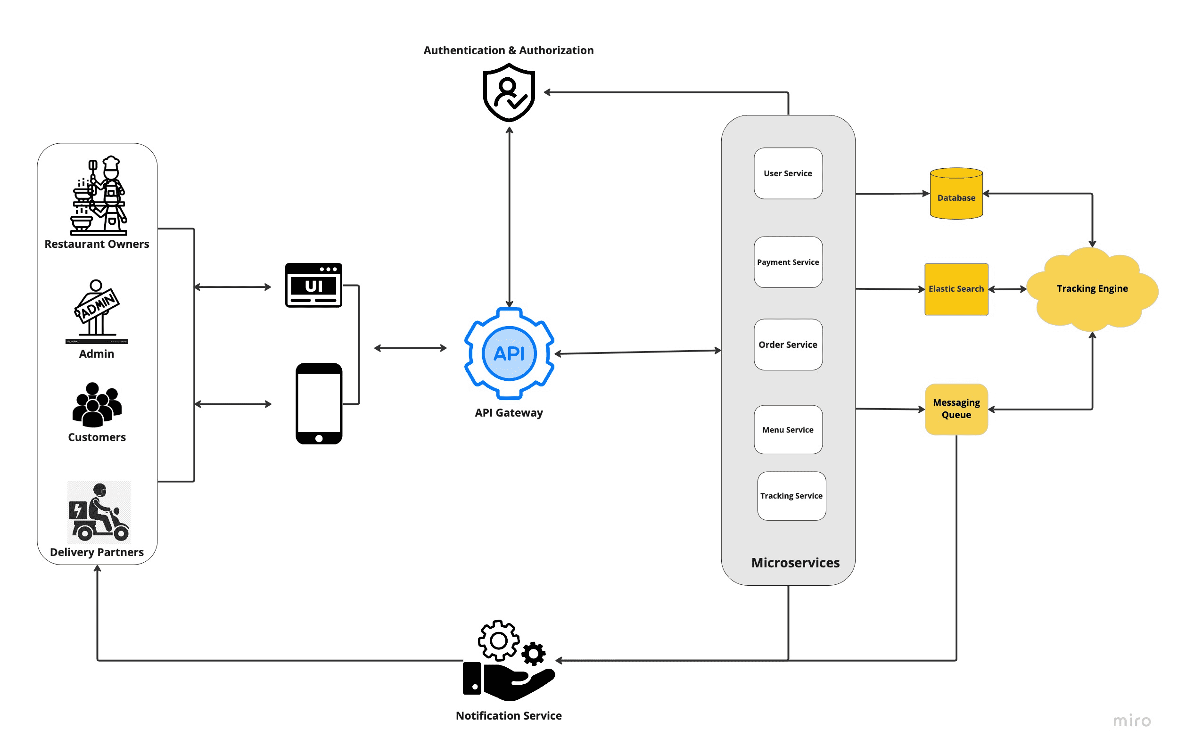
ARCHITECTURE DIAGRAM

Slide 12
ALGORITHM
Step1: User Preferences and Profile : Collect user preferences during on boarding, including cuisine types, dietary restrictions, preferred price range, and location.
Step2: Restaurant Data Management : Acquire and maintain a comprehensive database of restaurants with details such as name, location, cuisine, menu, reviews, ratings, and operational hours. Regularly update the database to ensure accuracy and relevance.
Step3: Search and Filtering: Use a ranking algorithm to prioritize search results based on a combination of user preferences and popularity.
Step4: Geo location : Utilize geo location algorithms to determine the user's current location. Integrate with mapping services to display nearby restaurants and provide directions.
Step5: Personalized Recommendations : Use collaborative filtering to recommend restaurants based on the preferences of users with similar tastes.

Slide 13
Step 6: Real-time Updates: Implement mechanisms to provide real-time information on restaurant status, promotions, and special events. Use push notifications to inform users about time-sensitive deals or new restaurant openings.
Step 7: Reviews and Ratings: Aggregate user reviews and ratings for each restaurant. Apply a weighted average algorithm to factor in the credibility of reviewers.
Step 8: Privacy and Security: Implement algorithms for secure user authentication and data encryption to ensure user privacy . Comply with data protection regulations and industry standards.

Slide 14
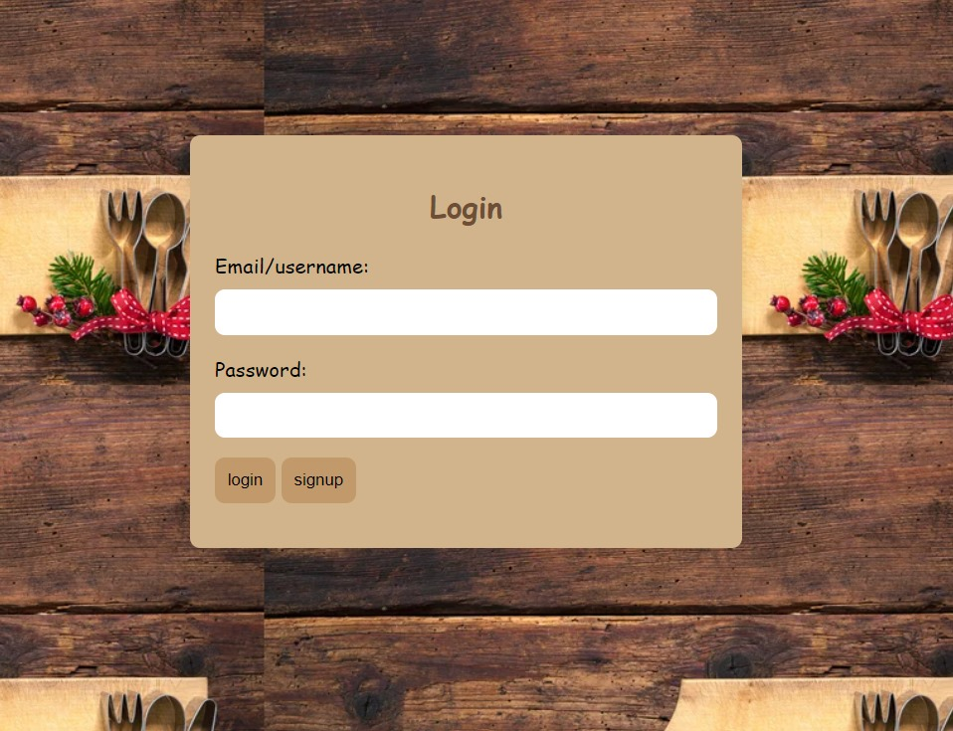
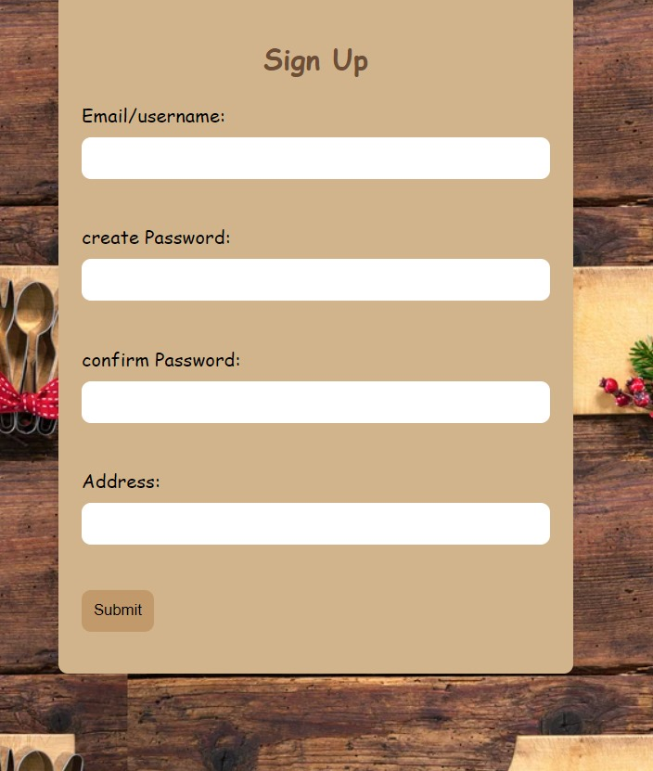
LOGIN AND SIGN-UP PAGE

Slide 15

APP SECURITY:
1. .Encryption: Use end-to-end encryption for data in transit and encrypt sensitive information at rest.
2.Authentication: Implement strong user authentication, including multi-factor authentication.
3. API Security: Secure API communications with HTTPS and validate API requests to prevent vulnerabilities.
4. Data Storage: Encrypt sensitive data stored on devices and servers, focusing on user credentials and payment information.
5. Security Audits: Conduct regular security audits and vulnerability assessments to identify and address potential weaknesses.
6. Token Management: Use secure practices for managing user sessions, including secure storage and token refresh mechanisms.
7. Payment Standards: Adhere to payment security standards like PCI DSS for secure financial transactions.

Slide 16
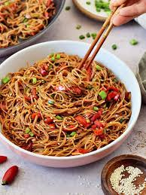
FUTURE UPDATES
Enable users to access basic restaurant information and reviews offline, ensuring they can still use the app in areas with limited or no internet connectivity.
Allow users to share their food experiences directly from the app to social media platforms, enhancing the app's visibility and user engagement.
Implement a notification system to alert users about nearby restaurants offering special discounts or deals, encouraging them to explore new places.

Slide 17
SYSTEM REQUIREMENTS
SOFTWARE REQUIREMENTS
Front end : HTML, CSS
Back end: python
Operating system: WINDOWS 11
HARDWARE REQUIRMENTS
processor: intel core i7
Ram: 16gb
SSD: 128gb

Slide 18
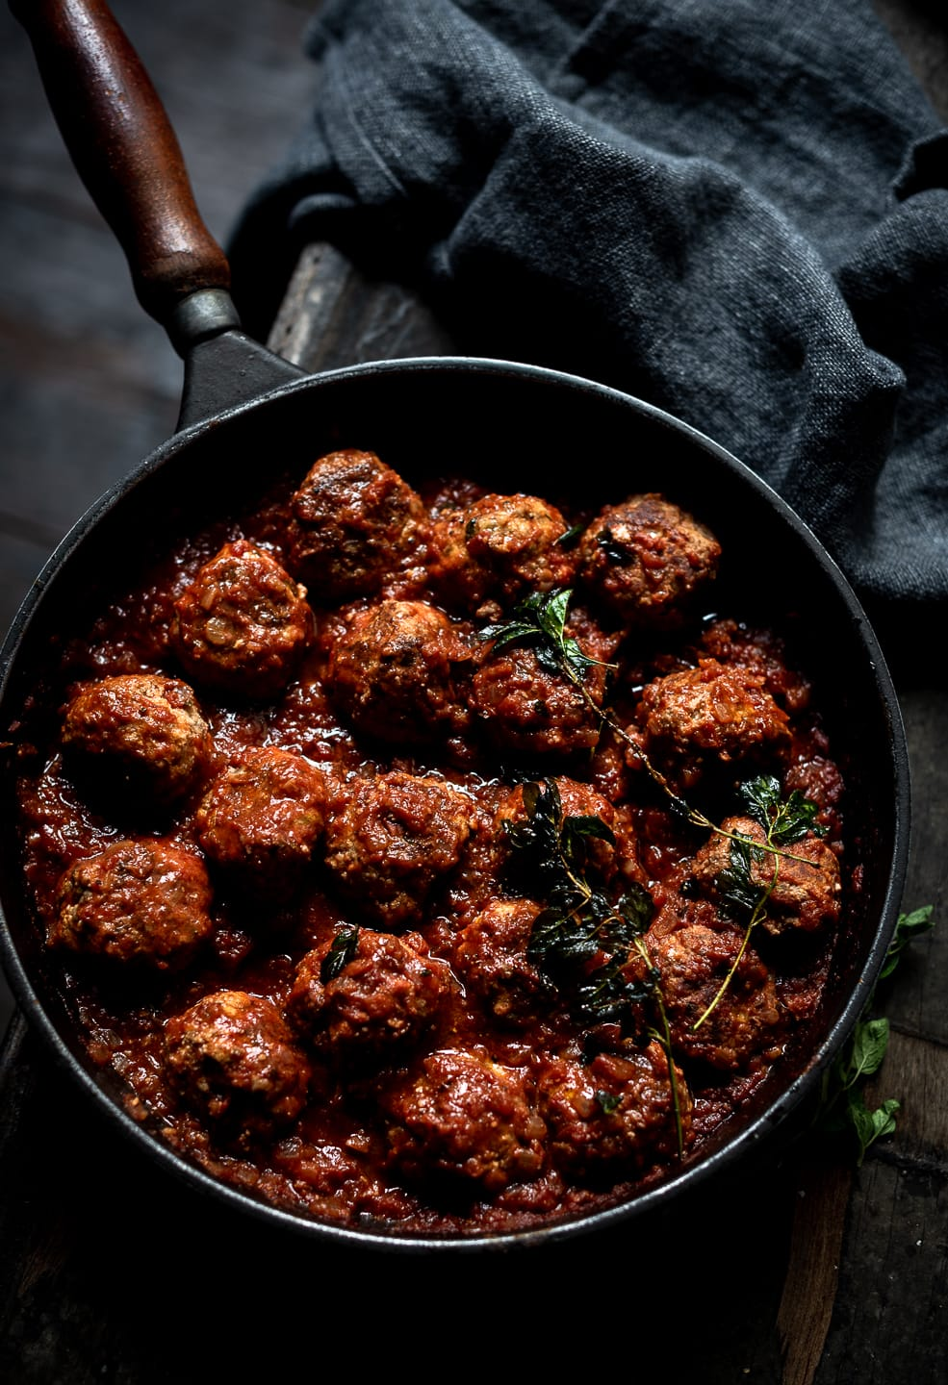
CONCLUSION
Choosing a restaurant or deciding what to eat can be challenging, but using a food finder app can simplify the process. These apps provide convenience, variety, and user reviews, making it easier to discover new culinary experiences. In conclusion, food finder apps are valuable tools for navigating the diverse world of dining options. Food finder apps not only streamline the decision-making process but also contribute to culinary exploration by exposing users to different cuisines and local gems. With features like personalized recommendations and real-time reviews, these apps enhance the overall dining experience, making them indispensable companions for those seeking convenience and diverse gastronomic adventures.

Slide 19
REFERENCE
Food Finder:
Yelp, Zomato , Swiggy, Uber Eats.
These are the some apps for food delivery and as well as food finding apps which the user wants, from these apps the reference has been taken.
App Name: "Food Finder"
Publisher/Developer: CS-Alpha Batch 4
Platform: IOS/Android
Version: 2.0.1
Year of Release: 2023

Slide 20

“ONLY FOR FOODIES”

