Slide 1

Gym Bro's Fitness Tracker
A full-stack project using Angular, Spring Boot, and PostgreSQL
Created by: Dominic Paredes

Slide 2

Introduction
Gym Bro's is a web-based fitness tracking application.
- Tracks Weight, Water Intake, and Steps.
- Built using Angular (Frontend), Spring Boot (Backend), PostgreSQL (Database).

Slide 3







Technologies Used
- Angular 17 (Frontend Framework)
- Spring Boot 3.4 (REST API Backend)
- PostgreSQL (Relational Database)
- DBeaver (Database Management Tool)
- Visual Studio Code
- Postman
- GitHub

Slide 4
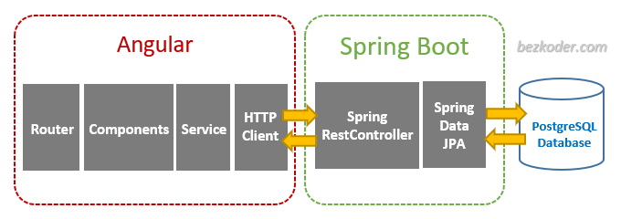
Design Overview
Frontend sends data via HTTP POST to Spring Boot API endpoints.
Spring Boot stores data in PostgreSQL database.
Angular fetches saved records via GET and displays in the UI.

Slide 5
Component Flow
User Input → Angular Form → HTTP POST → Spring Boot Controller → JPA Repository → PostgreSQL
Angular GET request fetches latest entries for display in each section.

Slide 6
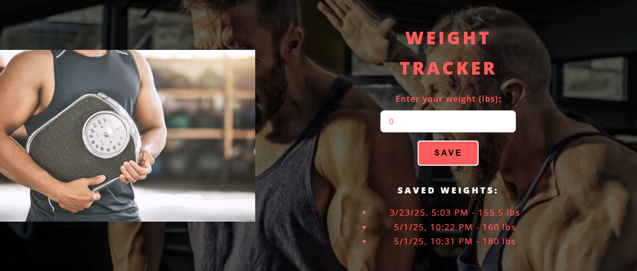

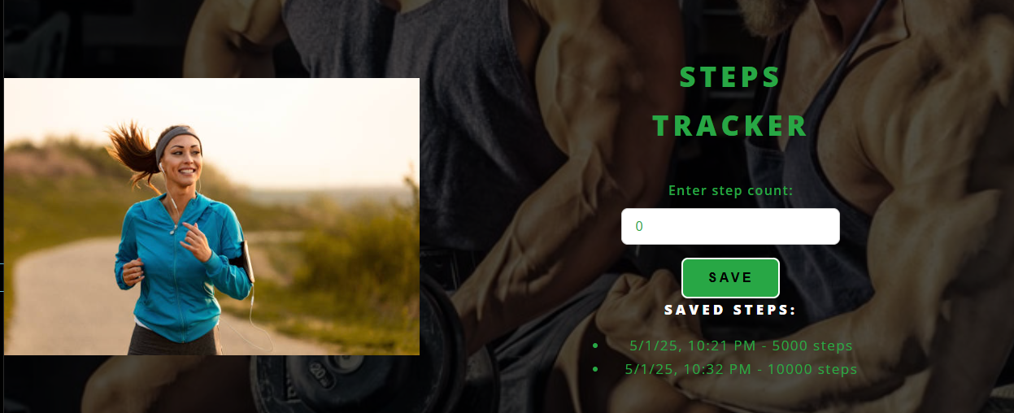
Screenshots & Features
- Weight Tracker: saves and lists weights by timestamp
- Water Tracker: records ounces of water daily
- Steps Tracker: logs step count with time of entry

Slide 7
Challenges & Learning
- Configuring PostgreSQL with Spring Boot
- Mapping REST endpoints correctly
- Styling embedded components to fit HTML template
- Understanding Angular's standalone component structure
Took more time than expected

Slide 8

Conclusion
This project showcases the integration of a modern frontend with a RESTful backend.
It demonstrates data flow between client and server with persistent storage.
The modular design makes it easy to expand features such as login, charting, and analytics.

