Slide 1
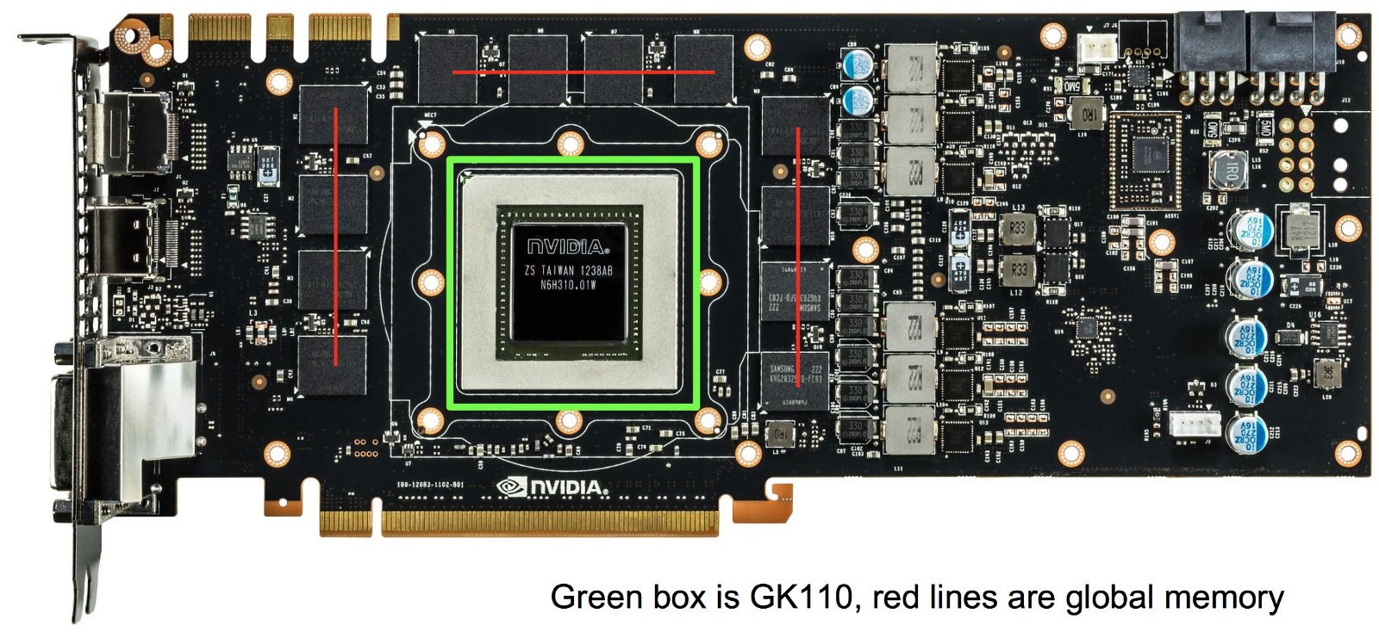
Graphical Processing Unit(GPU)
-Paresh Korani(758158)

Slide 2
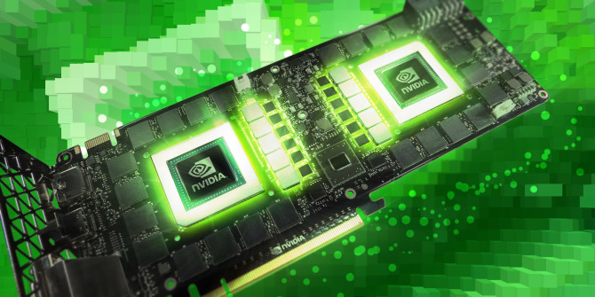
Contents:
Overview
Types Of Memory
System Memory v/s Graphics Memory
Most Used GPU’s
Important Parts of GPU’s
Evolution of GPU’s
Types OF API’s(Application Programming Interfaces)
DirectX/Direct3D

Slide 3
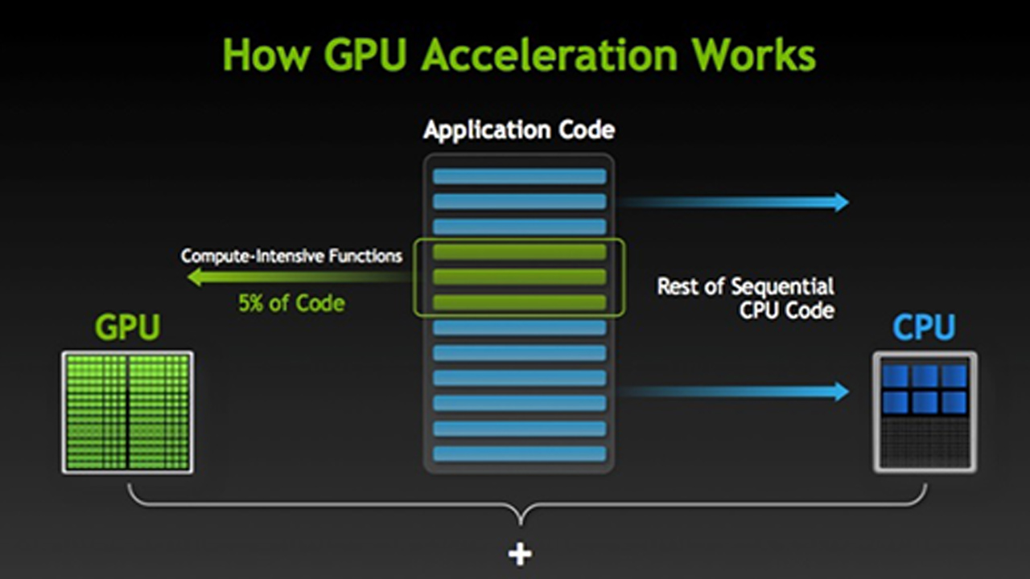
Overview
A graphics processing unit (GPU), also occasionally called visual processing unit (VPU), is a specialized electronic circuit designed to rapidly manipulate and alter memory to accelerate the building of images in a frame buffer intended for output to a display.
GPUs are used in embedded systems, mobile phones, personal computers, workstations, and game consoles. Modern GPUs are very efficient at manipulating computer graphics and image processing.
Their highly parallel structure makes them more efficient than general-purpose CPUs for algorithms that process large blocks of data in parallel. In a personal computer, a GPU can be present on a video card or embedded on the motherboard.

Slide 4
CPU v/s GPU:
CPUs and GPUs have a lot in common.
They are both silicon-based microprocessors.
At the same time, they are substantially different, and they are deployed for different roles.
Control
ALU
ALU
ALU
ALU
Cache
DRAM
DRAM
CPU
GPU
A GPU uses thousands of smaller and more efficient cores for a massively parallel architecture aimed at handling multiple functions at the same time.
They are 50–100 times faster in tasks that require multiple parallel processes, such as machine learning and big data analysis.

Slide 5
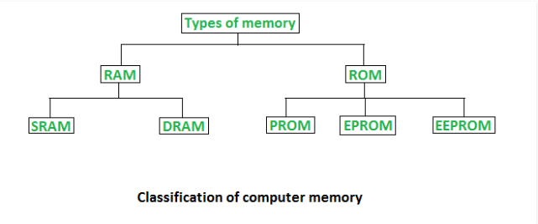
Types Of Memory

Slide 6
Types Of Memory
DDR:Transfer Data at Twice the clock cycle
DDR2:Faster and more efficient than DDR
DDR3:Consumes 30% less Power and Faster
DDR4:50% increased performance and bandwidth capabilities while decreasing voltage
GDDR4: Multi-Preamble to reduce data transmission delay
GDDR5:Type of Synchronous Graphics RAM and with a high bandwidth interface designed for use in graphics cards, game consoles, and high-performance computing.
Type | Memory clock rate (MHz) | Bandwidth (GB/s)
DDR | 200-400 | 1.6-3.2
DDR2 | 400-1066.67 | 3.2-8.533
DDR3 | 800-2133.33 | 6.4-17.066
DDR4 | 1600-4866 | 12.8-25.6
GDDR4 | 3000–4000 | 160–256
GDDR5 | 1000–2000 | 288–336.5
GDDR5X | 1000–1750 | 160–673
HBM | 250–1000 | 512–1024

Slide 7
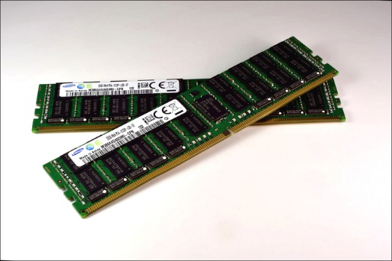
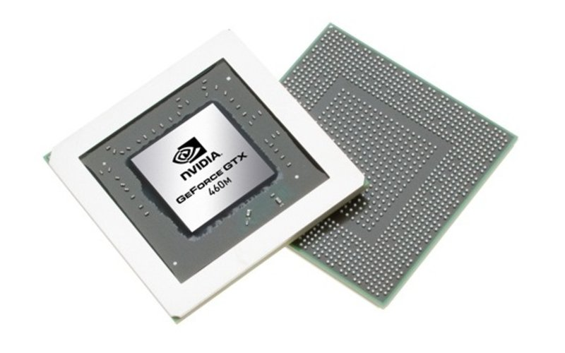
System Memory v/s Graphics Memory
System Memory | Graphics Memory
Considered as System RAM | Considered as Dedicated RAM
Lower Speed than Graphics Memory | Higher Speed Than System Memory
Quicker for performance | It is Wider and faster for bandwidth

Slide 8
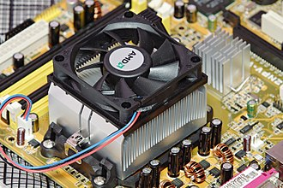
Important Parts of Graphics Unit:
Heat Sink:
A heat sink is mounted on most modern graphics cards. A heat sink spreads out the heat produced by the graphics processing unit evenly throughout the heat sink and unit itself. The heat sink commonly has a fan mounted as well to cool the heat sink and the graphics processing unit.
Not all cards have heat sinks, for example, some cards are liquid cooled, and instead have a waterblock; additionally, cards from the 1980s and early 1990s did not produce much heat, and did not require heatsinks. Most modern graphics cards need a proper thermal solution.
Video BIOS:
The video BIOS or firmware contains a minimal program for initial set up and control of the video card.
It may contain information on the memory timing, operating speeds and voltages of the graphics processor, RAM, and other details which can sometimes be changed.

Slide 9
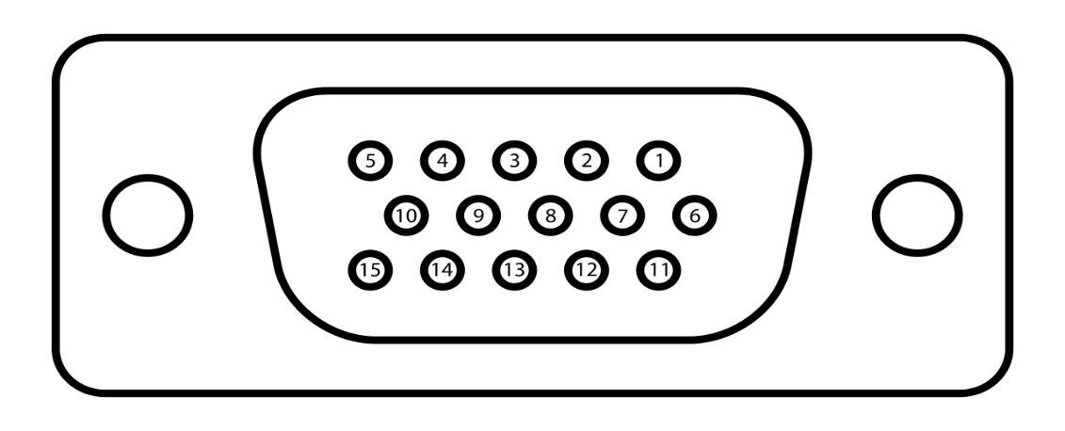
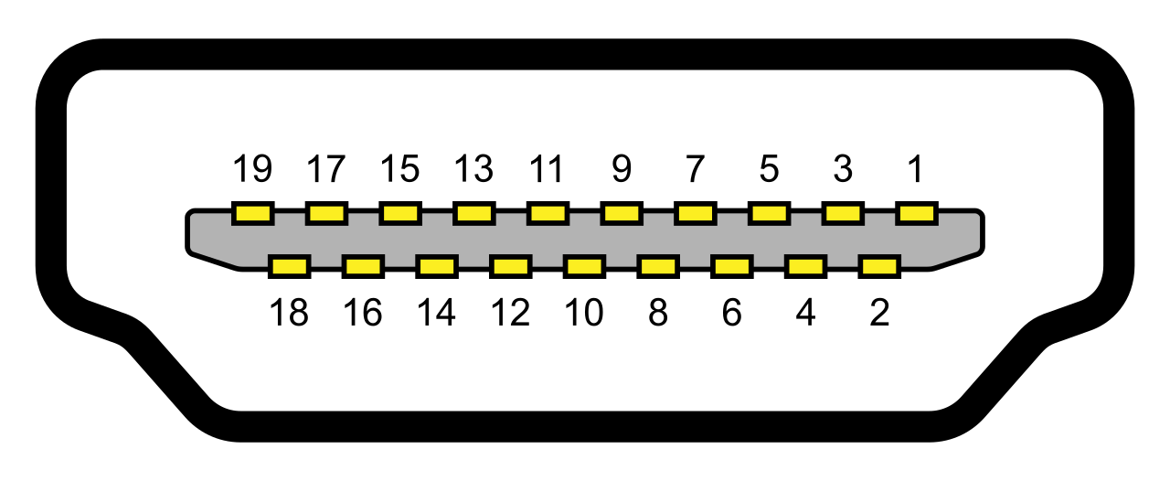
Video Memory:
The memory capacity of most modern video cards ranges from 1 GB to 12 GB. Since video memory needs to be accessed by the GPU and the display circuitry, it often uses special high-speed or multi-port memory
Output Interfaces:
Video Graphics Array(VGA)
The VGA analog interface is used for high definition video including 1080p and higher.
While the VGA transmission bandwidth is high enough to support even higher resolution playback
High Definition Multimedia Interface(HDMI)
HDMI is a compact audio/video interface for transferring uncompressed video data and compressed/uncompressed digital audio data from an HDMI-compliant device

Slide 10
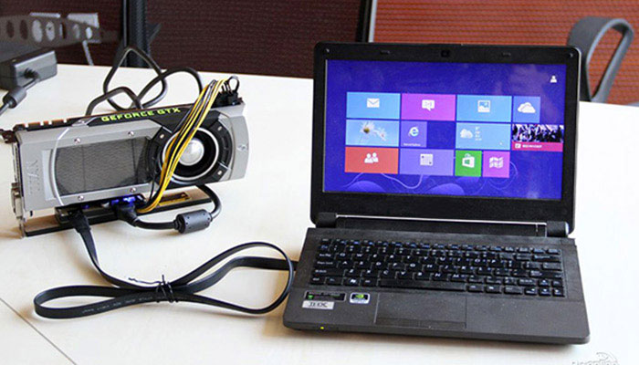
External GPU (EGPU):
An external GPU is a graphics processor located outside of the housing of the computer.
External graphics processors are sometimes used with laptop computers.
Laptops might have a substantial amount of RAM and a sufficiently powerful central processing unit (CPU), but often lack a powerful graphics processor, and instead have a less powerful but more energy-efficient on-board graphics chip..

Slide 11

Evolution OF GPU’s:
1980’s – No GPU. PC used VGA controller
1990’s – Add more function into VGA controller
1997 – 3D acceleration functions:
Hardware for triangle setup and rasterization
Texture mapping
Shading
2000 – A single chip graphics processor ( beginning of GPU
term)
2005 – Massively parallel programmable processors
2007 – CUDA (Compute Unified Device Architecture)

Slide 12
Most Used GPU’s:
Most GPUs are designed for a specific usage, real-time 3D graphics or other mass calculations:
Gaming
GeForce GTX, RTX
nVidia Titan X
Radeon HD
Radeon r5, r7, r9, RX, and Vega series
Cloud Gaming
nVidia Grid
Radeon Sky
Workstation
nVidia Quadro
nVidia Titan X
AMD FirePro
Radeon Pro
Cloud Workstation
nVidia Tesla
AMD FireStream
Artificial Intelligence Cloud
nVidia Tesla
Radeon Instinct
Automated/Driverless car
nVidia Drive PX

Slide 13
Types of API’s(Application Programming Interfaces):
Low Level 3D API’s:
Direct3D (a subset of DirectX)
Glide.
Mantle developed by AMD.
Metal developed by Apple.
MonoGame.
OpenGL and the OpenGL Shading Language.
High Level 3D API’s:
Crystal Space 3D
Java 3D
OpenGL performer
OpenSG
Flash Based API’s:
Stage 3D is library in Flash11 or later version

Slide 14

Direct3D(DirectX):
Microsoft DirectX is a collection of application programming interfaces (APIs) for handling tasks related to multimedia, especially game programming and video, on Microsoft platforms.
Originally, the names of these APIs all began with Direct, such as Direct3D, DirectDraw, DirectMusic, DirectPlay, DirectSound, and so forth. The name DirectX was coined as a shorthand term for all of these APIs (the X standing in for the particular API names) and soon became the name of the collection.
When Microsoft later set out to develop a gaming console, the X was used as the basis of the name Xbox to indicate that the console was based on DirectX technology.
Direct3D is widely used in the development of video games for Microsoft Windows and the Xbox line of consoles.
As Direct3D is the most widely publicized component of DirectX, it is common to see the names "DirectX" and "Direct3D" used interchangeably.
Types OF DirectX:
DirectX 9(2002)- For Windows 98 and XP
DirectX 10 (2003)-For Windows Vista
DirectX 11(2009)-For Windows 7
DirectX 12(2015)-For Windows 10 and XBOX ONE

Slide 15
Thank You!

