Slide 1
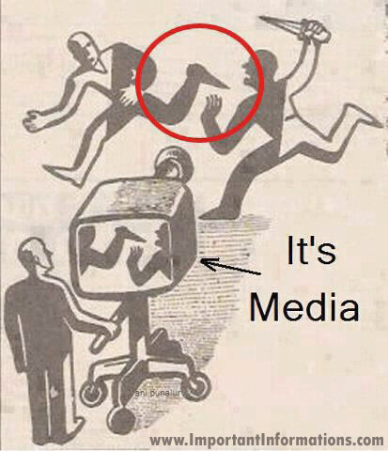

Slide 2
Is Indian media biased and opinionated?

Slide 3
Hindustan Times Group
Leading English newspaper in North.
Second best Hindi newspaper in North & East.

Slide 4
Hindustan Times Group
Owner History:
1924: Sunder Singh Lyallpuri (Founder of Akali Movement).
1933: Pandit Madan Mohan Malaviya (4 times president of INC), Lala Lajpat Rai (Leader, INC), Dr Mukund Ramrao Jayakar (Indian Lawyer) & G. D. Birla (Industrialist) with Birla paying most of the money.
Current: KK Birla Group and managed by Shobhana Bhartia (Rajya Sabha MP (2006 - 2012), INC).

Slide 5
Bennett, Coleman & Co. Ltd. (BCCL)
Third-largest newspaper in India by circulation.
Largest selling English-language daily in the world.

Slide 6
Bennett, Coleman & Co. Ltd. (BCCL)
Owner History:
1838: As The Bombay Times and Journal of Commerce, Raobahadur Narayan Dinanath Velkar.
1859: Bombay Standard and Chronicle of Western India merges with The Bombay Times and Journal of Commerce to form The Bombay Times & Standard.
1861: Robert Knight unite The Bombay Times & Standard with Bombay Telegraph & Courier to form The Times of India.
1890: Henry Curwen buys The Times of India with Charles Kane.

Slide 7
Bennett, Coleman & Co. Ltd. (BCCL)
1892: After Henry Curwen's death, Thomas Jewell Bennett with partnership with Franck Morris Coleman forms joint stock company Bennett, Coleman & Co. Ltd. (BCCL) which owns The Times of India.
1946: Ram Kishan Dalmia (founder of Dalmia-Jain Group) buys Bennett, Coleman & Co. Ltd. (BCCL) for 2crores.
1947: Ram Kishan Dalmia prosecuted for embezzlement and fraud in transferring ownership to himself.
1948: Sahu Jain Group (Sahu Shanti Prasad Jain) son-in-law of Ram Kishan Dalmia becomes owner.

Slide 8
Bennett, Coleman & Co. Ltd. (BCCL)
1960: Sahu Shanti Prasad Jain imprisoned for selling newsprint in black. Government of India took full control based on petition filed in Supreme Court. Replaced half of the directors, and appointed Bombay (Mumbai) High Court judge as chairman.
1969: Sahu Shanti Prasad Jain removed from the post of director by GOI under Supreme Courts order, appointed new board of directors, and appointed Nanasaheb Kunte (previously a INC member, now forming a new opposition party)
1976: GOI transferred ownership to Ashok Kumar Jain (Sahu Shanti Prasad Jain's son and Ramkrishna Dalmia's grandson).
1988: Ashok Kumar Jain has to flee the country when the Enforcement Directorate pursued his money laundering scams case strongly.
Current: Sahu Jain Group.

Slide 9
Indian Express Group
Widely circulated daily newspaper

Slide 10
Indian Express Group
Owner History:
1931: Started by P. Varadarajulu Naidu (Member of INC, President of Tamil Nadu Congress Committee)
1931: Soon sold to Swaminathan Sadanand (Founder of The Free Press Journal, and One of the initial shareholder of PTI).
1934: Due to financial difficulties, sold a part of stake to Ramnath Goenka.
1935: The Free Press Journal collapses, court battle and complete control of “Indian Express” goes to Ramnath Goenka (One of the initial member to the Constituent Assembly of India, INC candidate for 1952 election).
NOTE: Mithun Chakraborty’s role in Guru is based on Ramnath Goenka.

Slide 11
Indian Express Group
1979: Bhagwan Das Goenka, son, possible heir dies due to heart attack. Other two daughters are Krishna Khaitan and Radha Sonthalia.
1991: Ramnath Goenka dies, Family members takes over.
1999: Property dispute, Family member splits “Indian Express” into “The New Indian Express” (South) and “The Indian Express” (North).
Current: “The Indian Express” is owned by Viveck Goenka (Ramnath Goenka’s adopted son). ”The New Indian Express” is owned by Manoj Kumar Sonthalia (Son of Radha Sonthalia).

Slide 12
The hindu group
Second most circulated English-language newspaper in India.
Third most widely read English newspaper.
Leading newspaper of South.

Slide 13
The Hindu Group
Owner History:
1878: Started by Triplicane Six consisting of 4 law students and 2 teachers. T. T. Rangachariar, P. V. Rangachariar, D. Kesava Rao Pantulu and N. Subba Rao Pantulu, led by G. Subramania Iyer (a school teacher from Tanjore district) and M. Veeraraghavachariar (a lecturer at Pachaiyappa's College).
1898: Partnership between G. Subramania Iyer & M. Veeraraghavachariar broke, and M. Veeraraghavachariar became sole owner.
1905: Due to loss, brought by to S. Kasturi Ranga Iyengar (Past Legal Advisor).
Current: Family members as The Hindu Group, Kasturi and Sons Limited.

Slide 14
AnandaBazar patrika GROUP
Leading Bengali newspaper.

Slide 15
Anandabazar Patrika Group
Owner History:
1922: Prafulla Kumar Sarkar & Suresh Chandra Majumdar.
1958: Ashok Kumar Sarkar, son of Prafulla Kumar Sarkar.
Current: Aveek Sarkar, son of Ashok Kumar Sarkar.

Slide 16
D. B. Corp Limited
Leading newspaper of India
Leading Hindi newspaper of India.

Slide 17
D. B. Corp Limited
1956: Launched as Subah Savere in Bhopal.
1957: Good Morning India in Gwalior and renamed as Bhaskar Samachar.
1958: Renamed as Dainik Bhaskar.

Slide 18
Thank you

