Slide 1
Need at list week's rest
It sucks
I don't get paid enough
JOBS
What the hell
Its So Boring
TGIF
I Quit

Slide 2
Worst Jobs

Slide 3
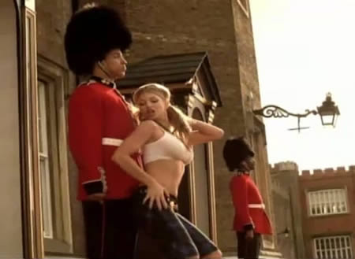

Slide 4
Guard at Buckingham Palace
Guard duty at Buckingham Palace is regarded as one of the worst jobs in the British Army. Soldiers spend several hours each day cleaning and pressing their uniforms and polishing their boots in preparation for one of the many kit inspections that they are likely to face before taking up their positions outside one of the royal palaces.
Any soldier whose turn-out is less than immaculate is likely to face a variety of punishments, such as extra guard duty

Slide 5
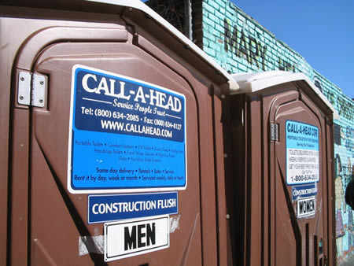

Slide 6
Portable Toilet Cleaner
Using a tank and a vacuum wand, cleaners must suck up all the waste in a portable toilet. After picking up any stray toilet paper, they also wash down all surfaces that could possibly be soiled, including the walls. This is when a high-pressure hose comes in handy and as you can imagine hosing a wall off in a closed space results in a lot of spray back.
Nevertheless, some cleaners grin and bear it — and take home $50,000 a year.

Slide 7
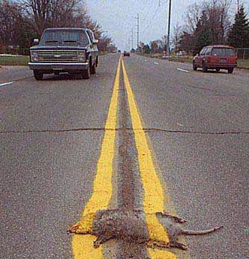

Slide 8
Road Kill Remover
Pretty self-explanatory. Roadkill collectors not only have the job of peeling the remains of dead creatures off the road, but they also have to do it while braving oncoming traffic.

Slide 9
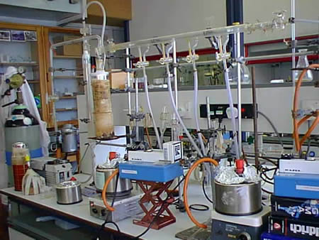

Slide 10
Flatus Odor Judge
Two brave souls had to repeatedly smell odors of other people’s farts. Sixteen healthy subjects volunteered to eat pinto beans and insert small plastic collection tubes into their behinds. After each “episode of flatulence,” The gas was transfered into a discrete container. The odor judges then sat down with at least 100 samples, opened the caps one at a time, and inhaled robustly. As their faces writhed in agony, they rated just how disgusting the smell was.

Slide 11
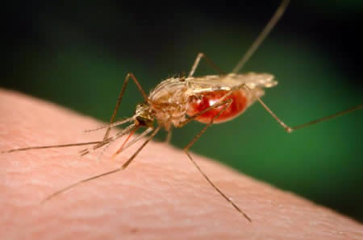

Slide 12
Brazil Mosquito Researcher
Scientists fighting malaria must study the biting habits of the mosquito that spreads this deadly disease. In order to study these insects Brazilian scientists must offer themselves as bait. In the early evening, when mosquito activity is busiest, a mosquito researcher finds a nice buggy area and sets himself up inside a mosquito-netting tent with a gap at the bottom. Mosquitoes fly in low and get trapped inside, where the researcher sits stoically, sacrificing his skin to science

Slide 13
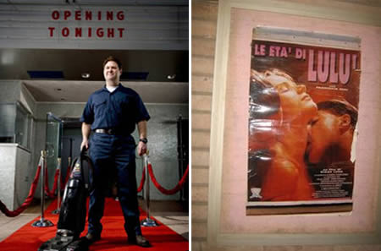

Slide 14
Janitor at a Porno Theater
A janitor is not a pretty job at the best of times, imagine being one in a porno theater. As you can imagine it’s not popcorn or empty drink cans they have to clean up between showings. But then again this job does have one perk, all the porn you could want for free!

Slide 15
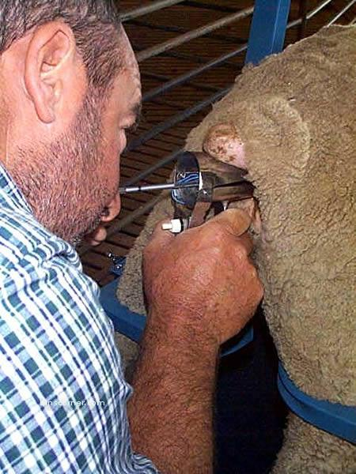

Slide 16
Animal Masturbator
There are many jobs which require the sperm of animals, researchers and farmers are just a couple who require such a product. The only way to obtain the sperm is of course to masturbate the animal and catch it in a pot. Whether its a pig, ram or bull its a job that not many people like doing.
When dealing with a bull there have been cases were people have been seriously injured during this procedure and even ended up in hospital.

Slide 17
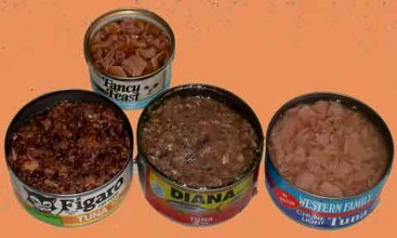

Slide 18
Cat Food Quality Tester
Somebody’s job in England is to test the quality of cat food. This job requires a person to:
Bury their face in a huge tub of cat food and sniff it to make sure it’s fresh.
Plunge arms in it up to the elbows and grope for bony bits and take them out.
Scoop up a huge dollop of it, smear it flat on a surface and prod it with fingers to test how much gristle is there.

Slide 19
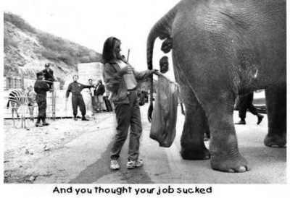

Slide 20
Manure Inspector
Animal manure is an important natural fertilizer, but first it has to be checked for contaminants like E.coli and salmonella. That’s where manure inspectors come in, not only do they get to search for bacteria that causes bloody diarrhea if ingested, they also have to wade through tons of animal waste.

Slide 21
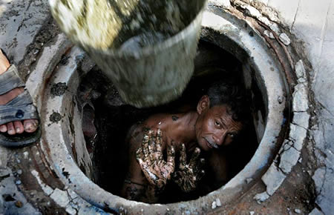

Slide 22
Sewers Cleaner
Meet Rakesh, he has the worst job ever. He has to sit in a low crouch at the bottom of a seven-foot-deep manhole, sloshing away in a swirl of human waste and sediment. Equipped with just a hoe a steel bar, and wearing only a pair of loose purple underpants, Rakesh has to empty the thick black sludge from a clogged sewer into a bucket that his fellow crew members hoist up and dump in the middle of a narrow road.

Slide 23
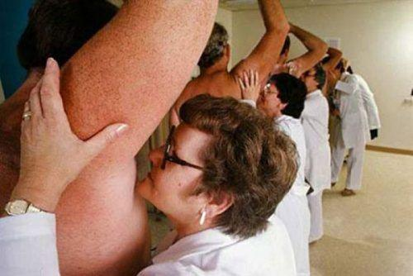
Deodorant Tester

Slide 24
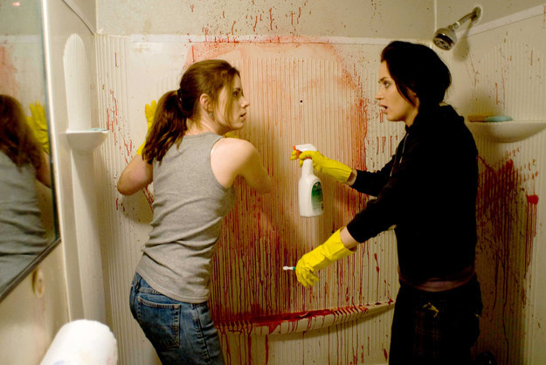
Crime Scene Cleaner

Slide 25
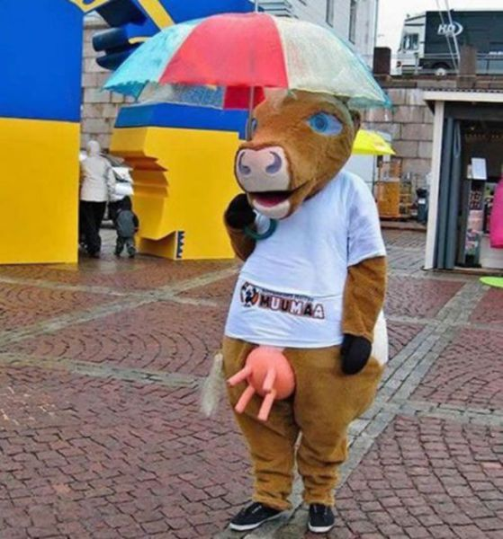
Teddy

Slide 26
Jobs at Life's Cost

Slide 27
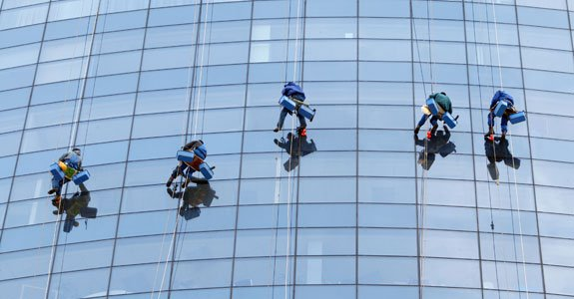
High Rise Window Cleaner

Slide 28
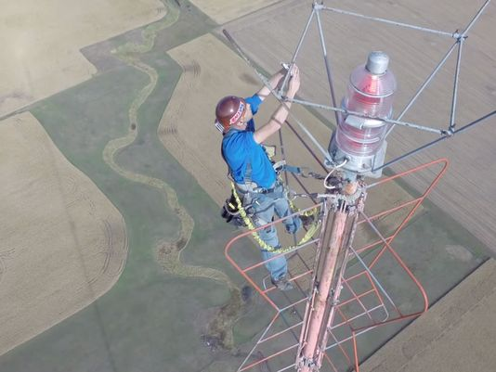
Bulb changing on a 1768 ft tower

Slide 29
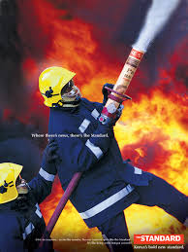
Firemen

Slide 30
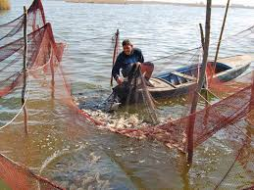
Fisher Men

Slide 31
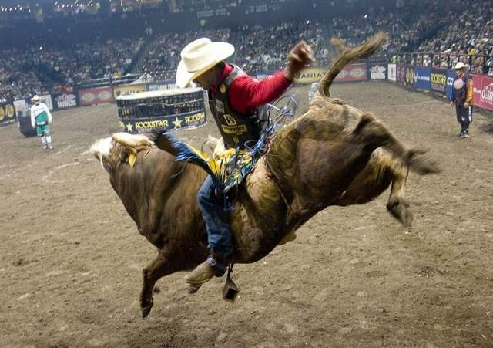
Bull Riders

Slide 32
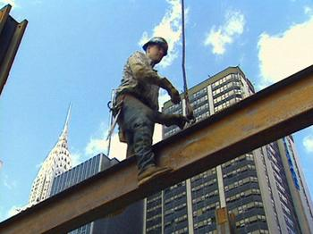
Still Workers

Slide 33
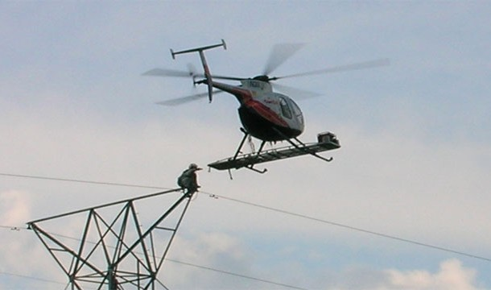
Lineman

Slide 34
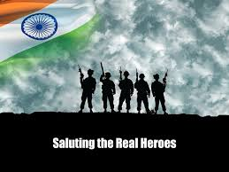
Armed Forces Jawans or Police

Slide 35
Jobs having Risk of others Life

Slide 36
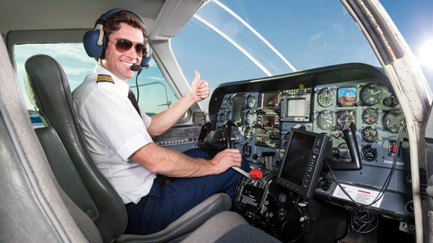
Pilot

Slide 37
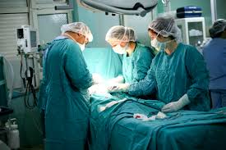
Doctors

Slide 38
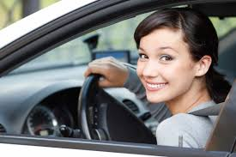
{Women} Driver

Slide 39
Jobs in which you put your life for saving others

Slide 40
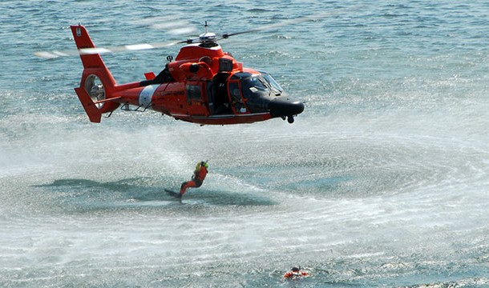
Rescue Team

Slide 41
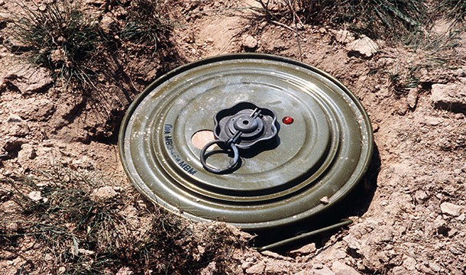
Land Mine Remover

Slide 42
Best Jobs

Slide 43
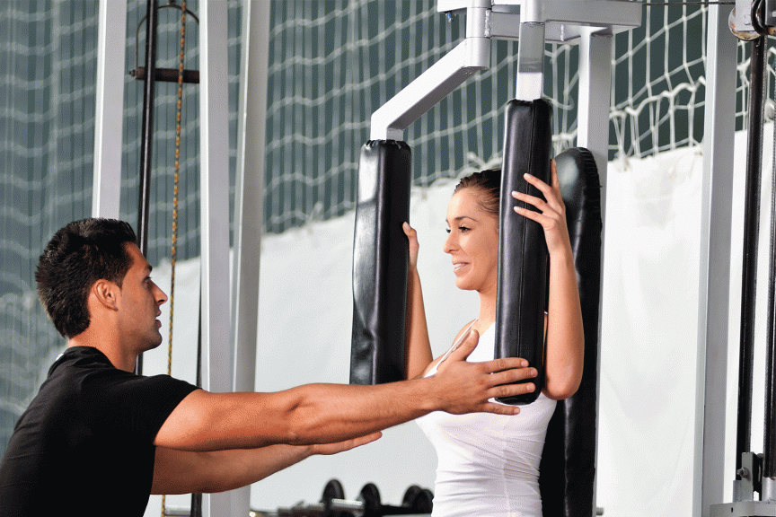
Personal Trainer

Slide 44
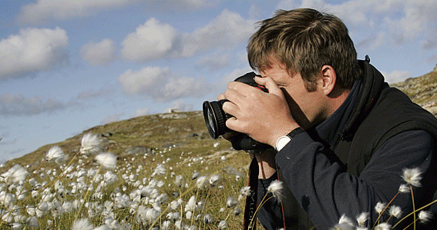
Photographer

Slide 45
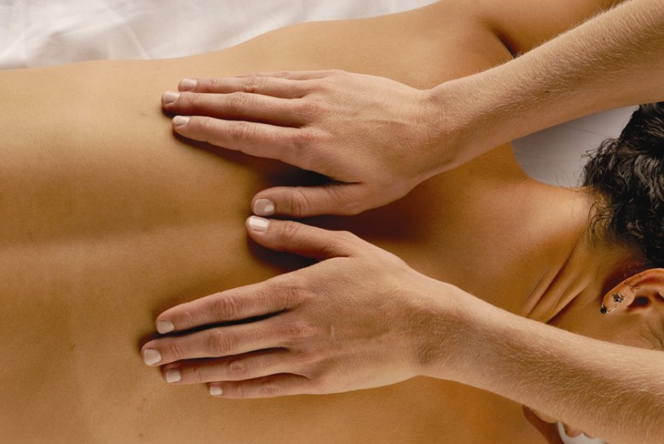
Massage Therapist

Slide 46
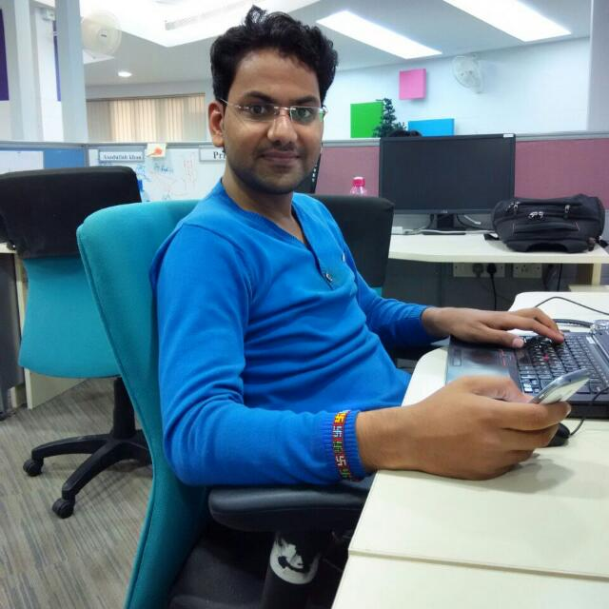
Working in IT

Slide 47
https://www.youtube.com/watch?v=PpWCBPkvGZU

