Slide 1
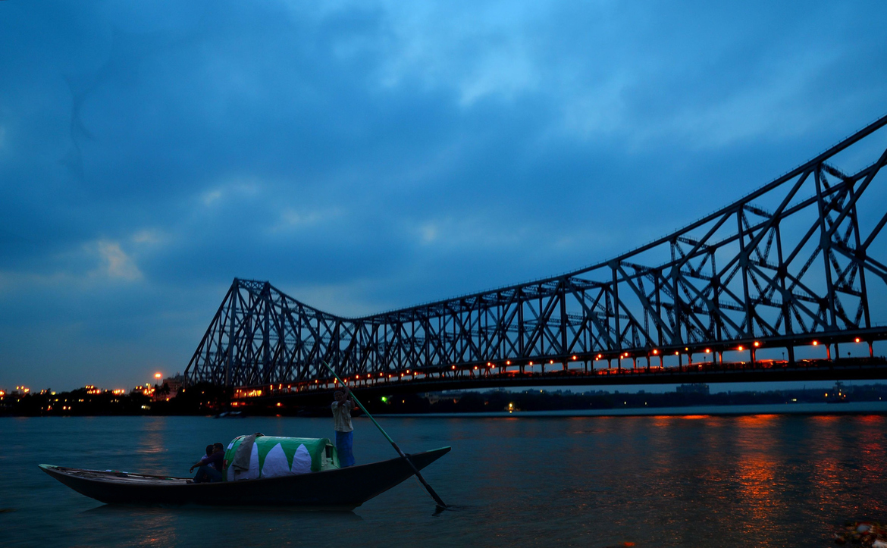
BENGAL
A true story…

Slide 2
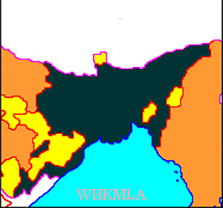
Bengal 1886
Welcome to

Slide 3
Bengal (Early Period)
Bengal Renaissance
Started by Raja Ram Mohan Roy
Ended with Rabindranath Tagore
East India Company
First direct control.
Zamindari System.
Brahmo Samaj.
Kolkata, largest city in India, fincancially & politically.

Slide 4
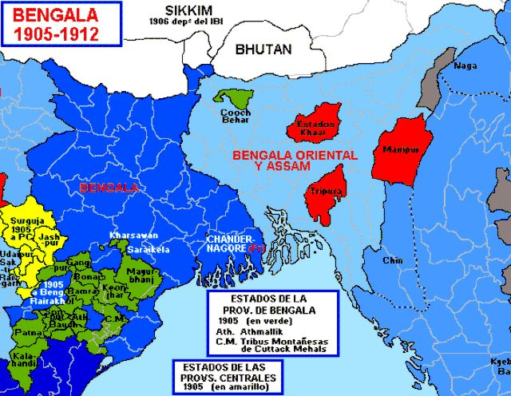
BENGAL 1905
Welcome to

Slide 5
Bengal (1905 - 1911 )
Based on Hindu majority vs Muslim majority
Suppress Indian Independence Movement.
Also, supported by Muslims due to poor condition of their community.
Suppress the dominance of Hindu businessmen & landlords over the governance of Bengal.
Opposition by Bengali Hindu’s.
Partition happened with West Bengal, Orissa & Bihar on one side and East Bengal & Assam on other side based on religious divide.
Religious identities defined by British.
Separate elections for Muslims and Hindus (1909).

Slide 6
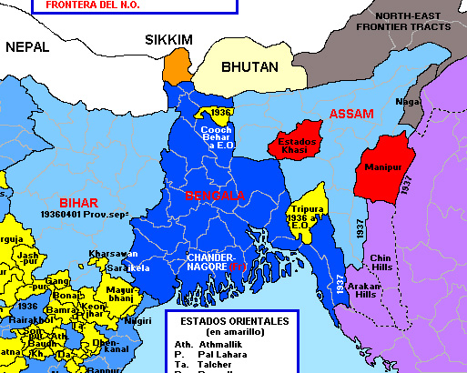
Bengal 1912
Welcome to

Slide 7
Bengal (1912)
Based on Language.
Bihar, Orissa & Assam separated out of Bengal. And, West Bengal & East Bengal as Bengal.
Moving capital as Calcutta to Delhi.
Politically weakening in any way by British.
Divide & Rule policy.

Slide 8
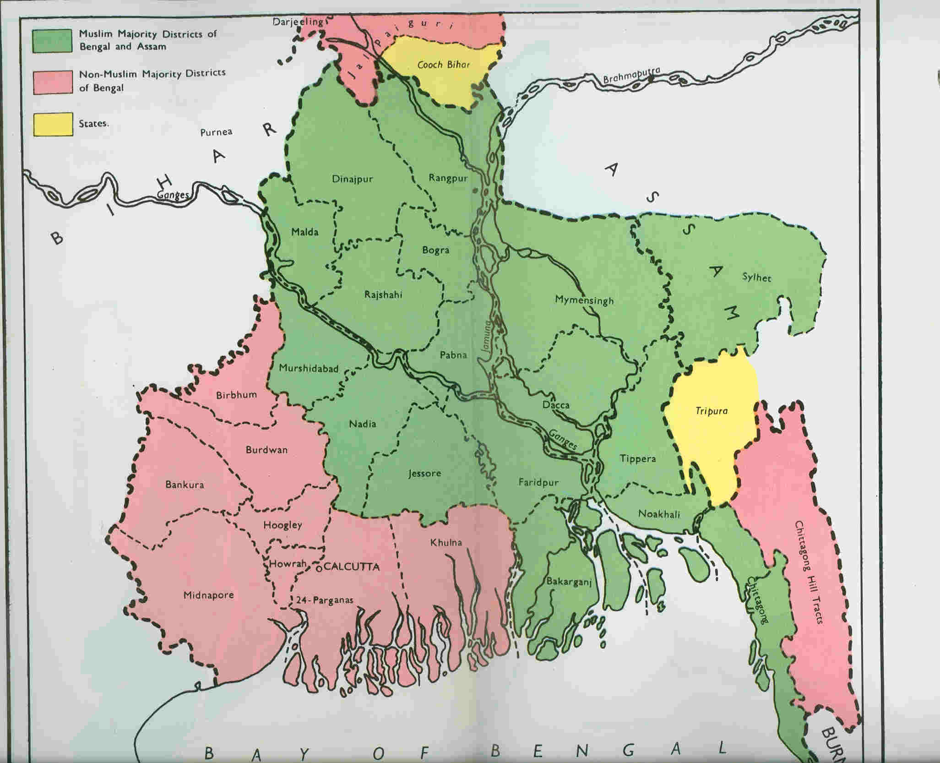
Bengal 1947
East Bengal
Welcome to
West Bengal

Slide 9
Bengal (1912 - 1947)
Direct Action Day (Great Calcutta Killings) [16th Aug, 1946]. Protest demanded by Muslim League for Muslim-majority Pakistan. Lead to riots. Large scale massacre.
Noakhali Riots (Noakhali Genocide or Noakhali Carnage) [Oct-Nov, 1946], happened in Noakhali district of Chittagong. Large scale massacre.
Syama Prasad Mookerjee described the incident as not being ordinary.
On 29 September 1946, the Government of Bengal had passed an ordinance prohibiting the press from publishing any correct information regarding any communal disturbances.
Start of Bengali Hindu Homeland Movement.
Separation.
Notes:
Noakhali (5000 killed, Hundreds of raped, Forcibly converted to Islam, 50,000 – 75,000 in relief camps Comilla, Chandpur & Agartala, 50,000 remained marooned.)

Slide 10
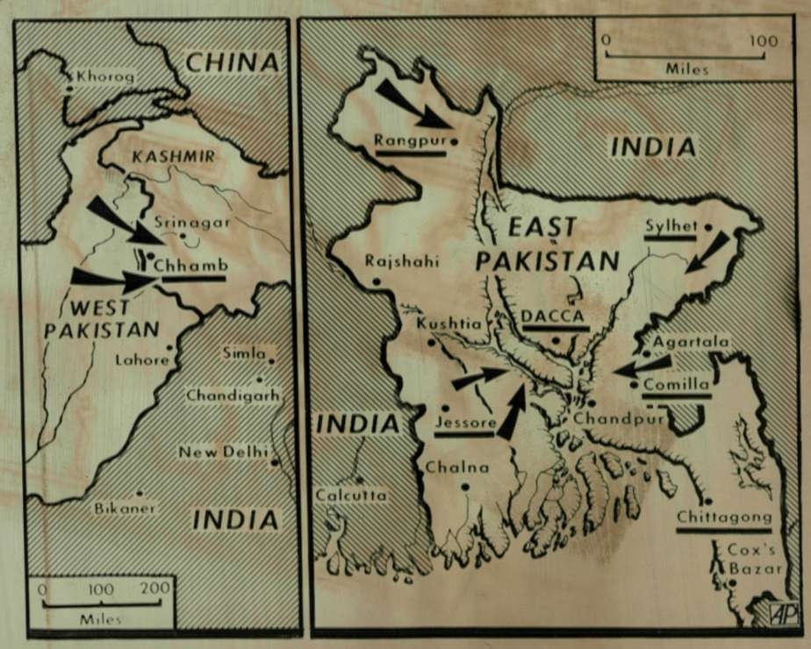
Bengal 1955
Welcome to

Slide 11
Bengal (after 1947)
Massive population transfer.
Gradual movement (different from Punjab).
Economically stronger population moved quicker. Poorer being large in number stayed due to uncertainty of future.
Communal riots started to rise from 1950.
Further population transfer started.
Nehru-Liaqat pact, 1950. Indian government stopped migration, and signed a bilateral treaty which confirmed minority rights to population who wanted to migrate. Both countries violated.
Economically, North-East was cut-off from India. No Railway link, Chittagong Port. Trade stopped.
India connected Assam by meter gauge in 1950. Nearest port was Kolkata port.

Slide 12
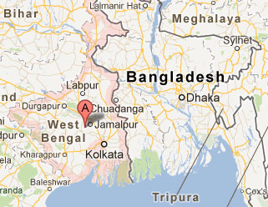
Bengal 1971
Welcome to

Slide 13
Bengal (1971)
Agitation is East Bengal to make Bangla an official language in Pakistan.
Awami League formed (1949) as a voice of Bengali’s, which broke out of Muslim League.
Started Bengali Language Movement (1952). Turning point for creation of Bangladesh.
Awami League was a secular group/party.
1954 elections, and rise of Awami League in forefront.
Within few month dismissed by constitution of Pakistan.

Slide 14
Bengal (1971)
Awami League came back to power in 1956 and started deepening relationship with UN.
Ayub Khan and his martial law (1958).
Banned current Awami League leader.
Banned all major political parties.
Top leadership of Awami League was arrested.
Military rule.
Huseyn Shaheed Suhrawardy, prominent Awami leader was found dead in Lebanon mysteriously.

Slide 15
Bengal (1971)
Start of Six-point movement (1960-66).
Awami League came back to power in 1970.
Operation Searchlight.
Planned military operation by Pakistan Army.
World’s one of the largest violation of Human Rights.
Around 58,000 – 3 million killed. 10 million refugees fled to India. And, 200,000 - 400,000 raped, also called as genocidal rape.
Mass destruction and human loss.
Incident of Dhaka University massacre.
Start of Mukti Bahini, Bengal’s own army supported by Awami League.

Slide 16
Bengal (1971)
Bangladesh Liberation War
Start of massive guerilla war by Mukti Bahini against Pakistani Army.
Economic & military aid by India (under the leadership of Indira Gandhi).
Became a International Event, with US (Richard Nixon) supporting Military of Pakistan.
Pakistan launched air-strike on India (called as Operation Chengiz Khan)
India formally joins the War (3rd December, 1971)
Bhutan recognizes Bangladesh as new country while the was going on.
Pakistan surrenders on 16th December, 1971.
Bangladesh formed.

Slide 17
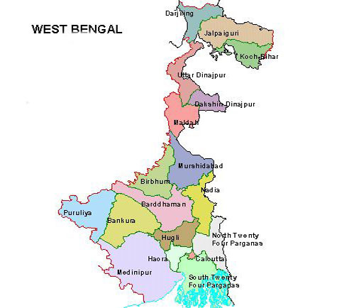
Bengal
Welcome to

Slide 18
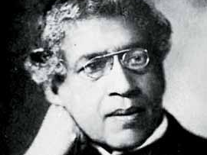
Jagadish Chandra Bose (1858 - 1937)
- Bengali polymath who was physicist, biologist, botanist, archaeologist, as well as an early writer of science fiction.
- Known for his contribution in Radio, Microwave optics, crescograph & Plant Science.

Slide 19
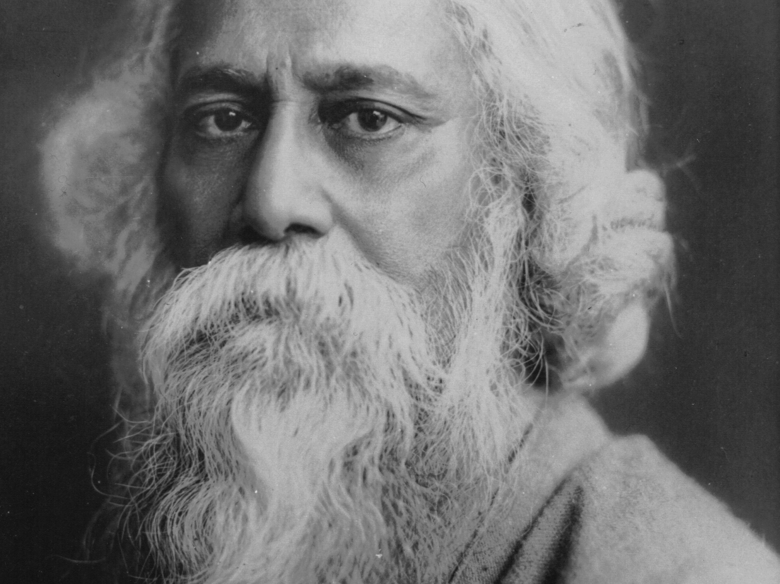
Rabindranath Thakur (1861 - 1941) a.k.a.: Rabindranath Tagore, Gurudeva
- Bengali polymath who reshaped Bengali Literature and Music, as well as Indian art with Contextual Modernism.
- First Asian to Win of Nobel Prize in Literature, 1913.
- Composer of Jana Gana Mana (Indian National Anthem), Amar Shonar Bangla (Bangladeshi National Anthem), Sri Lanka Matha [Translated] (Sri Lankan National Anthem)

Slide 20
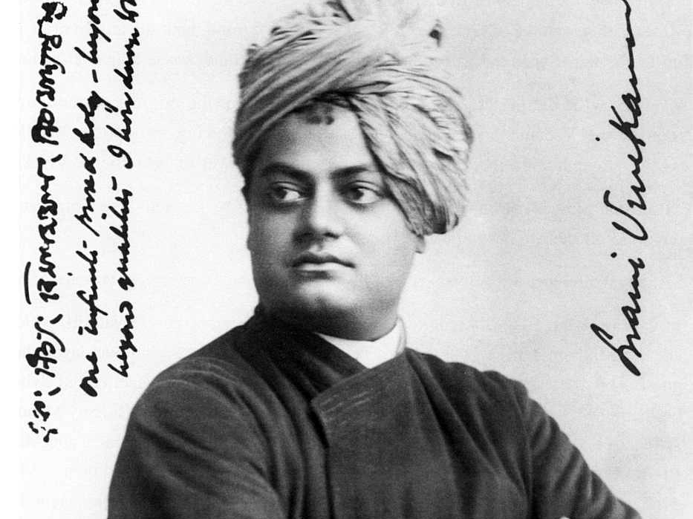
Narendra Nath Datta (1863 - 1902) a.k.a. Swami Vivekananda
- Introduced Indian philosophies of Vedanta and Yoga to the World.
- Credited for bringing Hinduism to the status of worlds major religions.
- Founder of Ramakrishna Mission & Math.

Slide 21
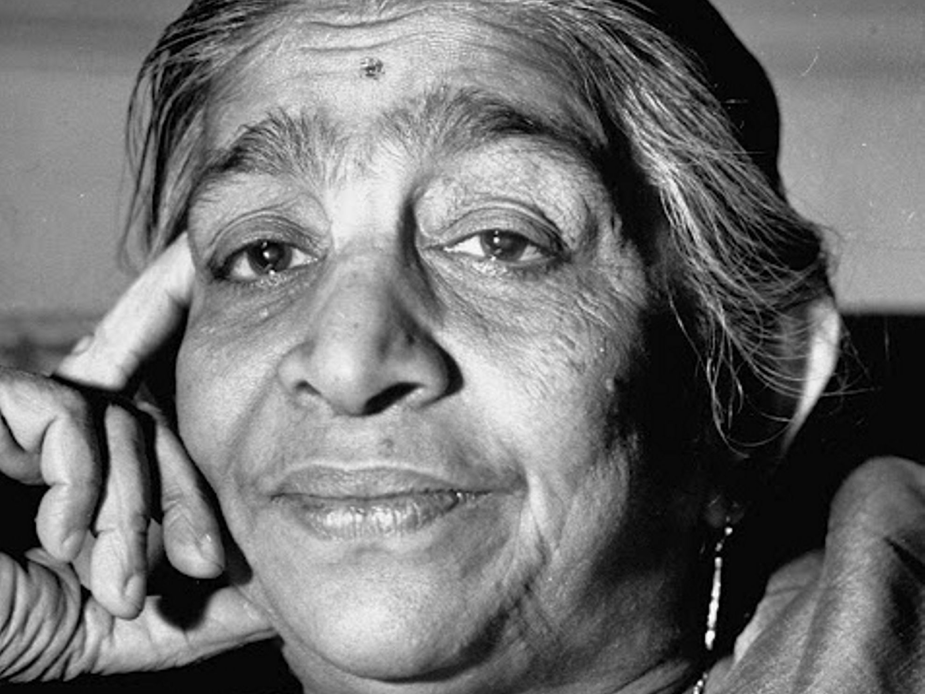
Sarojini Chattopadhyay (1879 - 1949) a.k.a. Sarojini Naidu, The Nightingale of India
- First woman governor of a state.
- Notable poet.
- Notable politician.

Slide 22
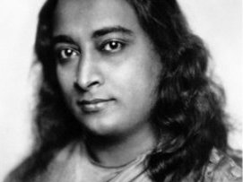
Mukunda Lal Ghosh (1893 - 1952) a.k.a. Paramahansa Yogananda
- Who introduced to the World, Meditation & Kriya Yoga
- Writer of “Autobiography of a Yogi”, the book that changed millions of life including notably Steve Jobs, Co-Founder of Apple Inc.,.

Slide 23
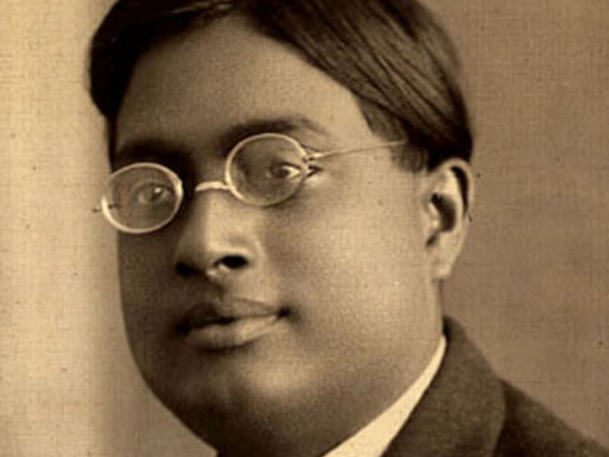
Satyendra Nath Bose (1894 - 1974)
- Physicist & Mathematician.
- Known for Quantum Mechanics which provided foundation for Bose-Einstein statistics and theory of Bose-Einstein Condensate.
- The class of particles that obey Bose-Einstein statistics is called bosons named after Bose.

Slide 24
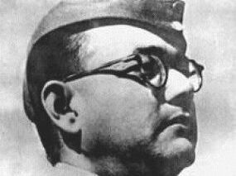
Subhas Chandra Bose (1897 - 1945) a.k.a. Netaji
Prominent figure Indian Independence Movement.
Founder of Indian National Army

Slide 25
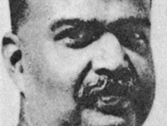
Shyama Prasad Mukherjee (1901 - 1953)
Founder of Bharatiya Jana Sangh (which later evolved as Bharatiya Janta Party).

Slide 26
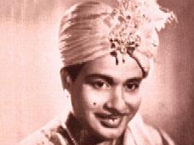
Protul Chandra Sorcar (1913 - 1971) a.k.a. P. C. Sorcar
International Magician known for his Indrajal shows performed in Japan and several other countries.

Slide 27
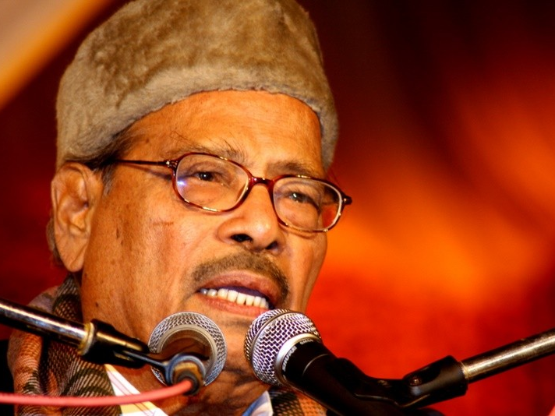
Prabodh Chandra Dey (1919 - 2013) a.k.a. Manna Dey
Recorded over 4000 songs.
Padma Shri, Padma Bhushan & Dadasahab Phalke Award.

Slide 28
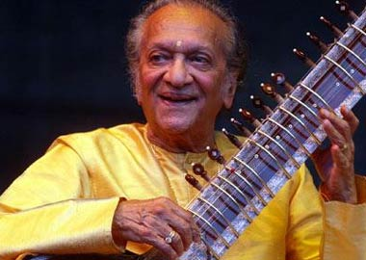
Robindro Shaunkor Chowdhury (1920 - 2012) a.k.a. Pandit Ravi Shankar
- Composer of Hindustani Classical Music.
- Associated with noted violinist Yehudi Menuhin & Beatles guitarist George Harrison for world tour promoting Indian Classical Music.
- Awarded Bharat Ratna & 3 time Grammy.
- Anoushka Shankar and Geetali Shankar (Norah Jones) are children.

Slide 29
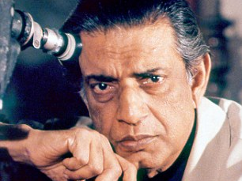
Satyajit Ray (1921 - 1992)
Winner of 32 Indian National Awards, Only Indian to win the Oscar while not being associated with Hollywood, and Bharat Ratna.

Slide 30
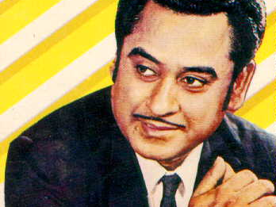
Abhas Kumar Ganguly (1929 - 1987) a.k.a: Kishore Kumar
Most successful playback singer of Hindi Film Industry.

Slide 31
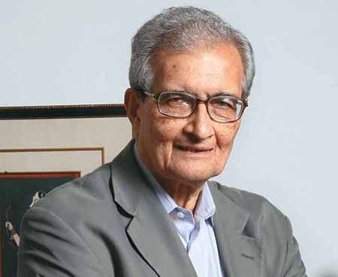
Amartya Kumar Sen (1933 - Present)
- Contributions to Human development theory.
- Nobel Prize for Economic Sciences.
- Bharat Ratna

Slide 32
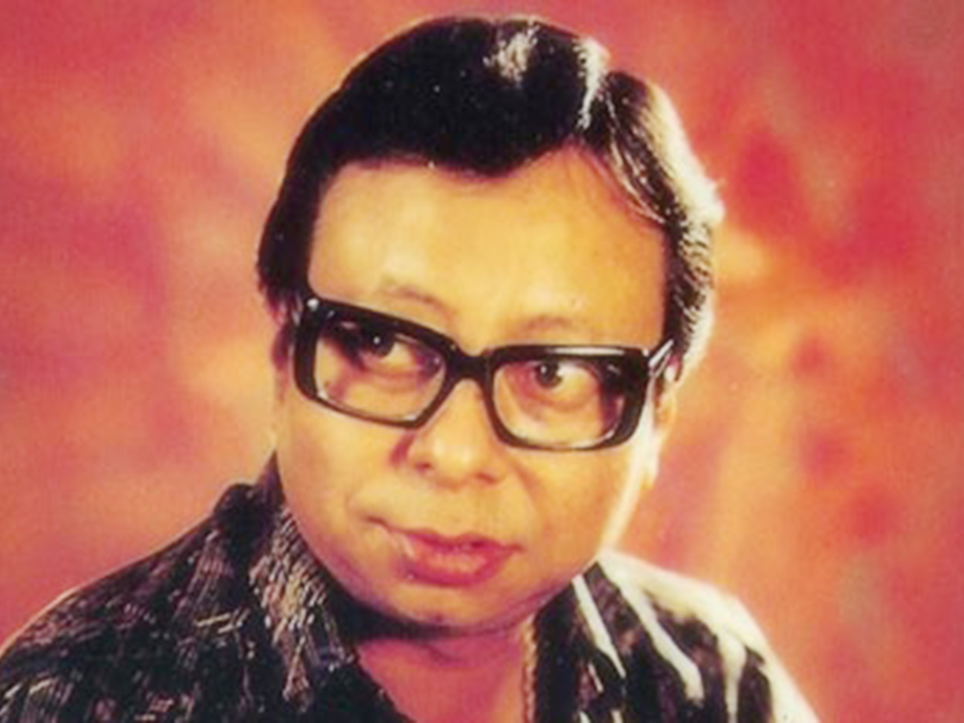
Rahul Dev Burman (1939 - 1994) a.k.a. Pancham Da
One of the seminal music directors of Indian Film Industry.

Slide 33
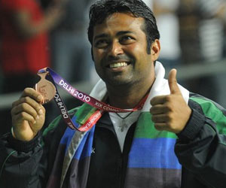
Leander Adrian Paes (1973 - Present)
Olympic Bronze Medalist, and Ace Doubles Tennis player.

Slide 34

Sushmita Sen (1975 - Present)
First Indian to win the Miss Universe crown in 1994.

Slide 35
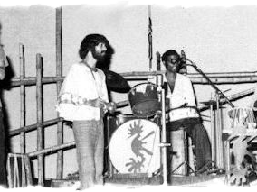
Moheener Ghoraguli (1976 – 1981 & 1995 - 1999)
India’s first rock band.
Famously known for Prithibita Naki (https://www.youtube.com/watch?v=I9iNVh582sw) sung in 70’s.

