Slide 1
Guess The Legends

Slide 2
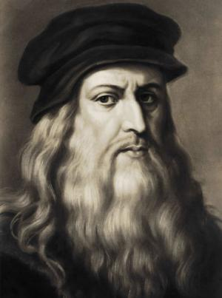

Slide 3
Leonardo da Vinci
Italian Painter
sculptor, architect, musician, mathematician, engineer, inventor, anatomist, geologist, cartographer, botanist, and writer
perhaps the most diversely talented person ever to have lived
Monalisa, The Last Supper, The Vitruvian Man, Lady with an Ermine,

Slide 4
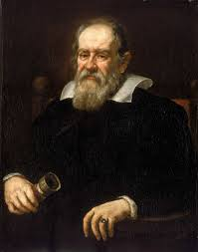

Slide 5
Galileo Galilei
Italian physicist, mathematician, engineer, astronomer, and philosopher
father of modern observational astronomy

Slide 6
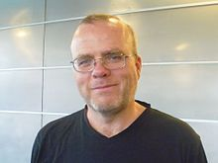

Slide 7
Rasmus Lerdorf
Canadian
Inventor of PHP
Distinguished Engineer, Etsy
He continues to contribute to the project.
He contributed to the Apache HTTP Server and he added the LIMIT clause to the MSQL DBMS

Slide 8
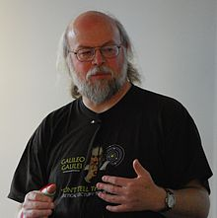

Slide 9
James Gosling
Canadian
Inventor of JAVA
Working at Liquid Robotics
adviser at the Scala company Typesafe Inc.
Strategic Advisor for Eucalyptus.

Slide 10
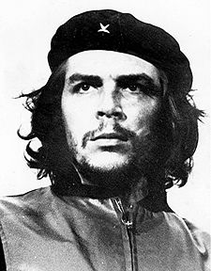

Slide 11
Che Guevara
Argentine Marxist revolutionary, physician, author, guerrilla leader, diplomat, and military theorist
A major figure of the Cuban Revolution

Slide 12
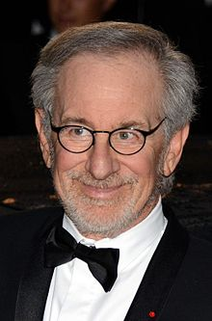

Slide 13
Steven Spielberg
American film director, screenwriter, producer, and business magnate.
Spielberg won the Academy Award for Best Director for Schindler's List (1993) and Saving Private Ryan (1998).
Jaws (1975), E.T. the Extra-Terrestrial (1982), and Jurassic Park (1993)

Slide 14
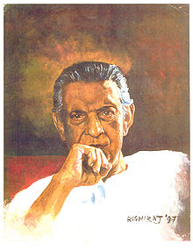

Slide 15
Satyajit Ray
an Indian Film director, producer, screenwriter, writer, music director, lyricist, caricature artist, regarded as one of the greatest auteurs of world cinema.
born in the city of Calcutta into a Bengali family
Ray's first film, Pather Panchali (1955), won eleven international prizes, including Best Human Documentary at the Cannes Film Festival.
32 Indian National Film Awards
an honorary Academy Award in 1992.
The Government of India honoured him with the Bharat Ratna in 1992.

Slide 16
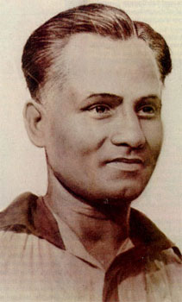

Slide 17
Dhyan Chand
an Indian field hockey player
greatest field hockey player of all time.
earned three Olympic gold medals (1928, 1932, and 1936) in field hockey.
Known as “The Wizard” for his superb ball control
scored more than 400 goals during his international career

Slide 18
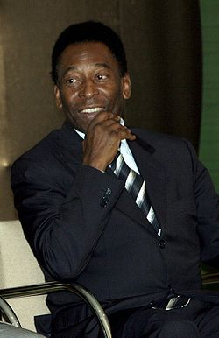

Slide 19
Pelé
Brazilian professional footballer who is widely regarded to be the greatest player of all time.
he was voted World Player of the Century by the International Federation of Football History & Statistics
In total Pelé scored 1281 goals in 1363 games
listed in the Guinness World Records for most career goals scored in football.

Slide 20
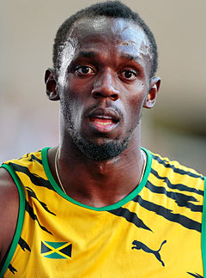

Slide 21
Usain Bolt
a Jamaican sprinter
the fastest person ever
the first man to win six Olympic gold medals in sprinting, and an eight-time World champion.
He was the first to achieve a "double double" by winning 100 m and 200 m titles at consecutive Olympics (2008 and 2012), and topped this through the first "double triple" (including 4×100 m relays).

Slide 22
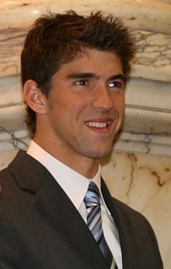

Slide 23
Michael Phelps
an American swimmer
the most decorated Olympian of all time, with a total of 22 medals.
Phelps also holds the all-time records for Olympic gold medals (18, double the second highest record holders)
most first-place finishes at any single Olympic Games

Slide 24
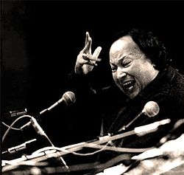

Slide 25
Nusrat Fateh Ali Khan
Pakistani musician, singer of Qawwali
one of the greatest voices ever recorded, he possessed an extraordinary range of vocal abilities
Extending the 600-year old Qawwali tradition of his family, Khan is widely credited with introducing Qawwali music to international audiences

