Slide 1
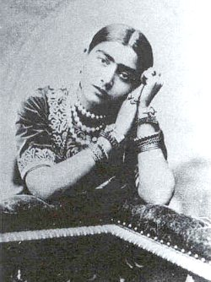
"My name is Gauhar Jaan"
26 June 1873 – 17 January 1930

Slide 2
She was born as ‘Angelina Yeoward ’ on 26 June 1873 in Azamgadh.
Father William Robert Yeoward, was an Armenian Jew working as an engineer in a dry ice factory in Azamgadh.
Mother, Victoria Hemmings a Jewish lady, was an Indian by birth, had been trained in music and dance.

Slide 3
1879: Parents’ marriage ended.
Migrated to Banaras in 1881, with a Muslim nobleman, 'Khursheed‘.
Later, Victoria, converted to Islam and became ‘Malka Jaan’
Angelina became 'Gauhar Jaan‘.

Slide 4
'Malka Jaan' became an accomplished singer, Kathak dancer and a courtesan in Banaras, and made a name for herself, as “Badi Malka Jan”
Badi (elder) because at that time three other Malka Jans were famous: Malka Jan of Agra, Malka Jan of Mulk Pukhraj and Malka Jan of Chulbuli, and she was the eldest among them.
Malka Jaan moved back to Calcutta in 1883, and established herself in the courts of Nawab Wajid Ali Shah.
Within three years she purchased a building at 24 Chitpore Road for Rs.40,000.

Slide 5
Gauhar started her training, she learnt pure and light classical Hindustani vocal music from, Kale Khan of Patiala, 'Kalu Ustad', Ustad Vazir Khan of Rampur, and Ustad Ali Baksh (founding members of Patiala Gharana).
She learnt Kathak from legendary Brindadin Maharaj (granduncle of Birju Maharaj).
Dhrupad dhamar from Srijanbai, and Bengali Keertan from Charan Das.
She also started to write and compose ghazals under the pen-name 'Hamdam' and became proficient in Rabindra Sangeet

Slide 6
Gauhar Jaan gave her maiden performance at the royal courts of Darbhanga Raj in 1887 and was appointed as court musician.
She started performing in Calcutta in 1896 and was called the 'first dancing girl' in her records.
She first visited Madras in 1910, for a concert in the Victoria Public Hall, and soon her Hindustani and Urdu songs were published in a Tamil music book.
In December 1911, she was famously invited to perform at the coronation of King George V at Delhi Durbar, where she sang a duet, Ye Hai Tajposhi Ka Jalsa, Mubarak Ho Mubarak Ho, with Jankibai of Allahabad

Slide 7
Begum Akhtar in her early days wanted to pursue a career in Hindi films, but after listening to the singing of Gauhar and her mother, she devoted herself to learning Hindustani classical music.
In her lifetime, she recorded more than 600 records from 1902 to 1920, in more than ten languages,[including Bengali, Hindustani, Gujarati, Tamil, Marathi, Arabic, Persian, Pushto, French, and English.
She would round off her performances for a record by announcing 'My name is Gohar Jan‘
She has left over 150 records and most of them are in the safe custody of record collectors.

Slide 8
She popularised light Hindustani classical music with her thumri, dadra, kajri, chaiti, bhajan, tarana renditions.
She mastered the technique of condensing performing the elaborate melody Hindustani classical style to just three and a half minutes for a record.
Her most famous song are, thumri sung in Bhairavi is
Mora nahak laye gavanava,
jabse gaye mori sudh hu na live,
Ras ke bhare Tore Nain,
Mere dard-e-jigar and
Bhajans like, Radhey Krishna Bol Mukhse.

Slide 9
India's first-ever record
India's first disc had Gauhar Jaan, singing a khayal in Raag Jogiya.
It is recorded on 2/14 November 1902, by Fred Gaisberg, an assistant to Emile Berliner (Father of Gramophone record,founded in England in 1898), who left America to become the first recording engineer with the Gramophone Company, London.
at the end of the trial recording Gauhar Jaan announced – "My name is Gauhar Jaan".
She agreed to do the recording session for a princely sum of 3,000 rupees.
By 1903, her records started appearing in Indian markets and were in great demand.

Slide 10
Her songs are also part of the 'Vintage Music From India' (1996) audio album, and her image forms its cover.
Frederick William Gaisberg and his assistants had arrived just three weeks before from England on their first Far East recording expedition. They had appointed a local agent for selecting and training artists for recording on gramophone discs. However, the agent selected Anglo-Indian artists and completely ignored local talent.
Gaisberg then sought the help of the local Police Superintendent, visited several theaters, attended mehfils at wealthy Jamindars’ palaces, and thus found at least one promising artist to begin with.
The artist was a very famous dancing girl, and her voice was very sweet; although not for European ears.

Slide 11
Gauhar Jan used to travel all over India, as a guest of patrons in the various Princely states. She also gave public performances, in which she would present ticketed programs, distributing an advance schedule of the items to be sung in her concert.
Because of Gauhar Jan the songs Radhe Krishna Bol Mukhase and Krishna Murari Binat Karat became popular bhajans and several singers used to sing them in concerts and on records.

Slide 12
In Calcutta, she used to ride in a baggi driven by four horses.
Used to pay fine of 1000 rupees for baggi riding.
She never wore the same jewels twice. Strikingly effective were her delicate black gauze draperies embroidered with real gold lace, arranged so as to present a tempting view of a bare leg and a naked navel. She was always bien soignee.
Threw a party spending 20,000 rupees when her cat produced a litter of kittens.
Donated only half the promised amount to Gandhiji’s ‘Swaraj fund’ when he did not keep the promise of attending the ‘fund raising’ concert and deputed a representative instead.
The Gramophone company reissued 18 songs in 1994 on audio tape and CD under the banner of ‘Chairman’s Choice’, which no one (except perhaps the Chairman) noticed, due to lack of adequate publicity.

Slide 13
She married her personal secretary - Saiyyad Gulam Abbas - a young man from Peshawar, and when she discovered his relations with other women, this led to several court cases and unpleasant incidents.
Later, she stayed with Mr Amrut Vagal Nayak in Bombay - a handsome actor on the Gujrathi stage.
This relation lasted for 3-4 years, and she learnt several songs composed by him including the famous Dadra Aan Ban Jiyamen Lagi.
The sudden death of Amrut Nayak was a big jolt that left her mentally disturbed.
She later served as a court singer in Darbhanga Raj and Rampur and finally joined the service of the Mysore Durbar, at the invitation of Krishna Raja Wadiyar IV of Mysore, and on 1 August 1928, she was appointed as a 'Palace musician' where she died in 1930.

Slide 14
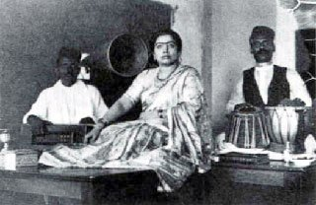
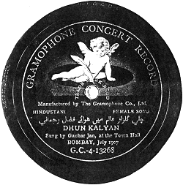
Gauhar Jan singing in 1902. A file photograph from H.M.V. Calcutta

