Slide 1
INDIAN CINEMA
Presented By Hayat Tawil Shahi

Slide 2
Indian cinema divided in 11 Languages
1. Assamese Cinema
2. Bengali Cinema
3. Bhojpuri Cinema
4. Kannada cinema
5. Malayalam Cinema
6. Marathi Cinema

Slide 3
Languages
7. Oriya Cinema
8. Punjabi Cinema
9. Tamil Cinema
10. Telugu Cinema
11. Hindi Cinema

Slide 4
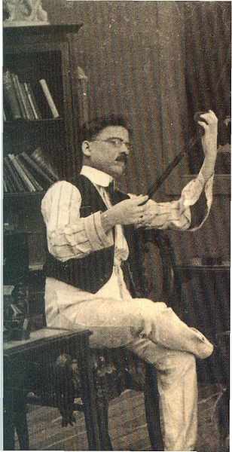
Father of Indian Cinema
Dhundiraj Goovind Phalke
Popularly known as
Dadasaheb Phalke.
He was a director, editor,
Sound recordist, special effects person and master of many other techniqes.
1870-1944

Slide 5
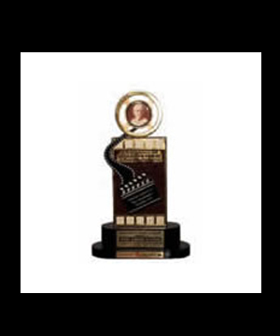
Dadasaheb Phalke Award
He laid the foundation for the beginning of a regular feature film industry in India.
The highest award in India Cinema is given in the name of Dadasaheb Phalke from the year 1969.

Slide 6
History of Indian Cinema
Indian Cinema history can be traced back to 1896.
It is when the famous Lumiere Brother’s of France demonstrated six soundless short films in Bombay.
Harishchandra Bhatvadekar made India’s first short film by 1899

Slide 7
1930’s
The 30’s is the decade of social protest in the history of Indian Cinema.
The 30’s saw sweeping changes to the industry.
Three major film centres were devoloped in Bombay, Calcutta and Madras.
Bombay was known for making of films geared for National distribution.
Calcutta and Madras were known for their regional films.

Slide 8
1930’s
Advancement of sound technology
It saw the rise of music in Indian Cinema with musicals such as Indra Sabha, Devi Devayani.
Marked the beginning of song and dance in Indian Cinema.

Slide 9
1930’s – 1940’s
Cinema came to be viewed as instrument of cultural revival.
The Indian Government has established a Films Division by 1949 .
Became one of the largest documentary film producers in the world with an annual production of over 200 short documentaries, each released in 18 languages with 9000 prints.

Slide 10
1940’s – 1950’s
In this period, the films occurred with concentration on vibrant song and dance.
The emergence of ‘playback singing’ took place.
Music became as an important ingredient in Indian Cinema.
South Indian Cinema gained prominence throughout India with the release of S.S.Vasan’s ‘Chandralekha’.

Slide 11
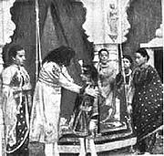
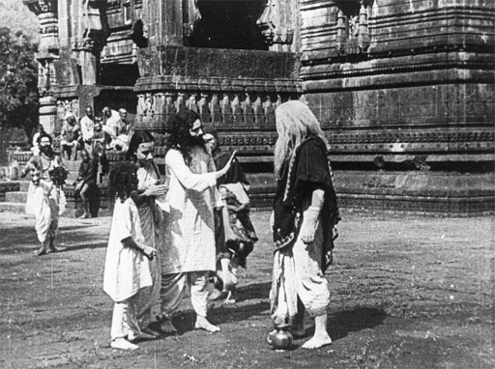
The first full length Indian feature film ‘RAJA HARISHCHANDRA’
It is the silent Indian film directed and produced by Dadasaheb Phalke in 1913.
The film had an all-male starcast, as no woman was available for playing female lead in the film, so the men played all the roles, and was 3700 feet long.

Slide 12
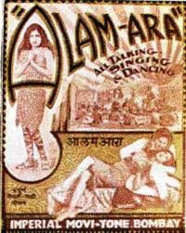
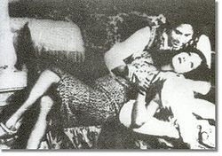
India’s first Talkie Film
‘ALAM ARA’
It was directed by Ardeshir Irani in 1931.
Both the movie and its music were widely successful.
The film also marked the beginning of filmi music in Cinema of India.

Slide 13
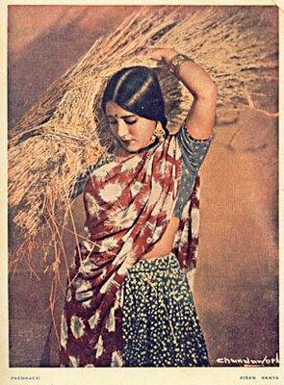
First Colour Film
‘KISAN KANYA’
Kisan Kanya was a 1937 Hindi feature film directed by Moti B. Gidvani.
It is largely remembered by the Indian public on account of it being India's first indigenously made colour film.

Slide 14

Prominent Film makers
HINDI
He was a famous film personality in India, and recipient of Dadasaheb Phalke Award.
He founded his own studio and produced and directed several films.
He was a notable writer and maker of documentaries.
Bhalji Pendharkar
1898-1994

Slide 15
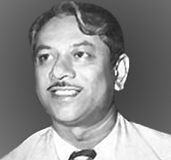
Prominent Film makers
HINDI
He is best known for directing Mother India(1957), which won the Filmfare Awards for Best Film and Best Director and was a nominee for the Academy Award for Best Foreign Language Film.
He set up the Mehboob Studio in Mumbai.
Mehboob khan
1907 - 1964

Slide 16
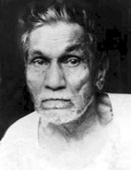
Prominent Film makers
MALAYALAM
He is the Father of Malayalam Cinema.
He produced, directed, wrote, photographed, edited and acted in the first film made in Kerala, named Vigathakumaran.
The Government of Kerala instituted the J. C. Daniel Award as a part of the Kerala state film awards.
J. C. Daniel
1893 - 1975

Slide 17
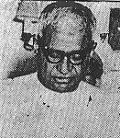
Prominent Film makers
BENGALI
He was a Dadasaheb Phalke Award winning and Padmabushan recipient.
He was an actor, film enterpreneur, director of Bengali Cinema.
He had set up a number of film production companies : Indo British FilmCompany, British Dominion Films, Lotus Film Company.
Dhirendra Nath Ganguly
1893 - 1978

Slide 18
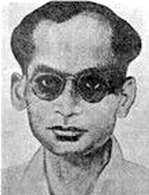
Prominent Film makers
Assameese
He is regarded as the ‘Father of Assamese Cinema’.
He was a playwright, songwriter, poet, writer and film maker from Assam.
His death anniversary (January 17) is celebrated as Silpi divas (Artists' Day) in his honor.
Jyoti Prasad Agarwala
1903-1953

Slide 19
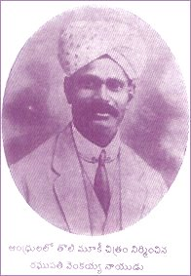
Prominent Film makers
TELUGU
He is the ‘Father of Telugu Cinema’.
He was the first owner of movie theatres in Madras, and the producer and director of the first few silent Indian movies and talkies.
The Government of AP honoured him by establishing Raghupati Venkaiah Award.
Raghupathi Venkaiah Naidu
1887 - 1941

Slide 20
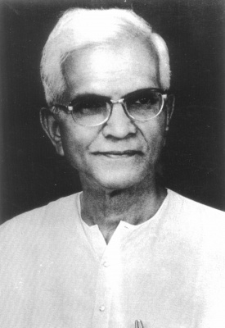
Prominent Film makers
TELUGU
L.V.Prasad was a famous actor, producer and director.
He was a recipient of the prestigious Dadasaheb Phalke Award for lifetime contribution to cinema from the Government of India for the year 1982.
L.V.Prasad
1930-1990

Slide 21
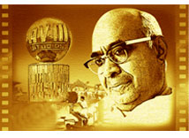
Prominent Film makers
TAMIL
He was an Indian Film Producer, director and philantropist who established the AVM Productions in Vadapalani, Chennai.
He is one of three movie moguls of the South Indian film industry.
A.V. Meiyappan
1934-1973

Slide 22
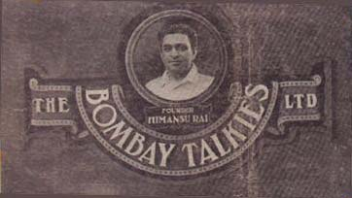
Prominent Film Production Companies in India (1950’s)
The Bombay Talkies Limited was founded in 1934 in Malad, Bombay by Himanshu Rai and Devika Rani.
It was a high tech movie studio of its time.
The Bombay Talkies was closed down in 1954.
Logo of Bombay Talkies

Slide 23
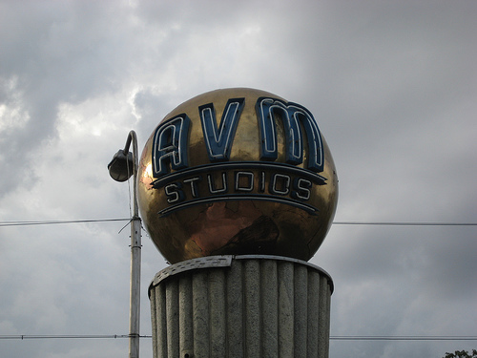
Prominent Film Production Companies in India (1950’s)
AVM is the oldest and largest film production studio in Kollywood.
AVM was founded by A.V. Meiyappan.
It is currently owned by M.Saravanan and his son, M.S.Guhan.
Tomb at the AVM
Studio in Chennai

Slide 24

Prominent Film Production Companies in India (1950’s)
It is a Bollywood film production company.
Tarachand Barjatya established this production in 1947.
In the era of 1960s to 1980s, Rajshri production became very successful.
Rajshri Productions Logo

Slide 25
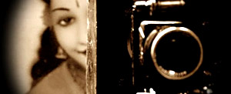
Prominent Film Production Companies in India (1950’s)
It was the first film production company in Bengal.
It was set up in 1898 by Hiralal Sen.
The company produced shows, generally exhibited at the Classic Theatre in Calcutta.
Royal Bio Scope

Slide 26
Indian Film Industry Today
Hindi Film Industry (Bollywood)
Kannada Film Industry (Sandalwood)
Malyalam Film Industry
Marathi Film Industry
Tamil Film Industry (Kollywood)
Telugu Film Industry (Tollywood)
Bengali Film Industry (Tollywood)

Slide 27
Awards
The Indian government has sponsored the National Film Awards (which first began in 1954), awarded by the government run Directorate of Film Festivals (DFF).
The Filmfare Awards ceremony is one of the oldest and most prominent film events given for Hindi films in India and is sometimes referred to as the “Bollowood Oscars”.

Slide 28
Central Board of Film Certification
For a film to be released publicly it must receive approval from the board.
It’s guidelines state:
- The Cinematograph Act lays down that a film has to be certified keeping the interests of sovereignty, integrity and security of India, friendly relations with foreign states, public order, morality etc. in mind.

Slide 29
Rating System
How do the rating system of india and US compare
India CBFC (Central Board of Film Certification) Ratings
U – Unrestricted Public Exhibition
UA – Unrestricted – but with parental supervision
A – Restricted to adults
S – Restricted to special class of persons
– Sanction of any of the above category subject to Excisions and Modifications
-- – Refusal for exhibition

Slide 30
THANK YOU
..
Notes:
dept. of visual communication

