Slide 1
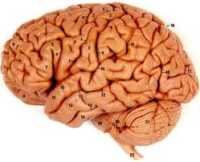
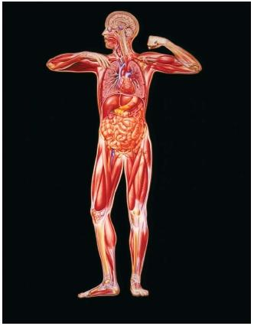
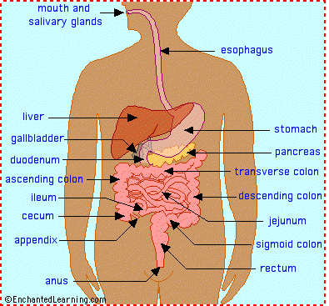

Slide 2
Some Interesting Facts about the Human Body
The human brain is the most complex and least understood part of the human anatomy.
Nerve impulses to and from the brain travel as fast as 170 miles per hour.
The brain operates on the same amount of power as 10-watt light bulb. The cartoon image of a light bulb over your head when a great thought occurs isn’t too far off the mark. Your brain generates as much energy as a small light bulb even when you’re sleeping.
The human brain cell can hold 5 times as much information as the Encyclopedia Britannica.

Slide 3
Our brain uses 20% of the oxygen that enters our bloodstream. The brain only makes up about 2% of our body mass, yet consumes more oxygen than any other organ in the body.
The brain is much more active at night than during the day.
Scientists say the higher your I.Q. the more you dream. average length of most dreams is only 2-3 seconds–barely long enough to register
Neurons continue to grow throughout human life.
Information travels at different speeds within different types of neurons. Some as 0.5 meters/sec or as fast as 120 meters/sec.

Slide 4
The brain itself cannot feel pain. While the brain might be the pain center when you cut your finger or burn yourself, the brain itself does not have pain receptors and cannot feel pain. That doesn’t mean your head can’t hurt. The brain is surrounded by loads of tissues, nerves and blood vessels that are plenty receptive to pain and can give you a pounding headache.
80% of the brain is water. Living brain tissue is a squishy, pink and jelly-like organ

Slide 5
Facial hair grows faster than any other hair on the body. If the average man never shaved his beard it would grow to over 30 feet during his lifetime.
Every day the average person loses 60-100 strands of hair.
Women’s hair is about half the diameter of men’s hair.
One human hair can support 3.5 ounces.
The fastest growing nail is on the middle finger.
Fingernails grow nearly 4 times faster than toenails.

Slide 6
The lifespan of a human hair is 3 to 7 years on average.
Human hair is virtually indestructible.
The largest internal organ is the small intestine. Our small intestine is actually four times as long as the average adult is tall.
The human heart creates enough pressure to squirt blood 30 feet.
The acid in your stomach is strong enough to dissolve razorblades.

Slide 7
The human body is estimated to have 60,000 miles of blood vessels. the distance around the earth is about 25,000 miles, more than two times around the earth.
We get a new stomach lining every three to four days. the walls of the stomach would soon dissolve due to the strong digestive acids in our stomach.
The surface area of a human lung is equal to a tennis court. These are filled with microscopic capillaries which oxygen and carbon dioxide.
Women’s hearts beat faster than men’s

Slide 8
Our left lung is smaller than your right lung to make room for your heart.
We could remove a large part of your internal organs and survive. The human body may appear fragile but it’s possible to survive even with the removal of the stomach, the spleen, 75 percent of the liver, 80 percent of the intestines, one kidney, one lung, and virtually every organ from the pelvic and groin area. You might not feel too great, but the missing organs wouldn’t kill you.
Sneezes regularly exceed 100 mph.

Slide 9
Coughs clock in at about 60 mph.
Women blink twice as many times as men do. That’s a lot of blinking every day. The average person, man or woman, blinks about 13 times a minute.
Feet have 500,000 sweat glands and can produce more than a pint of sweat a day. , men usually have much more active sweat glands than women.
During your lifetime, you will produce enough saliva to fill two swimming pools. Saliva plays an important part in beginning the digestive process and keeping the mouth lubricated.

Slide 10
The average person expels flatulence 14 times each day.
Earwax production is necessary for good ear health. It protects the delicate inner ear from bacteria, fungus, dirt and even insects. It also cleans and lubricates the ear canal.
The largest cell in the human body is the female egg and the smallest is the male sperm.
The three things pregnant women dream most of during their first trimester are frogs, worms and potted plants.

Slide 11
Your teeth start growing 6 months before you are born. few babies are born with teeth in place. One out of every 2,000 newborn infants has a tooth when they are born.
Babies are always born with blue eyes. The color of your eyes depends on the genes you get from your parents, but at birth most babies appear to have blue eyes. The reason behind this is the pigment melanin. The melanin in a newborn’s eyes often needs time after birth to be fully deposited or to be darkened by exposure to ultraviolet light, later revealing the baby’s true eye color.

Slide 12
After eating too much, your hearing is less sharp.
If saliva cannot dissolve something, you cannot taste it.
Women are born better smellers than men and remain better smellers over life.
Our nose can remember 50,000 different scents.
Even small noises cause the pupils of the eyes to dilate.

Slide 13
The ashes of a cremated person average about 9 pounds.
Nails and hair do not continue to grow after we die.
By the age of 60, most people will have lost about half their taste buds.
Your eyes are always the same size from birth but your nose and ears never stop growing.
By 60 years of age, 60-percent of men and 40-percent of women will snore.

Slide 14
Monday is the day of the week when the risk of heart attack is greatest. it’s a combination of too much fun over the weekend with the stress of going back to work that causes.
Humans can make do longer without food than sleep.
Over 90% of diseases are caused or complicated by stress.
A human head remains conscious for about 15 to 20 seconds after it is been decapitated.
if human eye was a digital camera , it would have 576 megapixels.

Slide 15
It takes 17 muscles to smile and 43 to frown.
Babies are born with 300 bones, but by adulthood the number is reduced to 206. The bones harden and fuse as the children grow.
The strongest muscle in the human body is the tongue.
The hardest bone in the human body is the jawbone.
We use 200 muscles to take one step.
The tooth is the only part of the human body that can’t repair itself.

Slide 16
About 32 million bacteria call every inch of your skin home. some harmful and some are even helpful in maintaining a healthy body.
Humans shed and regrow outer skin cells about every 27 days.
Three hundred million cells die in the human body every minute.
Every day an adult body produces 300 billion new cells.
Every tongue print is unique.
Your body has enough iron in it to make a nail 3 inches long.

Slide 17
Tears and mucus contain an enzyme (lysozyme) that breaks down the cell wall of many bacteria. This is to your advantage, as the mucus that lines your nose and throat, as well as the tears that wet your eyes are helping to prevent bacteria from infecting those areas and making you sick.
Our body gives off enough heat in 30 minutes to bring half a gallon of water to a boil.
It is not possible to tickle yourself.
Humans are the only animals to produce emotional tears.

Slide 18
Women burn fat more slowly than men, by a rate of about 50 calories a day.
For every pound of fat gained, you add seven miles of new blood vessels.
By the age of eighteen your brain stops growing.
Scientists say the higher your I.Q. The more you dream.
Our big toes have two bones each while the rest have three.
It takes the food seven seconds to get from your mouth to your stomach.

Slide 19
The enamel in your teeth is the hardest substance in your body.
A tiny pinhead-sized drop of blood contains 5,000,000 red cells, 5,000 white cells, as well as 300,000 platelets.
There is no link between brain size and intelligence – Einstein’s brain weighed just 1.2 kilograms.
Balance water is absorbed in Large Intestine
The large intestine takes out the waste.
Your thumb is the same length of your nose.

Slide 20
The body of an adult contains over 60,000 miles of blood vessels!
An adult's heart pumps nearly 4000 gallons of blood each day!
At rest, each heartbeat pumps out around 80 millilitres of blood.
A tiny pinhead-sized drop of blood contains 5,000,000 red cells, 5,000 white cells, as well as 300,000 platelets.
Left hand side of our brain controls right -side of our body whereas right-hand side controls left part of body .
everybody has a strong eye and one weak!

Slide 21
Our blood carries food & oxygen to all of your body.!
Blood is 6 times thicker than water.
It takes food only seven seconds to go from the mouth to the stomach.
unlike other body cells ,brain cells can not regenerate . Once brain cells are damaged ,they are not repaired !
The only part of the body that has no blood supply is the cornea in the eye.It takes in oxygen directly from air.
The only part of the body that has no blood supply is the cornea in the eye.It takes in oxygen directly from air.

