Slide 1
SOME FACTS
80% of a company's profits come from 20% of its customers
80% of a company's complaints come from 20% of its customers
80% of a company's profits come from 20% of the time its staff spend
80% of a company's sales come from 20% of its products
80% of a company's sales are made by 20% of its sales staff[
Quintile of population | Income
Richest 20% | 82.70%
Second 20% | 11.75%
Third 20% | 2.30%
Fourth 20% | 1.85%
Poorest 20% | 1.40%

Slide 2
SOME MORE FACTS
Microsoft noted that by fixing the top 20% of the most-reported bugs, 80% of the related errors and crashes in a given system would be eliminated
In load testing, it is common practice to estimate that 80% of the traffic occurs during 20% of the time.
In software engineering, Lowell Arthur expressed a corollary principle: "20 percent of the code has 80 percent of the errors. Find them, fix them!"

Slide 3
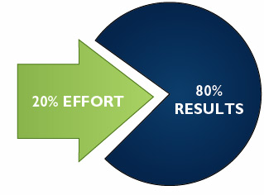
Pareto principle
DEFINITION of '80-20 Rule‘
The principle was suggested by management thinker Joseph M. Juran. It was named after the Italian economist Vilfredo Pareto, who observed that 80% of income in Italy was received by 20% of the Italian population. The assumption is that most of the results in any situation are determined by a small number of causes.

Slide 4
An 80/20 Lifestyle Blueprint
To start living 80/20 today you have only to do one thing – focus your energies on what you enjoy.

Slide 5
Some Questions
(1) Which 20% of activities are causing 80% of my happiness? (2) Which 20% of activities are causing 80% of my stresses? (3) Which 20% of work activities are causing 80% of my work results? (4) Which 20% of my friends are contributing to 80% of my fun? (5) Which 20% of my friends are contributing to 80% of my issues? (6) Which 20% of my skills and qualities are responsible for 80% of my success? (7) Which 20% of my beliefs are responsible for 80% of my tribulations?

