Slide 1
What is yours but used more by others?

Slide 2
Puzzles

Slide 3
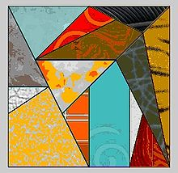
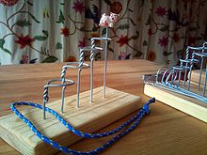
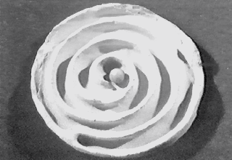
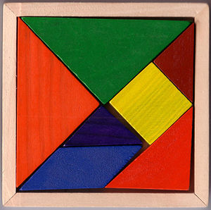
History
2550 BC - 2250 BC. Mohenjodaro “The Pick-Me-Up”
3rd century BC. Greece "Ostomachion"
2nd/3rd century AD China "Chinese Rings"
17th century AD Iran "Puzzle Locks"
18th century AD Japan and China "Tangram"
18th century AD England "Jigsaw puzzle"

Slide 4
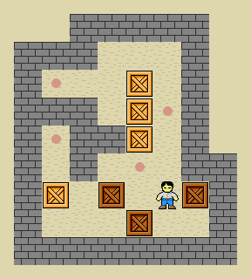
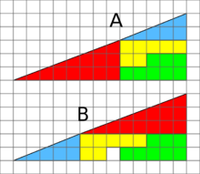
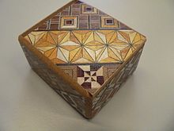
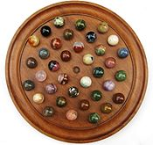
Types of puzzles
Mathematical puzzles
Mechanical puzzles
Paper-and-pencil
Word puzzles
Meta puzzles
Riddles
Missing square puzzle
Rubik's Cube
Sudoku
Crosswords
Puzzle Hunt

Slide 5
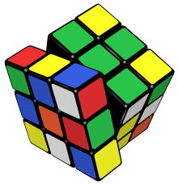
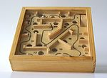
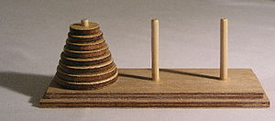
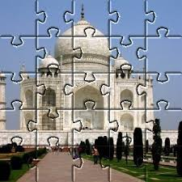
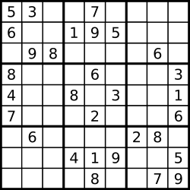
"Tom Marvolo Riddle" ⇔ ???

Slide 6
Why
Fine Motor Development
Congitive Skills
Problem Solving
Social Skills
Improved Memory
Heightened Creativity
Facilitating the Whole Brain Approach
Dopamine Production
Meditation

Slide 7
Get Puzzled!

