Slide 1
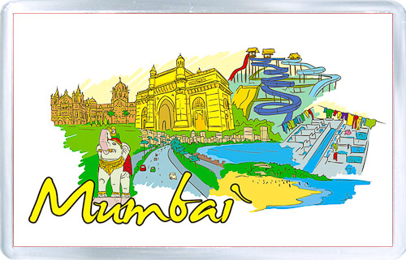
History of Bombay

Slide 2
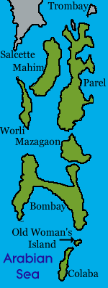
Pre-History
Breaking of Madagascar island formed different islands.
The islands were known as Heptanesia in ancient Greek.
Pleistocene sediments found around Kandivali on Salsette Island indicate habitation of stoneage man.

Slide 3
Age of indigenous empires[ till 13th Century]
The islands were incorporated into the Maurya Empire under Emperor Ashoka in the 3rd century BCE. (Kanheri & Mahakali caves).
For centuries, the islands were under the control of successive indigenous empire : Satavahanas, Abhiras, Vakatakas, Kalachuris(Jogeshwari temple), Chalukyas, Rastrakutas,silhara(walkeshwar temple, banganaga tank).
King Bhimdev from gujrat founded his kingdom in the region in late 13th century.(Capital Mahikawati).
Babulnath temple, Apollo bandar..etc

Slide 4
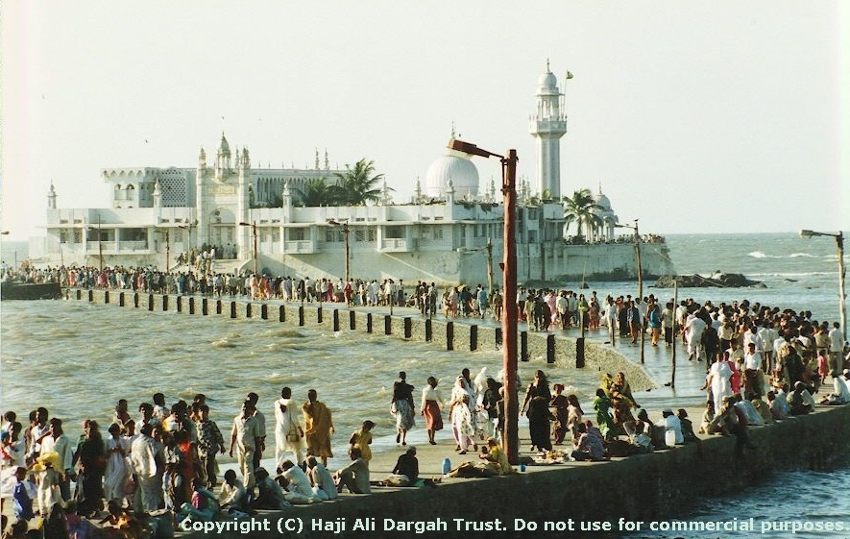
Islamic rule [1348-1534]
Haji Ali Dargah was built in honour the Muslim saint Haji Ali in 1431
Francisco de Almeida's ship sailed in 1508, and he called it Bom baía (Good Bay).
Portuguese paid their first visit to the islands on 21 January 1509 capturing Mahim Greek.
Treaty of Bassin placed islands into portuguese possesion ending islamic rule

Slide 5
Portuguese rule (1534-1661)
St. Michael Church in Mahim – 1540
St. Andrew Church at Bandra was built in 1575
Castella de Aguada - 1640 as a watchtower overlooking the Mahim Bay.
Dorabji Nanabhoy parsi, a trader, was the first Parsi to settle in Bombay in 1640 (Manager). 1668, British tax collector. Family held position till 1834.
The marriage treaty of Charles II of England and Catherine of Portugal on 8 May 1661 placed Bombay in British possession as a part of Catherine's dowry to Charles.

Slide 6
British Rule [From 1661 For 282 Years]
In 1668 an agreement led to the transfer of Bombay from Charles II to the English East India Company for an annual rent of £10.
Construction - Ware houses, Custom house, Mendham's Point, Naval Dockyard
1661 and 1675 increase in population from 10,000 to 60,000
St. Thomas Cathedral in 1718, which was the first Anglican Church in Bombay
Hornby Vellard engineering project -1782

Slide 7
British rule - construction
Elphinstone High School-1822 , college 1835.
Asiatic Society of Bombay (Town Hall) -1833
Bank of Bombay 1840.
Grant Medical College and hospital – 1845- Robert Grant.
First-ever Indian railway - 16 April 1853
Bombay Spinning and Weaving Company was the first cotton mill – 1854 tardeo.
University of Bombay - 1857

Slide 8
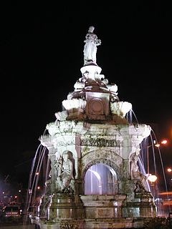
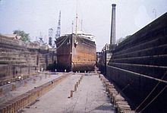
British Rule - Construction
Bombay Shipping Companies-1863
Flora Fountain -1864
Bombay Coast Navigation Company- 1866
Bombay Municipal Corporation -1872
Bombay Electric Supply and Transport – 1873
Bombay Gymkhana & BSE– 1875
Bombay Millowners' Assn - 1875
Bombay Time -1884
Princess Dock -1885

Slide 9
Indian Freedom Movement from 1885
Bombay Presidency Association & First Indian national congress session 1885
Victoria Terminus one of the finest stations in the world, was completed in May 1888
Dabbawalas - 1890
Taj hotel – 1898-1903, New Wing in 1973.
Bombay Chronicle started by Pherozeshah Mehta-1910
First electric locomotives in India were put into service from Victoria Terminus to Kurla in 1925.
Last British troops to leave India passed through the arcade of the Gateway of India on 28 February 1948, ending the 282-year-long period of the British.

Slide 10
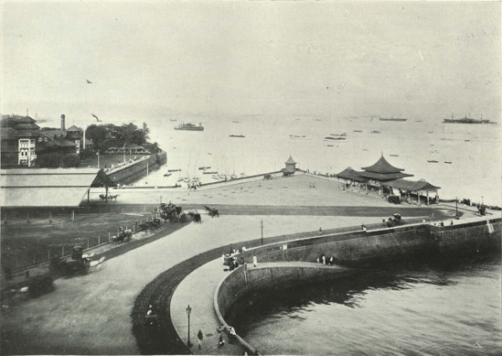
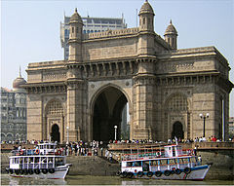
Gateway of India -1911

Slide 11
Independent India
Extention to Municipal corporation areas.
IIT Bombay 1958 - powai
States Reorganisation Committee recommended a bi-lingual state for Maharashtra-Gujarat, with Bombay as its capital.
Samyukta Maharashtra movement.
FloraFountain renamed to Hutatma chowk as memorial to the Samyukta Maharashtra movement.
Nehru Centre was established in 1972 at Worli.
Bombay Metropolitan Region Development Authority (BMRDA) -1975
Communal riots -1992-93.
Mumbai – 1996
Worli Sealink – 2000-2010 by Hindustan Construction Company.

Slide 12


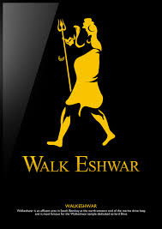
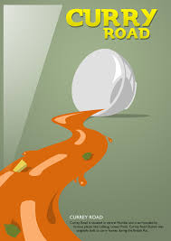

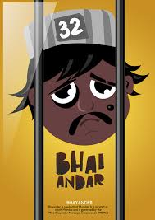


Thank you !!!

