Slide 1
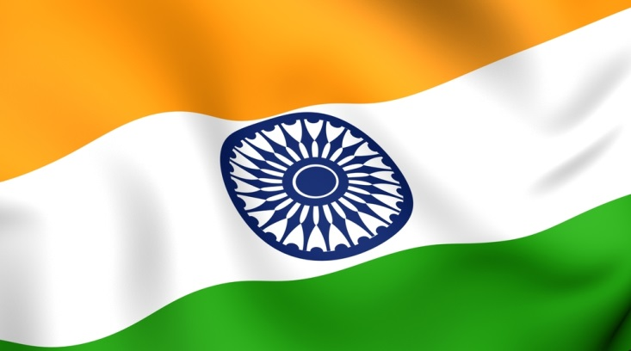
Constitution of India

Slide 2
Constitution of India
The present constitution of India was framed by the Constitution Assembly of India setup under Cabinet Mission Plan of May 16, 1946.
The first meeting of the Constituent Assembly took place of Dec 9, 1946 with Dr. Sachidanand Sinha as its interim President. Dr. Rajendra Prasad was elected as its President n Dec 11, 1947.
The all-important Drafting Committee working, from July 1947 to September 1948, was formed on August 29, 1947. Its members were:
Dr. B.R. Ambedkar
N. Gopalaswami Ayyar
K.M. Munshi
Syyed Mohd. Saadulla
N.Madhav Rao
D.P.Khaitan (T Krishnamachari, after Kahitan’s Death in 1948)
It was finally passed and accepted on Nov 26, 1949. The session of the Assembly was held on Jan 24, 1950, which unanimously elected Dr, Rajendra Prasad as the President of India.
In all the 284 members of the Assembly signed the official copies of the Indian Constitution which came into effect on Jan 26, 1950, known and celebrated as the Republic Day of India.

Slide 3
Constitution of India
Indian constitution has …
448 articles in 25 parts,
12 schedules,
5 appendices and
98 amendments - Changes

Slide 4
Fundamental Rights
Right to Equality
Article 14 :- Equality before law and equal protection of law
Article 15 :- Prohibition of discrimination on grounds only of religion, race, caste, sex or place of birth.
Article 16 :- Equality of opportunity in matters of public employment
Article 17 :- End of untouchability
Article 18 :- Abolition of titles, Military and academic distinctions are, however, exempted
Right to Freedom
Article 19 :- It guarantees the citizens of India the following six fundamentals freedoms:-
Freedom of Speech and Expression
Freedom of Assembly
Freedom of form Associations
Freedom of Movement
Freedom of Residence and Settlement
Freedom of Profession, Occupation, Trade and Bussiness
Article 20 :- Protection in respect of conviction for offences
Article 21 :- Protection of life and personal liberty
Article 22 :- Protection against arrest and detention in certain cases
Right Against Exploitation
Article 23 :- Traffic in human beings prohibited
Article 24 :- No child below the age of 14 can be employed
Right to freedom of Religion
Article 25 :- Freedom of conscience and free profession, practice and propagation of religion
Article 26 :- Freedom to manage religious affairs
Article 27 :- Prohibits taxes on religious grounds
Article 28 :- Freedom as to attendance at religious ceremonies in certain educational institutions

Slide 5
Fundamental Rights
Cultural and Educational Rights
Article 29 :- Protection of interests of minorities
Article 30 :- Right of minorities to establish and administer educational institutions
Article 31 :- Omitted by the 44th Amendment Act
Right to Constitutional Remedies
Article 32 :- The right to move the Supreme Court in case of their violation (called Soul and heart of the Constitution by BR Ambedkar)
Forms of Writ check
Habeas Corpus :- Equality before law and equal protection of law

Slide 6
Schedules
First Schedule
List of States & Union Territories
Second Schedule
Salary of President, Governors, Chief Judges, Judges of High Court and Supreme court, Comptroller and Auditor General
Third Schedule
Forms of Oaths and affirmations
Fourth Schedule
Allocate seats for each state of India in Rajya Sabha
Fifth Schedule
Administration and control of scheduled areas and tribes
Sixth Schedule
Provisions for administration of Tribal Area in Asam, Meghalaya, Tripura, Mizoram & Arunachal Pradesh
Seventh Schedule
Gives allocation of powers and functions between Union & States. It contains 3 lists
Union List (For central Govt) 97 Subjects.
States List (Powers of State Govt) 66 subjects
Concurrent List (Both Union & States) 47 subjects.

Slide 7
Schedules
Eighth Schedule
List of 22 languages of India recognized by Constitution
1. Assamese 2. Bengali 3. Gujarati
4. Hindi 5. Kannada 6. Kashmiri
7. Manipuri 8. Malayalam 9. Konkani
10. Marathi 11. Nepali 12. Oriya
13. Punjabi 14. Sanskrit 15. Sindhi
16. Tamil 17. Telugu 18. Urdu
19. Santhali 20. Bodo 21. Maithili
22. Dogri
Sindhi was added in 1967 by 21 Amendment
Konkani, Manipuri ad Nepali were added in 1992 by 71 amendment Santhali, Maithili, Bodo and Dogri were added in 2003 by 92 amendment
Ninth Schedule
Added by Ist amendment in 1951. Contains acts & orders related to land tenure, land tax, railways, industries.{Right of property not a fundamental right now}
Tenth Schedule
Added by 52nd amendment in 1985. Contains provisions of disqualification of grounds of defection
Eleventh Schedule
By 73rd amendment in 1992. Contains provisions of Panchayati Raj.
Twelfth Schedule
By 74thamendment in 1992. Contains provisions of Municipal Corporation.

Slide 8
Appendix
APPENDIX I
The Constitution ( Application to Jammu and Kashmir ) Order, 1954.
APPENDIX II
Re-Statement, with reference to the present text of the Constitution, of the exceptions and modifications subject to which the Constitution applies to the State of Jammu and Kashmir.
APPENDIX III
Extracts from the Constitution (Forty-fourth Amendment ) Act, 1978.

Slide 9
Indian Parliament
The President of India
The President in his role as head of legislature has full powers to summon and prorogue either House of Parliament or to dissolve Lok Sabha.
Lok Sabha (House of the People)
Lok Sabha is also known as the "House of the People" or the lower house and has members from 543 parliamentary constituencies. All of its members are directly elected by citizens of India on the basis of universal adult franchise, except two who are appointed by the President of India.
Rajya Sabha (Council of States).
Lok Sabha is also known as the "House of the People" or the lower house and has members from 543 parliamentary constituencies. All of its members are directly elected by citizens of India on the basis of universal adult franchise, except two who are appointed by the President of India.
The Rajya Sabha can have a maximum of 250 members in all. 238 members are to be elected from States and Union Territories and 12 are to be nominated by The President of India
Vidhan Sabha (Council of States).
The Vidhan Sabha or the Legislative Assembly, is the lower house or the sole house of the provincial (state) legislature in the different states of India.
Members of a Vidhan Sabha are direct representatives of the people of the particular state as they are directly elected by an electorate consisting of all citizens above the age of 18 of that state. Its maximum size as outlined in the Constitution of India is not more than 500 members and not less than 60 members.
Vidhan Parishedh
The Vidhan Parishad (or Legislative Council) is the upper house in those states of India that have a bicameral legislature. As of 2014, Seven (out of twenty-nine) states have a Legislative Council:
Andhra Pradesh,
Bihar,
Jammu and Kashmir,
Karnataka,
Maharashtra,
Telangana and
Uttar Pradesh .
The size of the Vidhan Parishad cannot be more than one-third the membership of the Vidhan Sabha. However, its size cannot be less than 40 members (except in Jammu and Kashmir, where there are 36 by an Act of Parliament.)

Slide 10
Indian Parliament
President of India
The President of India is the head of state of the Republic of India. The President is the formal head of the executive, legislature and judiciary of India and is the commander-in-chief of the Indian Armed Forces.
Legislative powers
Appointment powers
Financial powers
Judicial powers
Diplomatic powers
Military powers
Pardoning Powers
Emergency powers
National emergency
State emergency
Financial emergency
A President must be:
A citizen of India
Of 35 years of age or above
Qualified to become a member of the Lok Sabha
Certain office-holders, however, are permitted to stand as Presidential candidates. These are:
The current Vice President.
The Governor of any State.
A Minister of the Union or of any State (Including Prime Minister and Chief Ministers).[15]:72

Slide 11
Indian Parliament
Prime Minister of India
The Prime Minister of India, as addressed to in the Constitution of India, is the chief of government, chief adviser to the President of India, head of the Council of Ministers and the leader of the majority party in the parliament.
The prime minister leads the functioning and exercise of authority of the Government of India. He is invited by the President of India in the Parliament of India as leader of the majority party to form a government at the federal level (known as Central or Union Government in India) and exercise its powers.
head of:
Appointments Committee of the Cabinet;
Ministry of Personnel, Public Grievances and Pensions;
Ministry of Planning;
Department of Atomic Energy; and
Department of Space.
must be:
be a citizen of India.
be a member of the Lok Sabha or the Rajya Sabha. If the person chosen as the prime minister is neither a member of the Lok Sabha nor the Rajya Sabha at the time of selection, he or she must become a member of either of the houses within six months.
be above 25 years of age if he or she is a member of Lok Sabha or above 30 years of age if he is a member of the Rajya Sabha.
not hold any office of profit under the Government of India or the Government of any State or under any local or other authority subject to the control of any of the said Governments.

Slide 12
Indian Parliament
President Of Inidia
Prime Minister Of India
Chief_Minister
Mayor
District collector (or shortened to DM, Collector, or DC)
Tehsil
Sarpanch

