Slide 1
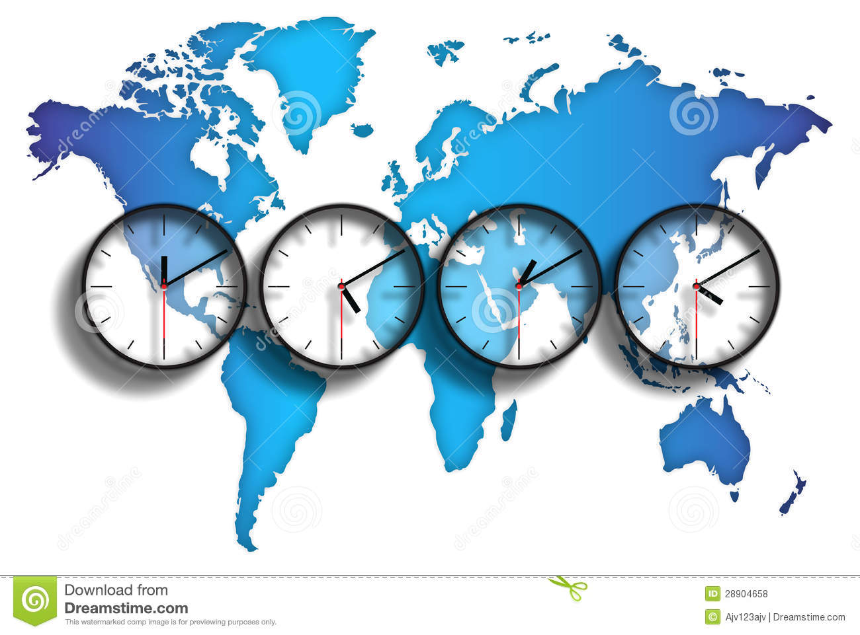
Time Zones

Slide 2
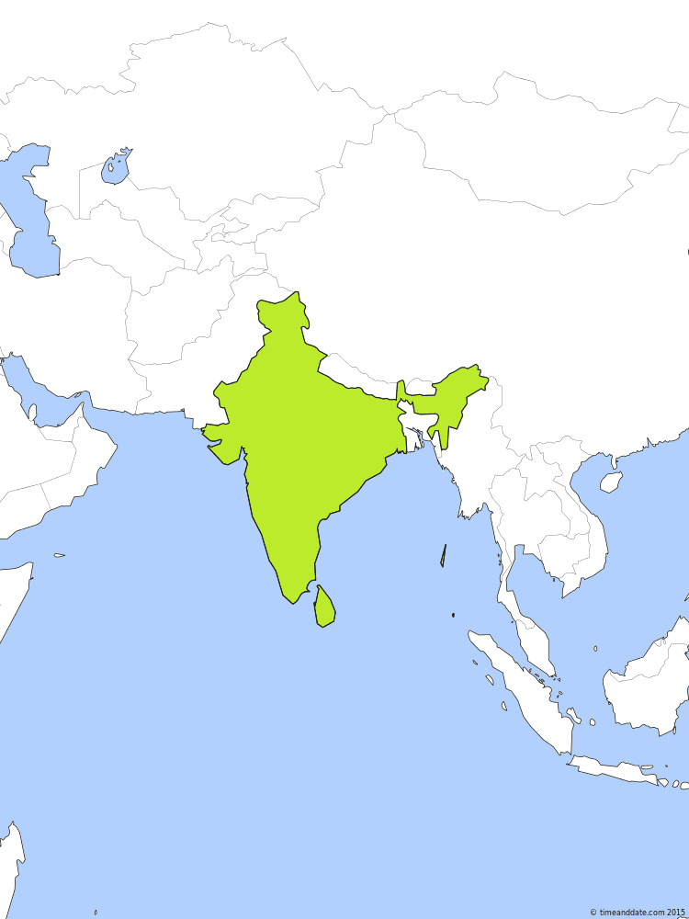
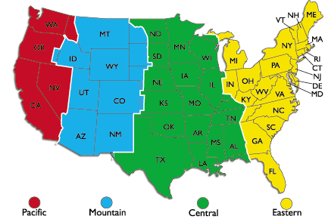
What is a Time Zone
A time zone is a region that has a uniform standard time for legal, commercial, and social purposes.

Slide 3
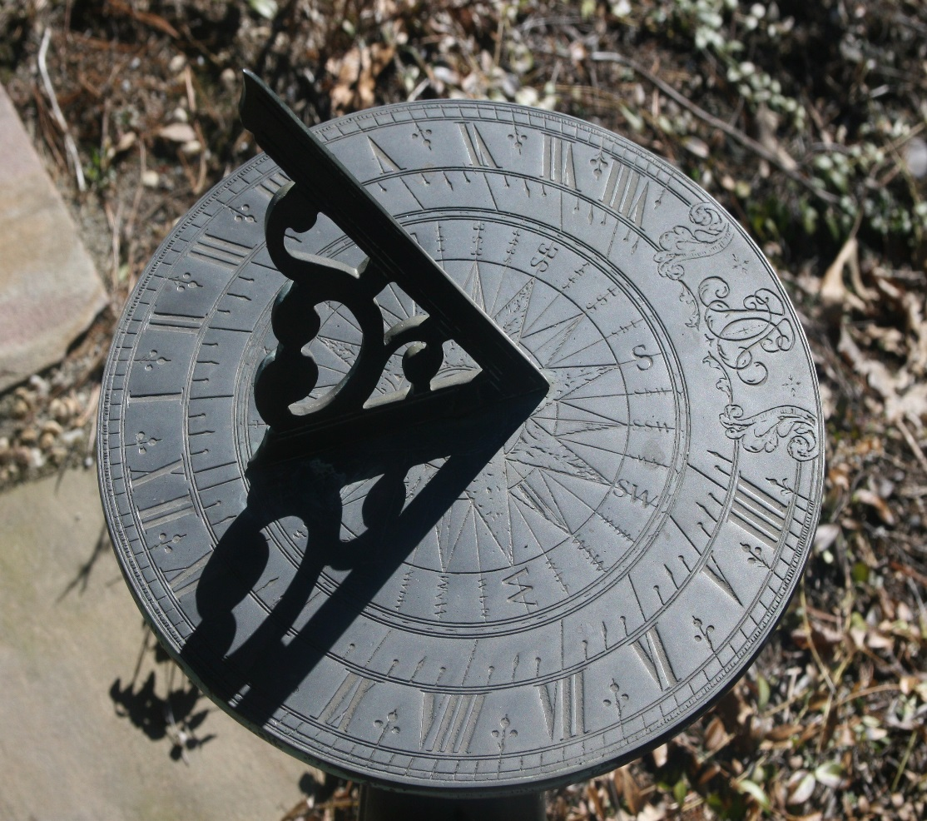
Time behind the Clocks
Prior to the invention of clocks, people marked the time of the day using the solar time.
Sun dial was one of the common instruments used for measuring time. It used to tell the time of the day based on the position of the sun.

Slide 4
Before the World came closer !!
Time differences between distant locations were barely noticeable prior to the 19th century because of long travel times and lack of long-distance communications.
The use of local solar time became increasingly awkward as railways and telecommunications improved.
Time zones were therefore a compromise, relaxing the complex geographic dependence while still allowing local time to be approximate with mean solar time.

Slide 5
Rail Road Time
American railroads maintained many different time zones during the late 1800s. Each train station set its own clock making it difficult to coordinate train schedules and confusing passengers. Time calculation became a serious problem for people travelling by train.
Every city in the United States used a different time standard so there were more than 300 local sun times to choose from.
Railroad managers tried to address the problem by establishing 100 railroad time zones, but this was only a partial solution to the problem.

Slide 6
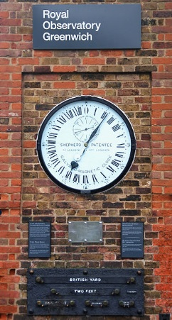
GMT - UTC
Greenwich Mean Time (GMT) refers to the mean solar time at the Royal Observatory in Greenwich, London, which became adopted as a global time standard.
Coordinated Universal Time (UTC) is arranged so that it runs no more than 0.9 seconds fast or slow of Greenwich Mean Time.

Slide 7
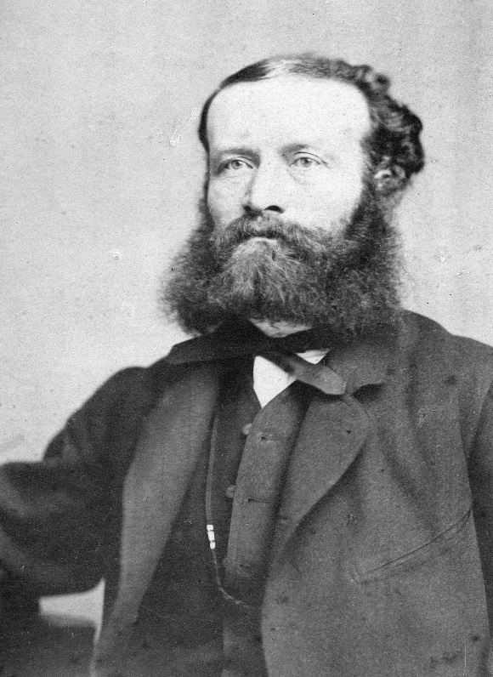
Man behind the concept of Time Zones
The idea to divide the Earth into time zones was proposed by the Scottish-born Canadian railway planner and engineer Sir Sanford Fleming (1827 - 1915) in the 1879.

Slide 8
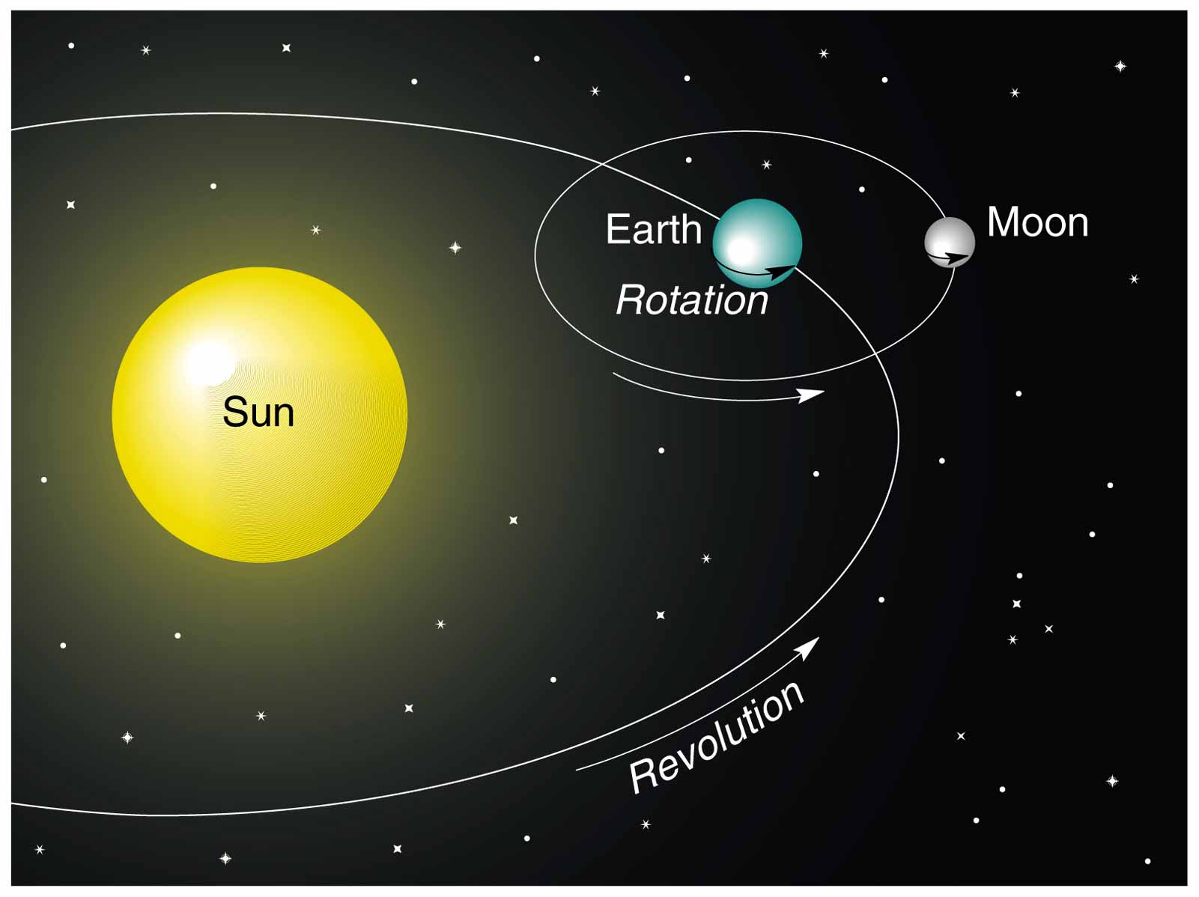
How Many Time Zones?
1 revolution of Earth = 365.25 days
6 hours x 4 years = Leap year
1 rotation of Earth = 24 hours
Circle = 360°
360° /24 = 15° = 1 hour
Earth rotates 15° each hour

Slide 9
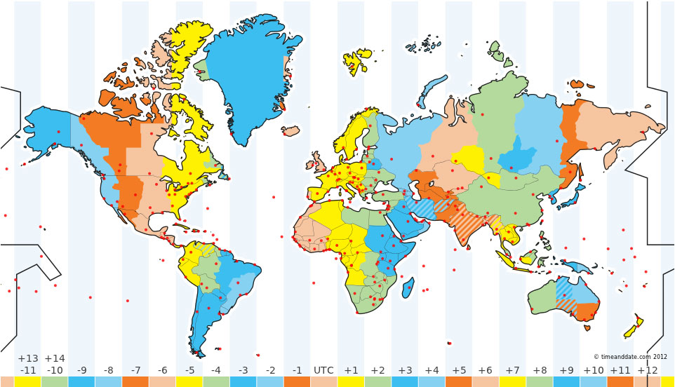
World Map Explaining the Time Zones

Slide 10
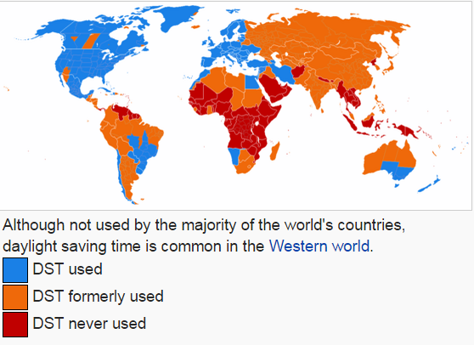
Daylight saving time (DST) or summer time
The practice of advancing clocks during summer months by one hour so that light extends into the evening hours—sacrificing normal sunrise times.
Typically, users of DST adjust clocks forward one hour near the start of spring and adjust them backward in the autumn to "normal" or regular time.

Slide 11
Few Facts….
France has the most time zones with a count of 12.
Time in India since after independence in 1947 is officially represented by the Indian Standard Time (IST, UTC+05:30).Some older time zones were:
Bombay time (UTC+04:51),
Madras time (UTC+05:21)
Calcutta time (UTC+05:54),
Port Blair mean time

Slide 12
Few Facts…. (Continued)
Sri Lanka follows the same time zone as that of India : Sri Lanka Standard Time (SLST) - 5 hours and 30 minutes ahead of GMT/UTC (UTC+05:30)
Greenwich, of GMT fame, is actually GMT +01:00 in the Summer
Samoa actually skipped 30th December 2011 to redraw the international date line & simplify relations with key trading partners Australia and New Zealand, time in the South Pacific nation

Slide 13
Few Facts…. (Continued)
Spain is in the "wrong" timezone. Most of mainland Spain is either on the same longitude as or further west than the UK. And yet, Spain is an hour ahead, time-wise.(This was done by Francisco Franco to match their clocks with Nazi Germany).
China observes one time zone UTC/GMT + 08:00 - which makes this time zone uncommonly wide. In the extreme western part of China the sun is at its highest point at 15:00, in the extreme eastern part - at 11:00.

Slide 14
Few Facts…. (Continued)
Some countries use different rules to start and end DST. For example, a law in Israel requires that summer must last at least 150 days.
Some places use quarter / hour offset from UTC/GMT.
Examples: Nepal is UTC/GMT +05:45
The International Space Station uses UTC/GMT. Time followed by OS too is UTC.

