Slide 1
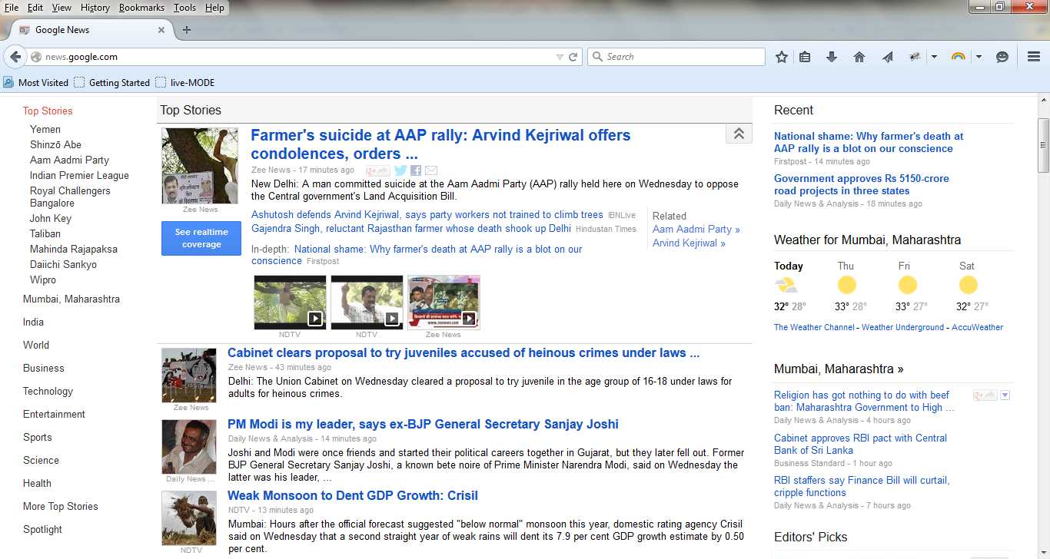

Slide 2
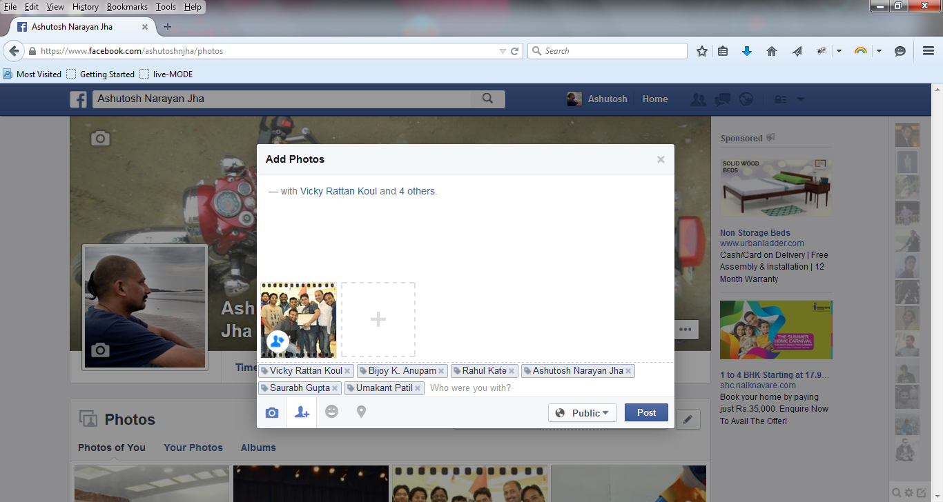

Slide 3
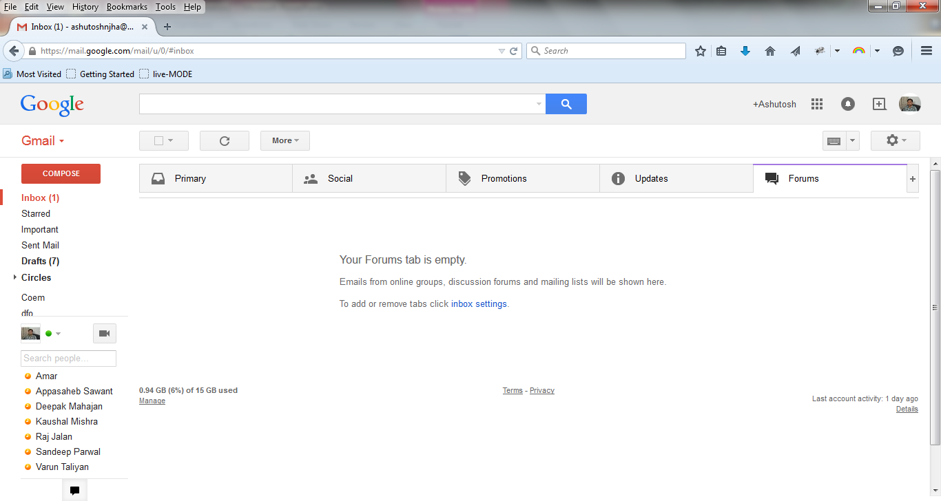

Slide 4
SPAM
_{SPAM}

Slide 5

I am a Machine
And I learn too !!

Slide 6
Machine Learning
Grew out of work in AI
New capability for computers
Examples:
Database mining
Large datasets from growth of automation/web.
E.g., Web click data, medical records, biology, engineering
Applications.
E.g., handwriting recognition, most of Natural Language Processing (NLP), Computer Vision.
Recommendation system

Slide 7
Definiton
Arthur Samuel (1959). Machine Learning: It is a Field of study that gives computers the ability to learn without being explicitly programmed.
Tom Mitchell (1998) Well-posed Learning Problem: A computer program is said to learn from experience E with respect to some task T and some performance measure P, if its performance on T, as measured by P, improves with experience E.

Slide 8
Suppose an email program watches which emails we do or do not mark as spam, and based on that learns how to better filter spam.
Classifying emails as spam or not spam (T)
Watching us label emails as spam or not spam (E )
The number (or fraction) of emails correctly classified as spam/not spam. (P)

Slide 9
Machine learning algorithms:
Supervised learning
Unsupervised learning
Supervised
Right Answer Given.
Unsupervised.
Let’s the machine decide the answer based on data set given.

Slide 10
Supervised

Slide 11
unsupervised
x₂
x₁

Slide 12
Supervised/Unsupervised
Given email labeled as spam/not spam, learn a spam filter.
Given a set of news articles found on the web, group them into set of articles about the same story.
Given a database of customer data, automatically discover market segments and group customers into different market segments.
Given a dataset of patients diagnosed as either having diabetes or not, learn to classify new patients as having diabetes or not.

