Slide 1
The Undercover Agent
AI's Deep Infiltration into Data Engineering
TechTonic Conference • From AI-Assisted to AI-Automated Delivery

Slide 2

The Problem: Manual Data Engineering

Slide 3
The Problem: Manual Data Engineering
Manual handoffs
between teams
Inconsistent
quality & SLAs
1
3
Months of
delivery cycles
Repetitive,
error-prone work
2
4

Slide 4
The Solution: Agentic AI Way
Specs
Fabric
Power BI
1
Driven Development
2
MCP Scaffolding
3
MCP Reporting
Data Ops
Feature-Driven
GitHub
4
Quality Framework
5
6
SDLC
Actions CI/CD

Slide 5

Pillar 1:
Well defined blueprint.

Slide 6
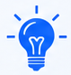

Pillar 1: Specs-Driven Development
Data contracts define schema, SLAs, lineage
YAML/JSON specs drive infrastructure creation
Single source of truth for requirements
Enables reproducible, testable pipelines
Key Benefit: Transform requirements into executable code automatically

Slide 7
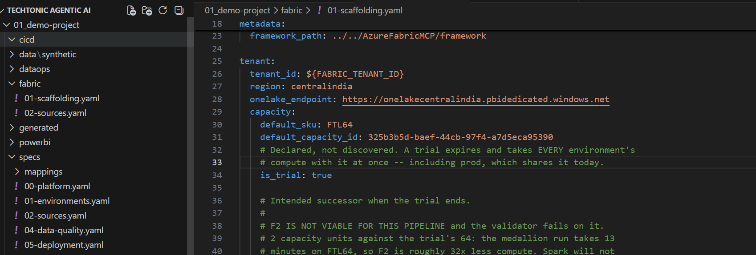
Sample Specs

Slide 8

Pillar 2:
Don’t solve the problem
until you've given it
the map of the environment.

Slide 9
Pillar 2:
Fabric MCP Scaffolding

Slide 10
Pillar 2: Fabric MCP Scaffolding
Metadata-driven notebook generation
Medallion architecture (Bronze→Silver→Gold)
Automatic schema inference & lineage
SQL Endpoint for read-only query access
Key Benefit: Create Fabric infrastructure and pipelines from JSON specs

Slide 11
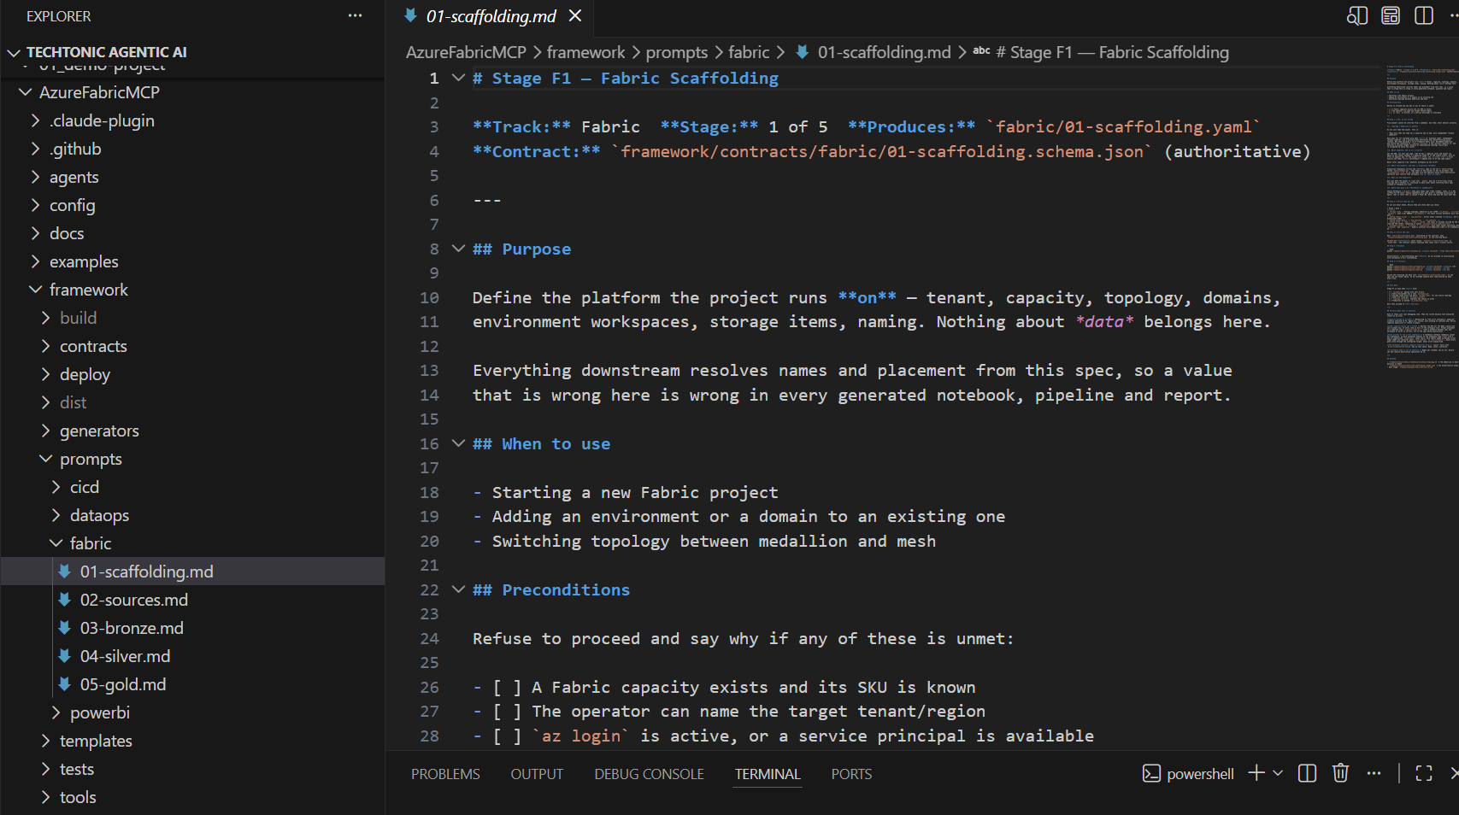
Sample Scaffolding Code

Slide 12

Pillar 3:
Plans start the mission.
Intelligence keeps the mission successful.

Slide 13
Pillar 3:
Power BI MCP Reporting

Slide 14
Pillar 3: Power BI MCP Reporting
Automated dashboard generation
Audit reports
Fabric SQL Endpoint native connectivity
Consistent branding & styling
Key Benefit: Generate production-ready reports automatically

Slide 15
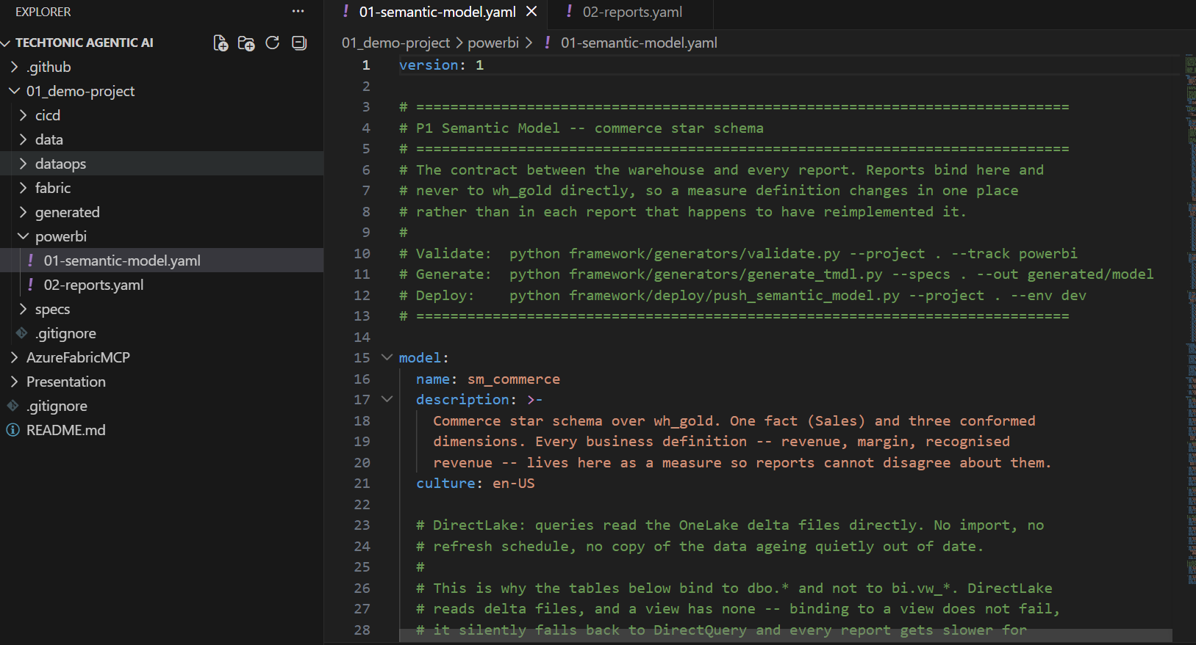
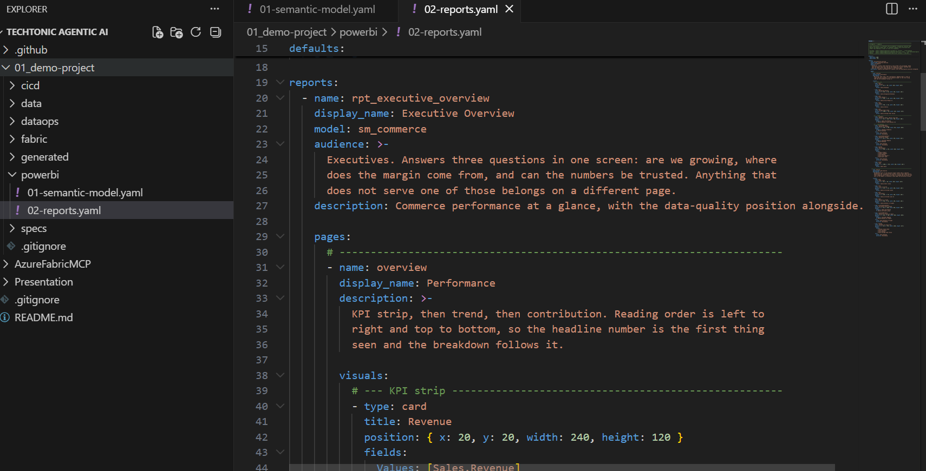
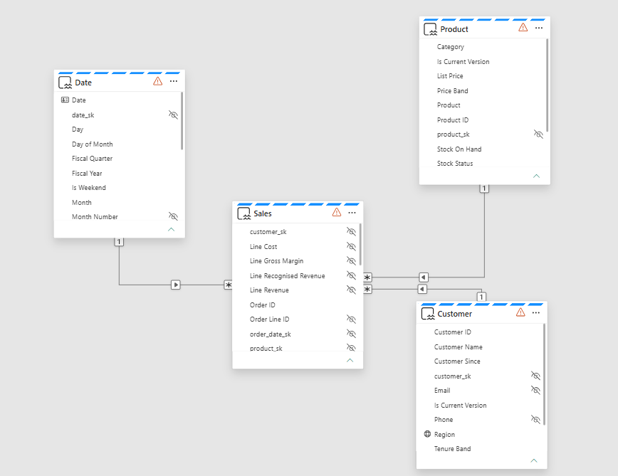
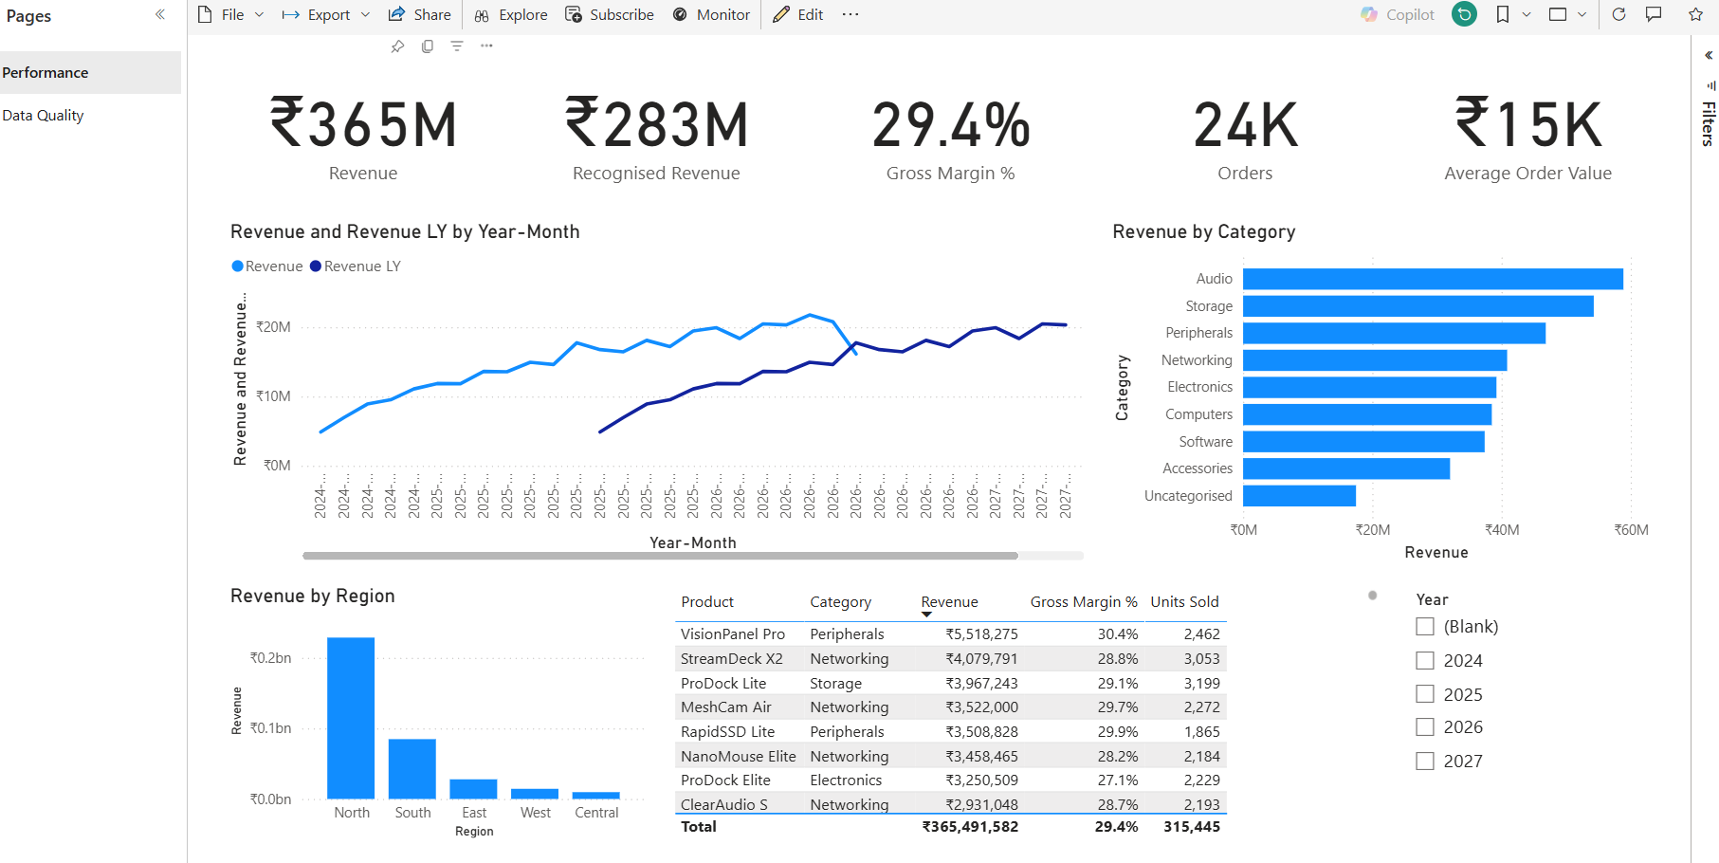
Power BI MCP Reporting

Slide 16

Pillar 4:
Dry Run Every Single Move.
If something fails,
we adjust.

Slide 17
Pillar 4: Data Ops
Quality Framework

Slide 18
Pillar 4: Data Ops Quality Framework
Great Expectations / DBT integration
SLA monitoring (Freshness, Completeness, Uniqueness)
Quality check notebooks per layer
Automated alerts & reporting
Key Benefit: 35+ quality checks passing automatically

Slide 19
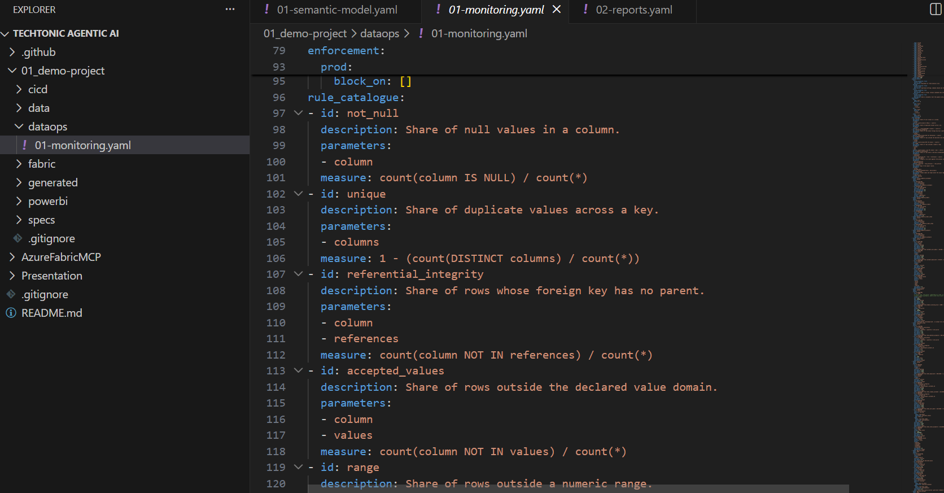
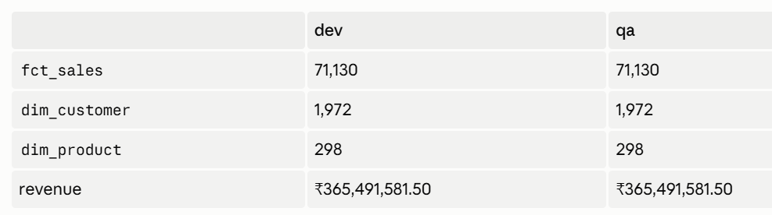

Slide 20

Pillar 5:
One Mission.
Many Specialists.
Clear Ownership

Slide 21
Pillar 5:
Feature-Driven SDLC

Slide 22
Pillar 5: Feature-Driven SDLC
Feature branch strategy (feature/bronze-*)
Pull request templates with lineage docs
Code review gates & CODEOWNERS
Automated schema validation
Key Benefit: Enforce quality & consistency at merge-time

Slide 23

Pillar 6:
Execution succeeds because
preparation was complete.

Slide 24
Pillar 6:
GitHub Actions CI/CD

Slide 25
Pillar 6: GitHub Actions CI/CD
PR validation & schema checks
Multi-environment promotion (dev→qa→uat→prod)
Automated deployment workflows
Slack notifications & audit logs
Key Benefit: Push-to-deploy data pipelines with safety gates

Slide 26
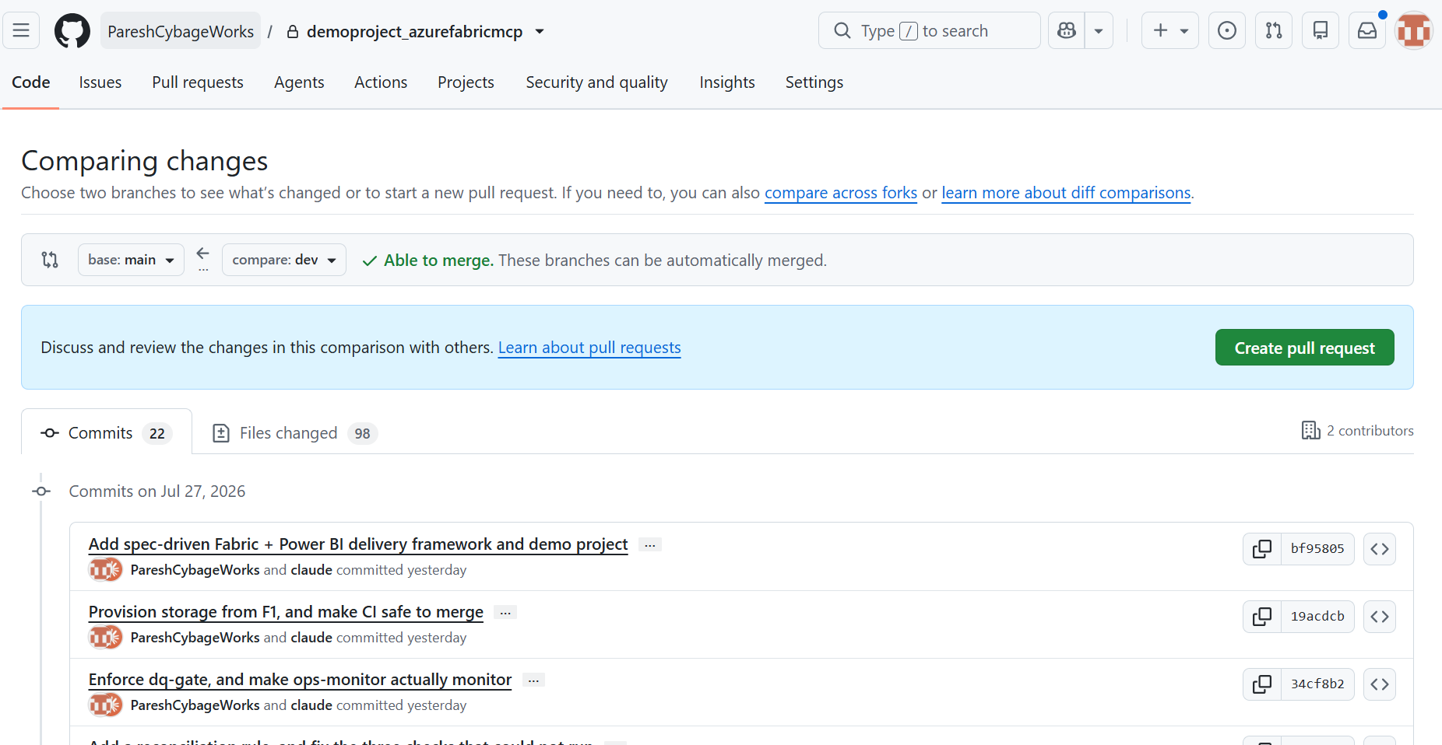

Slide 27
Six Pillars : One Mission
Specs
Fabric
Power BI
1
Driven Development
2
MCP Scaffolding
3
MCP Reporting
Data Ops
Feature-Driven
GitHub
4
Quality Framework
5
6
SDLC
Actions CI/CD

Slide 28

Master Orchestrator :
Many teams. One strategy. One mission.

Slide 29
AI Orchestrator Flow
Business Goal
AI Master Orchestrator
(Claude)
MCP Servers
Support Services
Specs Engine Config Parsing
Fabric MCP Infrastructure
Power BI MCP Analytics
Feature-Based Agents
Data Ingestion
Transform (DBT)
Quality Validation
Analytics
DevOps
Monitoring
Security
Feedback Loop
CI/CD Pipeline
GitHub Actions
Test→Deploy Dev→Deploy QA→Approval→Prod
Compliance
Legend
Synchronous (Direct flow)
Enterprise AI Solution
Asynchronous (Feedback/Parallel)

Slide 30
Demo Flow: 7-Step End-to-End Execution
Layer 1: Data Ingestion Sources
APIs
REST, GraphQL
Real-time
Databases
SQL, PostgreSQL
Relational
Files
CSV, Parquet
JSON
Event Streams
Kafka, Event Hub
Streaming
Cloud Storage
Azure Blob
ADLS Gen2
Monitoring
Health Checks
Metrics & Alerts
Security
Authentication
RLS/OLS
✓ Compliance
Auditing
Governance
Layer 2: Fabric Lakehouse - Medallion Architecture
Legend
BRONZE - Raw Data Layer
SILVER - Transformed Data
GOLD - Analytics Ready
SQL Endpoints
T-SQL Access
→ Synchronous Flow
shopify_customers.delta
Raw Data
shopify_orders.delta
Raw Data
shopify_products.delta
Raw Data
dim_customers.delta
Cleaned
fct_orders.delta
Validated
dim_products.delta
Deduplicated
sales_analytics.delta
Aggregated
customer_analytics.delta
Metrics
product_performance.delta
BI Ready
⇢ Asynchronous Flow
✓ Aggregated metrics
✓ Pre-calculated
✓ BI optimized
DBT
Transformations
Testing
Key Metrics
✓ Immutable history
✓ Full fidelity
✓ Audit trail
✓ Deduplicated
✓ Business rules
✓ Ready for BI
✓ Quality: 99%+
Layer 3: Data Quality & Operations
✓ End-to-End: <5 min
✓ Availability: 99.99%
Great Expectations
Quality Checks
Validation
SLA Monitoring
Freshness &
Completeness
Data Contracts
Governance
Compliance
Audit Logging
Change Tracking
Compliance
Complete Data Flow:
Ingestion → Bronze → Silver (DBT) → Gold
→ Quality Checks → Power BI → Reports → Monitoring
Layer 4: Power BI Analytics & Reporting
Semantic Model
Star Schema
Relationships
DAX Measures
YTD, YoY, LTV
Aggregations
Dashboards
Executive,
Operational
Reports
Paginated &
Mobile
Implementation (8 Weeks)
Week 1: Infrastructure
Week 2-3: Data Engineering
Week 4: Quality & Ops
Week 5: Analytics
Week 6-7: Automation
Week 8: Operations
Layer 5: Deployment & Automation (CI/CD)
GitHub Actions
Workflows
CI/CD
DEV
Environment
Testing
QA
Environment
Validation
PROD
Environment
Live
Layer 6: MCP Servers & AI Orchestration
Fabric MCP
Workspace Ops
Lakehouse Mgmt
Power BI MCP
Semantic Models
Deployment
DBT Cloud API
Transformations
Testing
GitHub API
CI/CD Workflows
Automation
Claude AI
Orchestration
Automation

Slide 31
The Infiltration: What Changed
Like a master heist, AI agents have silently taken over the repetitive work...
BEFORE: Manual Delivery
AFTER: AI-Automated Delivery
• Requirements gathering (manual)
✓ Specs define everything (YAML/JSON)
• Design & architecture meetings
✓ AI generates infrastructure
• Hand-code notebooks (trial & error)
✓ Auto-scaffolded notebooks
• Manual data quality checks
✓ Automated SLA monitoring
• Spreadsheet-driven deployments
✓ GitOps deployment pipeline
• Weeks of troubleshooting
✓ Minutes to production
• Knowledge silos
✓ Reproducible & auditable

Slide 32
Key Takeaways
Specs-Driven Architecture
AI Agents as Builders
Speed = Competitive Edge
1
Let JSON/YAML specs drive infrastructure, not manual clicks
2
Agents (Claude, Copilot) can generate production code & infrastructure
3
90 minutes for what took
3 months—release more frequently
Quality Built-In
Reproducibility & Audit
Teams > Tools
4
Automated SLA checks prevent bad data from reaching users
5
Every build is repeatable, tracked in Git, auditable end-to-end
6
70% of engineer time now spent on innovation, not operations

Slide 33
AI Engineering Principle
D
efine Specifications
H
arness MCP
nderstand Context
efine Iteratively
U
R
N
avigate with Intelligence (Power BI)
A
ssign AI Agents
H
armonize Workflows
eploy with GitHub Actions
D
I Orchestrator
ealize Business Value
A
R

Slide 34

AI Engineering Principle
D
efine Specifications
H
arness MCP
U
nderstand Context
R
efine Iteratively
A
ssign AI Agents
N
avigate with Intelligence (Power BI)
D
eploy with GitHub Actions
H
armonize Workflows
A
I Orchestrator
R
ealize Business Value

Slide 35

AI Engineering Principle
D
H
U
R
A
N
D
H
A
R

Slide 37


Slide 38



Slide 39
Thank You

