Slide 1
The Undercover Agent
AI's Deep Infiltration into Data Engineering
Like the legendary heist. But here, the infiltrators solve problems. 🎭
TechTonic Conference • From AI-Assisted to AI-Automated Delivery

Slide 2

The Problem: Manual Data Engineering

Slide 3
The Problem: Manual Data Engineering
💼 Manual handoffs between teams
⏱️ Months of delivery cycles
❌ Inconsistent quality & SLAs
🔄 Repetitive, error-prone work
📊 Result: Data teams spend 70% of time on operations, 30% on innovation

Slide 4
The Solution: 6 Pillars of Automated Delivery
1
Specs
Driven Development
2
Fabric
MCP Scaffolding
3
Power BI
MCP
Reporting
4
Data Ops
Quality Framework
5
Feature-Driven
SDLC
6
GitHub
Actions CI/CD

Slide 5

📋 Pillar 1:
No improvisation.
Everything written down.
Every move planned.

Slide 6
📋 Pillar 1: Specs-Driven Development
• Data contracts define schema, SLAs, lineage
• YAML/JSON specs drive infrastructure creation
• Single source of truth for requirements
• Enables reproducible, testable pipelines
💡 Key Benefit
Transform requirements into executable code automatically

Slide 7
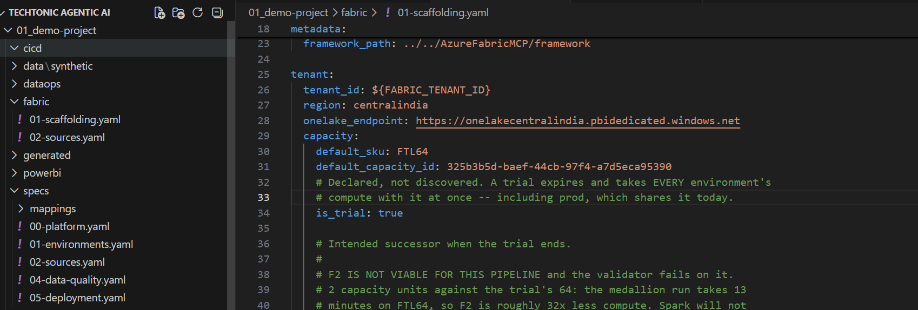

Slide 8

📋 Pillar 2:
Don’t solve the problem
until you've given it
the map of the environment.

Slide 9
🏗️ Pillar 2: Fabric MCP Scaffolding
• Metadata-driven notebook generation
• Medallion architecture (Bronze→Silver→Gold)
• Automatic schema inference & lineage
• SQL Endpoint for read-only query access
💡 Key Benefit
Create Fabric infrastructure and pipelines from JSON specs

Slide 10
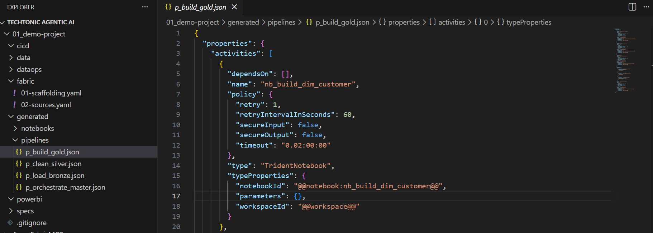

Slide 11
📋 Pillar 3:
Plans start the mission.
Intelligence keeps the mission successful.

Slide 12
📊 Pillar 3: Power BI MCP Reporting
• Automated dashboard generation
• 4 dashboard types (Sales, Quality, Executive, Self-Service) and Data Audit Reports
• Fabric SQL Endpoint native connectivity
• Consistent branding & styling
💡 Key Benefit
Generate production-ready reports automatically

Slide 13

📋 Pillar 4:
Dry Run Every Single Move.
If something fails,
we adjust.

Slide 14
✅ Pillar 4: Data Ops Quality Framework
• Great Expectations integration / DBT
• SLA monitoring (Freshness, Completeness, Uniqueness)
• Quality check notebooks per layer
• Automated alerts & reporting
💡 Key Benefit
35+ quality checks passing automatically

Slide 15

📋 Pillar 5:
Complex missions succeed when responsibilities are clear
Not when everyone does everything

Slide 16
🔀 Pillar 5: Feature-Driven SDLC
• Feature branch strategy (feature/medallion-*)
• Pull request templates with lineage docs
• Code review gates & CODEOWNERS
• Automated schema validation
💡 Key Benefit
Enforce quality & consistency at merge-time

Slide 17

📋 Pillar 6:
Execution succeeds because preparation was complete.

Slide 18
⚙️ Pillar 6: GitHub Actions CI/CD
• PR validation & schema checks
• Multi-environment promotion (dev→qa→uat→prod)
• Automated deployment workflows
• Slack notifications & audit logs
💡 Key Benefit
Push-to-deploy data pipelines with safety gates

Slide 19

📋 Master Orchestrator:
Many teams. One strategy. One mission.

Slide 20
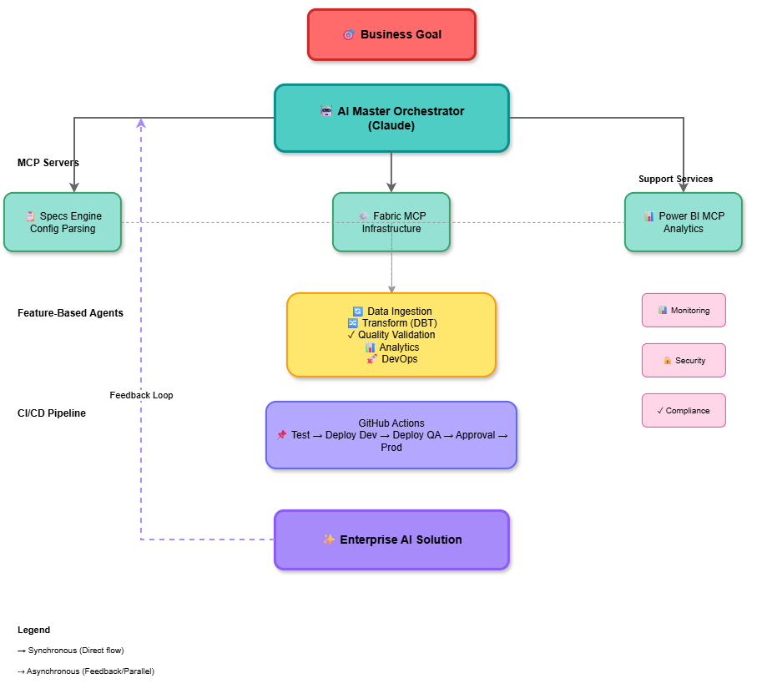
⚙️ AI Orchestrator Flow

Slide 21
Demo Flow: 7-Step End-to-End Execution
1
2
3
4
5
6
7
📊
Synthetic Data
📋
Data Contract
🏗️
Fabric Scaffold
▶️
Execute Pipeline
📊
Create Reports
✅
Quality Check
🚀
Deploy
5 min
10 min
15 min
20 min
15 min
10 min
10 min
📈 Expected Results
✅ 35 quality checks passed
📊 3 dashboards created (Sales, Quality, Executive)
💾 7 tables (3 Bronze, 2 Silver, 2 Gold)
⚡ Complete automation in 90 minutes

Slide 23
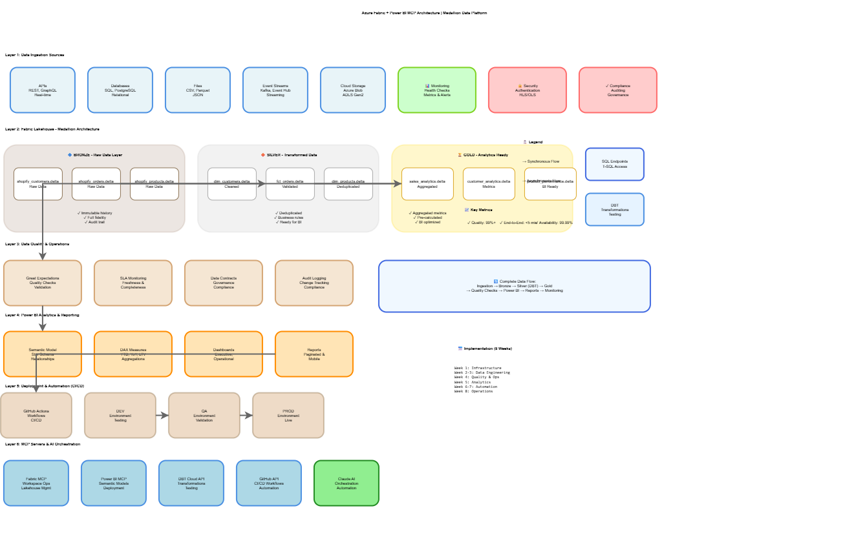

Slide 24
Results: Speed, Consistency, Quality
90 min
100%
35
0
Total Time
SLA Compliance
Quality Checks
Manual Errors
Before vs. After
Delivery Time
❌ 2-3 months
✅ 90 minutes
Process
❌ Manual handoffs
✅ Automated pipeline
Team Capacity
❌ 70% Ops work
✅ 30% Ops work
Quality
❌ Ad-hoc QA
✅ Automated SLA checks

Slide 25
The Infiltration: What Changed
Like a master heist, AI agents have silently taken over the repetitive work...
❌ BEFORE: Manual Delivery
✅ AFTER: AI-Automated Delivery
• Requirements gathering (manual)
✓ Specs define everything (YAML/JSON)
• Design & architecture meetings
✓ AI generates infrastructure
• Hand-code notebooks (trial & error)
✓ Auto-scaffolded notebooks
• Manual data quality checks
✓ Automated SLA monitoring
• Spreadsheet-driven deployments
✓ GitOps deployment pipeline
• Weeks of troubleshooting
✓ Minutes to production
• Knowledge silos
✓ Reproducible & auditable

Slide 26


Slide 27
Key Takeaways
📋
Specs-Driven Architecture
🤖
AI Agents as Builders
⚡
Speed = Competitive Edge
Let JSON/YAML specs drive infrastructure, not manual clicks
Agents (Claude, Copilot) can generate production code & infrastructure
90 minutes for what took 3 months—release more frequently
✅
Quality Built-In
🔒
Reproducibility & Audit
🎯
Teams > Tools
Automated SLA checks prevent bad data from reaching users
Every build is repeatable, tracked in Git, auditable end-to-end
70% of engineer time now spent on innovation, not operations

Slide 28
AI Engineering Principle
Define Specifications
Harness MCP
Understand Context
Refine Iteratively
Assign AI Agents
Navigate with Intelligence (Power BI)
Deploy with GitHub Actions
Harmonize Workflows
AI Orchestrator
Realize Business Value

Slide 29


